Slide 1
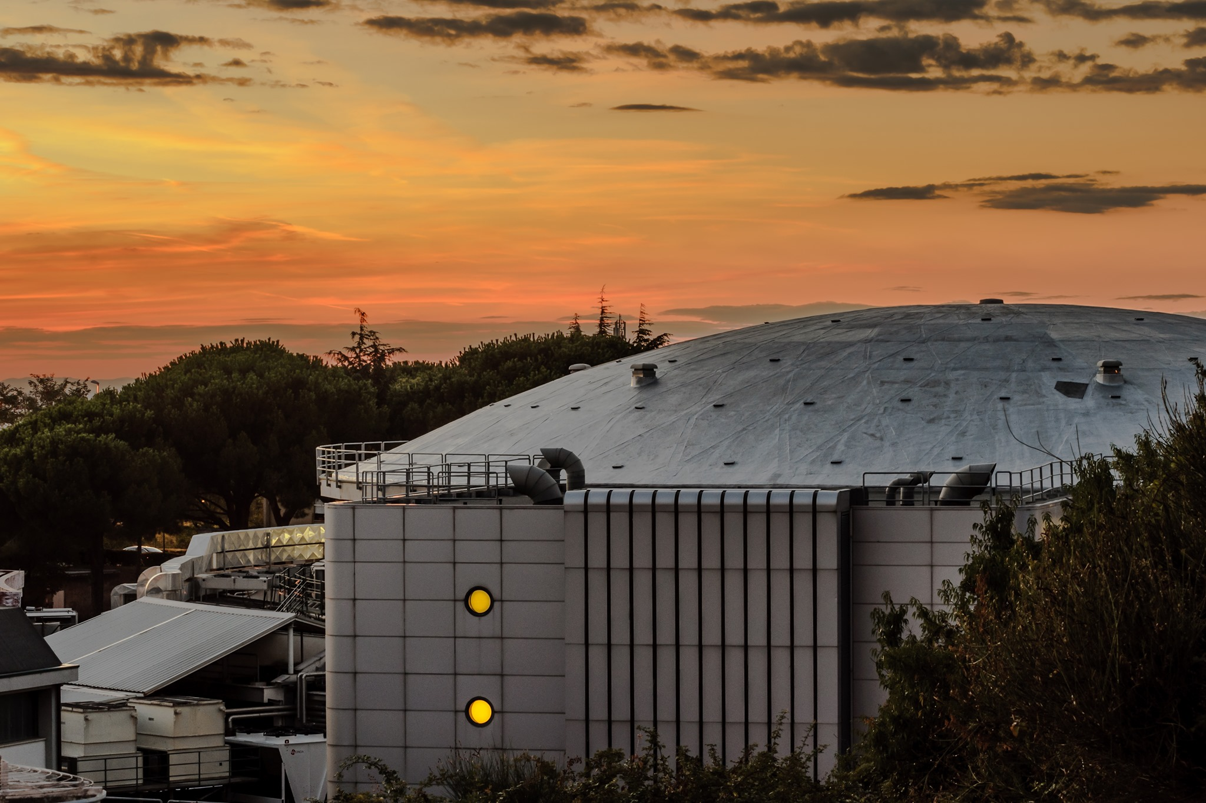

Excited QCD, Benasque Science Center (Spain), 14-19 January 2024
Kaonic atoms at the DAΦNE Collider in Italy:
a strangeness Odyssey
Catalina Curceanu on behalf of the SIDDHARTA-2 Collaboration

Slide 2


Slide 3
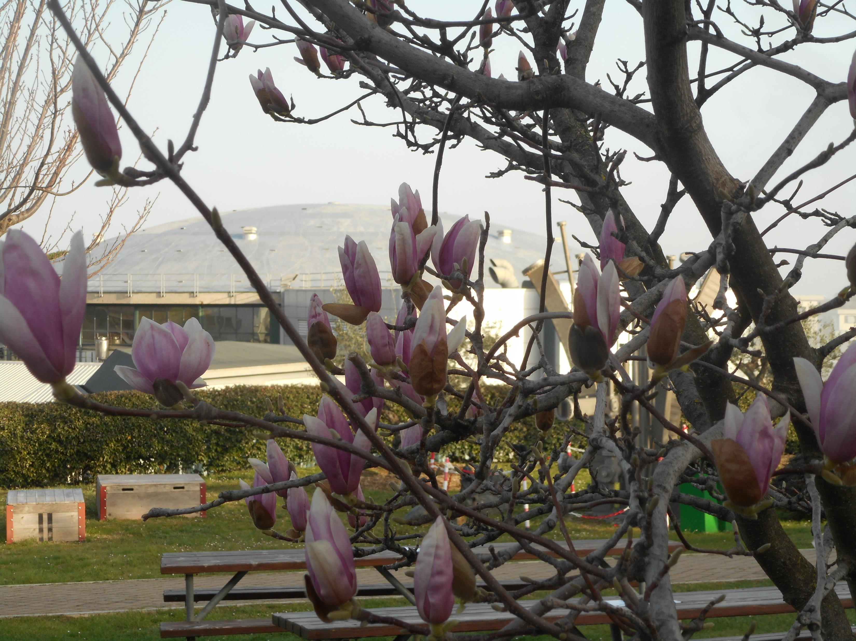

Slide 4






SIDDHARTA-2
SIlicon Drift Detector for Hadronic Atom Research by Timing Applications
LNF-INFN, Frascati, Italy
SMI-ÖAW, Vienna, Austria
Politecnico di Milano, Italy
IFIN –HH, Bucharest, Romania
TUM, Munich, Germany
RIKEN, Japan
Univ. Tokyo, Japan
Victoria Univ., Canada
Univ. Zagreb, Croatia
Univ. Jagiellonian Krakow, Poland
ELPH, Tohoku University
CERN, Switzerland
Helmholtz Inst. Mainz, Germany
Francesco Sgaramella
A new renaissance for kaonic atoms at DAΦNE: future measurements and perspectives

Slide 5

Part of the SIDDHARTA-2 collaboration

Slide 6
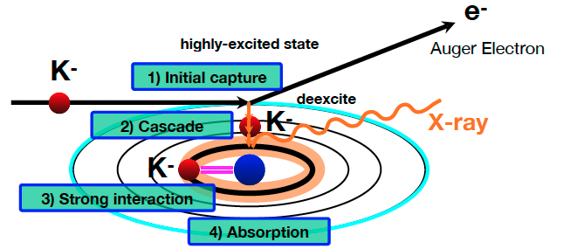
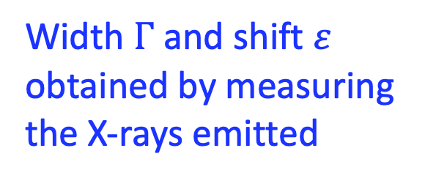
Kaonic atom Formation
Width $Γ$ and shift $ε$ obtained by measuring the X-rays emitted
Catalina Curceanu (A. Scordo)
A new renaissance for kaonic atoms at DAΦNE: future measurements and perspectives

Slide 7
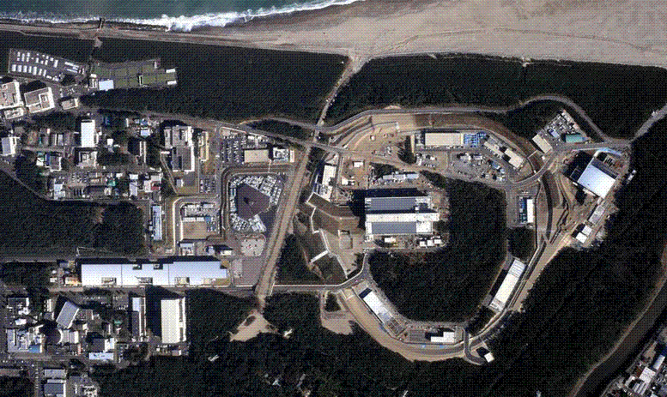
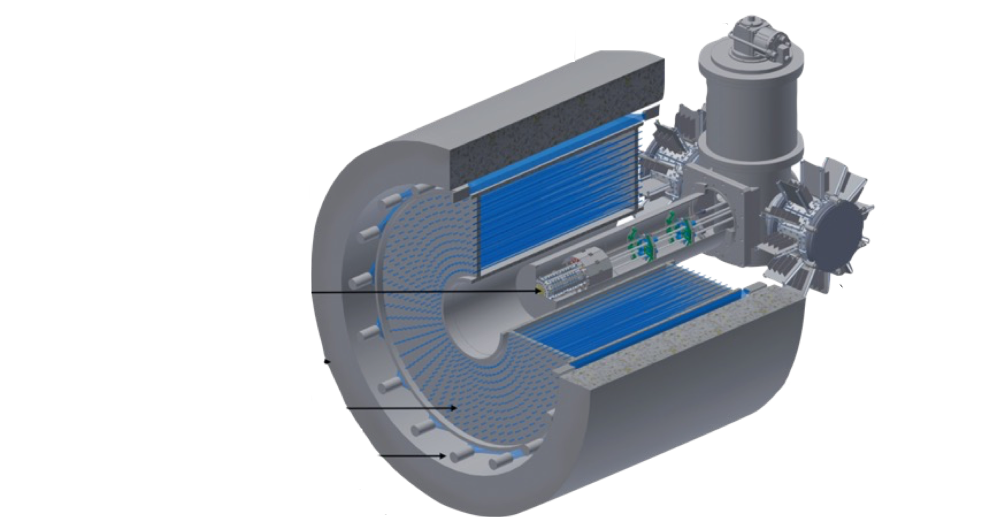
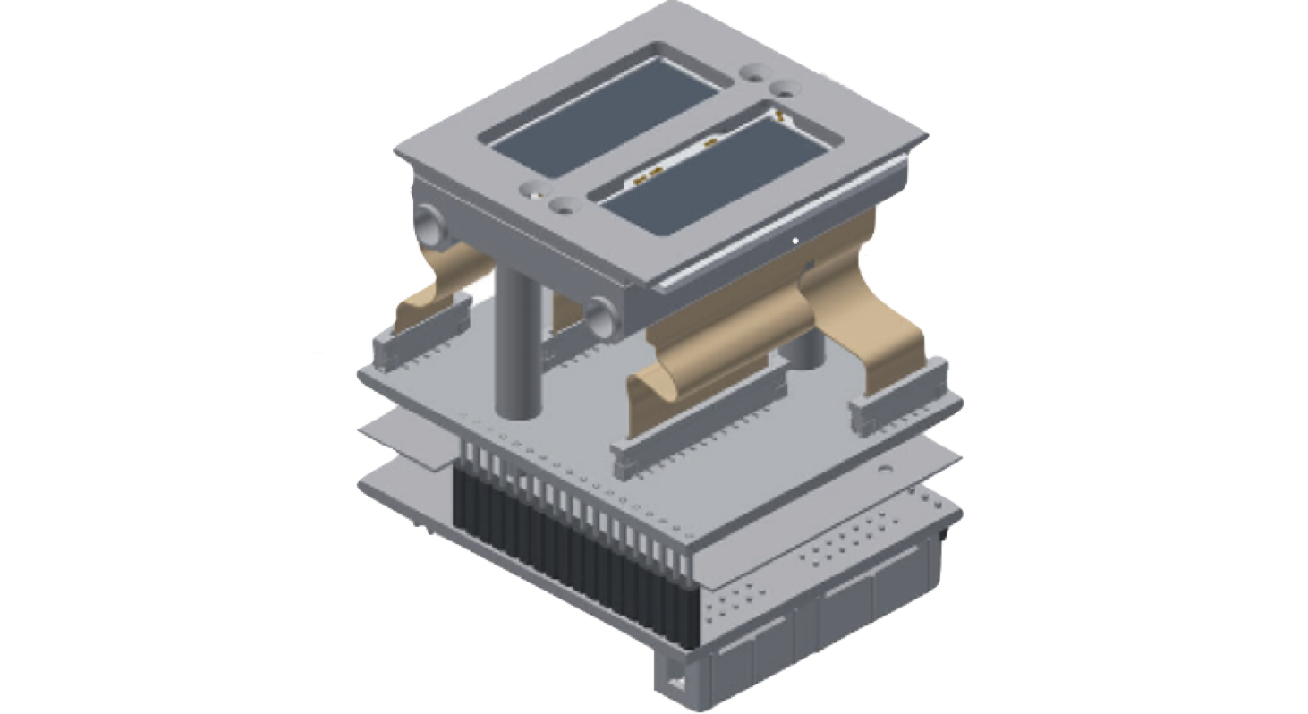
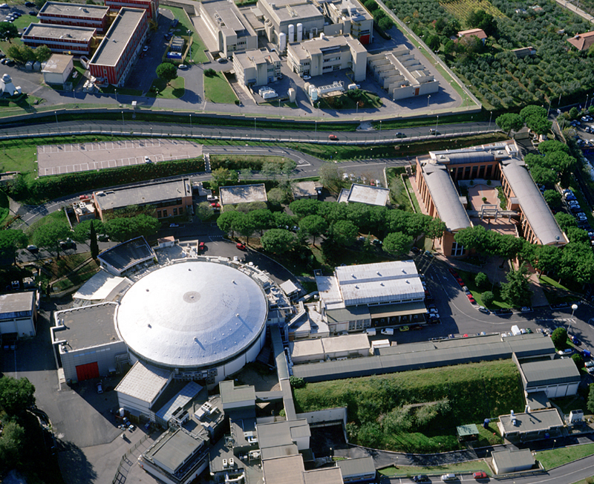
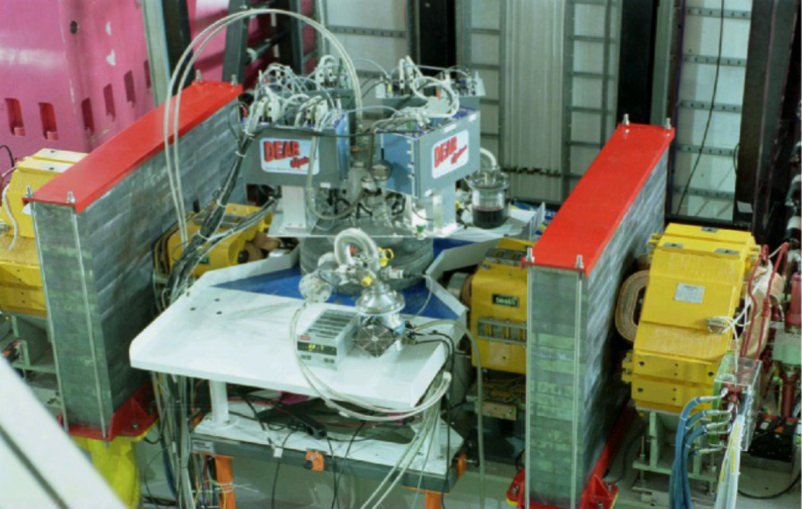
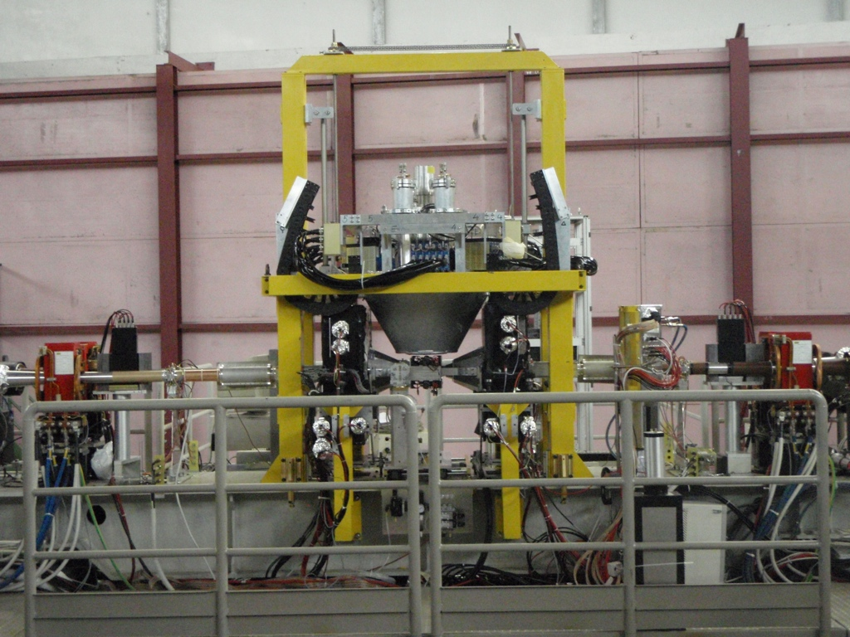
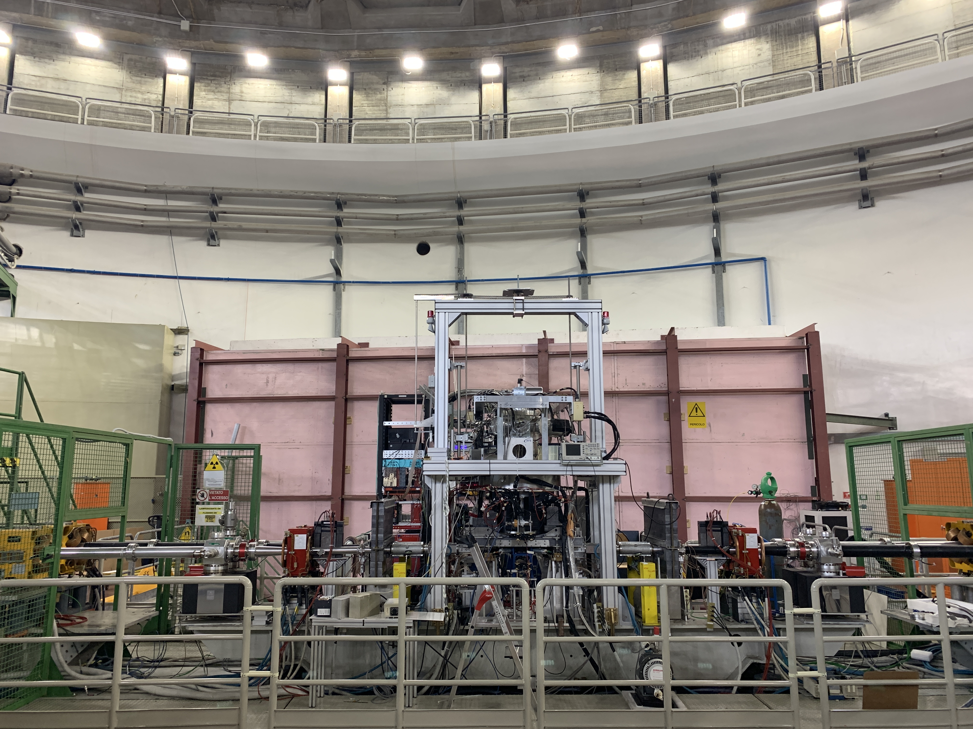
A long journey
J-PARC
The modern era of light kaonic atom experiments
Catalina Curceanu, Carlo Guaraldo, Mihail Iliescu, Michael Cargnelli, Ryugo Hayano, Johann Marton, Johann Zmeskal, Tomoichi Ishiwatari, Masa Iwasaki, Shinji Okada, Diana Laura Sirghi, and Hideyuki Tatsuno
Rev. Mod. Phys. 91, 025006 – Published 20 June 2019
DAFNE
DEAR
2002
SIDDHARTA
2009
SIDDHARTA-2 2022

Slide 8


Slide 9
On self-gravitating strange dark matter halos around galaxies
Phys.Rev.D 102 (2020) 8, 083015
Fundamental physics
New Physics
Dark Matter studies
The modern era of light kaonic atom experiments
Rev.Mod.Phys. 91 (2019) 2, 025006
Kaonic atoms
Kaon-nuclei interactions (scattering and nuclear interactions)
Kaonic Atoms to Investigate
Global Symmetry Breaking
Astrophys.J. 881 (2019) 2, 122
Merger of compact stars in
the two-families scenario
Symmetry 12 (2020) 4, 547
Part. and Nuclear physics
QCD @ low-energy limit
Chiral symmetry, Lattice
Astrophysics
EOS Neutron Stars
The equation of state of dense matter:
Stiff, soft, or both?
Astron.Nachr. 340 (2019) 1-3, 189

Slide 10
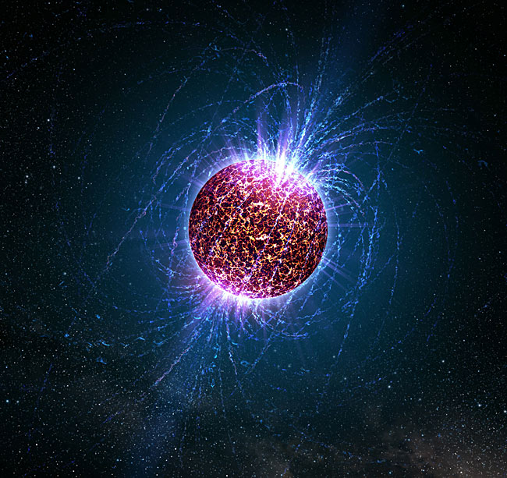


Slide 11
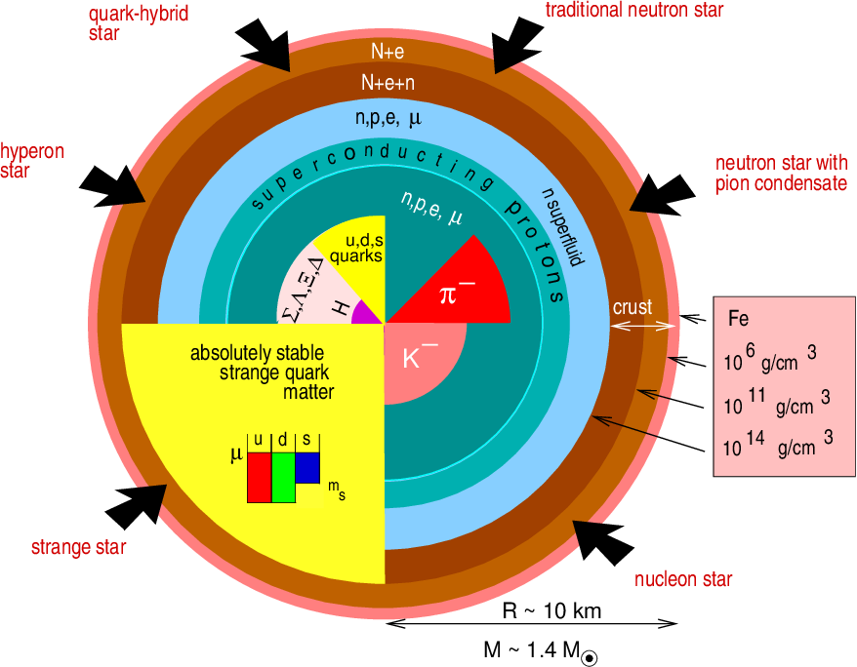
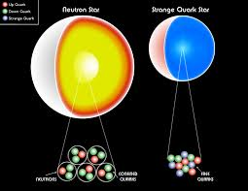

Slide 13



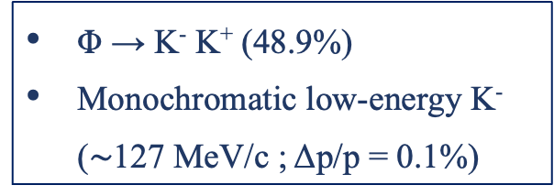


LNF - ${ e}^{+}e^{−}$ Accelerator Complex
Φ → K⁻ K⁺ (48.9%)
Monochromatic low-energy K⁻ ($\sim$127 MeV/c ; Δp/p = 0.1%)
DA$Φ$NE
LINAC
$$e^{+}$$
$$Φ$$
$$e^{−}$$
DAMPING RING
Catalina Curceanu (A. Scordo)
A new renaissance for kaonic atoms at DAΦNE: future measurements and perspectives

Slide 14
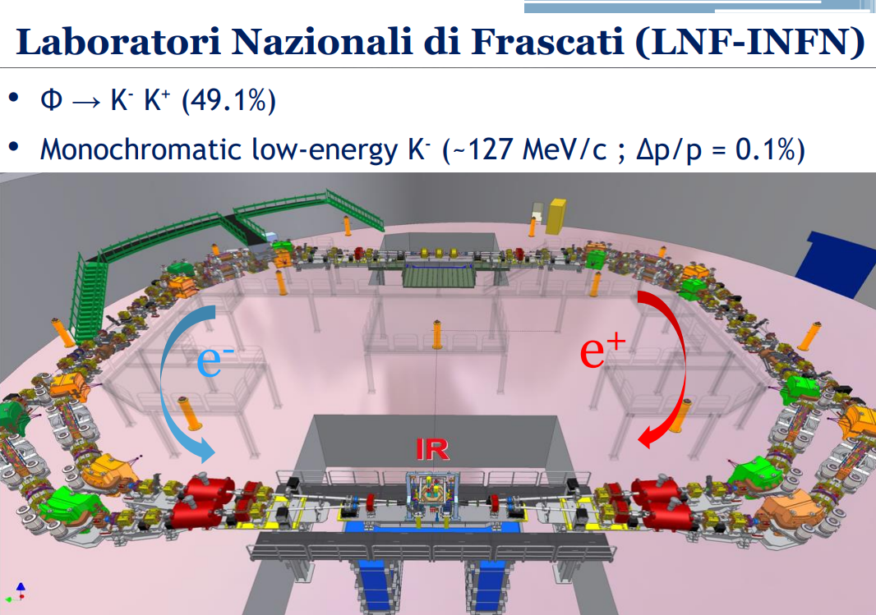

Slide 15
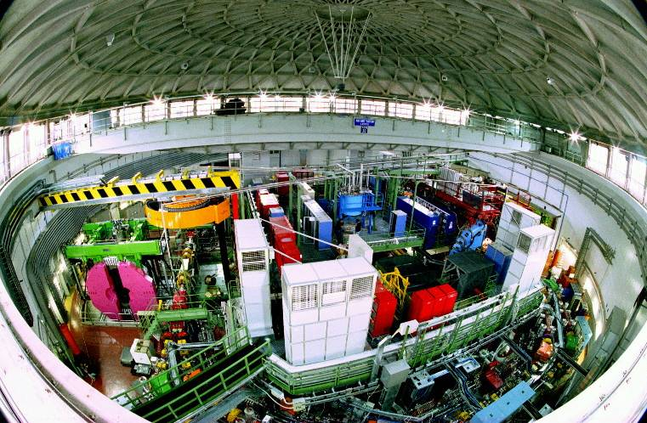
DAΦNE

Slide 16
The DAFNE principle
K+
e⁺
e⁻
e⁺
e⁻
e⁺
Φ
e⁻
e⁻
e⁻
e⁺
e⁺
e⁺
e⁻
e⁺
e⁻
e⁻
e⁺
e⁻
e⁻
K-
Flux of produced kaons: about 1000/second

Slide 17
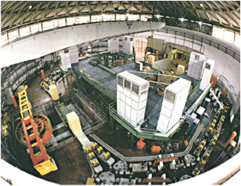

Φ → K⁻ K⁺ (49.1%)
Monochromatic low-energy K⁻ (~127MeV/c)
Less hadronic background due to the beam
( compare to hadron beam line : e.g. KEK /JPARC)
Suitable for low-energy kaon physics:
kaonic atoms
Kaon-nucleons/nuclei interaction studies

Slide 18
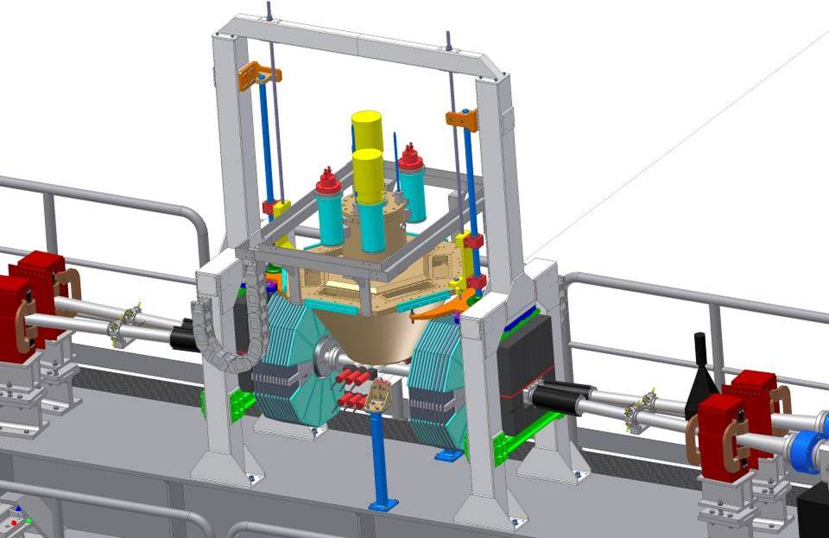

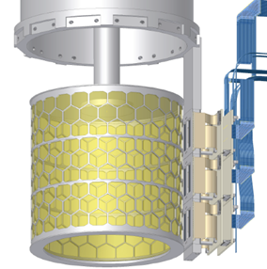

SIDDHARTA overview
Target
Detect
by SDDs
K⁻
e⁻
Detect by two scintillators
Φ
510 MeV/c
e⁺
127 MeV/c
Δp/p=0.1%
K⁺
510 MeV/c
y
x
z
18

Slide 19










SIDDHARTA - 2009
SIlicon Drift Detector for Hadronic Atom Research by Timing Applications
LNF- INFN, Frascati, Italy
SMI- ÖAW, Vienna, Austria
IFIN – HH, Bucharest, Romania
Politecnico, Milano, Italy
MPE, Garching, Germany
PNSensors, Munich, Germany
RIKEN, Japan
Univ. Tokyo, Japan
Victoria Univ., Canada
EU Fundings: JRA10 – FP6 - I3H
FP7- I3HP2
Rev.Mod.Phys. 91 (2019) 2, 025006

Slide 20
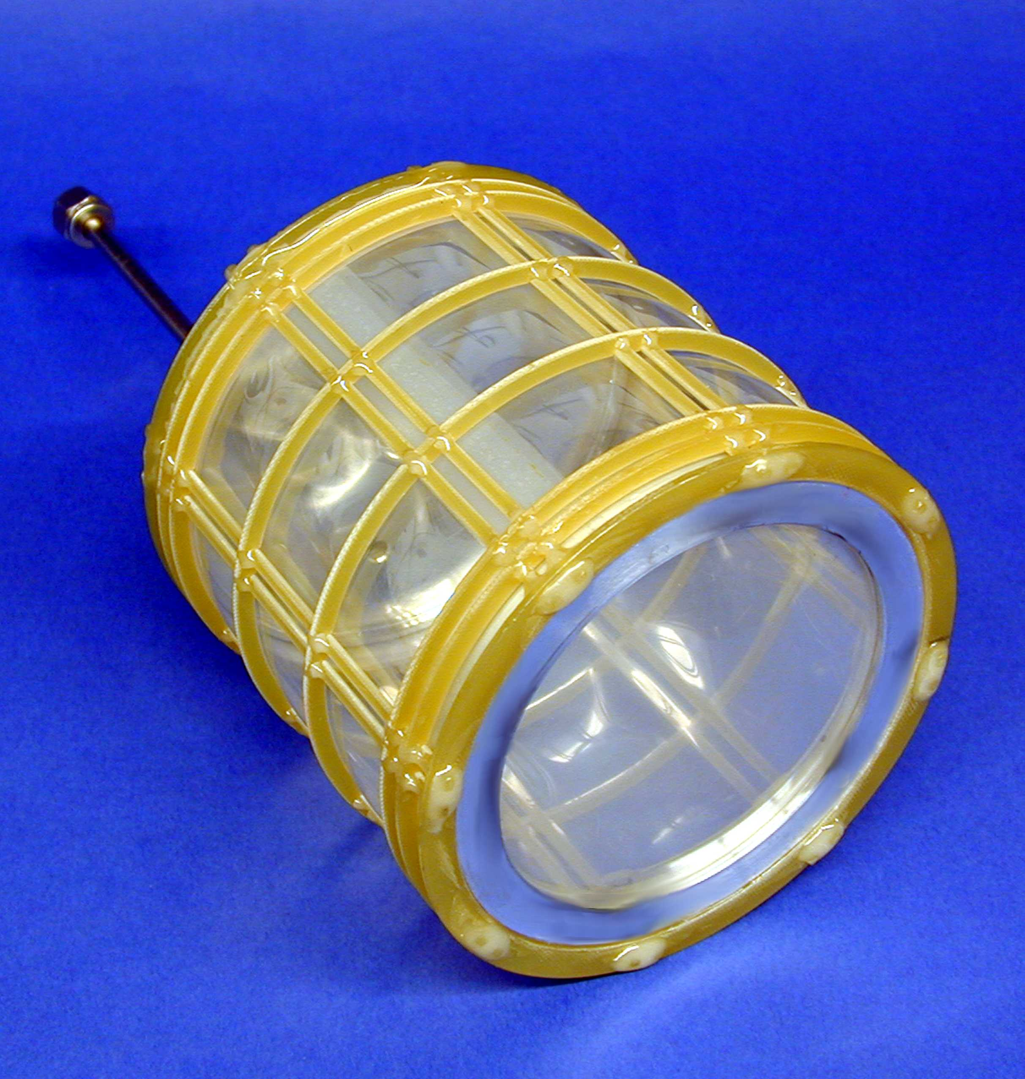
The Cryogenic Target Cell
Notes:
Gewicht = 410 g

Slide 21
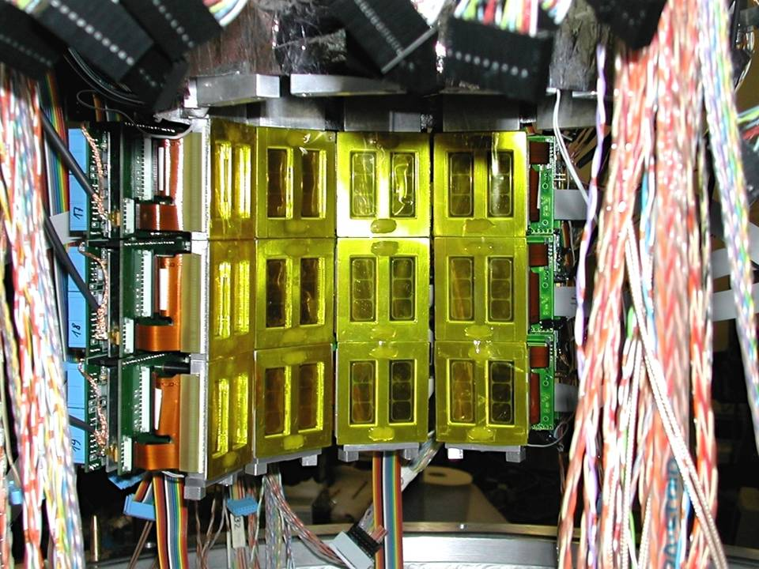

1 cm² x 144 SDDs

Slide 22
Kaonic helium (puzzle)

Slide 23
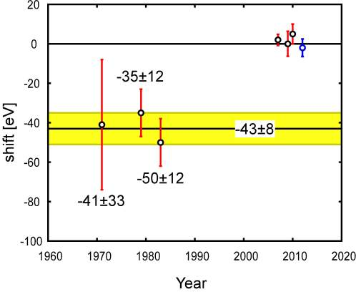
Kaonic 4 old data
KHe4

Slide 24
E570 solved the kaonic hydrogen puzzle
KHe4

Slide 25

KHe-4 energy spectrum at SIDDHARTA
K-He data taking
PLB681(2009)310; NIM A 628(2011)264
Ti foil
No-coincidence
Target
Fe55
Degrader
coincidence

Slide 26
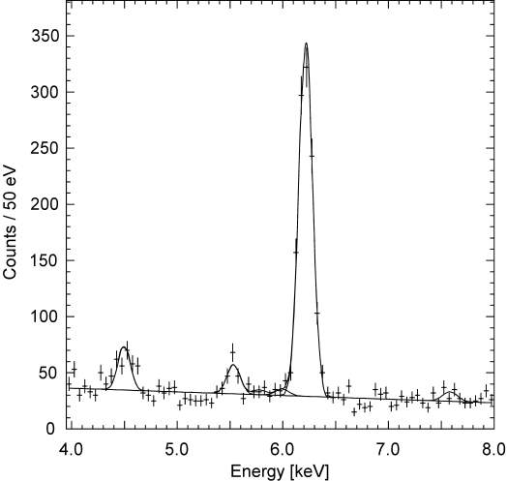
Kaonic Helium-3 energy spectrum
X-ray energy of K-3He 3d-2p
K-³He (3d-2p)
QED value:
Ti Ka
K-C
K-O
K-N
World First！
Observation of K-³He X-rays
Determination of
strong-interaction shift
arXiv:1010.4631v1 [nucl-ex], PLB697(2011)199

Slide 27
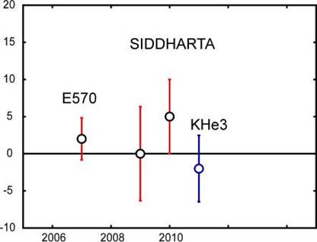
Comparison of results
 | Shift [eV] | Reference
KEK E570 | +2±2±2 | PLB653(07)387
SIDDHARTA (He4 with 55Fe) | +0±6±2 | PLB681(2009)310
SIDDHARTA (He4) | +5±3±4 | arXiv:1010.4631, PLB697(2011)199
SIDDHARTA (He3) | -2±2±4
*error bar

Slide 28
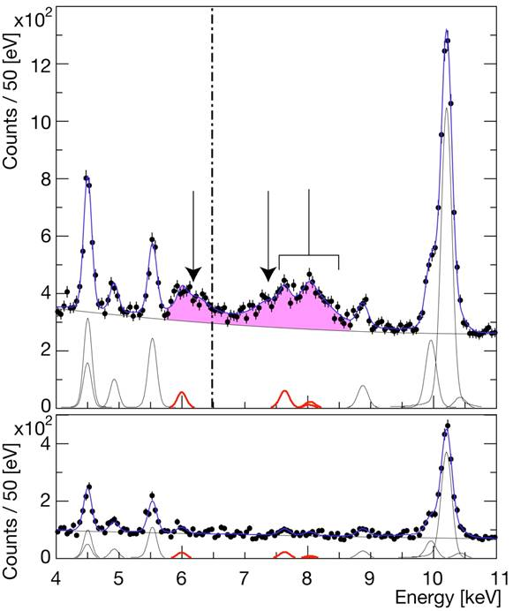
Hydrogen
spectrum
EM value
K-p Kα
Kaonic hydrogen
Kα
Kβ
higher
KC54
Ti Kα
KC65
simultaneous
fit
Ti Kβ
KC75
KO65
KO76
KN65
Cu
KAl87
Deuterium
spectrum
Background estimation

Slide 29
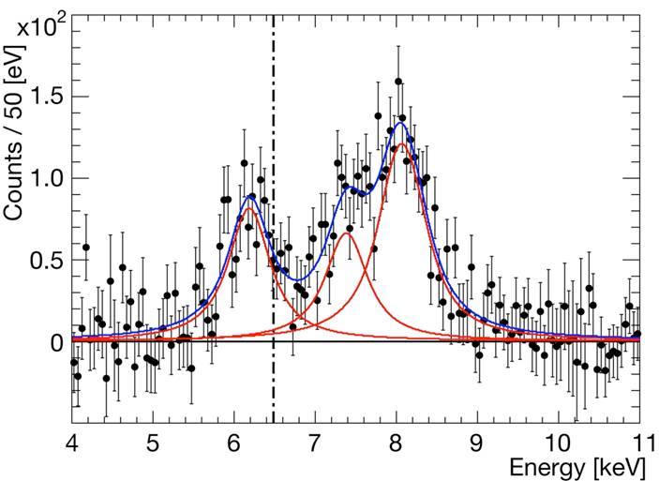
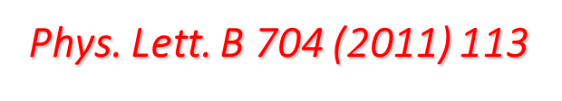
Residuals of K-p x-ray spectrum
after subtraction of fitted background
ε_{1S}= −283 ± 36(stat) ± 6(syst) eV
Γ_{1S}= 541 ± 89(stat) ± 22(syst) eV
Kaonic hydrogen
higher
Kα
Kβ
EM value
K-p Kα

Slide 30
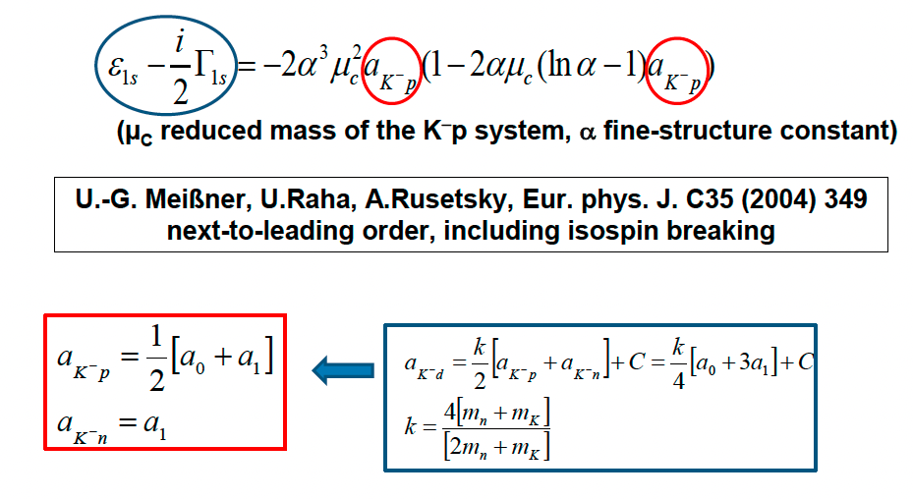
SIDDHARTA-2 Scientific Goal
To perform the first measurement ever of kaonic deuterium X-ray transition to the ground state (1s-level) such as to determine its shift and width induced by the presence of the strong interaction (but also other kaonic atoms).
Analysis of the combined measurements of kaonic deuterium and kaonic hydrogen
Experimental determination of the isospin-dependent
K-N scattering length
Catalina Curceanu (A. Scordo)
A new renaissance for kaonic atoms at DAΦNE: future measurements and perspectives

Slide 31
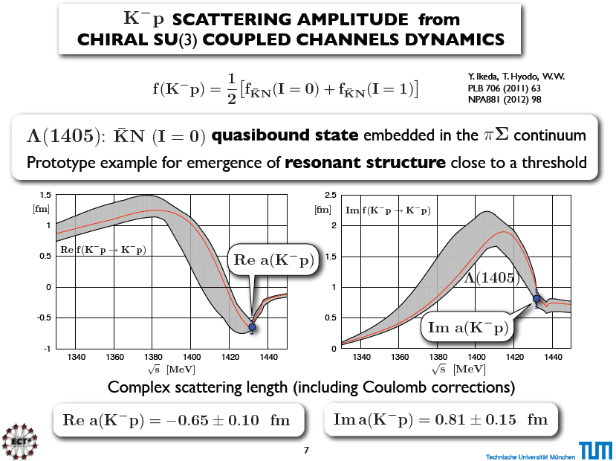

Slide 32
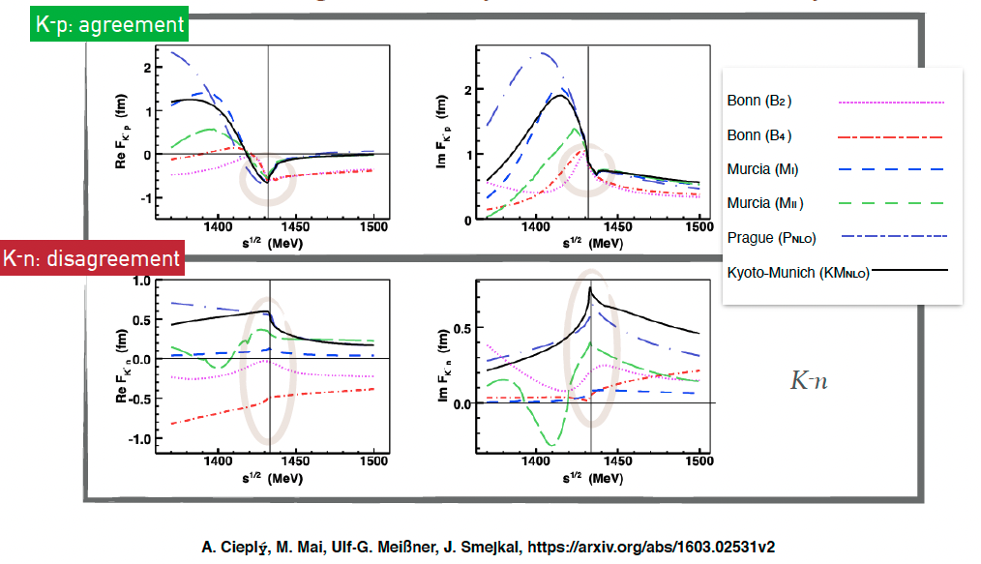
Kaonic atoms – scattering amplitudes
A new renaissance for kaonic atoms at DAΦNE: future measurements and perspectives

Slide 33
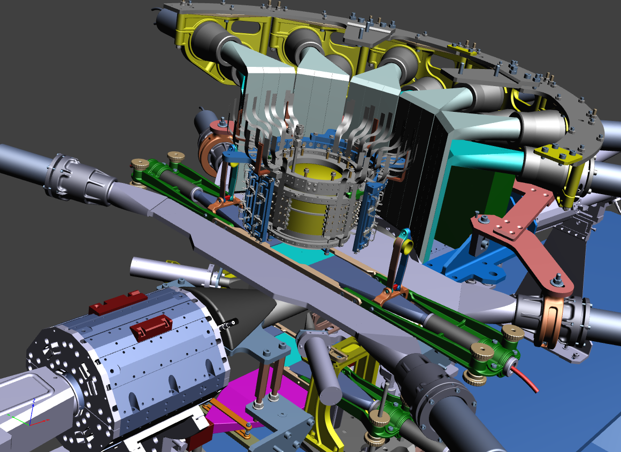

The SIDDHARTA-2 apparatus
Experimental Measurement
Veto-1
Target
Veto-2
384 SDDs
Kaon Trigger
Veto-3

Slide 34
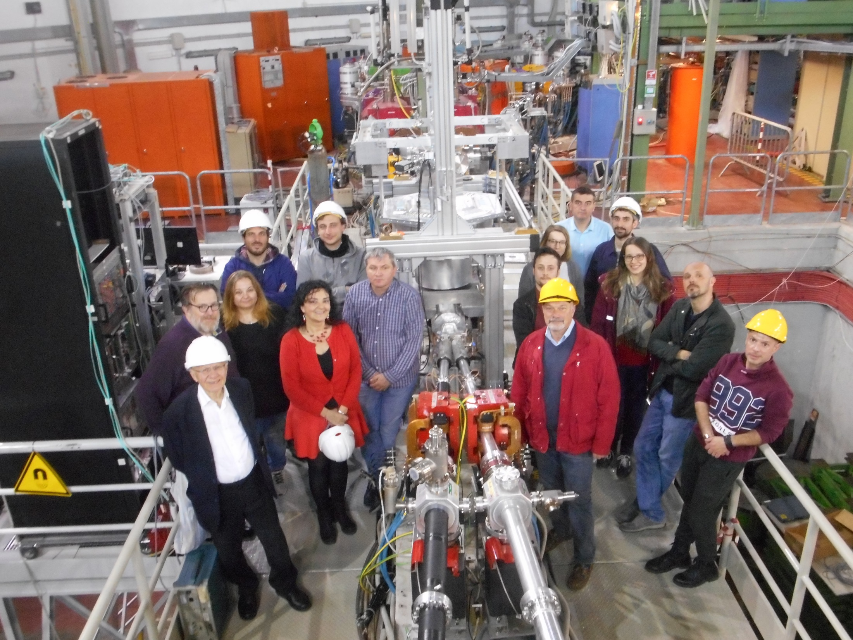
SIDDHARTA-2 installed on DAFNE

Slide 35
SDD installation
calibration target
SDD installed around the target

Slide 36
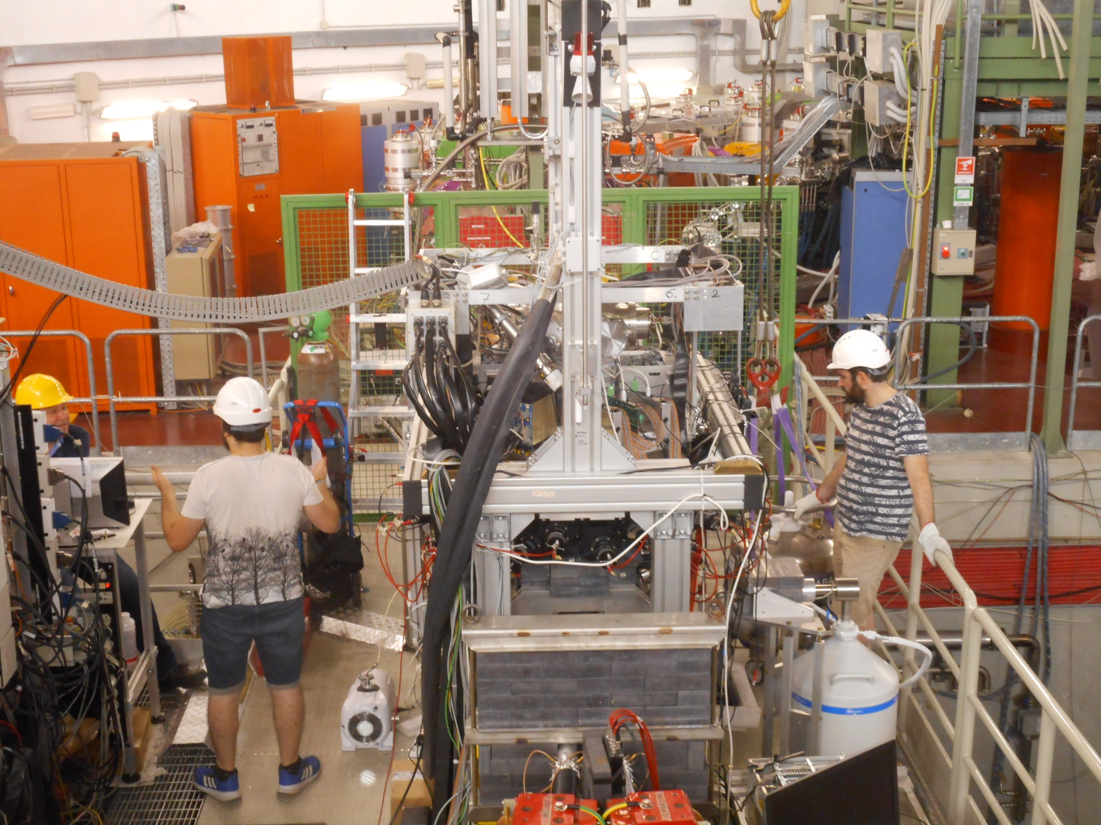

Slide 37



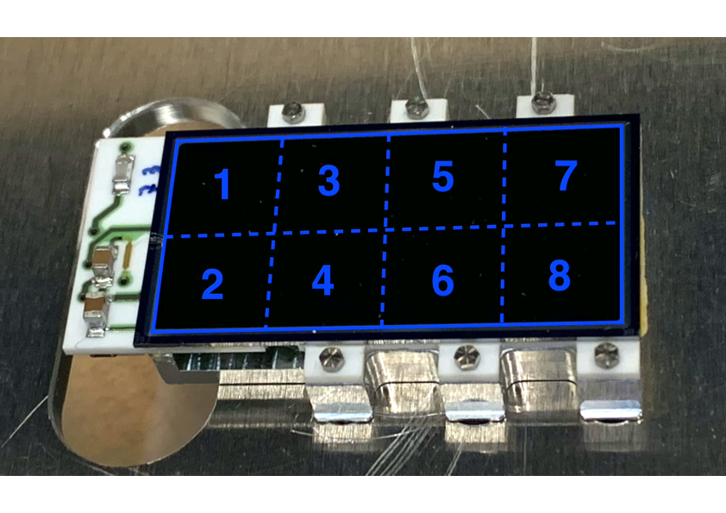
Silicon Drift Detectors
SDD cross section
8 SDD units (0.64 cm²)
for a total active area of 5.12 cm²
Thickness of 450 μm which ensures a high collection efficiency for X-rays of energy between 5 keV and 12 keV
Catalina Curceanu (A. Scordo)
A new renaissance for kaonic atoms at DAΦNE: future measurements and perspectives

Slide 38
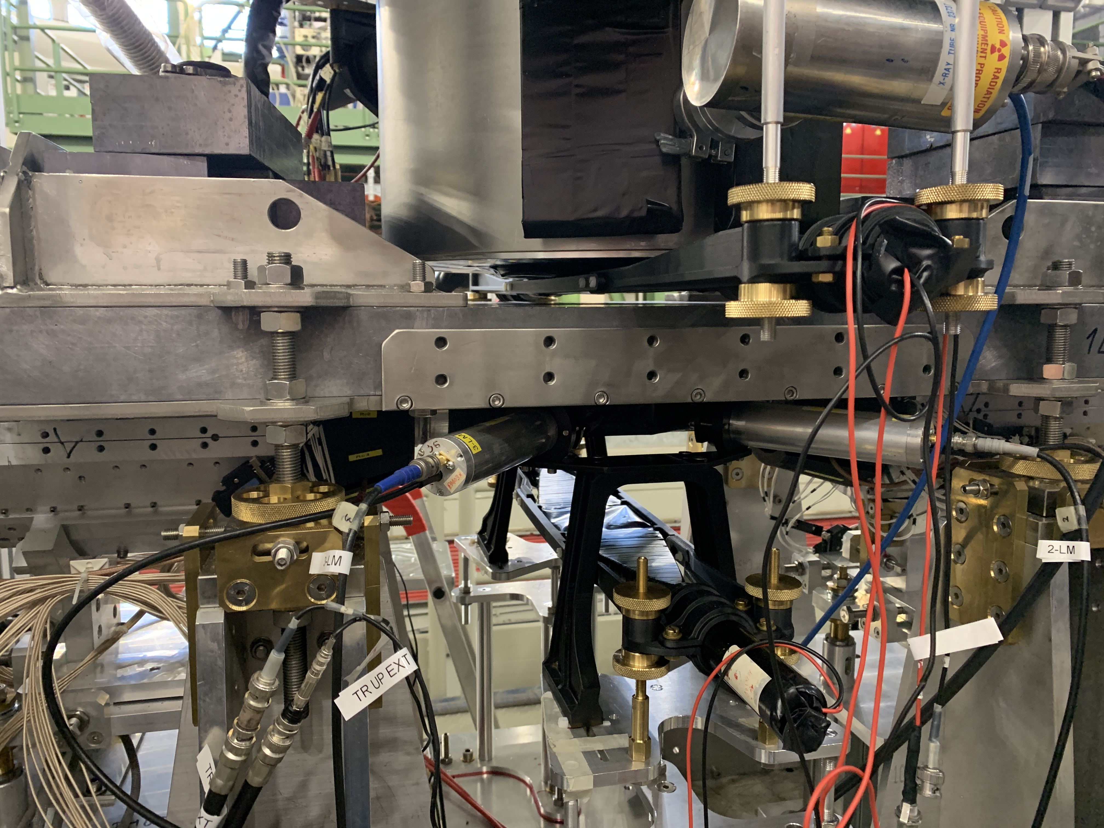
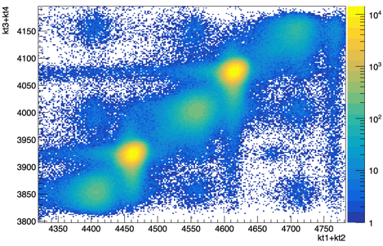



Kaon Trigger
Kaons
Kaon trigger up
$$K^{−}$$
MIPS
e⁻
e⁺
$$K^{+}$$
Kaon trigger down
The ToF is different for Kaons, m(K)~ 500 MeV/c² and light particles
originating from beam-beam and beam-environment interaction (MIPs).
Can efficiently discriminate by ToF Kaons and MIPs!
Catalina Curceanu (A. Scordo)
A new renaissance for kaonic atoms at DAΦNE: future measurements and perspectives

Slide 39
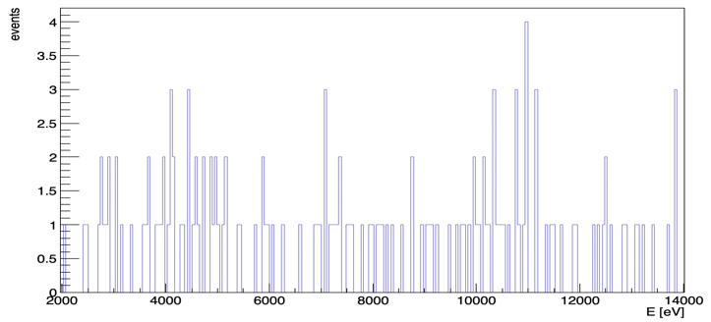
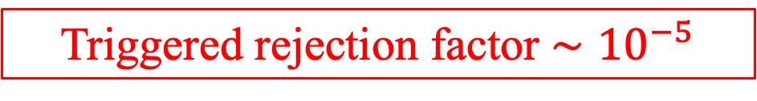
Kaon Trigger
Triggered rejection factor $∼{10}^{−5}$
Catalina Curceanu (A. Scordo)
A new renaissance for kaonic atoms at DAΦNE: future measurements and perspectives

Slide 40
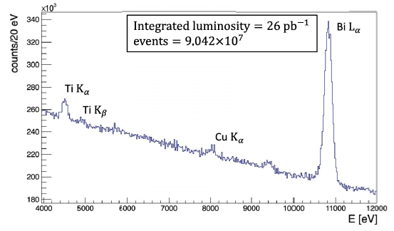
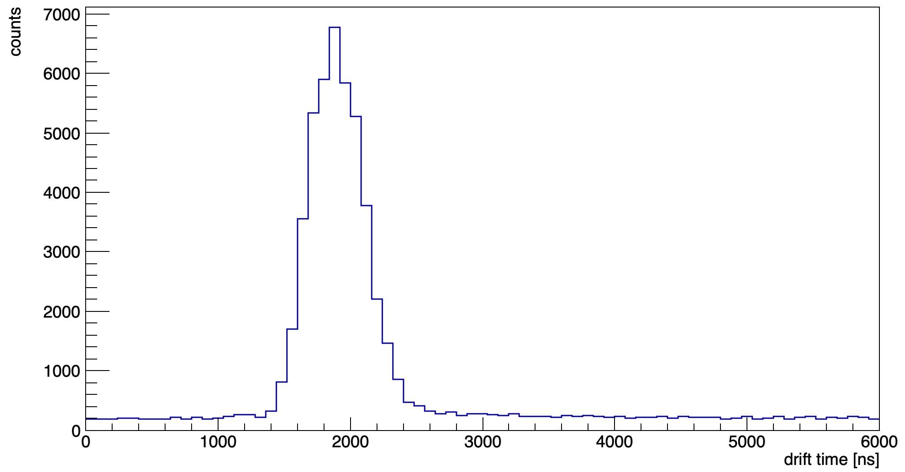

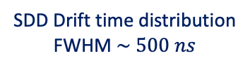
Kaonic ⁴He $3d→2p$ measurement
Kaon Trigger
SIDDHARTINO spectrum before applying the kaon trigger and the drift time rejection
Kaons
MIPS
SDD Drift time distribution
FWHM $\sim 500 ns$
Catalina Curceanu (A. Scordo)
A new renaissance for kaonic atoms at DAΦNE: future measurements and perspectives

Slide 41
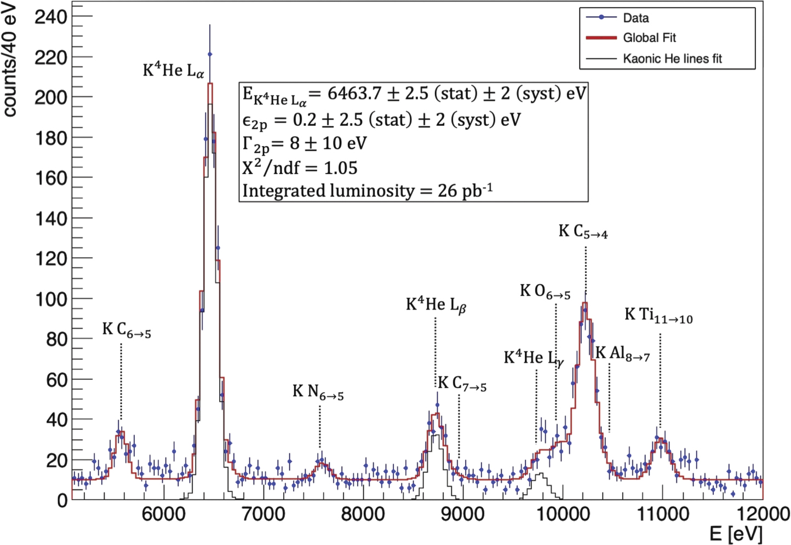
SIDDHARTINO (2021)
D Sirghi et al 2022 J. Phys. G: Nucl. Part. Phys. 49 055106

Slide 42
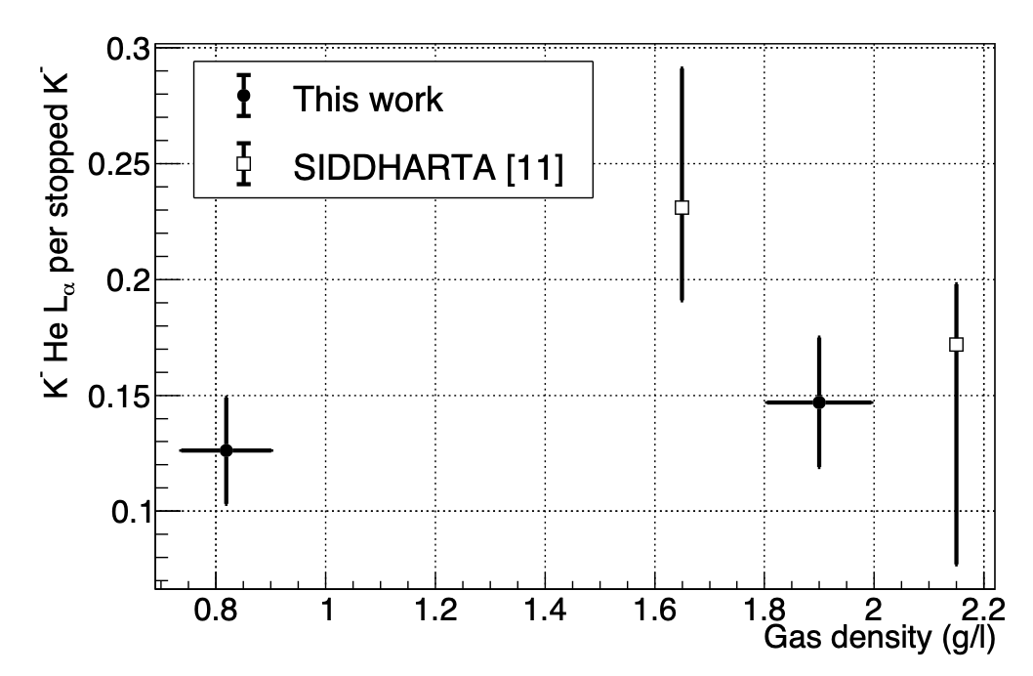
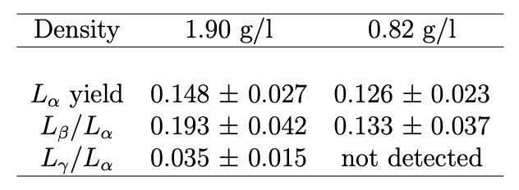
K-⁴He low density run: 0.75% liquid helium density -> yields at lowest measured density
SIDDHARTINO (2021)
D.L. Sirghi, et al. Nuclear Physics A 1029 (2023) 122567

Slide 43
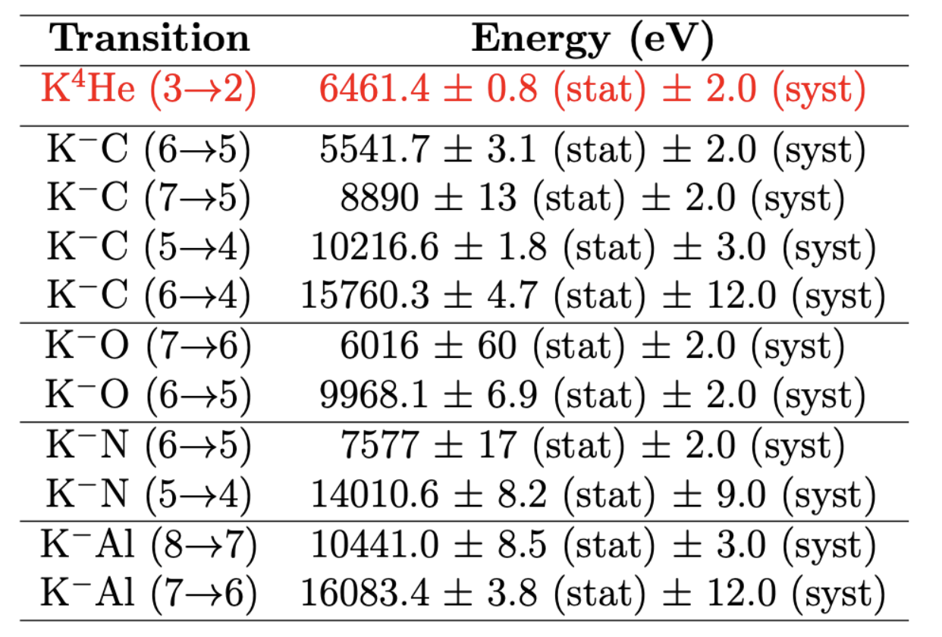
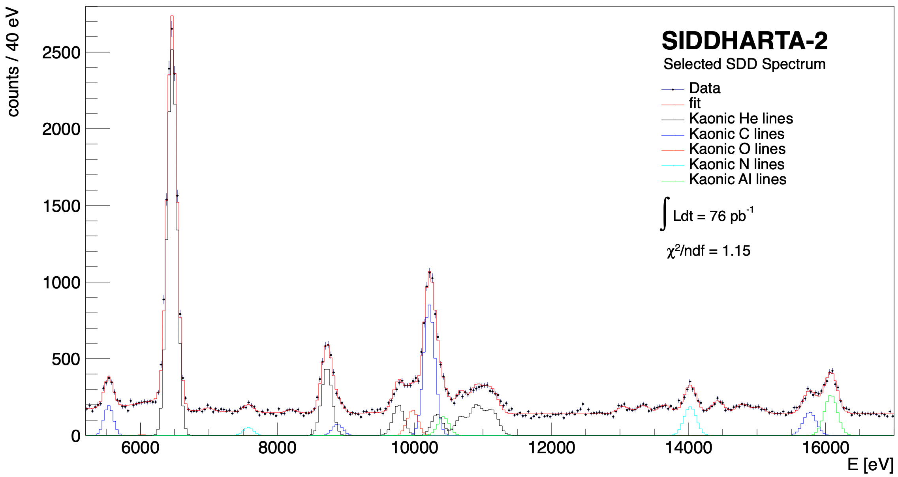
SIDDHARTA-2 (2022)
Measurements of high-n transitions in intermediate mass kaonic atoms
K⁴He 3->2
KAl 8->7
KO 6->5
K⁴He 5->2
KC 5->4
KC 7->5
KO 7->6
K⁴He 4->2
KAl 7->6
KC 6->5
K⁴He L-high
KN 5->4
KC 6->4
KN 6->5
Sgaramella, F., al. Eur. Phys. J. A 59, 56 (2023)

Slide 44
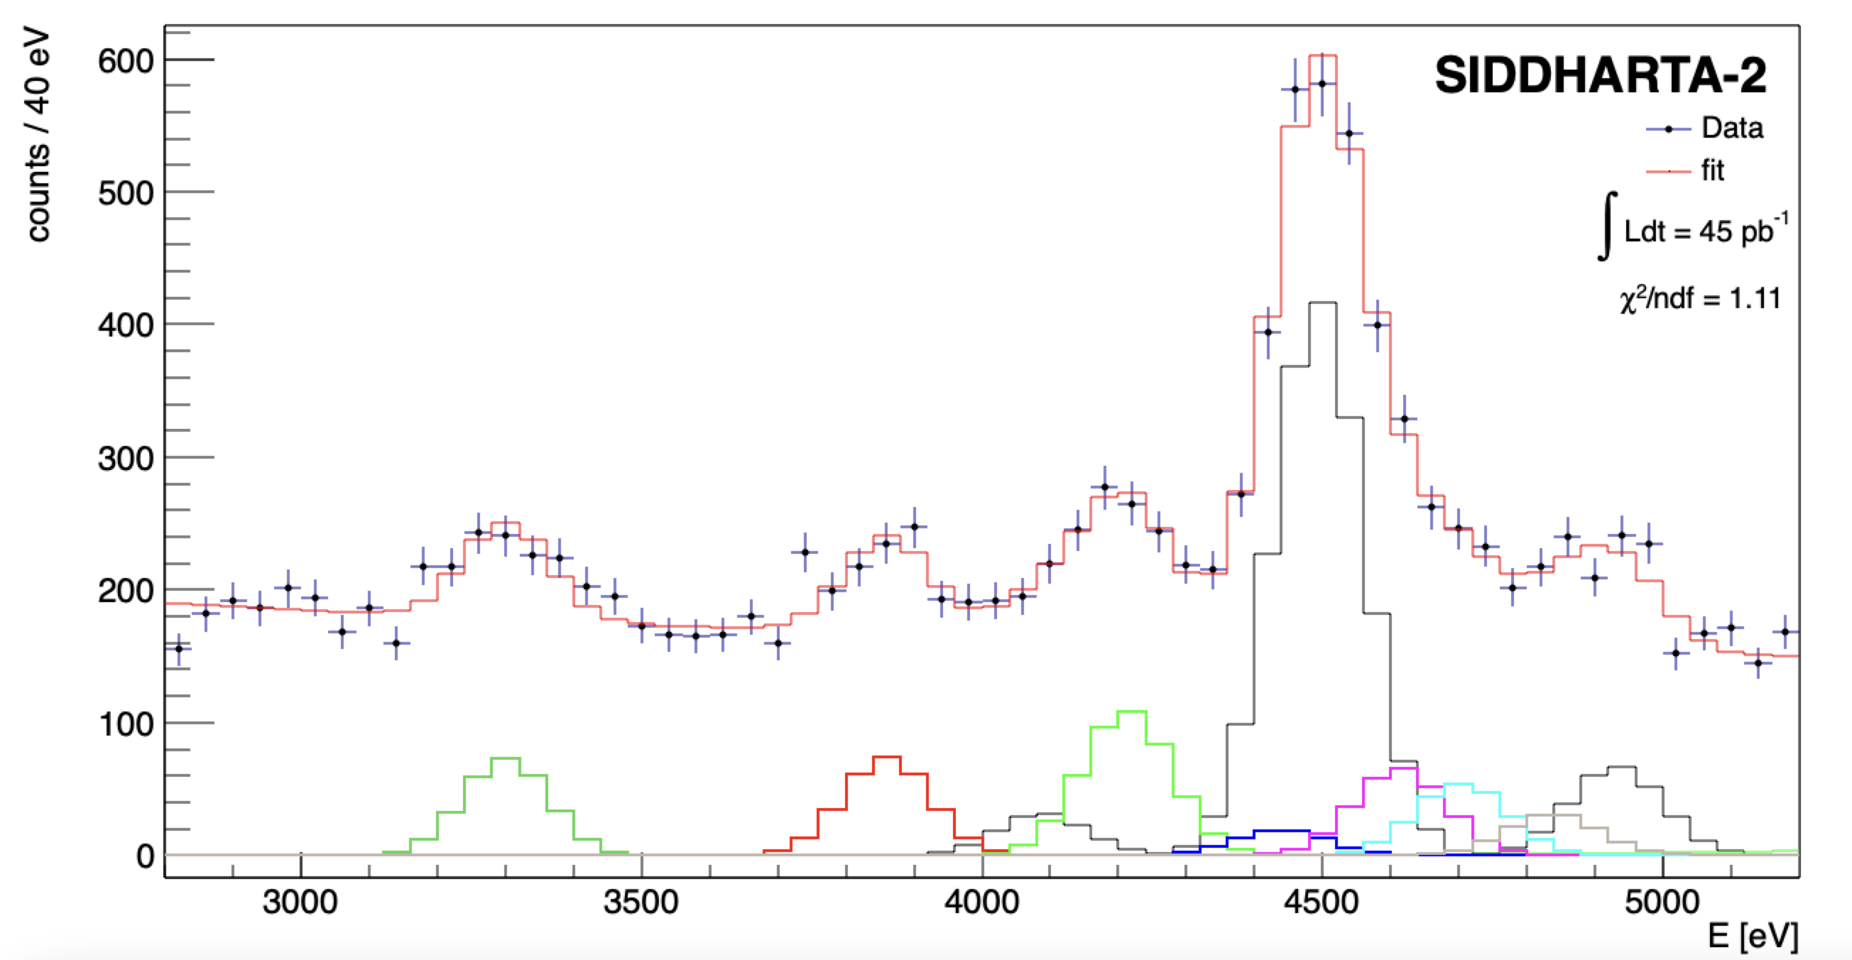





SIDDHARTA-2 Kaonic ⁴He – M-type transitions
KHe 6->3
(M$γ$)
KHe 7->3
(M$η$)
KHe 8->3
4435.4 eV
KHe 9->3
4587.3 eV
KHe 11->3
4696.6 eV
Line | Energy [eV]
K-⁴He M | 3300.8 13.2 (stat) 2.0 (sys)
K-⁴He M | 3860.4 13.6 (stat) 2.2 (sys)
K-⁴He M | 4214.1 19.6 (stat) 2.2 (sys)
 | X-ray relative yield
M/ M | 0.48 0.11
M/ M | 0.43 0.12
L/ M | 0.91 0.14
L/ L | 0.172 0.008
L/ L | 0.012 0.001
KHe 10->3
4696.6 eV
Ti K$α$
KHe 5->3
(M$β$)
Ti K$β$

Slide 45
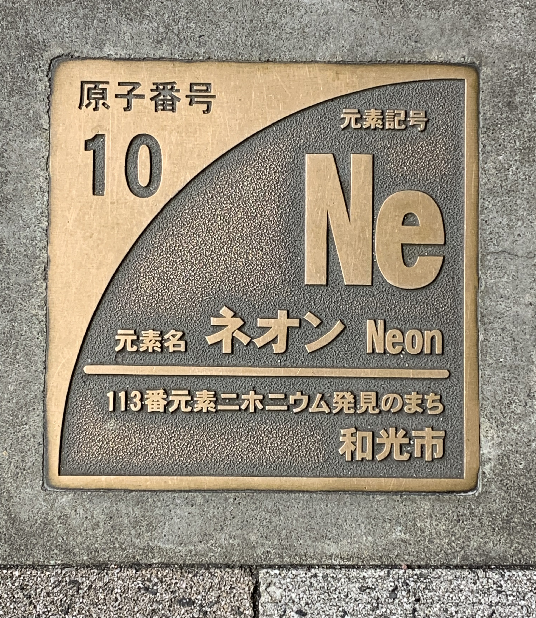
kaonic Neon

Slide 46
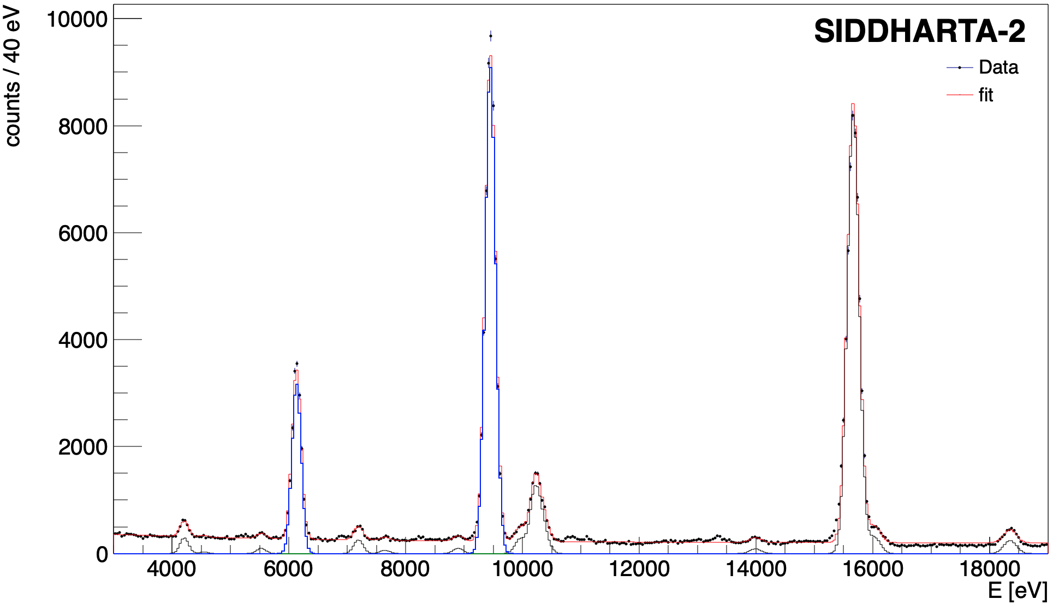





First measurement of kaonic neon X-ray transitions
The Kaonic Neon measurement (2023)
First measurement of kaonic neon X-ray transitions ( record of precision $<1$ eV )
Line | Energy [eV]
K-Ne 9$⟶$8 | 4206.35$±$ 3.75 (stat)
K-Ne 8$⟶7$ | 6130.86 $±$ 0.71 (stat) $±$ 2 (sys.)
K-Ne 7$⟶6$ | 9450.08$±$ 0.41 (stat) $±$ 2 (sys.)
K-Ne 6$⟶5$ | 15673.30 $±$ 0.52 (stat) $±$ 5 (sys.)
K-Ne 7->6
K-Ne 6->5
Implications on
kaon - multinucleon interaction,
Exotic atoms cascade
and kaon mass
?Rydberg constant
K-Ne 8->7
KO 6->5
KC 5->4
K-Ne 9->8
KAl 7->6
KC 6->4
KC 7->5
KAl 8->7
KO 5->4
Kaonic Neon Yield analysis on going $⟶$ paper in preparation
46

Slide 47




The (charged) Kaon mass puzzle and kaonic Neon
Kaon mass (K-Ne $8⟶7$and K-Ne $7⟶6$) = $493.671 ±0.021 \left(stat\right) MeV$
(stat. error $\sim 15$keV including the K-Ne $6⟶5$ )
GALL 88
DENISOV 91
Preliminary
SIDDHARTA-2
Kaon mass discrepancy
BACKENSTO 73
The kaonic Neon measurement to determine the K⁻ (K⁺) mass
Particle Data Group, 2020, 083C01 (2020)
CHENG 75
BARKOV 79
LUM 81
Less systematic uncertainty with respect to DENISOV 91 and GALL 88 measurements, thanks to the use of a low Z gas (Ne) target
Kaon mass [MeV]
Impact on the charmonium spectrum and on all processes in which charged kaons are involved
It could solve the kaon mass discrepancy issue

Slide 48

Present status

Slide 49

The Kaonic Lead Measurement (Zagreb Uni)
Integrated luminosity: 109.38 pb⁻¹ ( June – July 2023)
Preliminary analysis of June-July 2023 data (D.. Bosnar and I. Friščić) :
Gaus+linear function was fitted for each peak:
(10 -> 9) : 906 events in peak,
position 209.191 ± 0.171 keV
(9 -> 8) : 947 events in peak,
position 292.939 ± 0.134 keV
(8 -> 7) : 943 events in peak,
position 427.200 ± 0.152 keV
Optimization and detailed analysis is in progress-> towards a publication
Preliminary

Slide 50

SIDDHARTA-2
the kaonic deuterium measurement

Slide 51


SIDDHARTA-2 K-d measurement
achievable precision
Kaonic deuterium run in (all) 2023/4
Monte Carlo for an integrated luminosity
of 800 pb⁻¹
to perform the first measurement of the strong interaction induced energy shift and width of the kaonic deuterium ground state
(similar precision as K-p) !
Significant impact in the theory of strong interaction with strangeness
A new renaissance for kaonic atoms at DAΦNE: future measurements and perspectives

Slide 52
Kaonic deuterium measurement
Liu, Thomas 2020
achievable
precision
Weise 2017
Oset 2001
Mizutani 2013
Meißner 2011
Gal 2007
Shevchenko 2012
52

Slide 53



Kaonic deuterium data analysis – Run1
First run, May – July 2023, integrated luminosity 200 pb⁻¹ (with injections)
Refined data calibration completed
KC6->5
5545 eV
ROI
KC5->4
10216 eV
VERY PRELIMINARY
KO6->5
9968 eV
KO7->6
6007 eV
KC7->5
8886 eV
KN6->5
7595 eV
Fe $K_{α}$
6400 eV
Cu K$α$
8041 eV

Slide 54


Project Timeline – Future plans
First run with SIDDHARTA-2 optimized setup for 200 pb⁻¹ integrated luminosity: May – July 2023 - completed
Second run Autumn – Winter 2023 goal: estimated 350 pb⁻¹ finished 14th December
Third run 2024 – goal: 400 pb⁻¹
Calibration: solid targets – Li, B, Be – 100-150 pb
Integrated luminosity 100-150 pb⁻¹ (1 month)
Goal: integrated luminosity $∼$400 pb⁻¹
Start kaonic deuterium Run3
2024, January
End Run3
2024
Total: 900 pb⁻¹
(to ensure 800 pb⁻¹ of useful data)
Light kaonic atoms Run
(Li - Be - B)
Extension of the SIDDHARTA-2 run, also as post-calibration
End of kaonic deuterium Run2
2023, December
Total: 500 pb⁻¹
Run2 expected integrated
luminosity
$∼200−3$00 pb⁻¹
(with injections)

Slide 55

Strangeness precision frontier at DAΦNE: a unique opportunity for measurements of kaonic atoms along the periodic table: will represent a reference in physics with strangeness
Present status: old and very old measurements with low precisison (some even wrong: kaonic helium puzzle)
We propose to do precision measurements along the periodic table at DAΦNE for:
Selected light kaonic atoms
Selected intermediate mass kaonic atoms
Selected heavy kaonic atoms
charting the periodic table

Slide 56

EXtensive Kaonic Atoms research:
from LIthium and Beryllium to Uranium
EXKALIBUR

Slide 57

Future plans beyond SIDDHARTA-2: EXKALIBUR
proposal to perform fundamental physics at the strangeness frontier at DAFNE
for a 3-years period (post-SIDDHARTA-2)
EXtensive
Kaonic
Atoms research: from
LIthium and
Beryllium to
URanium
We propose to do precision measurements along the periodic table at DAFNE for:
Kaonic Hydrogen: 200 pb⁻¹ – with SIDDHARTA-2 setup – to get a precision < 10 eV (KH)
Selected light kaonic atoms (LHKA)
Selected intermediate and heavy kaonic atoms charting the periodic table (IMKA)
Ultra-High precision measurements of Kaonic Atoms (UHKA)
Dedicated runs with different types of detectors: CZT detectors, HpGe, SDD 1mm, crystal HAPG spectrometer from VOXES project - MODULAR
Fundamental physics at the strangeness frontier at DAΦNE. Outline of a proposal for future measurements,
C. Curceanu et al., Front.in Phys. 11 (2023) 1240250
EXKALIBUR

Slide 58

Light and Heavy Kaonic Atoms measurements: LHKA
  KH Kaonic Hydrogen: 200 pb⁻¹ – with SIDDHARTA-2 setup – to get a precision < 10 eV (present precision about 40 eV shift and 90 eV width) very important for theory (QCD at threshold with strangeness – physic below threshold) – as soon as possible! (Weise, Nucl Phya A 2021)
  2) Setup with 1 mm SDD detectors:
  Kaonic Li; Be; B; He in the energy region 10-40 keV – precision < 2-3 eV
  SDDs are being built
  2) Setup with 2 HPGe detectors/CdZnTe
  Heavy kaonic atoms: transitions above 70 keV
  Kaonic Pb, W – precision at the level of 3-10 eV
  HPGe available (Zagreb) and ready for use
  Total required integrated luminosity: 200 + 400 (200) pb⁻¹
$$E_{KHe 3→2}\left(eV\right)=6463.7±2.5 \left(stat\right)$$
$$ε_{2s}=0.2±2.5 \left(stat\right)±2 \left(syst\right)$$

Slide 59




Light and heavy kaonic atoms measurements: LHKA setup
Li, Be, B targets

Slide 60


Solid target system for light kaonic atoms: e.g. Li – Be – B
kaonic Li-transitions
3-2 ~15 keV
4-2 ~21 keV
5-2 ~23 keV
4-3 ~ 5 keV
5-3 ~ 8 keV
6-3 ~ 9 keV
5-4 ~2.5 keV
6-4 ~ 4 keV
KLi
⁵⁷Co
The energy spectra of light kaonic atom transitions for Li, Be and B targets below 17 keV can achieve a precision below 2-3 eV, for an integrated luminosity of about 200 pb⁻¹ (including calibrations and test).

Slide 61





Development of 1 mm SDD Detector Modules (C. Fiorini; G. Deda; G. Borghi)
Single SDD Module: the Prototype Design
1 mm SDD array
SDD monolithic array (designed and produced by Fondazione Bruno Kessler, FBK):
$2×4$ matrix, square pixels, each one having active area of $8×8$ mm²;
1-mm-thick, total chip dimensions are 20 mm $×$ 36 mm;
Spectroscopic measurements with a first prototype with partially working channels:
irradiation with an ⁵⁵Fe X-ray source;
detector temperature: -30° C;
spectra acquired with SFERA APP, shaping time 6 $μ$s;
best energy resolution @5.9keV (Mn-K$α$ peak ): 138.2 eV, (channel 2).
61

Slide 62



Light kaonic atoms measurement with SIDDHARTA-2
The energy spectra of light kaonic atom transitions for Li, Be and B can achieve a precision below 2-3 eV,
for an integrated luminosity of about 100-150 pb^{-1;} ;
Use of present SDDs + 1mm SDDs and target materials financed – construction ongoing
SDD 1mm detector
Multi element target (Li, Be, B) under construction financed by INFN (gr 3)
Production run very successfully concluded at FBK: test of all the devices with automatic probers – completed
First SDD samples delivered to PoliMi – July 2023
Development of the new PCB and DAQ on going

Slide 63




CdZnTe detectors: next run with 16 cm²
16 cm² CdZnTe detectors to perform X-ray spectroscopy of kaonic carbon and aluminium in parallel with SIDDHARTA-2 kaonic deuterium run (L. Abbene, A. Buttacavoli, F. Principato, A. Scordo)
New lead shield installed
Two modules (8 CdZnTe) installed and ready
MCarlo: For KAl (4→3) with 10% yield we expect :
10 (signal) ev/pb⁻¹

Slide 64

Intermediate and Heavy Kaonic Atoms measurements
IHKA
  Setup with CdZnTe detectors:
  (talk F. Sgaramella and J. Zmeskal)
  Kaonic Ti, V, Zr, Ag, between 40 and
  200 keV keV – precision 3-5 eV
  CdZnTe are developed within
  ASTRA STRONG-2020 project
  Ph1, Ph2, Ph3
  3) Setup with 2 HPGe detectors continued
  Heavy kaonic atoms: transitions above 70/100 keV
  Kaonic Co, Au, Pt – precision at the level of 5-10 eV (depending on energy of transition)
  HPGe available and ready for use (Zagreb Univ. plus Mainz – additional HPGe)
  Ph1, Ph2, Ph3
  Total required integrated luminosity: 400 (200) pb⁻¹

Slide 65

Intermediate and heavy kaonic atoms measurements: IHKA setup
Ti, V, Zr, Ag targets
Cd(Zn)Te
ASTRA STRONG-2020

Slide 66
New physics? Cascade calculations – Paul Indelicato
In principle one could use precision measurements of K - atoms to set constraints on some sort of new physics.
The best sensitivity will be for masses of mediating particles in the ~ few MeV mass range.
(Maxim Pospelov)
Randolf Pohl: similar to muonic atoms -> proton radius
We study feasibility!

Slide 67

Knscat and int: KAON-NUCLEI SCATTERING and INTERACTION
The present knowledge of total and differential cross sections of low energy kaon-nucleon reactions is very limited.
Below 150 MeV/c there is a “desert” - the experimental data are very scarce and with large errors and practically no data exist below 100 MeV/c.
Kaon-nucleon scattering/interaction data are fundamental to validate theories: chiral symmetries; lattice calculations; potential models etc.

Slide 68


KN1: elastic scattering, layout
charged kaon
detector
TPC
Scint. bars
read out
with SiPMs
K⁻
beam pipe
kaon monitor
K⁺
TPC prototyping ongoing at:
Sendai Univ., Japan
SMI, Austria (EU-STRONG2020)
0 cm
25 cm
50 cm

Slide 69

KN2 – inelastic scattering, layout
Charged kaon
detector
TPC
“Sandwich” type
calorimeter
32 layers Pb –
liq. Scintillator,
thickness 25 cm
Cryogenic target:
Solid H2, D2, Ar
Liquid He
TPC
Kaon monitor
0 cm
25 cm
50 cm

Slide 70


The Modern Era of precision measurements of hadronic (kaonic) atoms fosteres a deeper understanding of the antikaon-nuclei interactions at threshold, which is fundamental to unveil the mechanisms at work on non-perturbative strangeness QCD.
Implications going from particle and nuclear physics to astrophysics.

Slide 71







Neutron star EOS
Particles structure
Cold Dense matter
Strangeness Fundamental Physics
Mass generation, visible Universe
QCD
Chiral symm.
Strangelets & Dark Matter

Slide 72

ThanK You

Slide 73


Slide 74

Gantt chart – possible implementation of the kaonic atoms measurements
Total integrated Luminosity:
200 + 400 (200) + 400 (200) + 400 pb⁻¹

Slide 75

Ultra-High precision measurements of Kaonic Atoms
UHKA
  Setup with 8 VOXES lines (crystal HAPG spectrometer):
  Kaonic C, N, He: precision < 0.5 eV
  VOXES detector developed; financing for building 8 lines required (possibility of external funding)
  Will be ready within early 2025
  2) Feasibility test (measurements) for kaon-nuclei scattering exp.
  With TPG detector
  TPC developed by Sendai ELPH Japan, SMI-Vienna and LNF-INFN (HP2, HP3 EU)
  KP nuclear scattering – feasibility for FUTURE MEASUREMETS (2 years after KA)
  Total required integrated luminosity: 400 pb⁻¹

Slide 76



Ultra-high precision measurements of kaonic atoms
UHKA (VOXES or TES)
  Modern Instrumentation, 2015, 4, 32-4
JINST 13 (2018) 04, C04002

Slide 77

Alessandro Scordo

Slide 78

Alessandro Scordo

Slide 79
Fundamental Physics at the strangeness frontier at DAFNE:
We have a very rich and broad scientific case for unique measurements of kaonic atoms and kaon-nuclei interactions processes at DAFNE contributing to understand physics going from chiral symmetry breaking to neutron stars EOS setting LNF in forefront of these studied – 5 years after SIDDHARTA-2 (modular)
The proposed measurements have the potential to guide the developments of physics at the strangeness frontier in the coming decade, being fundamental not only for a better understanding of the strong interaction (QCD), but also in astrophysics and particle physics.
DAFNE AND J-PARC – Consortium?

