Slide 1
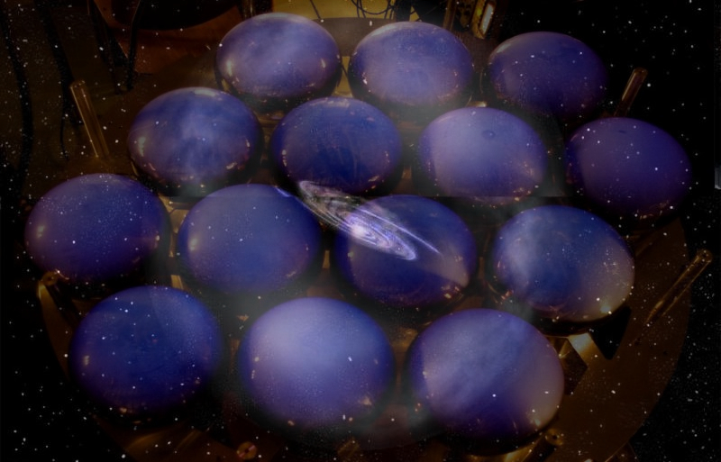


Direct Detection of Dark Matter
Roberto Santorelli
CIEMAT

Slide 2
Outline:
Dark matter direct detection : who, where, what?
Physics landscape
  High mass WIMPs
  Annual modulation
Finally a signal?
Prospects of the experiments
My (Biased) opinion: how to move forward?
Summary

Slide 3
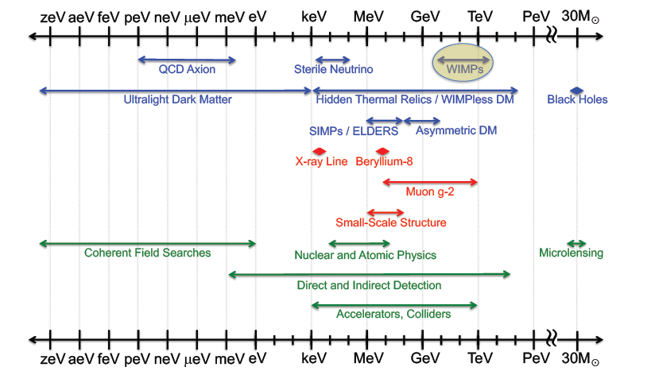
Feng 2023
The landscape of particle dark matter candidates (blue), spanning almost a 100 orders of magnitude in mass

Slide 4
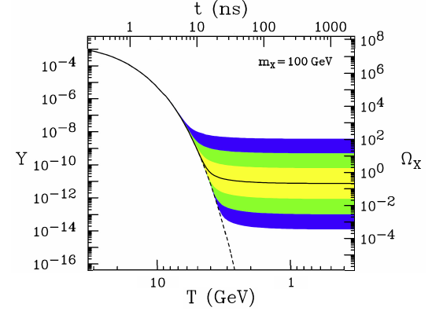
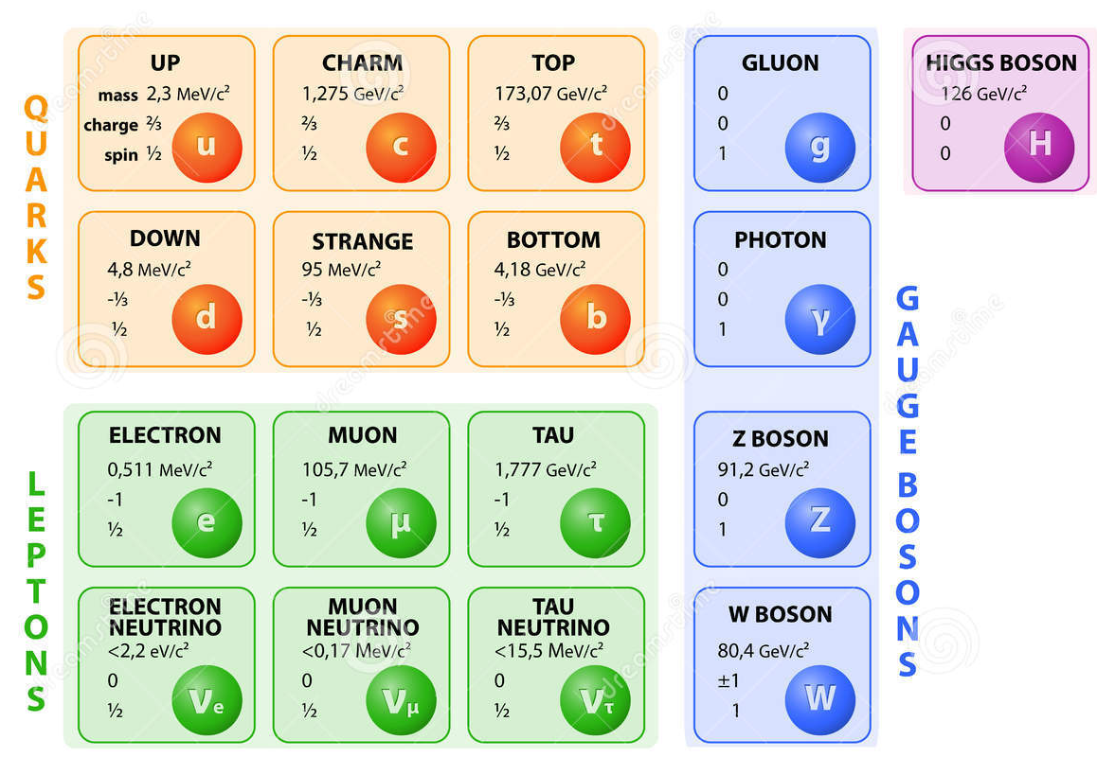
What is Dark Matter made of?
Weak-scale particles with O(1) couplings freeze out with the desired relic density and
make excellent dark matter candidates.
Assuming the simple production mechanism of thermal freezeout, WIMPs are produced with the right relic density to be dark matter.
remarkable triple coincidence particle theory, cosmology, experiments
  all motivate WIMPs: g ∼ 1 and masses m ∼ 10 GeV − 10 TeV
evolution of a thermal relic’s number density
No color charge
No electric charge
Non-relativistic
No strong self-interaction
Stable, or very long-lived

Slide 5

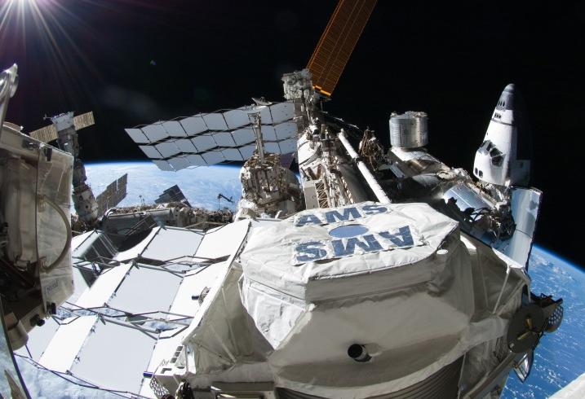
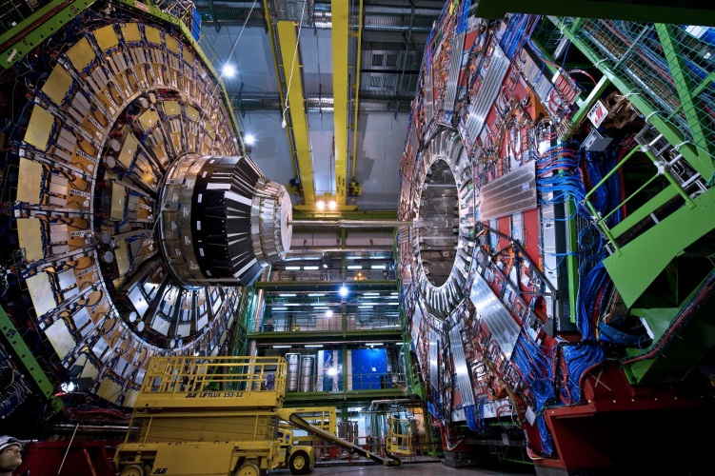
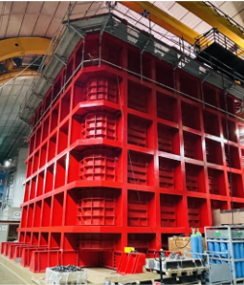
Detection
χ
χ
χ
χ
q
q
q
Above ground Collider Underground
If WIMPs are produced by thermal freezeout in the early universe, there is typically an effective DM-DM-SM-SM 4-point interaction.
Viewing this interaction with the arrow of time running in various directions:
DM annihilation now DM in the collisions of SM particles DM scattering off normal matter

Slide 6

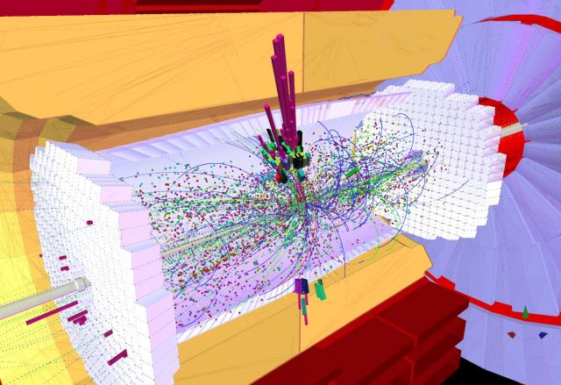
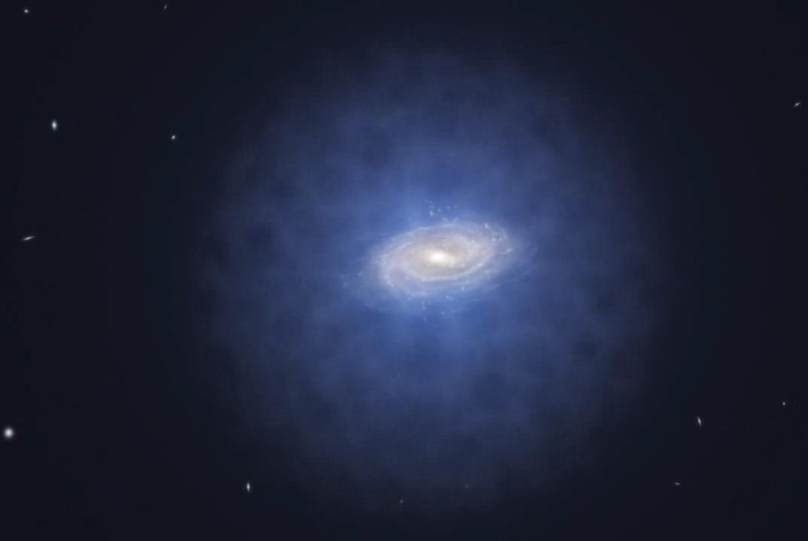
Detection
χ
χ
χ
χ
q
q
q
Above ground Collider Underground

Slide 7
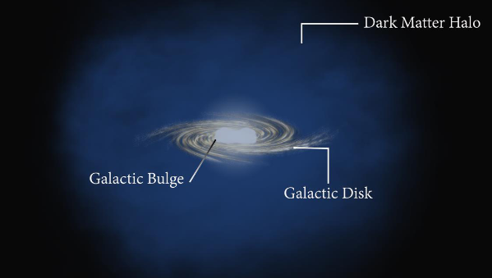
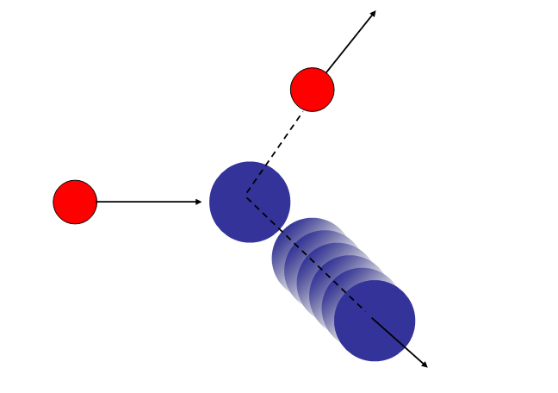
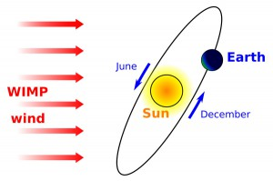
Dark Matter direct detection
Dark Matter distributed in a spherical halo around the Milky Way (first-order approximation)
Isothermal Maxwell-Boltzmann velocity distribution 220-240 km/s and V_{esc}=540-580 km/s
V_{e}~245 km/s WIMP velocity relative to Earth
Local density = 0.3 GeV/cm³
^{J.Bovy S.Tremaine APJ} ⁷⁵⁶ ²⁰¹²
→ 1e⁵ cm⁻²s⁻¹ for M_{W}=100 GeV/c²
Spin Independent: χ scatters coherently off of the entire nucleus A: σ∼A²
Spin Dependent: mainly unpaired nucleons contribute to scattering amplitude: σ∼J(J+1)
Ar,Xe,Ge…Nuclei
(at rest)
WIMP β~10⁻³
E_{recoil}
Scattering non relativistic :
coupling spin-dependent / spin-independent
Notes:
7

Slide 8
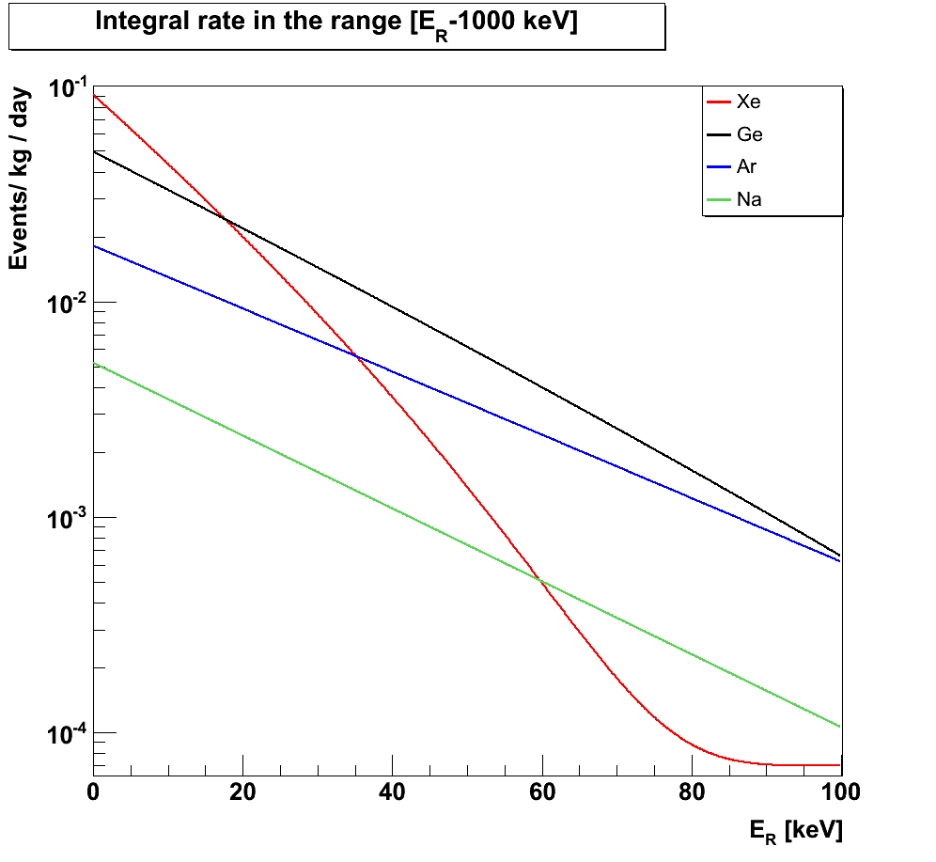
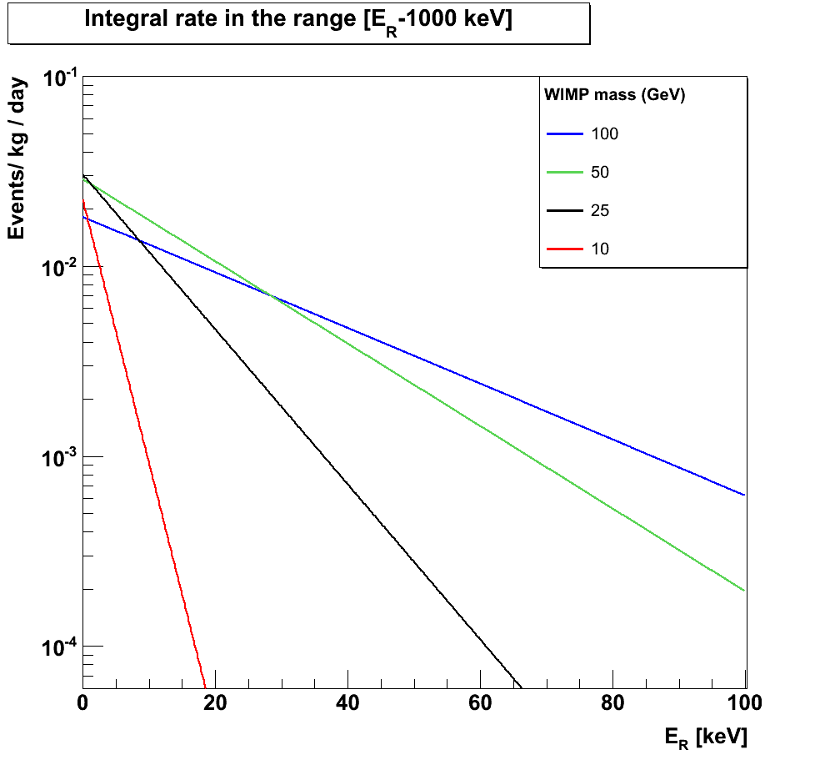
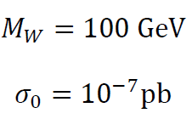
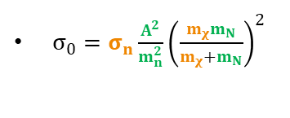

Recoil spectrum
Recoil energy
J.D. Lewin, P.F. Smith, Astropart. Phys. 6 (1996),87
Kinematic factor
momentum transfer
Most probable energy
reduced mass
Differential Recoil Energy spectrum
$R_{0}=\frac{2}{\sqrt{π}}\frac{N_{A}ρ_{χ}}{A{∙m}_{χ}}σ_{0}v_{0}$
Particle physics
Detector
DM halo
$σ_{0}=σ_{n}\frac{A^{2}}{m_{n}^{2}}{\left(\frac{m_{χ}m_{N}}{m_{χ}+m_{N}}\right)}^{2}$
←Heavier target
→ Heavier WIMPs
Other Corrections:
Earth annual modulation
Finite Galactic escape velocity
Finite Energy range
Notes:
8

Slide 9
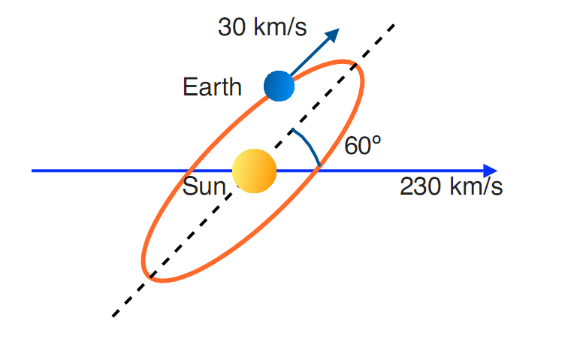
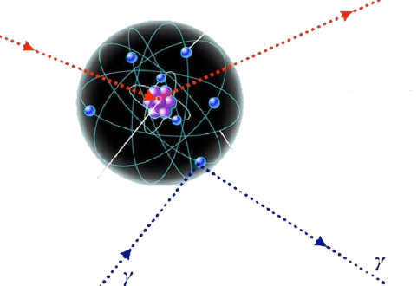
Experimental signature
Nuclear recoils ~ keV
Featureless recoil spectrum (no bump)
Single scatters (uniform throughout the detector volume)
χ
Notes:
9

Slide 10
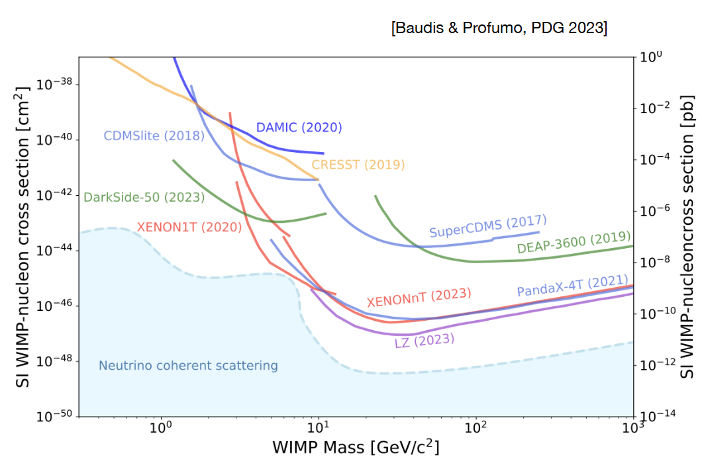
WIMP parameter space (S.I.)
Baudis-Profumo, PDG 2024

Slide 11
WIMP parameter space (S.I.)
Baudis-Profumo, PDG 2024

Slide 12
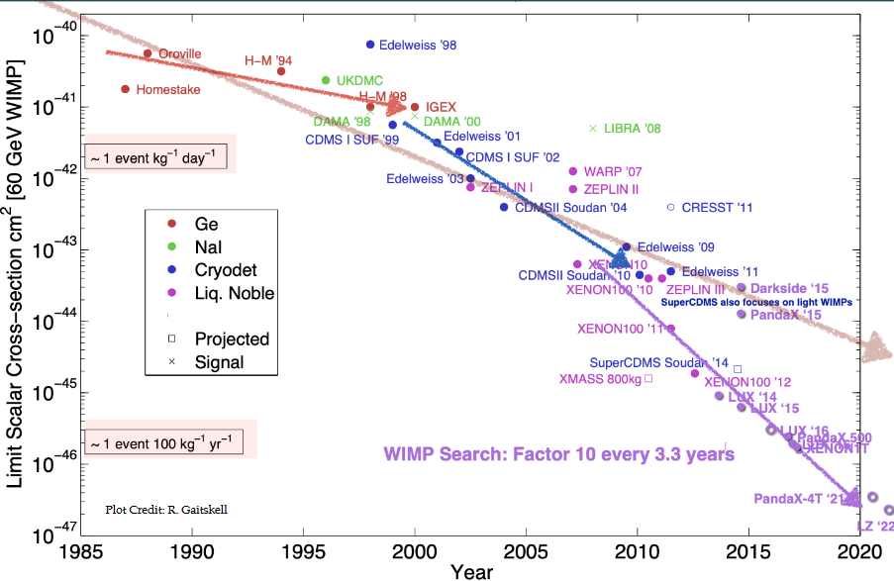
The race for Dark Matter

Slide 13
Progresses on many fronts…
Event rates as low as a few per year per tonn are predicted
Improved technologies
Optimized detector design
New sensors (e.g. SiPMs)
New Veto design
Better techniques able to filter a weak signal out of background and noise
Data mining, machine learning….etc

Slide 14
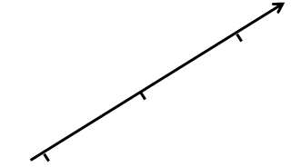
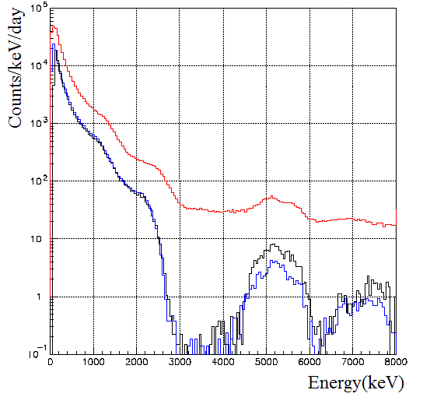
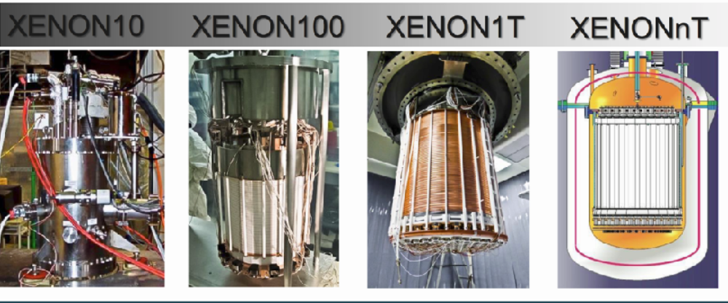
Basics of the rare events search
Two fundamental concepts :
10³
10⁻¹
Increase the active mass
Reduce the background
10²
10⁻²
10¹
10⁻³

Slide 15
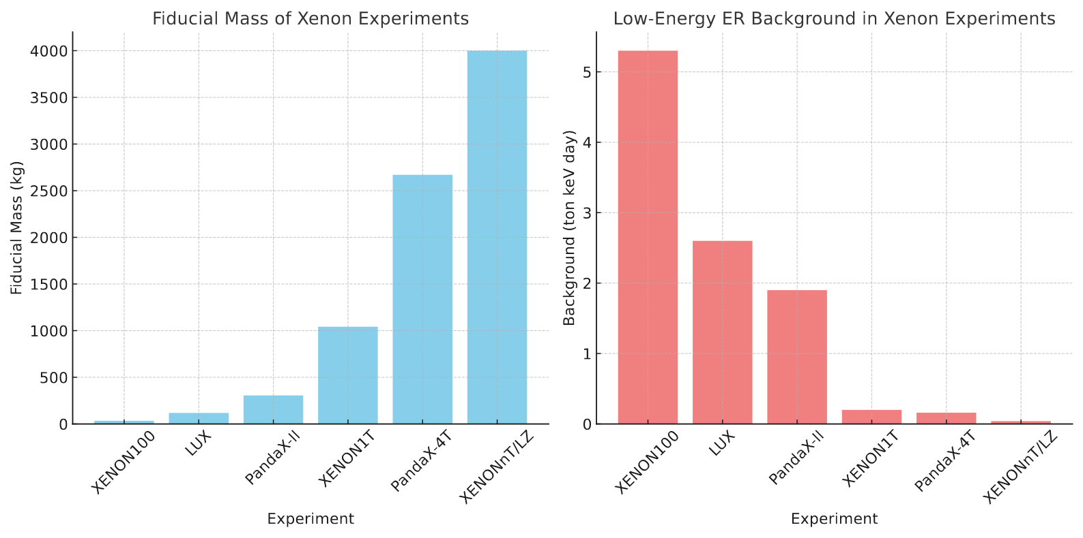

Slide 16
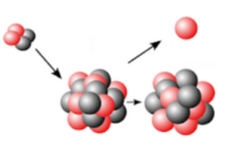
WIMP D.D - backgrounds
Backgrounds:
Mitigation strategies:
Surface treatment, Rn daughter (Pb-210-Po210) polishing, material radiopurity
Deep UG labs, active Muon Veto
ER discrimination techniques, materials radiopurity
Shielding (active+passive), Fiducial volume, ER discrimination techniques, materials radiopurity
Shielding (active+passive), materials radiopurity
α : higher energy depositions but degraded surface α and (α,n) reaction
μ : materials activation above/under –ground. Fast neutrons
β : ER
γ : ER
n: NR in the ROE (Signal → potentially irreducible background
> 10¹⁰ times our signal

Slide 17
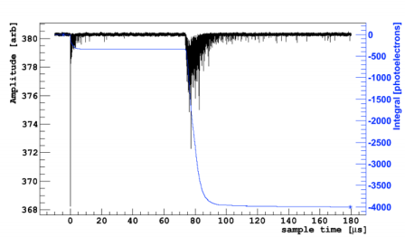
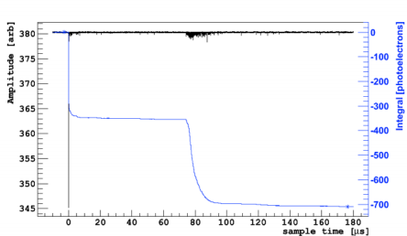
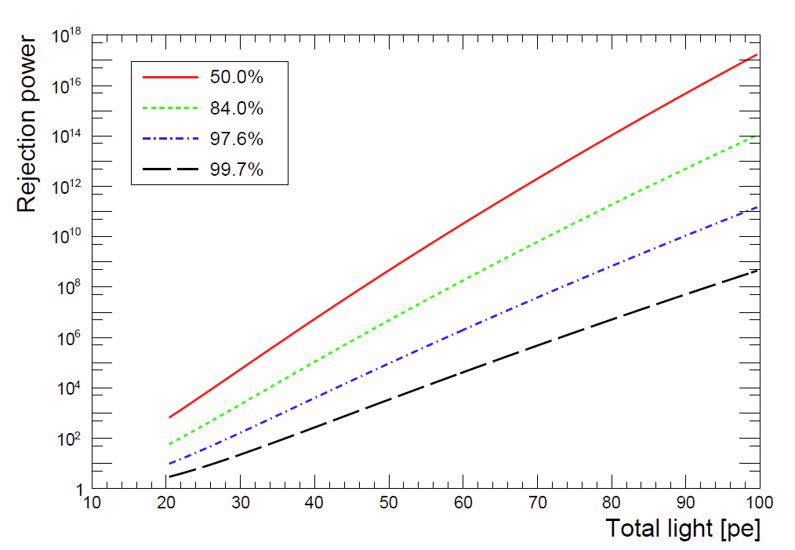
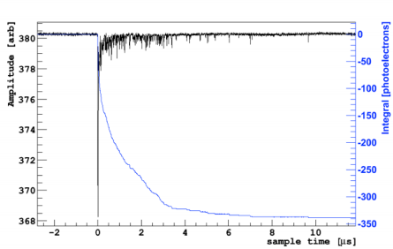
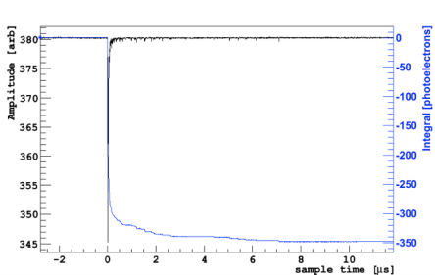
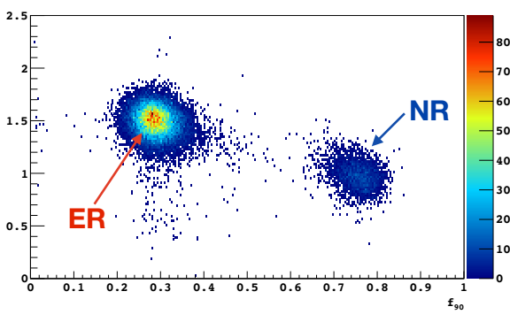
Event discrimination technique in Ar
ER-like event
NR-like event
ArDM @ LSC JCAP 12 (2018) 011
NR acceptance
S1/S2
Due to an enhancement of the recombination process
S1
only
Slow component ≈ 70 %
Slow component ≈ 10 %
Log₁₀(S2/S1)
f₉₀
Notes:
17

Slide 18
WIMP D.D - backgrounds
Mitigation strategies:
Surface treatment, Rn daughter (Pb-210-Po210) polishing, material radiopurity
Deep UG labs, active Muon Veto
ER discrimination techniques, materials radiopurity
Shielding (active+passive), Fiducial volume, ER discrimination techniques, materials radiopurity
Shielding (active+passive), materials radiopurity
Very low background techniques
are
mandatory!

Slide 19
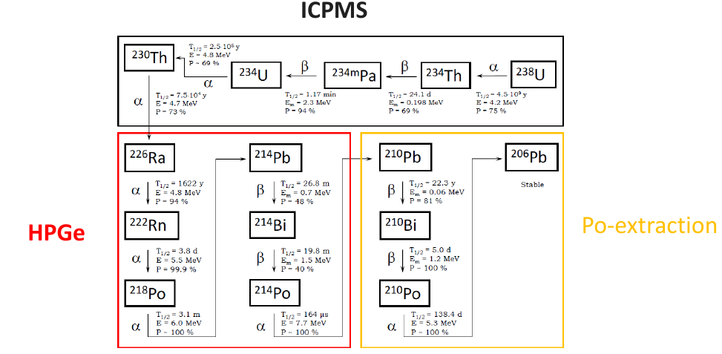
Equilibrium in the U-238 chain
BREAKING OF THE SECULAR EQUILIBRIUM AT ²²⁶Ra
SECOND BREAKING OF THE EQUILIBRIUM IN ²¹⁰Pb

Slide 20
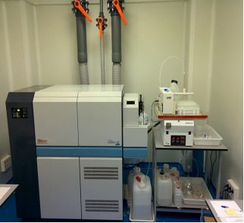
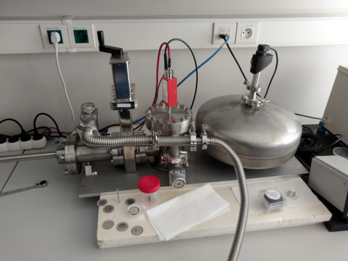
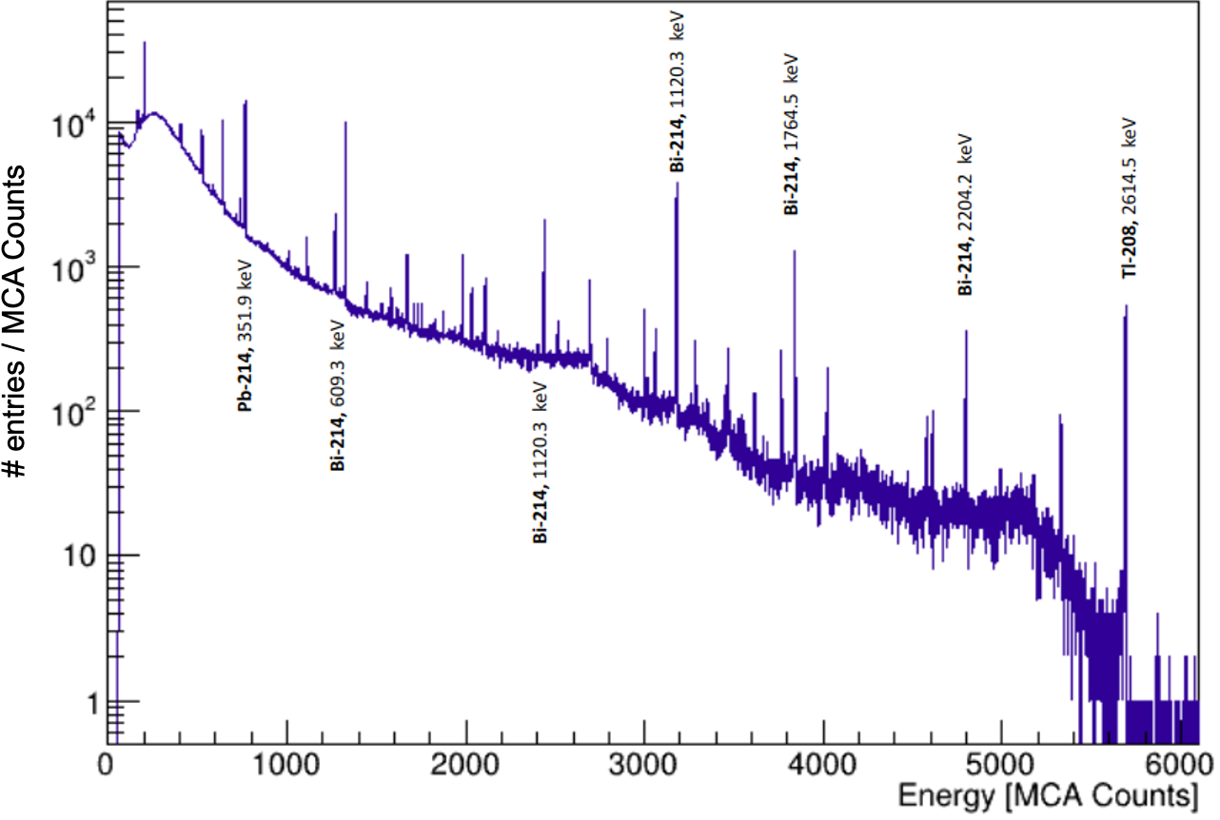
Equilibrium in the U-238 chain
Radiochemical
Little mass needed
Relatively fast
Digestion
Destructive
Only Po-210 (Pb-210)
ICPMS
Very little mass needed
Relatively fast
Digestion
Destructive
Only U-238 (Th-232)
HPGe
Larger mass needed
Slow
Non-destructive
Gamma activity (⁴⁰K+...)

Slide 21
Equilibrium in the U-238 chain
Worldwide effort involving
  underground facilities: LSC (Sp), Gran Sasso (It), Boulby (UK), SNOLAB (Ca)
  + CIEMAT (Sp), Jagiellonian Univ. (Pl), Aix-Marseille U. (Fr), Mendeleev U. (Ru), Temple (US)...
Monitor the history of exposure of materials to cosmogenic radiation
Surface (and not so surface) screening

Slide 22
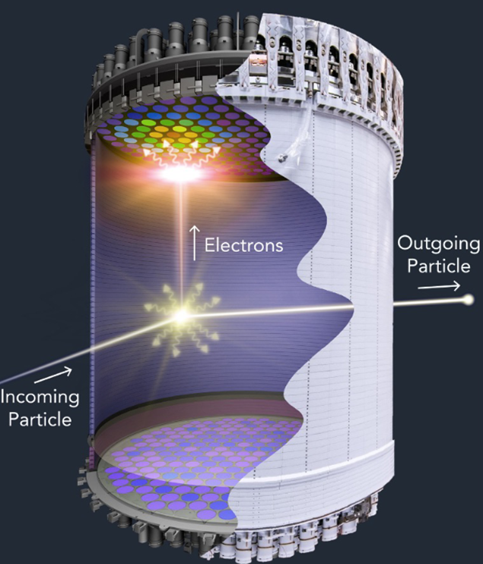
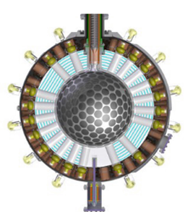
Single-phase vs Dual-phase
Simple approach/operations
Better control of the radiopurity
More scalable
Better position reconstruction
Single site vs multi site rejection
Charge+light bkg rejection
Lower energy threshold

Slide 23
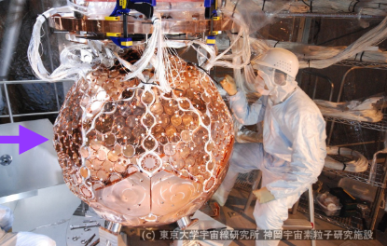
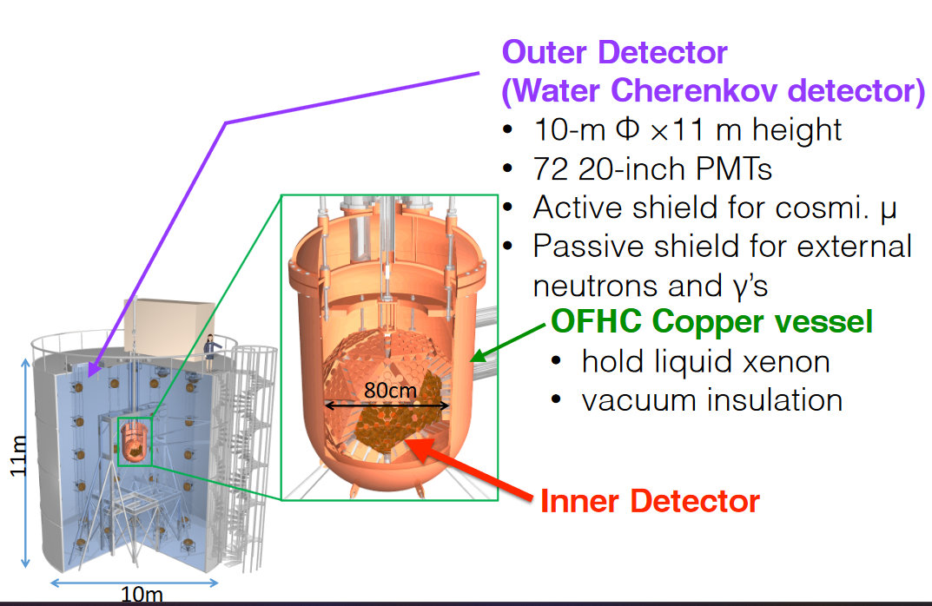
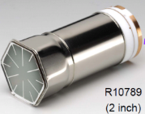
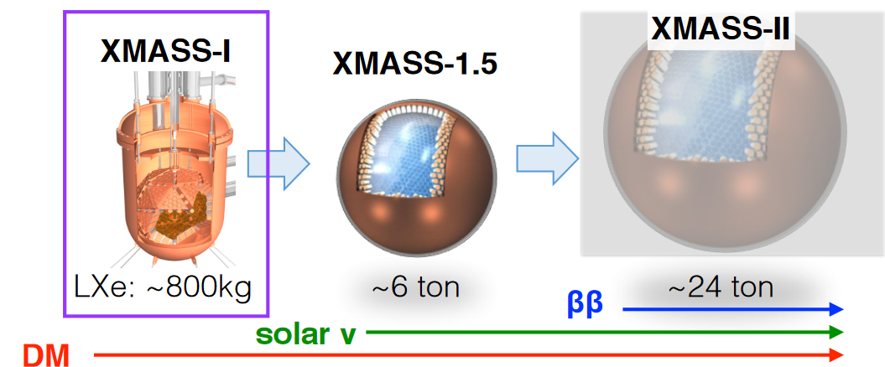
XMASS @ Kamioka
XMASS-I: 835 kg active mass / 642 PMTs for photon detection

Slide 24
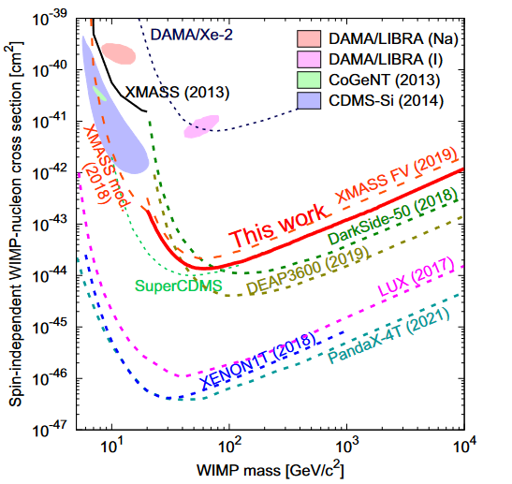
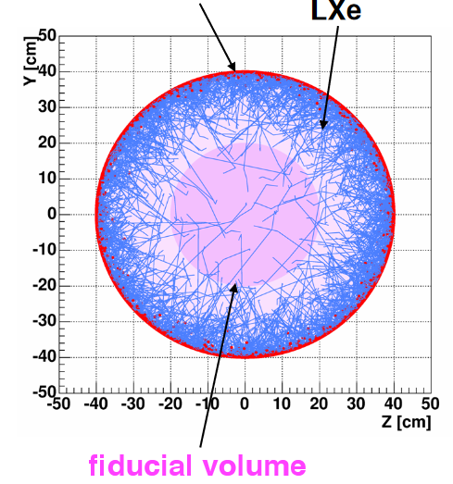
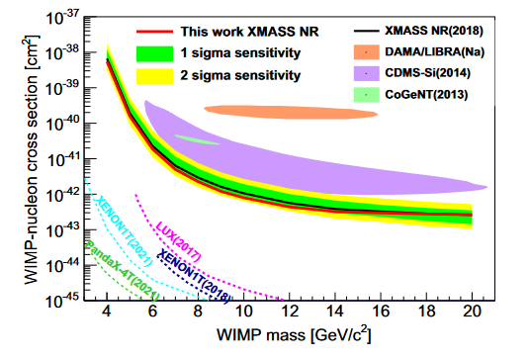
XMASS@Kamioka
Took data between 2013 and 2019, accumulating over 1590 days of live time
Efficient light collection with a yield of ~14 photoelectrons/keVee
Self-shielding properties enable reliable position reconstruction
> 1 keVee
Surface radon background reduction is crucial, with levels 10x lower than LUX and XENON-100
40 kg fiducial volume with a 40 keV energy threshold
PHYS. REV. D 108, 083022 (2023)

Slide 25
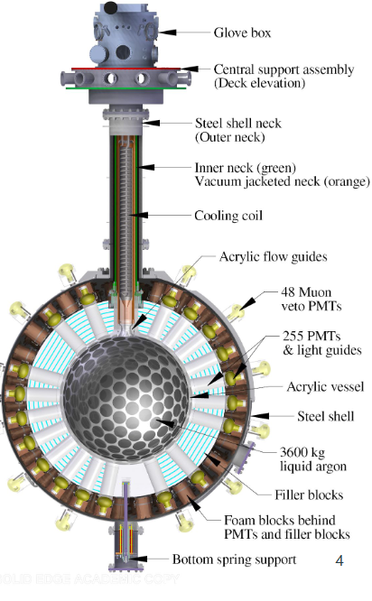
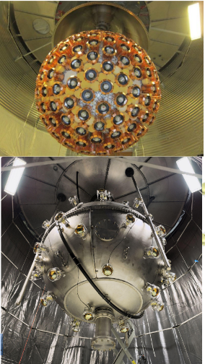
DEAP-3600 @ SNOLAB
Target : 3269±24 kg of LAr in acrylic vessel
Photon detection: 255 HQE PMTs connected via acrylic light guides
Inner surface of vessel coated with TPB wavelength shifter
Shielding: Filler blocks between LGs used for thermal insulation and neutron shielding
Veto: Steel shell is immersed in 300 tons of H₂O, viewed by 48 veto PMTs.

Slide 26
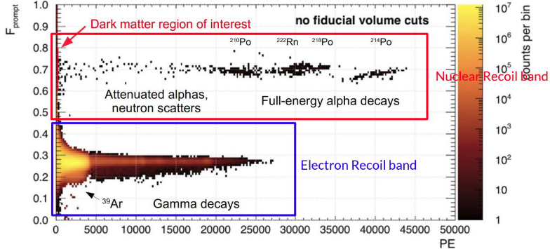
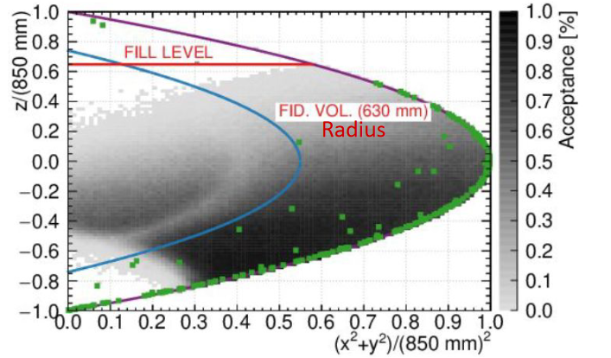
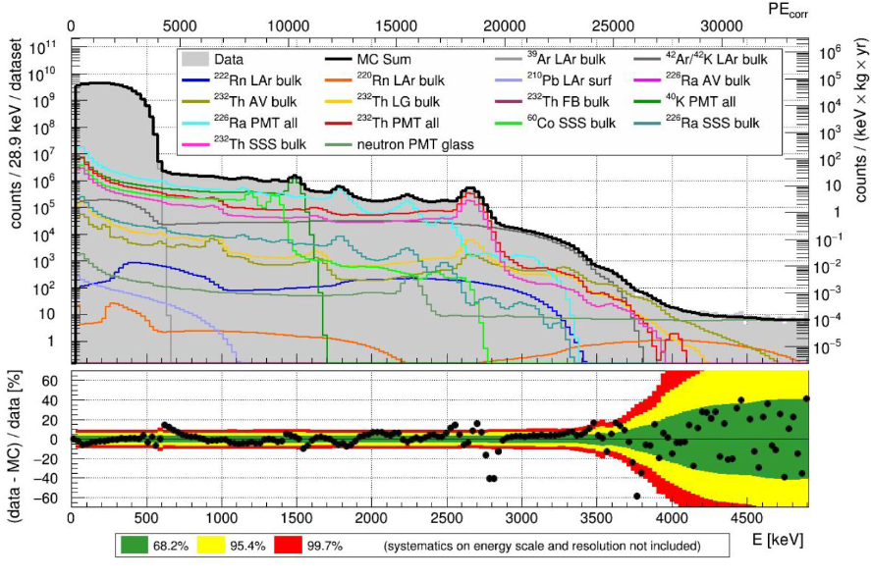
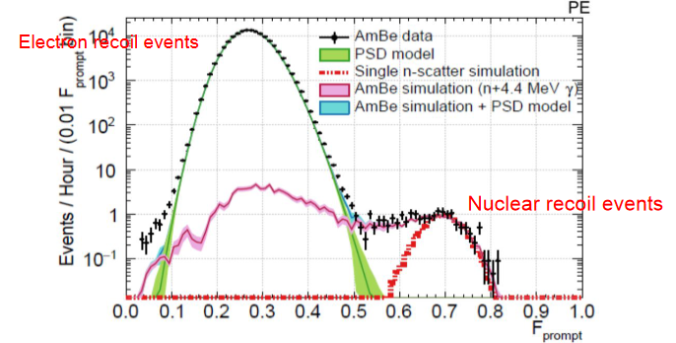

Slide 27




First year dataset : November 2016 -
October 2017
(231 live days)
No WIMP-like signals: 0 events in ROI
Physical Review D, 100, 022004 (2019)
Coming up
3 Year Dataset (Nov 2016 to March 2020) expect ~800 days of lifetime instead of 231 days
Data taking scheduled to resume in Summer 2024. Data taking for 2 more years

Slide 28

XENONnT @ LNGS

Slide 29



XENONnT @ LNGS
Time Projection Chamber (TPC)
• 8.5 t ultra pure xenon target
• 5.9 t Xe observed by 494 PMTs
• Active target diameter/ drift length:
1.3m/1.5m
• Drift field 23 kV/cm
Neutron Veto (NV)
• (Gd-salted) W.C. detector
• 120 8” PMTs inside
enclosure of reflective panels
• Neutron tagging efficiency of
53% in pure water
Muon Veto (MV)
• 700 t W.C. detector
• 84 8” PMTs
• Active veto against muons
• Passive shielding

Slide 30

XENONnT @ LNGS
          March 2020
          Installation of the TPC UG at LNGS, a few days before the first COVID19 lockdown
July-December 2020
Installation of the nVeto
Filling of the cryostat with LXe
Water Tank closed and filled with demi-water
January-June 2021
Commissioning, commissioning, commissioning…
July-November 2021
Science Run 0
in 2022
Refurbishment of Rn Distillation Column
Start of Science Run 1
Commissioning of the GdPlant with demi-water
Search of new physics with ER: PRL 129, 161805 (2022)
in 2023
First insertion of Gd-Sulphate in the GdPlant
First results on WIMP search with NR: PRL 131, 041003 (2023)
First insertion of Gd-Sulphate in the Water Tank. Start of Science Run 2.
Initial results with 97.1 live days (2022)
6.9 tons active LXe volume
5x bckg reduction wrt Xenon-1T
No low-energy ER excess found excluding BSM
explanation of XENON1T excess
Phys. Rev. Lett. 129, 161805 (2022)

Slide 31

XENONnT @ LNGS
ER Background
Dominated by radon background (²¹⁴Pb beta decay, GXe extraction only)
Sub-dominant ⁸⁵Kr background (cryo. Distillation)
Surface Background
              ²¹⁰Pb plate-out at the PTFE walls leading to ²¹⁰Po
              α-decays with electron loss
              Suppressed by fiducial volume cut
Accidental Coincidences
Random pairing of isolated S1 and S2 signals
Suppression using a gradient BDT cut based on S2 shape, R and Z information
NR Background
Radiogenic neutron rate constrained by NV tagging
CEvNS constrained from solar ⁸B neutrino flux
Phys. Rev. Lett. 131, 041003

Slide 32

XENONnT @ LNGS

Slide 33



XENONnT: ⁸B neutrinos
XENONnT measures the CEvNS signal in Xe from solar ⁸B neutrinos for the first time!
→ First astrophysical neutrino measurement via CEvNS
XENONnT coll. - IDM2024
2.7 σ

Slide 34


Blind analysis with an exposure of 3.51 t×y
37 observed events above 0.5 keV, with ${26.4}_{−1.3}^{+1.4}$ events expected from backgrounds.
Background-only hypothesis is rejected with a statistical significance of 2.73 σ.
The measured 8B solar neutrino flux of ${4.7}_{−2.3}^{+3.6}$ × 10⁶ cm⁻² s⁻¹ consistent with results from dedicated solar neutrino experiments.
The measured neutrino flux-weighted CEνNS cross-section on Xe of ${1.1}_{−0.5}^{+0.8}$ × 10⁻³⁹ cm² is consistent with the Standard Model prediction.
https://www.arxiv.org/pdf/2408.02877

Slide 35




LZ @ SURF
Data thus consistent with the background-only hypothesis
Operation extended thought 2028

Slide 36



LZ - results
PRL 131 (2023)
σ_{SI} < 9.2 x 10⁻⁴⁸ cm² @36 GeV
σ_{S}I = 2.3 × 10⁻⁴⁸ cm2 at 43 GeV/c2
LZ @ LIDINE2024
WS2024-only best limit

Slide 37






PANDA-X @ Jinping
Preliminary 2024
R. Santorelli LI - International Meeting on Fundamental Physics 37

Slide 38


Slide 39


Slide 40




DarkSide-20k @ LNGS
Nested detector with
  ProtoDUNE-like cryostat: 8 x 8 x 8 m³ hosting 650 t of atm Ar
  SS vessel+structure hosting 99 t underground Ar.
  UAr + acrylic Veto for neutrons and γ.
  Central Dual-phase Ar TPC:
21 m² of SiPM + 5 m² in veto.
  Coverage in TPC Optical plane > 90%
    50 t UAr (20 t fiducial)
    348 cm drift
    Cathode @ -73.4 kV

Slide 41

DarkSide-20k @ LNGS
The present projection - based on a 10 yr run, giving a fiducial volume exposure of
200 t yr - is 6.3 x 10⁻⁴⁸ cm² for 1 TeV/c² WIMP for the 90% C.L. exclusion.
  neutrons after cuts < 0.1 in 10 y
  < 0.05 from β and γ

Slide 42

³⁹Ar in Atmospheric Argon (AAr)
β-emitter with 565 keV endpoint, T_{1/2}=269 y (cosmogenic)
Pure beta emitter, no accompanying gamma radiation
∼17 mBq/m³ in atmosphere
Present in AAr due to the production process (isotopic abundance ∼ 8×10⁻¹⁶ g(³⁹Ar)/g(^{Nat}Ar) )
Argon from underground gas reservoirs → shielded from cosmic rays
Production from natural radioactivity reactions (e.g. (α, n)-induced on ³⁹K) suppressed if the gas is from the mantle (ppb level of U and Th)
1400 ± 200 ³⁹Ar depletion factor in UAr with respect to AAr
Phys. Rev. D 93, 081101 (2016)

Slide 43

Extraction – Purification – Measurement
International effort underway to procure radiopure argon extracted from underground reservoirs
Three sites to extract, purify and measure the radiopure argon

Slide 44




DArT in ArDM @ LSC
Main Lab under mount Tobazo
~850 m rock
~2500 mwe
1400 m²
ArDM detector:
850 kg active volume (≈2 t total)
  Cryogenic low rad. PMT arrays (R5912 2×12)
  50 cm passive neutron shield (Poly, 20 ton)
Data taken 2014-2018

Slide 45




ArDM preparation
13 new cryogenic PMTs (R5912) for the veto
New reflector cage with TPB on the reflector panels
New 6 t inner Pb shield

Slide 46
The future

Slide 47

LAr- plans
ARGO:
400 tons UAr (300 fiducial),
250 m² pdm covering full acrylic vessel surface
A.B. McDonald: “Dark matter detection with liquid argon“Nucl. Phys. B 1003 (2024) 116436

Slide 48
LAr- plans

Slide 49

LXe- plans: EU+USA
XLZD = XENON + LUX-ZEPLIN (LZ) + DARWIN
From a consortium to a collaboration. Goal: to build the ultimate LXe detector
Plot by C. O'Hare
~60-t scale LXe detector

Slide 50


Slide 51
LXe- plans: China
PANDAX-XT
43 TONNES, 10-YEAR RUN
ARXIV: 2402.03596 [HEP-EX] 2024

Slide 52



Biased opinion 1: pile-up problems
Massive detectors with several meters drift:
S1 and S2 pile-up
→ mis reconstruction of the interactions

Slide 53

Biased opinion 2:

Slide 54

Biased opinion 2: space charge

Slide 55

Biased opinion 2: space charge

Slide 56



Annual modulation
Considering (at least locally) an isotropic DM halo, the annual modulation is due to the combination of the earth’s motion about the sun and the sun’s motion about the center of the galaxy
$${\vec{v}}_{χH}={\vec{v}}_{χL}+{\vec{v}}_{⊙}+{\vec{v}}_{⊕}\left(t\right)$$
$${\vec{v}}_{⊙}+{\vec{v}}_{⊕}\left(t\right)=\left(227±20\right)+\left(14.43±0.08\right)\cos\left(\frac{2π}{1\text{yr}}\left(t−\left(0.419±0.002\right)\right)\right)\frac{\text{km}}{\text{s}}$$
“WIMP Wind” coming from the
direction of Cygnus
Result: Larger (and more energetic)
WIMP flux in summer than in winter
Maximum of velocity expected between June 2nd and 3rd (≈ 241 km/h)
Minimum of velocity expected between December 2nd and 3rd (≈ 213 km/h)
± 6,4 % variation
Magnitude of the rate modulation effect expected to be of the order of (up to 10%), but larger
modulations possible close to threshold

Slide 57


Annual modulation
Requirements:
1) Cosine-like modulation of the rate
2) In low energy range
3) Period of 1 year
4) Phase at about June 2nd
5) For single-hit events in a multi-detector set-up
With modulation amplitude in the region of maximal sensitivity
must be <7% for usually adopted halo distributions, but it can
be larger in case of some possible scenarios
Recoil energy for two dates in the year
modulation amplitude as a function of recoil energy
Rotation of the Earth around its own axis:
≈0.5 km s⁻¹ at the equator << orbital velocity (30 km s⁻¹)
S_{m,d} ~ 0.015 S_{m,y}

Slide 58


DAMA/LIBRA @ LNGS
DAMA/NaI
Concluded on July-2002
7 annual cycles collected
Exposure 0.29 ton×yr
DAMA/LIBRA Phase I
From 2003 to 2010
7 annual cycles
1.04 ton x yr
Rate in ROI [2,6]keV ~ 1 dru
DAMA/LIBRA Phase II
From 2011 – present
First release in 2018 with 7 annual cycles and 1.13 ton x yr
Replaced PMTs (higher QE, lower radioactivity and noise)
Improved LY from ≈6.8 to 8 ph.e/keV and s/E by ~10%
Energy threshold below 2 keV
Rate in ROI [1,6]keV ~ 0.7 dru
Accumulated ~ 3 ton x yr 20 yr underground

Slide 59



DAMA/LIBRA @ LNGS
Model independent evidence of a particle DM component in the galactic halo:
Phase I + Phase II n_{σ}~ 14
with rate in ROI ~ 1 dru and S_{m}~0.01 dru
A clear modulation is present in the (1-6) keV energy interval
Sm values compatible with zero are present just above
Sm in (6–14) keV random fluctuate around zero; χ²=20.3/16 dof (P=21%)
Nucl.Phys.Atom.Energy 22 (2021) 4, 329-342
Cerulli IDM24
No Modulation above 6 keV

Slide 60

Absenceof modulation? No
χ2/dof= 130/69 (1-2 keV);
176/69 (1-3 keV);
202/69 (1-6 keV);
157/69 (2-6 keV)
Fit on DAMA/LIBRA-phase2
Acos[ω(t-t₀)]; t₀ = 152.5 d, T = 1.00 y
1-2 keV
A = (0.0224 ± 0.0030) cpd/kg/keV
χ²/dof = 75.8/68 7.4 σ C.L.
1-3 keV
A = (0.0191 ± 0.0020) cpd/kg/keV
χ²/dof = 81.6/68 9.7 σ C.L.
1-6 keV
A = (0.01048 ± 0.00090) cpd/kg/keV
χ²/dof = 66.2/68 11.6 σ C.L.
2-6 keV
A = (0.00933 ± 0.00094) cpd/kg/keV
χ²/dof = 58.2/68 9.9 σ C.L.

Slide 61

Moscow University Physics Bulletin, 2022, Vol. 77, No. 2, pp. 291–300.

Slide 62


ANAIS @ LSC
In operation since Aug. 2017
9 crystals 12.5 kg each manufactured by Alpha Spectra Inc. (CO, USA)
Passive shielding with archeological Pb (10 cm), low-activity Pb (20 cm), and neutron moderator (40 cm)
Rn box ( 0.6 Bq/m3) and muon veto with plastic scintillator
        Events with less than one second from a muon are rejected
            Periodic calibrations with ¹⁰⁹Cd (88, 22,11.6 keV) and ⁴⁰K, ²²Na (internal control populations)
            Average light yield ~ 14.5 phe/keV
            Accumulated ~ 0.6 ton x yr 7 yr underground

Slide 63


Slide 64

COSINE-200 @ Yangyang
Conceived in 2013 and in operation since Sept. 2016 at Yangyang, South Korea.
8 crystals (4x2 array) with total mass of 106 kg manufactured by Alpha Spectra Inc. (CO, USA)
            Total effective mass is 61.3 kg
Active shielding with 2,200 L of LAB LS in an acrylic box viewed by 8 5-inch PMTs
Additional passive shielding with Cu (3 cm) and Pb (20 cm)
Muon veto with plastic scintillators (3 cm)
  Events within 30 ms from a tagged muon are removed
  Energy scale stability monitored through the 46.5 keV γ from internal ²¹⁰Pb decay and tested with 3.2 keV X-ray from ⁴⁰K
BTD analysis to remove PMT noise
Average light yield ~12.4 phe/keV (14.8 in selected sub-set)
Accumulated ~ 0.4 ton x yr 8 yr underground

Slide 65
Experiment | Target Mass [kg] | Exposure | Light yield [phe/keV] | Energy threshold (analysis threshold) | R.A. Levels (Key Isotopes) | Bkg % | Bkg Event rate in ROI [2,6] keV
DAMA/LIBRA | 250 | ≈ 3 ton yr | ≈ 6 (8 in phase II) | ≈ 2 keV ( 2- 6 keV) ≈ 1 keV ( 1- 6 keV) in P-II | 210Pb 26 uBq/kg 3H < 90 μBq/kg 40K 14 ppb Saint Gobain crystals | 13 % < 15 % 20 % | ≈ 1 dru
ANAIS-112 | 112.5 | ≈ 0.3 | ≈ 14.5 | ≈ 1 keV ( 1- 6 keV) | 210Pb 800 uBq/kg 3H 100 mBq/kg 40K 30 ppb Alpha Spectra crystals | 32,5 % 26,5 % 12 % | ≈ 3.2 dru
COSINE-100 | 106 (60 kg for DM search) | ≈ 0.17 | ≈ 12.4 (14.8 in selected sub-set) | ≈ 1 keV ( 1- 6 keV) | 210Pb 800 uBq/kg 3H 100 uBq/kg 40K 30 ppb Alpha Spectra crystals (Merck for COSINE-200) | 40.9 % 51.5 % 5% (with 40K + 238U + 232Th +87Rb) | ≈ 2-3 dru

Slide 66

A. IANNI - IDM2024

Slide 67

Criticism - I
DAMA/LIBRA publishes residuals that highlight the annual modulation, but they do not publish enough data to make an independent verification easy. They should clarify residuals for: Different energy bins, Different periods, Comparison to control datasets (e.g., periods when modulation should not be present, such as during periods of no WIMP interaction)
Unlike experiments like ANAIS-112, COSINE-100, and others, DAMA/LIBRA has not provided a comprehensive breakdown of potential background sources in the same detail
ANAIS provides detailed breakdowns of each possible background source (as shown in the slide you provided), helping to separate potential signal from background noise. These include: Concentrations of potassium and tritium in the detector, Radon contamination, Time-varying sources such as environmental temperature or humidity changes.

Slide 68
Criticism - II
The other experiments provide plots showing the energy spectrum of events, including both modulated and unmodulated components. This allows for a clearer understanding of how the signal behaves across different energy ranges.
DAMA/LIBRA has not published detailed background-subtracted energy spectra that could help in better understanding their signal, especially for lower-energy events where dark matter interactions are expected
There is also a lack of systematic uncertainty analysis for their detectors. Given that the modulation signal is subtle, understanding the response of the detectors to small changes is crucial. DAMA/LIBRA has not provided detailed accounts of the possible systematics, such as:Temperature effects on the NaI(Tl) crystals and the changes in the detector environment over time.

Slide 69
Modulation: Current status
Experiment | Location | Target | Mass [kg] | Status
DAMA/LIBRA | LNGS | NaI(Tl) | 250 | running
ANAIS-112 | LSC | NaI(Tl) | 112.5 | running
COSINE-100 | Y2L | NaI(Tl) | 106/61.3 | upgrading
COSINE-200 | Yemilab | NaI(Tl) | ~200 | in preparation
SABRE North/South | LNGS + SUPL | NaI(Tl) | ~50 | in preparation
COSINUS | LNGS | NaI | ~1 | in preparation
PICOLON | Kamioka | NaI(Tl) | ~50 | In preparation
So far DM-Ice, NaIAD, DAMA/LIBRA, ANAIS-112, and COSINE-100 have been attempting to search for DM with an array of NaI(Tl) detectors. New programs are under development: COSINE-100+, COSINE-200, SABRE, COSINUS, and PICOLON. R&D: ANAIS+, ASTAROTH

Slide 70

COSINUS @ LNGS
Operation of NaI as cryogenic detector
Low threshold (in particular for nuclear recoils)
Precise energy information
Signal-only measurement of potential DM signal
(first NaI detector with particle identification on
event-by-event basis-> high discrimination for NR signals )
Dry dilution refrigerator to reach 10 mK
NaI undoped crystals made by SICCAS
35 g (108 g) for Phase I (II)
• Detector under installation/commissioning at LNGS
• External Water Tank as active muon veto
It also reduces cosmogenic neutron flux ~x100
• Staged approach
2025 start data taking with 8 detectors
2025-2026 Run1:100 kg x day
>2026 Run2: 1000 kg x day
Two-channel readout
(phonon + scintillation light):
- Low nuclear recoil threshold
- Signal to background discrimination on an
event-by-event basis
- Signal-only measurement

Slide 71




Water tank:
Good moderator for neutrons
Instrumentation of water tank with 30PMTs
- Veto of (cosmogenic) muons via Cherenkov light emitted in water
Rate of cosmogenic neutrons:
No veto: ( 3.5 ± 0.7) cts kg−1 yr−1
With veto: <(0.30 ± 0.02) cts kg−1 yr−1
(target exposure of 1000 kg days)

Slide 72
SABRE @ LNGS + SUPL
SABRE (Sodium-iodide with Active Background RejEction) : NaI(Tl) North-South «twin» experiments at LNGS (Italy) and SUPL (Australia)
Rule out seasonal effects
Proof-of-Principle (PoP) at LNGS Exploit active background rejection with a liquid scintillator and Test crystals radio-purity → Aim to 0.1 dru in ROI
liquid scintillator based active veto (distilled from Borexino)
(single-hit events are events with only one crystal triggered with no measurable energy in the LS • multi-hit events are events with more than one crystal triggered or with at least one crystal and a measurable energy deposition in the LS. )
the Astro Grade NaI powder was developed in collaboration between Princeton University and Sigma-Aldrich (today Merck) with potassium < 10ppb after fractional recrystallization purification (Astro Grade), available on the market exploitation of zone refining purification to achieve radio-purity goal
Status: SABRE North, TDR submitted for review; SABRE South detector deployment to be completed in 2025
from Merck

Slide 73


SABRE @ LNGS + SUPL
SABRE North and South detectors have common core features:
• Same crystal production and R&D.
• Same detector module concept (Ultra-pure crystals and HPK R11065)
• Common simulation, DAQ and data processing frameworks
• Exchange of engineering know-how with official collaboration agreements between the ARC Centre of Excellence for Dark Matter and the INFN
SABRE North and South detectors have different shielding designs:
• SABRE North has opted for a fully passive shielding due to the phase out of organic scintillators at LNGS.
→ Direct counting and simulations demonstrate that this is
compliant with the background goal of SABRE North at LNGS.
• SABRE South will be the first experiment in SUPL, the liquid scintillator will be used for in-situ evaluation and validation of the background in addition to background rejection and particle identification.

Slide 74

Run in 2020 with liquid scintillator and NaI-33 crystal
○ 2 tons active veto with 10 x 8-inch PMTs +
H₂O shielding
● Exploited successfully ⁴⁰K tagging with sensitivity
at the level of 1 ppb
● Demonstration by direct counting of first crystal
production after DAMA/LIBRA with background
in [1,6] keV of order 1 cpd/kg/keV
● PoP-dry run in 2021/22: passive shielding with
additional layer of copper
○ confirmed background level

Slide 75
Take home message - I
Four DM experiment currently taking data in high WIMP mass region (one LAr-SP and three Xe-TPCs)
DarkSide-20k being constructed, data-taking from 2026
So-far, no signal of DM
Low-energy signal from XENON-1T ruled out
First astrophysical neutrino measurement via CEvNS by XENONnT
Ongoing collaboration efforts on-going between the experiment: ~100 t active mass detectors foreseen in the next year
from Merck

Slide 76
Take home message - II
DAMA/LIBRA end of data taking by 2024 Crucial comprehensive analysis of background time dependence ongoing
ANAIS-112 and COSINE-100: Stronger tests of DAMA/LIBRA
Prospects:
ANAIS+: Replace PMTs witn SiPM in LAr
COSINE-200: High radio-purity achieved in kg size crystals
COSINUS: Advanced detector deployment UG commissioning starting soon
SABRE: PoP-> demonstrated a background of ∼ 1.2 cpd/kg/keV [1-6] keV ROI (An array of 9 crystals for a total mass of ∼ 45 kg late 2025 (first crystal) to early 2027 (last crystal)
PICOLON: high radiopurity
Expression of intent to merge know-how, experience, and equipment to solve this long lasting conundrum (ANAIS, COSINE, SABRE)
from Merck

Slide 77

Thank you
from Merck

Slide 78
Bonus slides

Slide 79


PICOLON: Intense effort to remove radioactive impurities from NaI powder by multiple recrystallization and cation exchange resin

Slide 80



2025 start data taking with 8 detectors
2025-2026 Run1:100 kg x day
>2026 Run2: 1000 kg x day
Production and assembly
of 8 detector modules for
Run 1
Start data taking
@LNGS beginning 2025
-> collect 100 kg days

Slide 81



ANAIS+: ANAIS-112 sensitivity is constrained by anomalous light
events attributed to the PMTs (dominating the events rate below 10 keV)
• Aggressive filtering has been developed to remove them, but
efficiency is low (even after improvements by new ML procedure)
and limits the energy threshold
MAIN GOAL
Lower the energy threshold Eth <0.5 keV in NaI detectors
CSI(Tl) crystal

Slide 82



Rate in ROI [1,6] keV ~ 3 dru
With 2022 exposure (0.173 ton x yr) n_{σ} ~ 2.3
With 10 yr exposure n_{σ} ~ 4
Time-dependent background model in ROI: 210Pb: 40.9% (T1/2 = 22.2 yr) on average 0.8 mBq/kg 3H: 51.5% (T1/2 = 12.3 yr) flat: 5% includes 40K + 238U + 232Th +87Rb 22Na+109Cd+113Sn+127Te+121mTe+121Te: 2.6% 8 exponentially decaying components with fixed initial activity
Phys.Rev.D 106 (2022) 5, 052005

Slide 83


ANAIS-112 crystals radio-purity
Detailed radio-purity reports: As shown in the ANAIS slide, they provide detailed contamination levels for elements like 210Pb^{210}\text{Pb}210Pb and 3H^{3}\text{H}3H, showing exactly how much each background component contributes to the observed rate.
Background in ROI dominated by: 210Pb: 32.5% (T1/2 = 22.2 yr) on average 0.8 mBq/kg 3H: 26.5% (T1/2 = 12.3 yr) K: 12% on average 30 ppb 22Na: 2% (T1/2 = 2.6 yr)
210Po build-up indicates that: a) 210Pb contamination occurs at the end of growth; b) 210Po and not 210Pb is removed during growth
Blank module in operation since 2nd year to help understading unexplained events below 2 keV
Rate in ROI [2,6] keV ~ 3.2 dru With 8 yr exposure n_{σ} ~ 5 (only statistical error)

Slide 84

Can muons explain the DAMA signal?
• Modulation phase inconsistency
• Muons interacting directly in the detectors
do not fulfill the DM requisites
• Not enough muon-induced fast neutrons
to account for the signal
But still some open questions:
• (Delayed) effect of muons in PMTs?
• Slow phosphorescence in NaI?

Slide 85






Av. interaction rate:
· $\frac{dR}{dE}$​: Event rate (number of interactions per unit of energy).
· N_{target}​: Number of target nuclei in the detector.
· $ρ_{χ}$​: Dark matter density in the galaxy.
· $M_{χ}$​: Mass of the WIMP particle.
· v: Velocity of the WIMP relative to the target.
· f(v): Velocity distribution of the WIMPs in the galactic halo.
· $\frac{dσ}{dE}$​: Differential cross section as a function of energy E and velocity vvv.
$η\left(t\right) :$Modulation factor for the relative velocity between Earth and WIMPs.
v₀​: Characteristic velocity of the WIMPs (~220 km/s).
· ω: Angular frequency, ω=2π/1y
· t₀​: Time of the maximum modulation, which typically corresponds to June
$$\frac{dR}{dE}=N_{\text{target}}\frac{ρ_{χ}}{M_{χ}}\int{d^{3}}vf\left(v\right)v\frac{dσ}{dE}\left(E,v\right)$$
V. modulation factor
$$η\left(t\right)=\frac{v_{⊙}+v_{⊕}\left(t\right)}{v_{0}}≃1.03+0.066\cos\left(ω\left(t−t_{0}\right)\right)$$
Rate modulation
$$\frac{dR}{dE}\left(η\left(t\right)\right)=\frac{dR}{dE}\left(η_{0}\right)+\frac{∂}{∂η}{\left(\frac{dR}{dE}\right)}_{η_{0}}Δη\cos\left(ω\left(t−t_{0}\right)\right)$$
Event rate in energy bin k
· $S_{0,k}$​: Constant (non-modulated) component of the event rate.
· $S_{m,k}$: Modulated (time-dependent) component of the event rate.
$$S_{k}\left(t\right)=S_{0,k}+S_{m,k}\cos\left(ω\left(t−t_{0}\right)\right)$$

Slide 86

Space charge
Ions have drift velocity which is five/six orders of magnitude lower than the el.
Without taking into account the liquid motion:
${ }_{i}\sim 2∙{10}^{−4}{cm}^{2}V^{−1}s^{−1}$ (T.H. Dey , T.J. Lewis , J. Phys. D: Appl. Phys. 1 (8) - 1968)
  ${ }_{i}\sim 1.6∙{10}^{−3}{cm}^{2}V^{−1}s^{−1}$ (M. Torti , Proceedings of the Fourth International Conference on New Frontiers in Physics - 2015 )
  At $E_{d}$=1 kV/cm, ${ v}_{i}\sim 1.6∙{10}^{−5}mm$/$s$ to be compared to ${ v}_{e}\sim 2 mm$/$s$
${ v}_{i} ≪$ $v_{e}  _{i} ≫$ $_{e}$ Depending on drift field, ionization rate,
(+liquid motion ...etc)
The electrons drift to the anode, the ions stay!
The space charge can locally modify the electric field, the drift lines and the velocity of electrons
The electron drift in a positively charged volume (neutral target only when the field is off)

Slide 87





UAr assay @ LSC
Talk by V. Pesudo (Monday, July 8th)

Slide 88

DarkSide materials DB structure
Online database that centralizes the full assay process
New material or component? Assay request!
Sample allocation depending on available mass and needs
Information on sample/assay status
Storage and organization of results.

Slide 89

DarkSide materials Web interface
Online database that centralizes the full assay process
New material or component? Assay request!
Sample allocation depending on available mass and needs
Information on sample/assay status
Storage and organization of results.
DB: Web-interface

Slide 90

The number of background neutrons N_{n} from (α,n) reactions in a material can be calculated by:

Slide 91



Neutron yield calculation
DarkSide is the first experiment with the (α,n) neutron background fully calculated with Geant4
SaG4n: Simple and versatile tool provided to the community SaG4n (http://win.ciemat.es/SaG4n/)
“Neutron production induced by α-decay with Geant4”, Nucl. Instrum. Methods A 960, 163659 (2020)
Exploiting evaluated libraries (JENDL)
Detailed geometries (actual geometry and border effects)
Neutron transport, precise tracking
Biasing techniques

Slide 92


Background budget spreadsheet
R.A. budget spreadsheet
Storing the results of the samples, materials composition, contribution to the bkg …
(α,n) neutron background γ event rate(VETO+TPC)

Slide 93
Operation protocols
Protocols that account for all steps in the manipulation of every component that makes it into the detector:
  Storage upon arrival
  Storage during any intermediate step
  Every time that things need to be unbagged and rebagged
  Manufacturing
  Assembly
  Cleaning
  Testing
  Final storing
  Final assembly
Every relevant action on a vPDU is registered in a DB with an identifying code and a time stamp.
Each facility has an appointed person responsible for the interaction with the Materials WG.

Slide 94


(α,n) white paper
2405.07952
Multidisciplinar WG on (α,n) neutron yield studies
alphan@ciemat.es
Members of several DM experiments + Neutrino + Nuclear + IAEA:
DarkSide-20k
XENON
LZ
CRESST …

Slide 95




OFHC copper vessel with two top pipes.
Two 1 cm² SiPMs at top and bottom with the electronics integrated.
External acrylic support structure. Cylinder + two SiPM supports.
Internal acrylic cylinder and two disks covered with TPB (200 μg/cm²).
Reflector around SiPMs and between acrylic cylinders.
Act.volume of 1.4 kg: 620 evt/week for UAr (0.73 mBq/kg).

Slide 96


N-yields:
Values for 1 ppb Th-232 and U-238
(U-235 with its natural abundance)
(α,n) cross-section on Argon

Slide 97

Taking 60 GeV WIMP for illustration only
Now at O(~1) event/millennium/kg
Credit: A. Manalaysay/R. Gaitskell

Slide 98
Experimental aspects
Large Exposure (Mass × Time) : 100s ton × year
Low Energy Threshold : ~10 keV_{NR}
Event topology : γ/β, α, μ
3D Event Reconstruction : neutrons
Material radiopurity : < mBq/kg
Discrimination between Signal and Bkg : > 99.99…%
Low Background Rate : <0.1 evt in the exposure
Extremely low background technique required and good discrimination NR-ER

Slide 99



Recovering sensitivity
Neck events will have a
different time profile.
● distinct PSD pattern.
● More light collected.
● Out of the ROI.
Finalize refined analysis and unblind

Slide 100



Gd-loaded Water: 0.2% of Gd in mass -> 3.4 t of Gd-sulphate-octahydrate;
(technology from EGADS-SK)
Cherenkov light is detected by 120 8” high-QE low-radioactivity PMTs
(Hamamatsu R5912) installed in water 1m away from the cryostat;
- High-reflectivity ePTFE panels confine an inner nVeto region (33 m3) with large light-collection efficiency
AmBe calibration: tagging
efficiency of 68%, (the highest ever measured in a water Cherenkov
Detector)

Slide 101








2405.07952
(α,n) reactions
𝐸_{𝛼} is the initial energy of the 𝛼 particle;
𝜂_{𝑖} is the number density of nuclide 𝑖;
𝜂 is the number density of the material;
𝜎^{𝑖}(𝛼,𝑋𝑛)(𝐸) is the neutron production x-sec for the nuclide 𝑖
𝜀(𝐸) = − $\frac{dE}{dx}$ is the stopping power of the material
http://win.ciemat.es/SaG4n/
Multidisciplinar WG on (α,n) neutron yield studies:
Members of several DM experiments + Neutrino + Nuclear + IAEA:
DarkSide-20k, XENON, LZ, CRESST …
alphan@ciemat.es

Slide 102


Slide 103


Slide 104

SiPMs
Custom cryogenic SiPMs developed in collaboration with Fondazione Bruno Kessler (FBK), in Italy.
• Photon detection efficiency (PDE) ~45%
• Low dark-count rate < 0.01 Hz/mm2 at 77K (7 VoV)
• Timing resolution ~ 10 ns • SNR>8 for 10x10cm2
Mass production of the raw wafers at LFoundry (Italy)
SiPM testing and assembling facility at NOA (Nuova officina Assergi).

Slide 105




Extraction/Purification
URANIA project: Production ready for construction in Cortez mine, Colorado. First procurement of ∼100 ton from the CO₂ wells
∼250 kg/d, 99.99% purity
(120t +25th per 0vbb)
ARIA project: Ar chemical purification by cryogenic distillation (1t/day)
350 m height, 31.8 cm inner cryogenic distillation column (Sardinia, Italy)
Production rate with ARIA in chemical purification mode (DarkSide-20k): ∼1ton/day
Production rate with ARIA in isotopic separation mode: several kg d⁻¹
Medical applications (isotope supply)

Slide 106
from Merck

Slide 107



Cryogenic detectors: phonons (TES or NTD) and charge (electrodes on the surfaces)
operate the crystals with HV electric field applied to the crystal drifts charges
Second detection channel for background discrimination
sensitivity to single e-/h+ pairs
SuperCDMS@SNOLAB: Super Cryogenic Dark Matter Search
Infrastructure @
SNOLAB under
construction
from Merck

Slide 108

from Merck

Slide 109

Status: All towers underground
from Merck

Slide 110

from Merck

Slide 111

from Merck

Slide 112

from Merck

Slide 113


CRESST: Cryogenic Rare Event Search with Superconducting Thermometers
-> Scintillating cryogenic detectors
Operated @ LNGS (Italy) in a low-background dilution refrigerator
Thin wafer detector: (2x2x0.04) cm3, Si or silicon-on-sapphire
(SOS) as light detector for scintillating absorbers
from Merck

Slide 114

from Merck

Slide 115

from Merck

Slide 116


Spherical proportional counters: Metallic sphere filled with gas, with a central anode producing a radial electric field
• different gases and mixtures (Ne, He, H)
• low threshold (single-ionization)
• sphere provides optimal volume/surface ratio
Bubble chamber:
Superheated state of the liquid: bubble nucleation when a particle (such as a dark matter candidate or a neutron) causes a sufficiently energetic nuclear recoil.
• Great potential for nuclear recoil discrimination: insensitive to electron-recoil DM (bubble nucleation requires highly localized energy deposition)
from Merck
Also: DarkSPHERE, ECuME)

Slide 117

DarkSide-20k sensitivity to low mass WIMPs

Slide 118


in ArDM
Installation in ArDM by the end of 2024
Commissioning of DArT in ArDM in 2024/25
In the long term, DArT will measure on a regular basis the UAr batches received from URANIA/ARIA before their use in DarkSide-20k
Signal: 𝛽 decays of ³⁹Ar (ROI ∈ [0,600] keV) with < 10 keV deposited in the veto (minimal veto threshold)
Background: untagged 𝛾 particles mainly from the radioactive decays in the detector materials (+ external)
Depletion factor with respect to AAr | Statistical uncertainty [%]
10 | 0.4
100 | 1.3
1400 | 6.7
14000 | 41.1
Monte Carlo
Signal 620 evt/week (D.F. 1400)
→ S/B > 1 for UAr
“JINST 15 (2020) 02, P02024.

