Slide 1
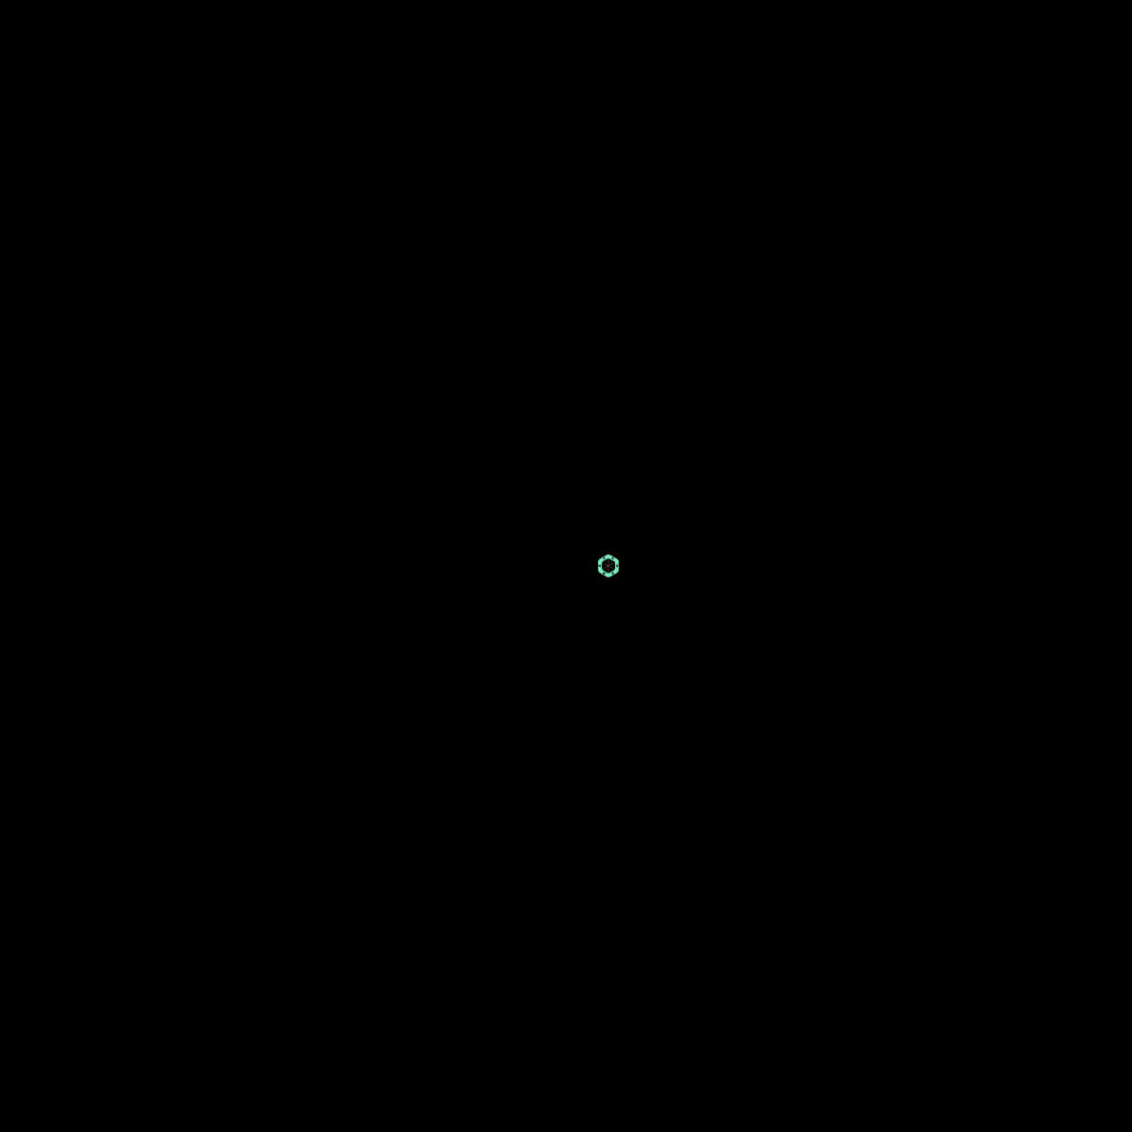

  Superconducting quantum processor design with KQCircuits
®
  Alessandro Landra
  Tech Lead, IQM Quantum Computers
github.com/iqm-finland/KQCircuits

Slide 2
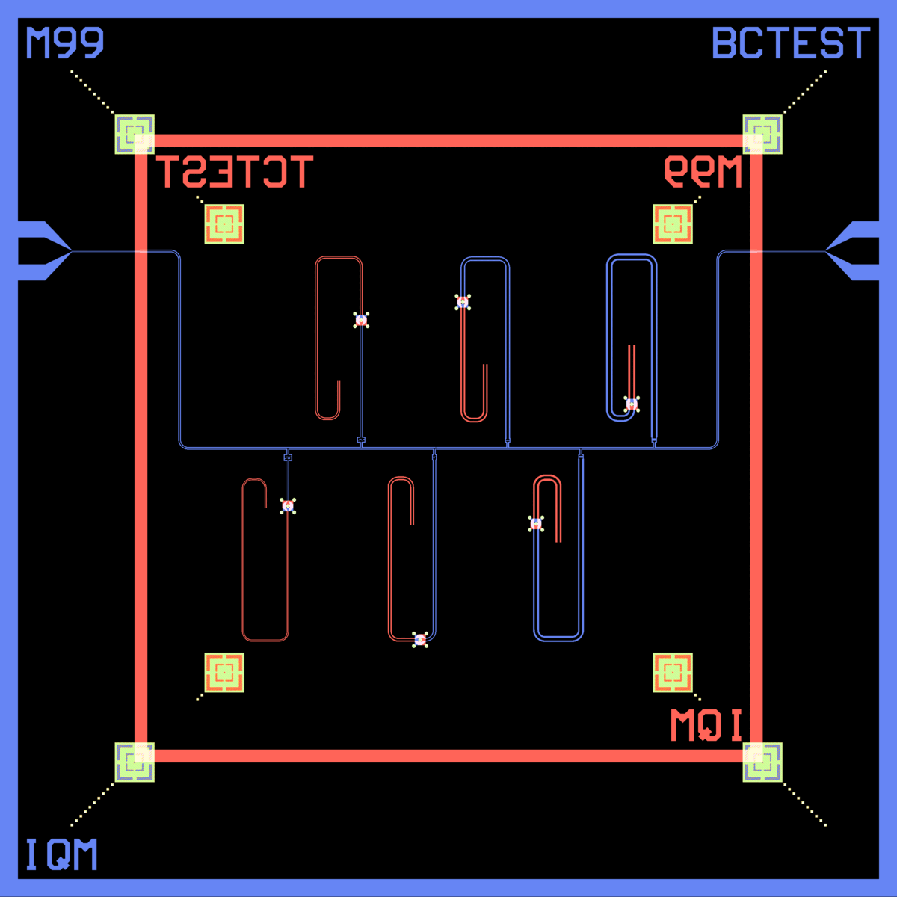
Superconducting quantum processor
  Piece of Si covered by metal film
  Geometry etched to the film
  Can consist of
    Qubits
    Couplers
    Readout resonators
    Drivelines and fluxlines
    Probelines

Slide 3
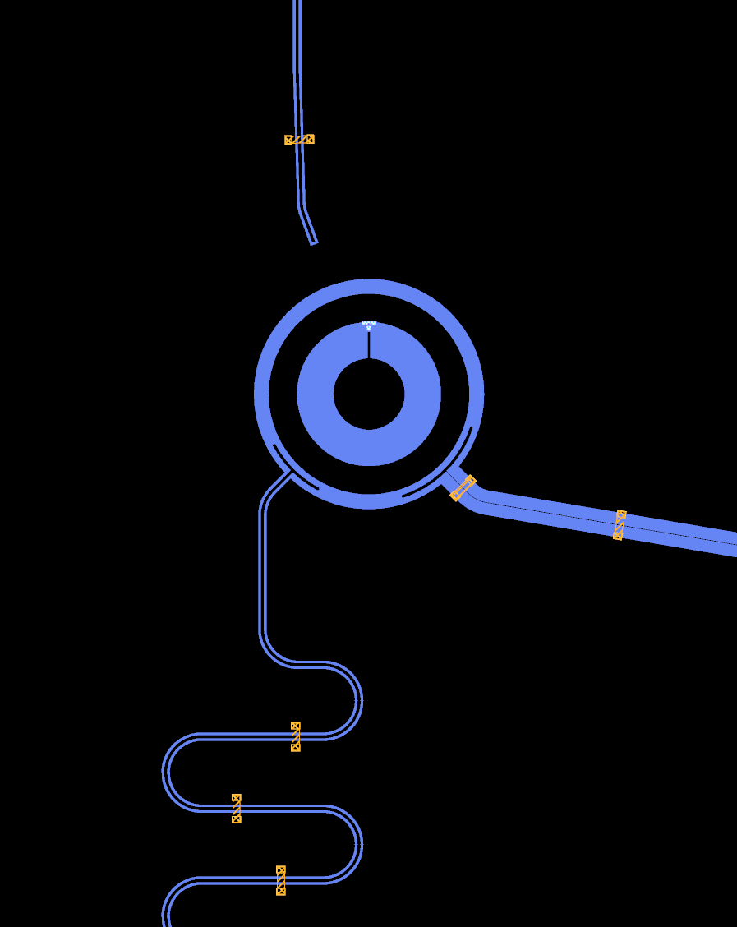
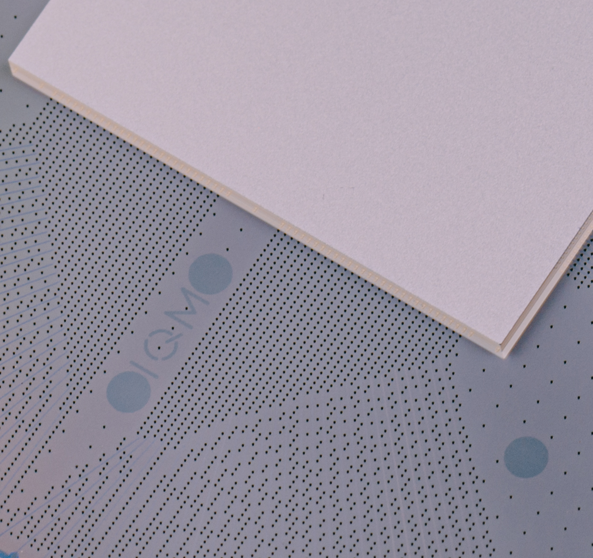
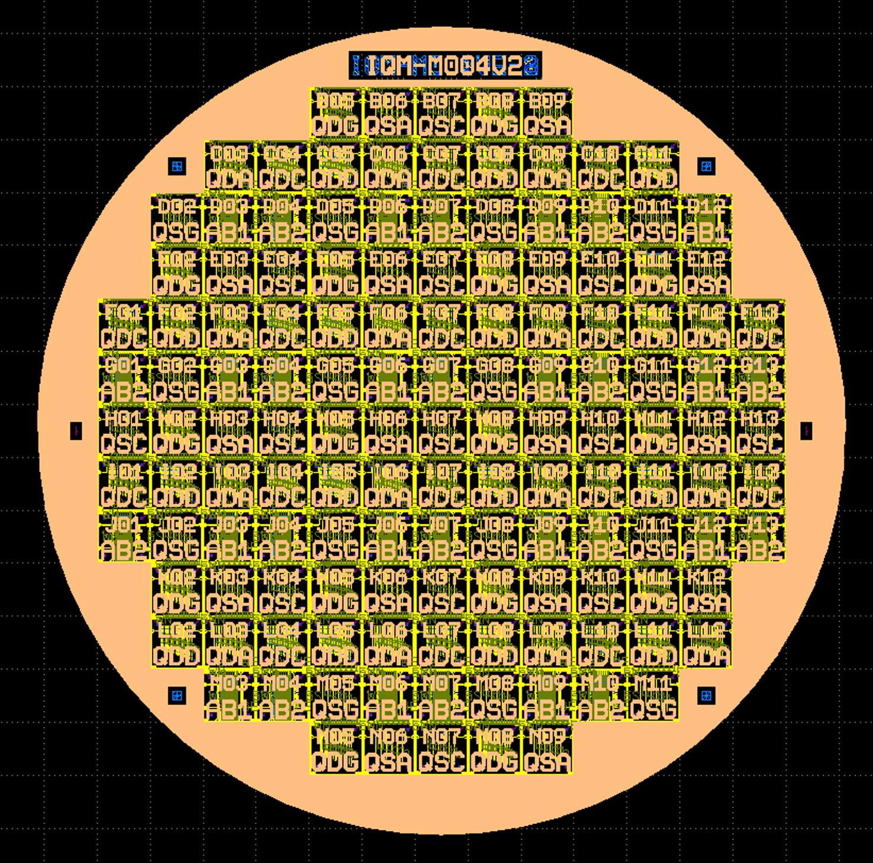
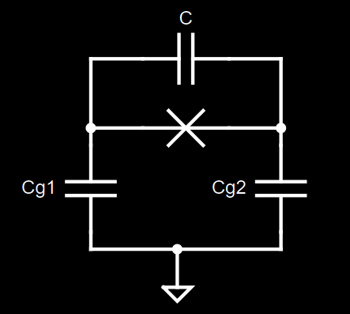

QPU design process
$$H(ω, g)$$
Hamiltonian
Circuit
Geometry
KQC
Mask Layout
KQC
Fabrication
Element library
Components FEM
(enabled by KQC)
Validation
Netlist, DRC, Full FEM
(enabled by KQC)

Slide 4
What is KQCircuits?
An open-source framework for designing superconducting circuit geometry
Library of standard, reusable Elements and Chips
Focus on parametrized design enables large scale and reusable designs
Mask export
Tools for quality control and validation
  Integrates with finite element simulation tools

Slide 5
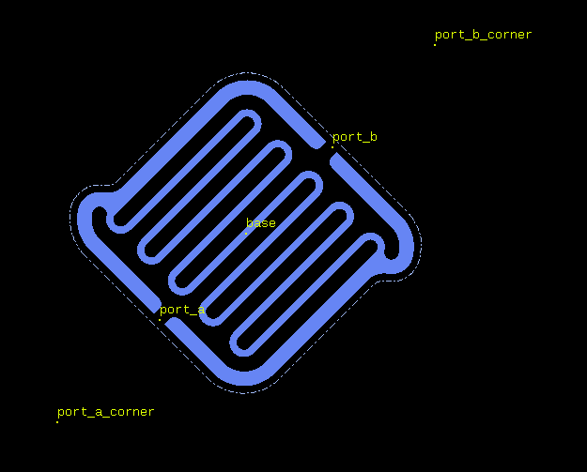
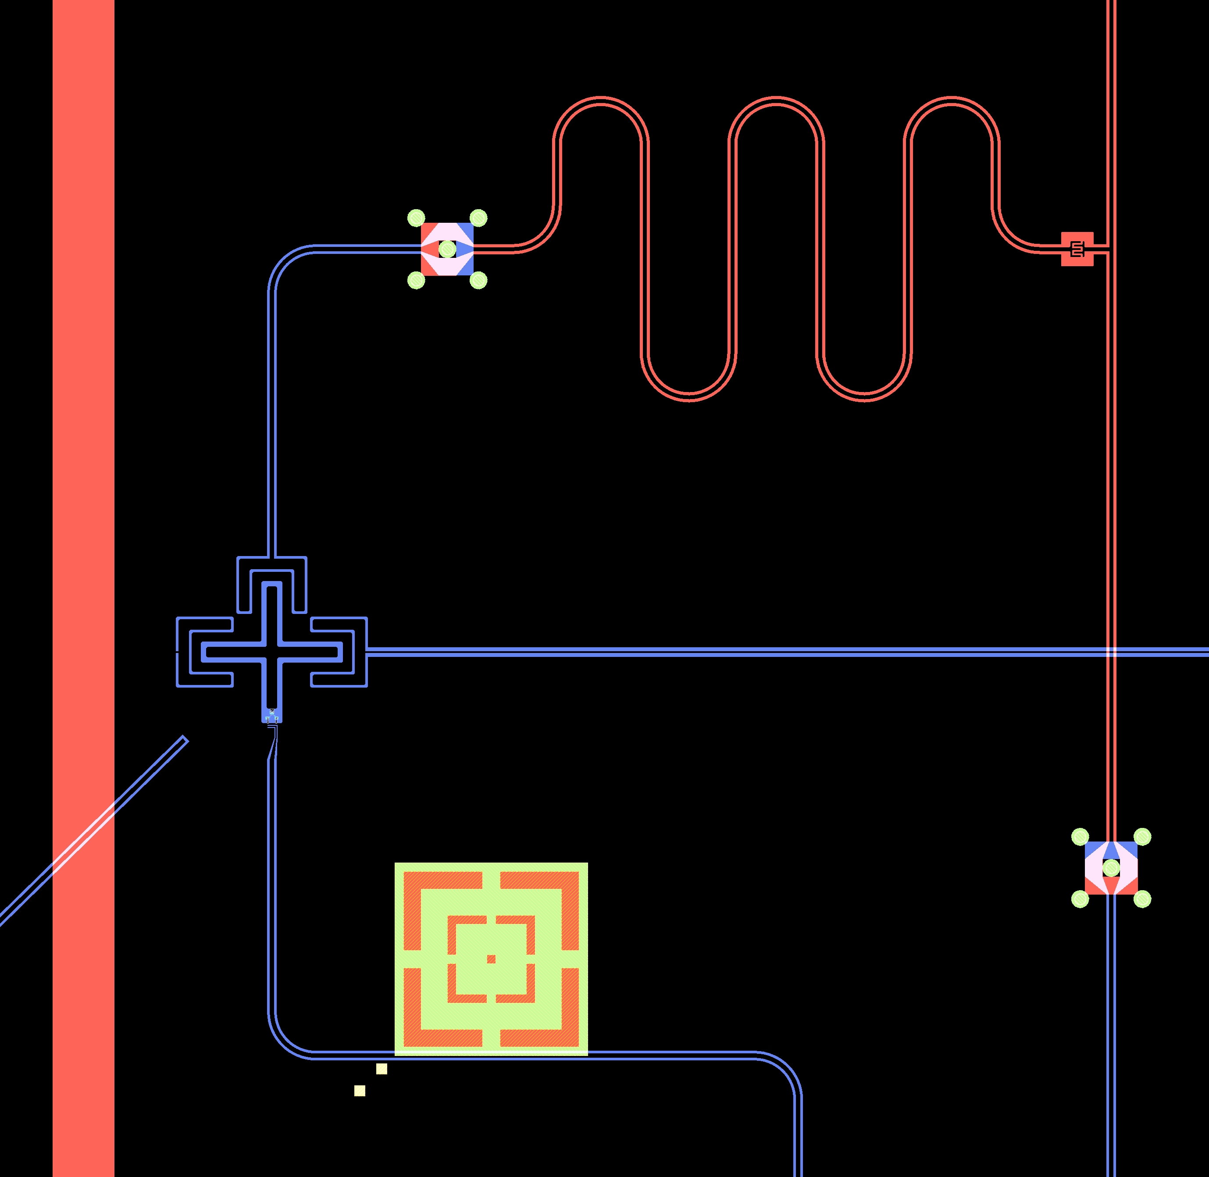
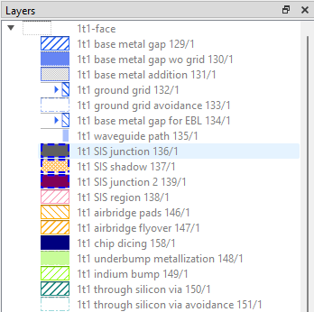
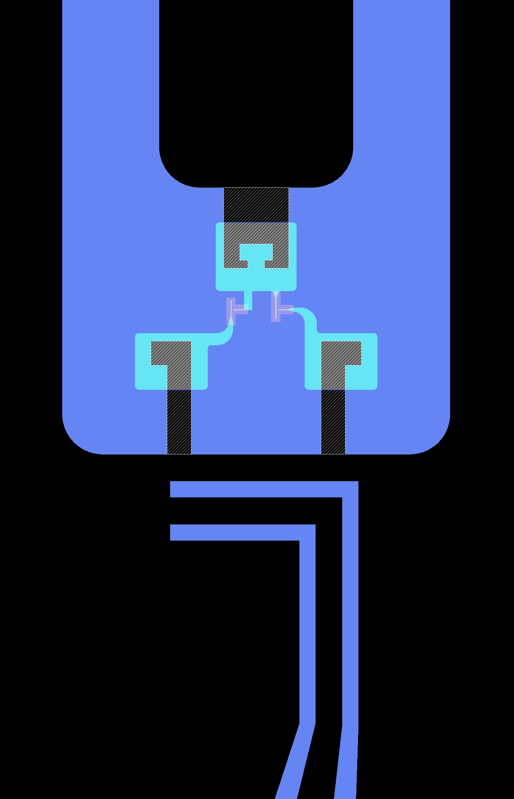
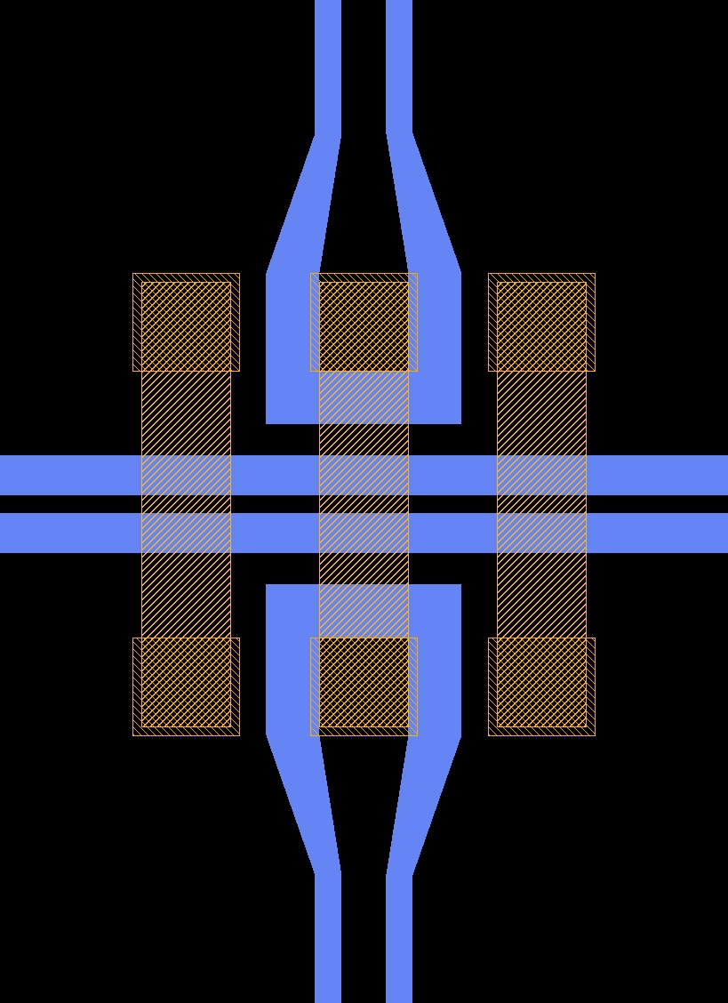
class Element(pya.PCellDeclarationHelper):
"""Element PCell declaration.
PCell parameters for an element are defined as class attributes of Param type.
Elements have ports.
"""
LIBRARY_NAME = "Element Library"
LIBRARY_DESCRIPTION = "Superconducting quantum circuit library for elements."
LIBRARY_PATH = "elements"
a = Param(pdt.TypeDouble, "Width of center conductor", 10, unit="μm")
b = Param(pdt.TypeDouble, "Width of gap", 6, unit="μm")
n = Param(pdt.TypeInt, "Number of points on turns", 64)
r = Param(pdt.TypeDouble, "Turn radius", 100, unit="μm")
margin = Param(pdt.TypeDouble, "Margin of the protection layer", 5, unit="μm")
face_ids = Param(pdt.TypeList, "Chip face IDs list", ["1t1", "2b1", "1b1", "2t1"])
display_name = Param(pdt.TypeString, "Name displayed in GUI (empty for default)", "")
protect_opposite_face = Param(pdt.TypeBoolean, "Add opposite face protection too", False)
Concepts
Part 1
PCell Library
Reference points
Standard for layers
Face

Slide 6
Concepts
Part 2
Wafer 3
3b1
3b2
Interconnect
2t2
2t1
Face in details
Wafer 2
2b1
Interconnect
2b2
1t3
1t2
1t1
Wafer 1
1b1
1b2
b=bottom
t=top

Slide 7
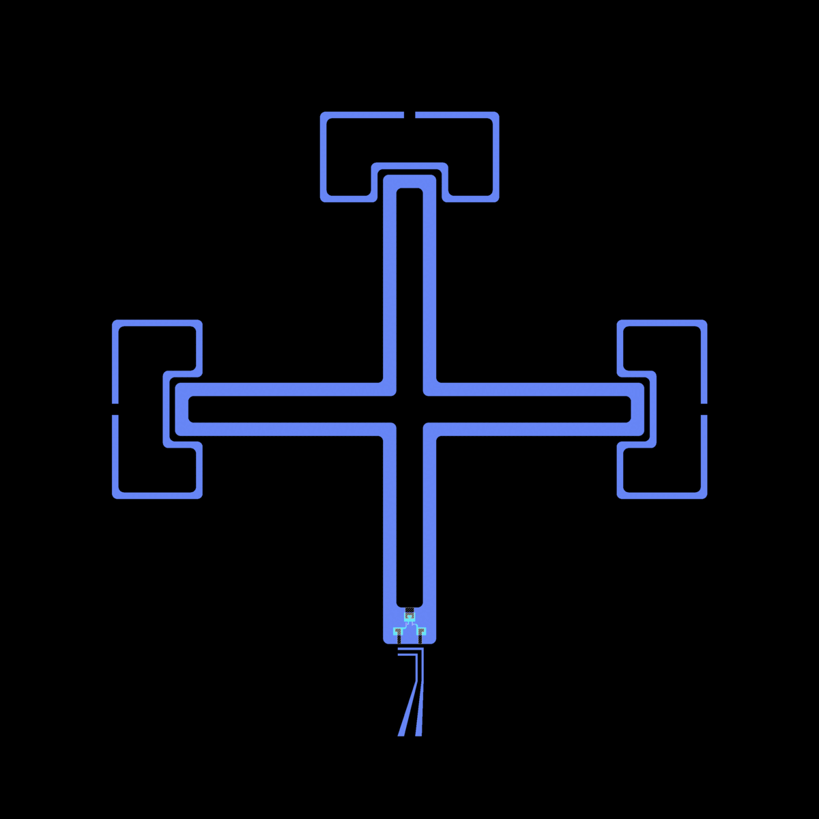
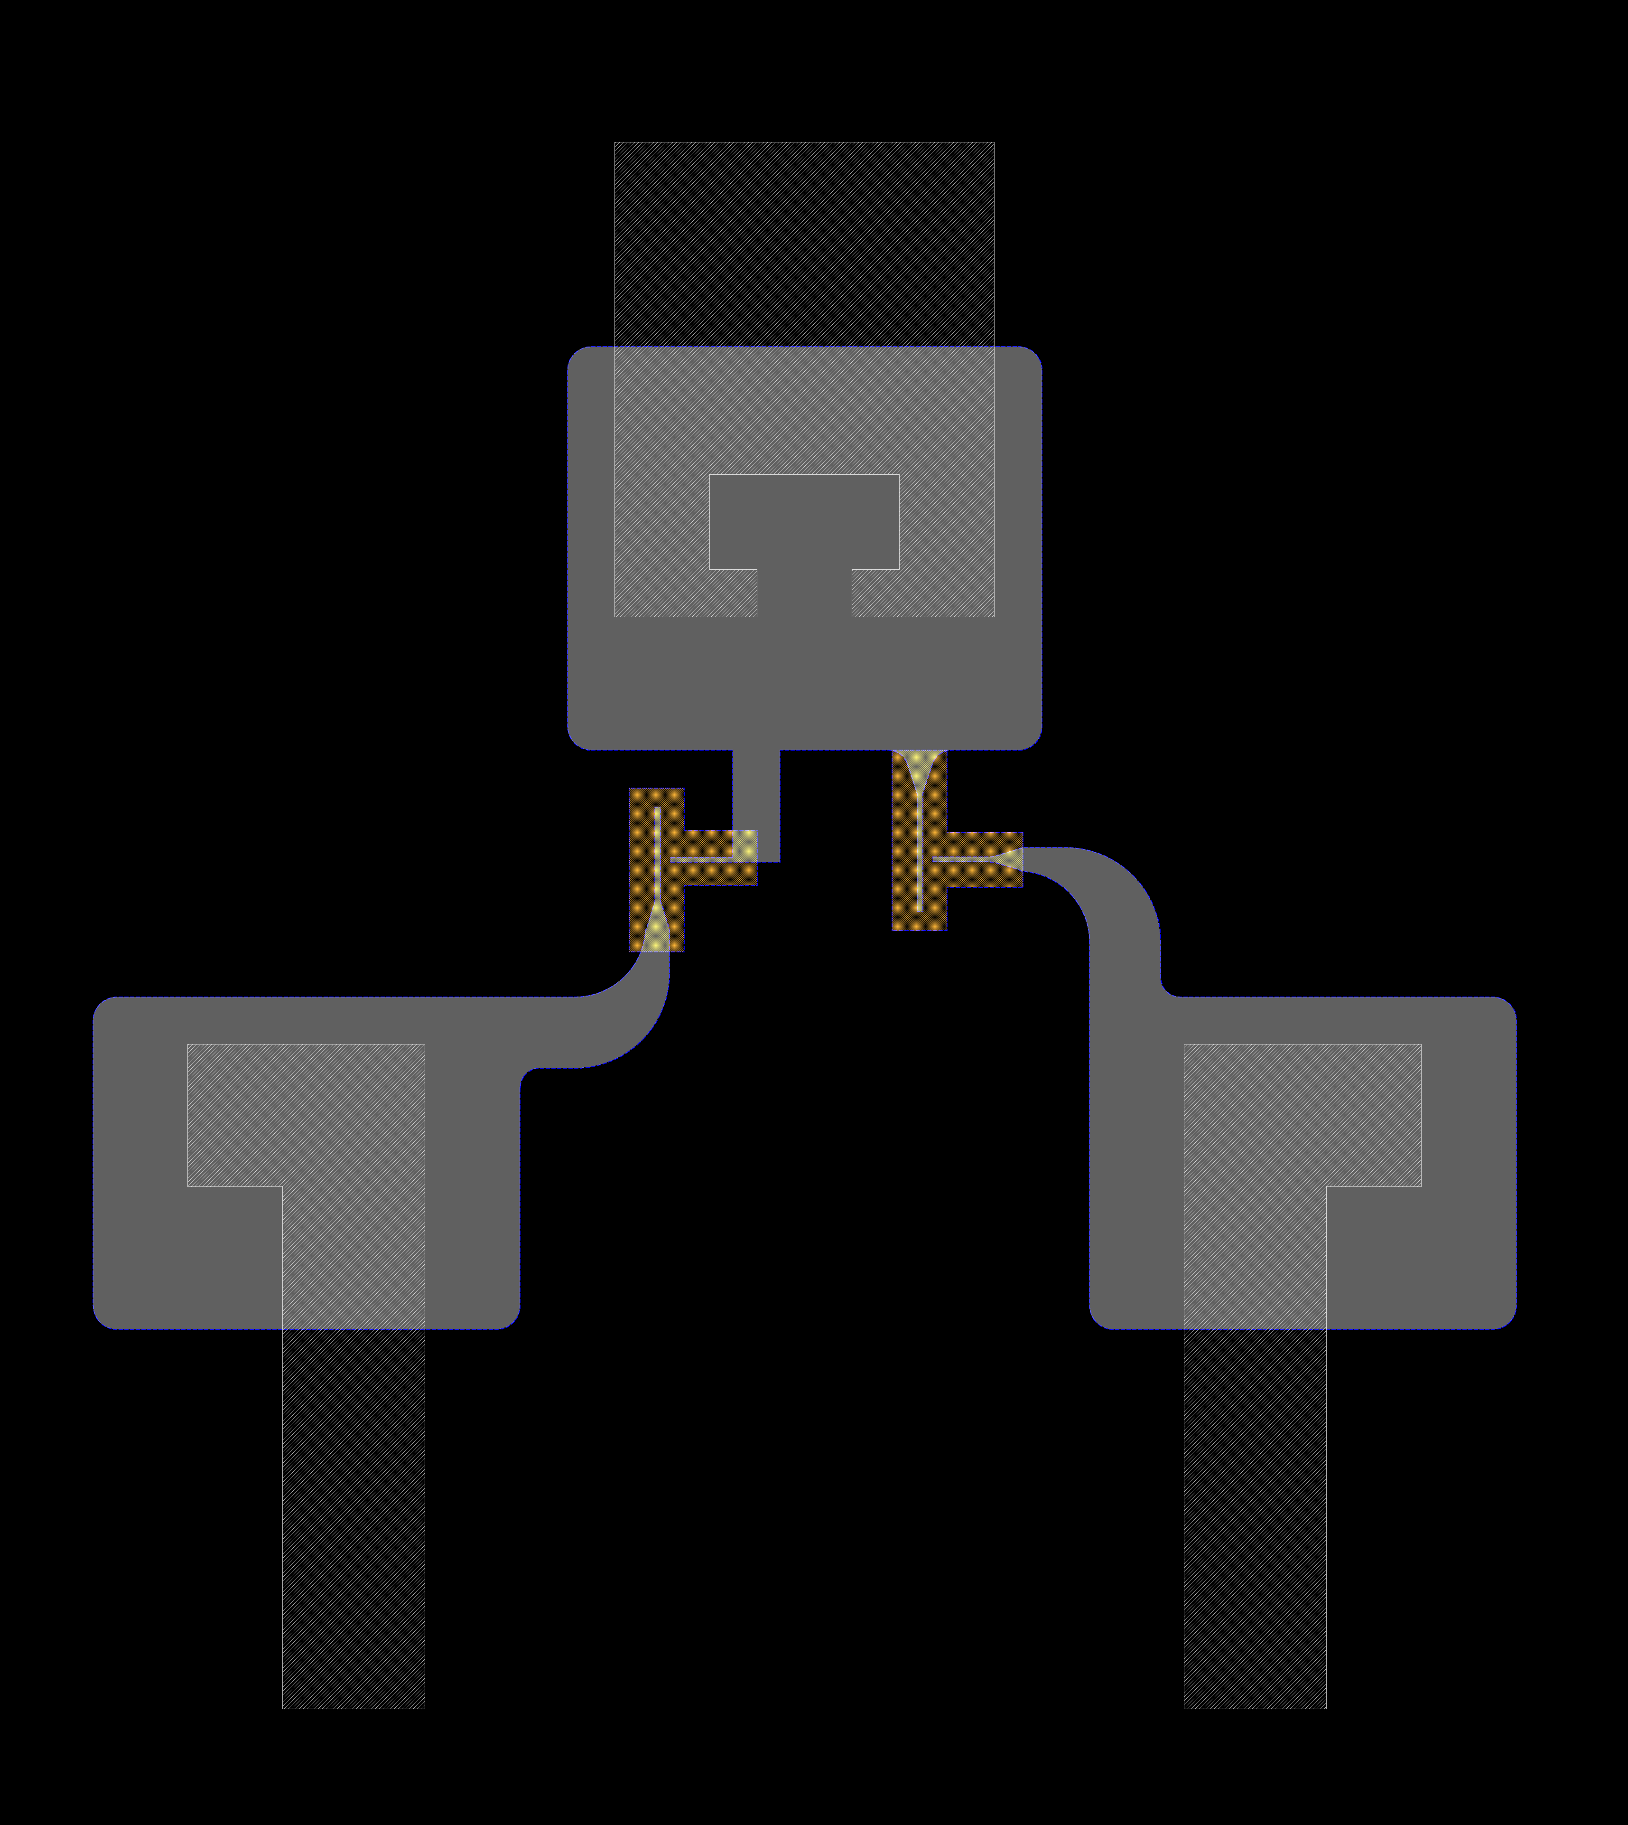
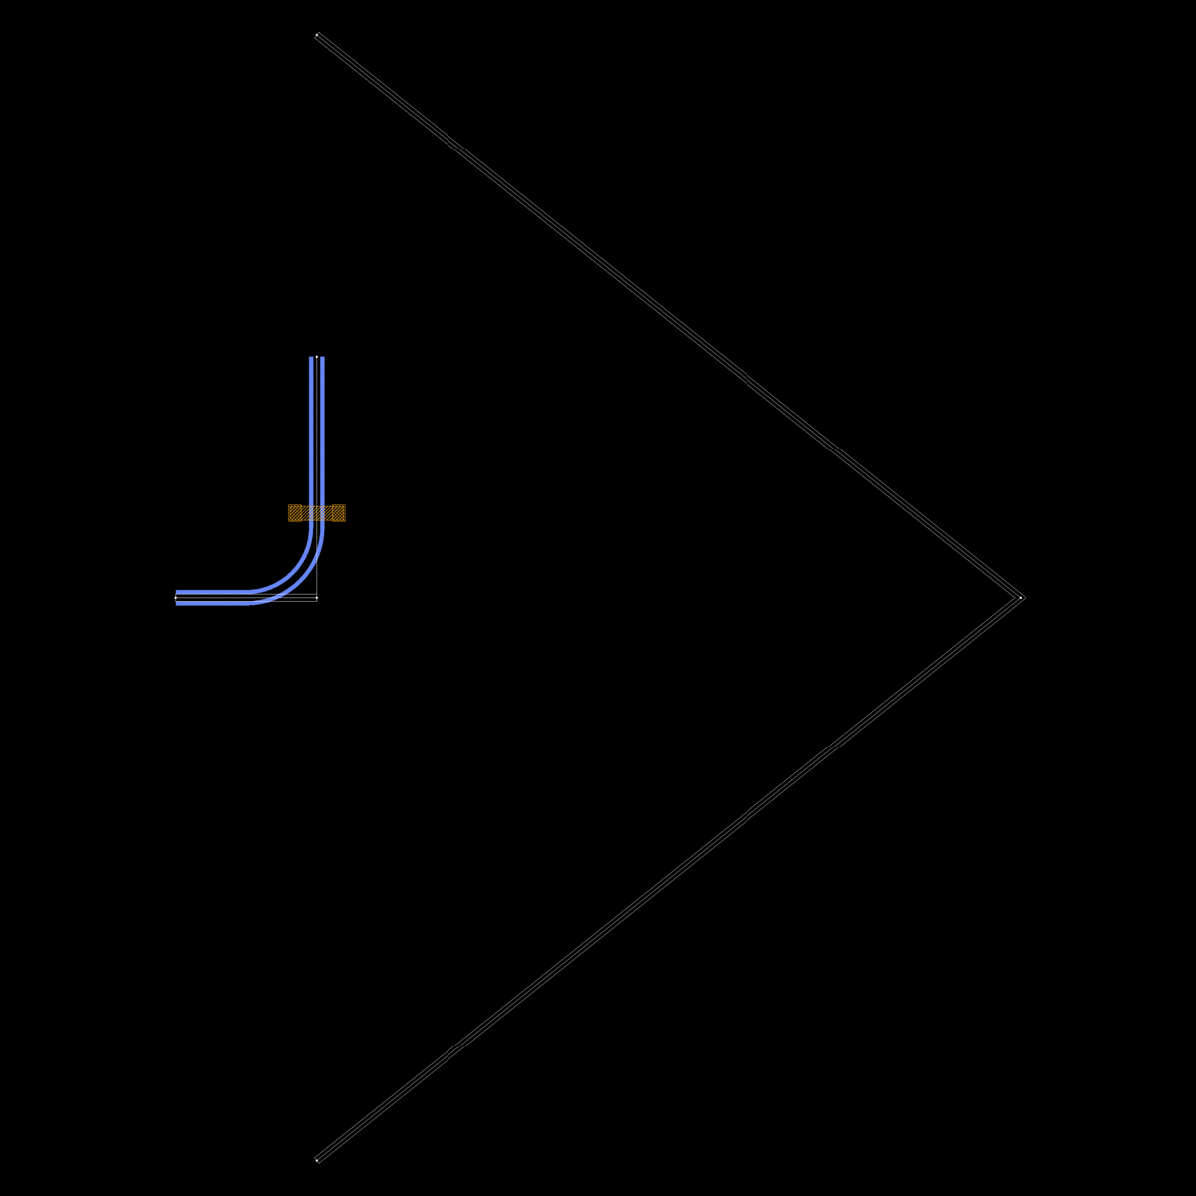
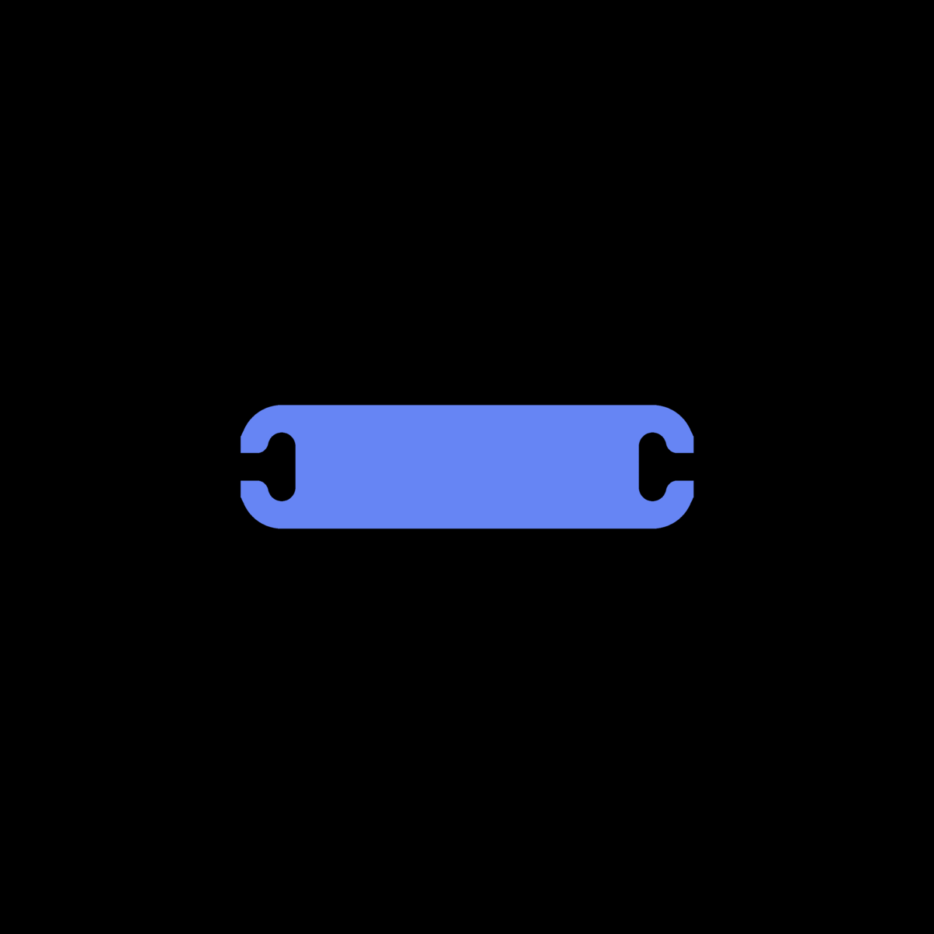
Basic elements Chips

Slide 8
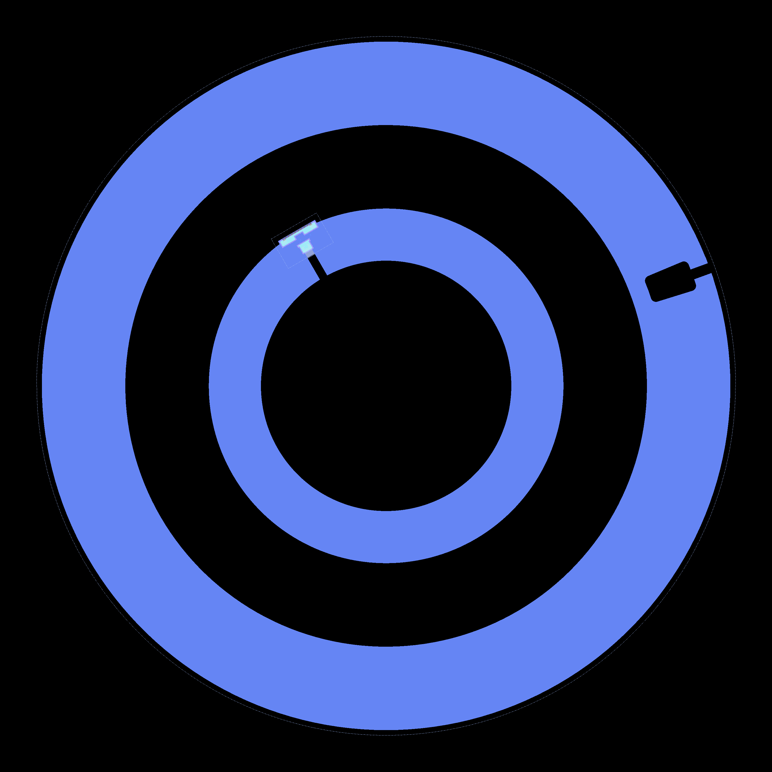
Parametrized design
@add_parameters_from(Element, n=180)
class ConcentricTransmon(Qubit):
"""The PCell declaration for a concentric transmon.
A concentric transmon consists of two islands, one inner and one outer, connected by a Josephson Junction/s.
Multiple couplers can be defined. They can have custom waveguide impedance, size and shape.
Each coupler has reference points, numbered starting from 1. Driveline can be connected to the drive port.
"""
# Qubit geometry
r_inner = Param(pdt.TypeDouble, "Internal island radius", 120, unit="μm", docstring="Radius of the outer edge of the inner island")
r_outer = Param(pdt.TypeDouble, "External island radius, measured at the outer edge", 250, unit="μm",
docstring="Radius of the external qubit island")
outer_island_width = Param(pdt.TypeDouble, "Outer island radial width", 80, unit="μm", docstring="Width of the external island")
ground_gap = Param(pdt.TypeDouble, "Ground plane padding", 80, unit="μm")
squid_angle = Param(pdt.TypeDouble, "Angular position of the Josephson Junction/s, where the positive x-axis", 120, unit="degrees")
# Couplers parameters (the list size define the number of couplers)
couplers_r = Param(pdt.TypeDouble, "Radius of the couplers positioning", 290, unit="μm")
couplers_a = Param(pdt.TypeList, "Width of the coupler waveguide's center conductors", [10, 3, 4.5], unit="[μm]")
couplers_b = Param(pdt.TypeList, "Width of the coupler waveguide's gaps", [6, 32, 20], unit="[μm]")
couplers_angle = Param(
pdt.TypeList,
"Positioning angles of the couplers, where 0deg corresponds to positive x-axis",
[340, 60, 210],
unit="[degrees]",
)
couplers_width = Param(pdt.TypeList, "Radial widths of the arc couplers", [10, 20, 30], unit="[μm]")
couplers_arc_amplitude = Param(pdt.TypeList, "Couplers angular extension", [35, 45, 15], unit="[degrees]")
...

Slide 9
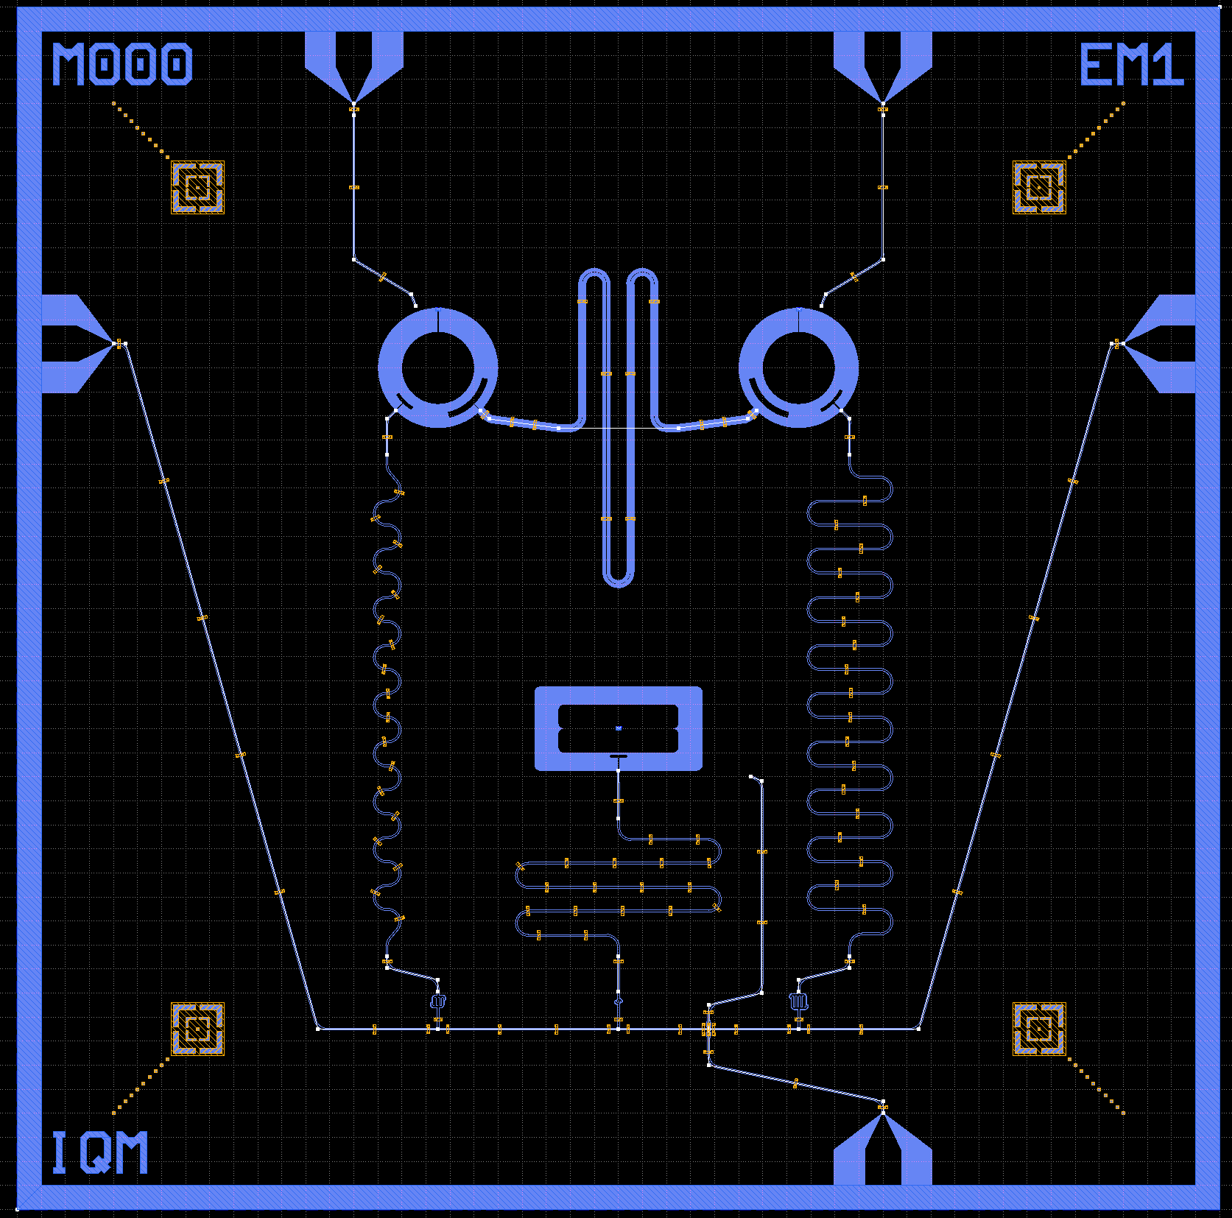
Parametrized design
@add_parameters_from(
DoublePads,
coupler_extent=[150, 20],
island1_extent=[1000, 200],
island2_extent=[1000, 200],
island_island_gap=200,
ground_gap=[1400, 900],
drive_position=[-1100, 400],
)
class MunchQubits(Chip):
"""Demonstration chip with two circular single island qubits, one floating island qubit, three readout resonators,
one probe line, three drivelines and one resonant coupler."""
name_chip = Param(pdt.TypeString, "Name of the chip", "EM1")
# Readout parameters
readout_res_lengths = Param(pdt.TypeList, "Readout resonator lengths", [11500, 12700, 8000], unit="[μm]")
kappa_finger_control = Param(
pdt.TypeList, "Finger control for the input capacitor", [3.32, 4.21, 1.46], unit="[μm]"
)
# Coupling parameters
coupler_length = Param(pdt.TypeDouble, "Resonant coupler length", 9800 ], unit="μm")
# Circular qubit 1 parameters
couplers_a_qb1 = Param(pdt.TypeList, "Width of the coupler waveguide's center conductors", [10, 3], unit="[μm]")
couplers_b_qb1 = Param(pdt.TypeList, "Width of the coupler waveguide's gaps", [6, 32], unit="[μm]")
couplers_angle_qb1 = Param(
pdt.TypeList,
"Positioning angles of the couplers, where 0deg corresponds to positive x-axis",
[225, 315],
unit="[degrees]",
)
couplers_width_qb1 = Param(pdt.TypeList, "Radial widths of the arc couplers", [30, 50], unit="[μm]")
couplers_arc_amplitude_qb1 = Param(pdt.TypeList, "Couplers angular extension", [25, 65], unit="[degrees]")
…

Slide 10
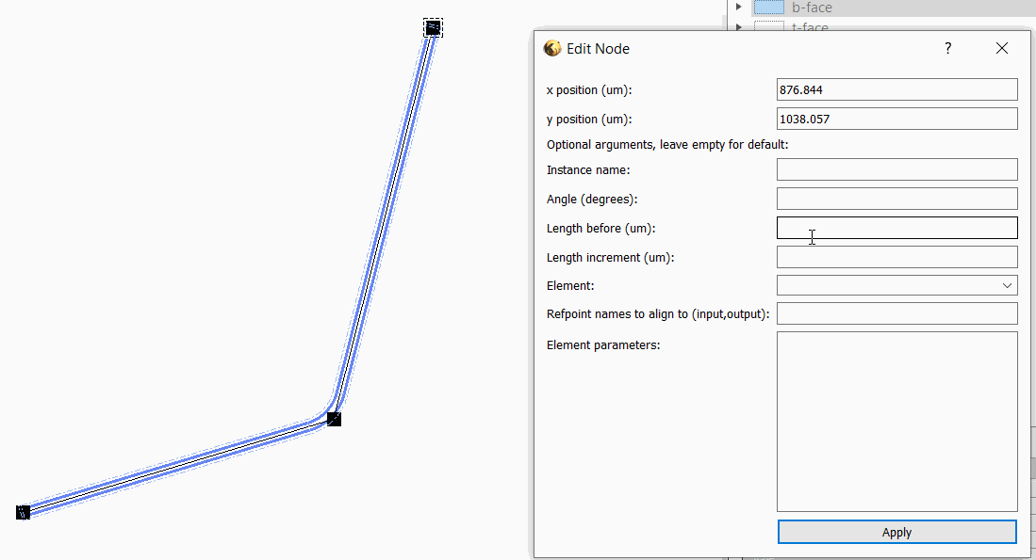
Tools for composing complex chip layouts
Composite waveguides
  Inline elements (capacitors, splitters, …)
  Adjustable-length segments
Hybrid GUI + code workflow
    Sketch layout in GUI
    Generate & edit Python code
    View / edit / route in GUI
    Export & verification

Slide 11
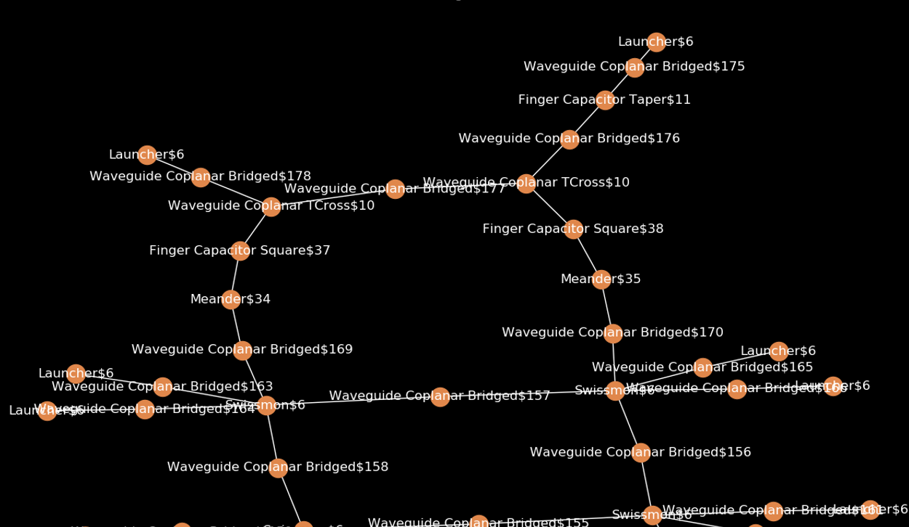
Validation and mask export
Validation tools
Netlist export
Design rule check (DRC):
  Checks spacing of structures in critical layers
  Checks crossing waveguides
  Target: detect simple geometry errors
Custom FEM verification
  Estimate e.g. crosstalk effects
  KQC export + manual simulation work
Mask Layout generation

Slide 12
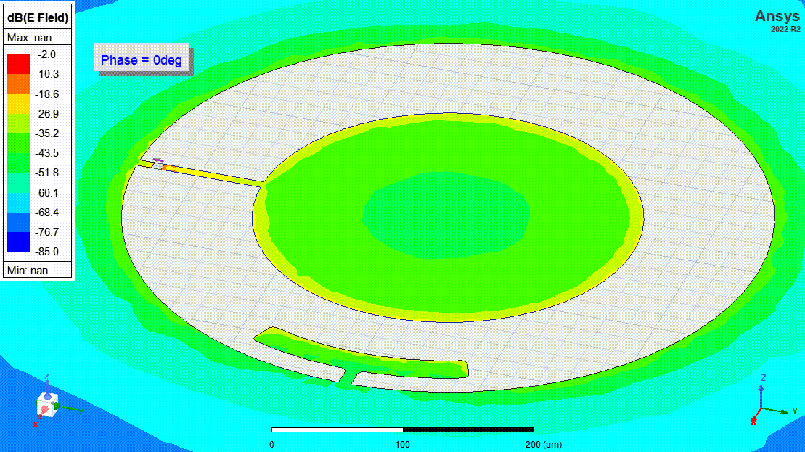
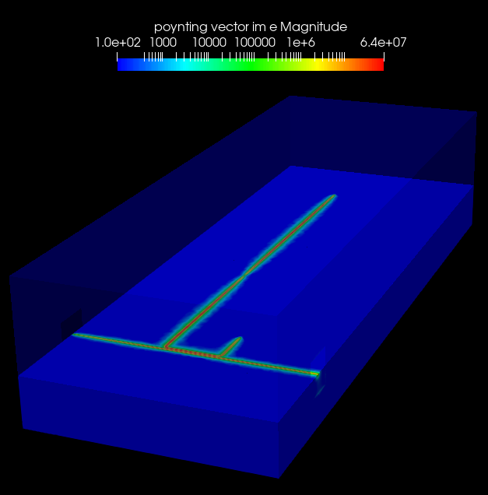
FEM simulations
Ansys Q3D
  Capacitance matrix extraction
Ansys HFSS
  Full wave, S parameters
  Eigenmode EPR with linearized qubits
  Fluxline mutual inductance and RF coupling
Elmer FEM
  Capacitance extraction
  2D cross-sections (e.g. waveguides)
  Full wave, S parameters
Sonnet
  S parameters, capacitance extraction from S parameters

Slide 13
Extra material for the school
INSTALLATION INSTRUCTIONS:
Install latest klayout (currently 0.29) from KLayout Layout Viewer And Editor if you use windows. For Mac homebrew Homebrew — The Missing Package Manager for macOS (or Linux) klayout is recommended if you don’t have the .dmg installed already. When brew is installed then use this klayout — Homebrew Formulae
Open klayout once and eventually from its Setup set the default behavior to be “Editor” instead of “Viewer”. In editing mode tab
Close klayout
Have python 3.10/3.11 installed on your pc/mac. Either from python.org or from Anaconda (the second is recommended for Mac users, or brew python alternatively)
Create a virtual environment for KQC ( venv — Creation of virtual environments — Python 3.12.2 documentation or Anaconda in the second case)
Have an IDE for writing python code installed. Recommended pycharm free, or vscode. Point your IDE to your newly created python environment
Install git on your pc/mac Git - Downloads (git-scm.com) . In Mac git can come preinstalled use git --version in terminal to check if it exists already (otherwise it could come with Xcode and command line tools)
You will find KQC at GitHub - iqm-finland/KQCircuits: KLayout Python library for integrated quantum circuit design.
Go with your terminal into your home folder and do git clone https://github.com/iqm-finland/KQCircuits.git
A new folder KQCircuits will appear into your home folder
With your terminal enter the main KQCircuits folder and do the following steps in developer guide “Develper setup” and “Klayout standalone usage” (found also into the KQC documentation KQCircuits documentation — KQCircuits documentation (iqm-finland.github.io))
First terminal command to run into the KQCircuits folder is python setup_within_klayout.py (replace with python3 if python command does not exist)
Second terminal command to run into the KQCircuits folder is python -m pip install -e klayout_package/python
If you now open klayout you should see a face based layer system on the right column, some elements/chips libraries in the bottom left corner, and a KQCircuits entry on the top toolbar of KLayout
Close klayout
Now you can open your python IDE of choice (e.g pycham/vscode) and checkout the branch for this spring school iqm-finland/KQCircuits at demo-for-school (github.com) to start coding!
NOTE: If you have some troubles, you can also check this past guide instead GitHub - iqm-finland/KQCircuits-winter-school: KLayout Python library for integrated quantum circuit design. This fork includes exercises for the 2023 iteration of the Winter School for some visual aid, but you should not clone the winter school KQC of this second guide, but the standard KQCircuits linked in the steps above!

Slide 14
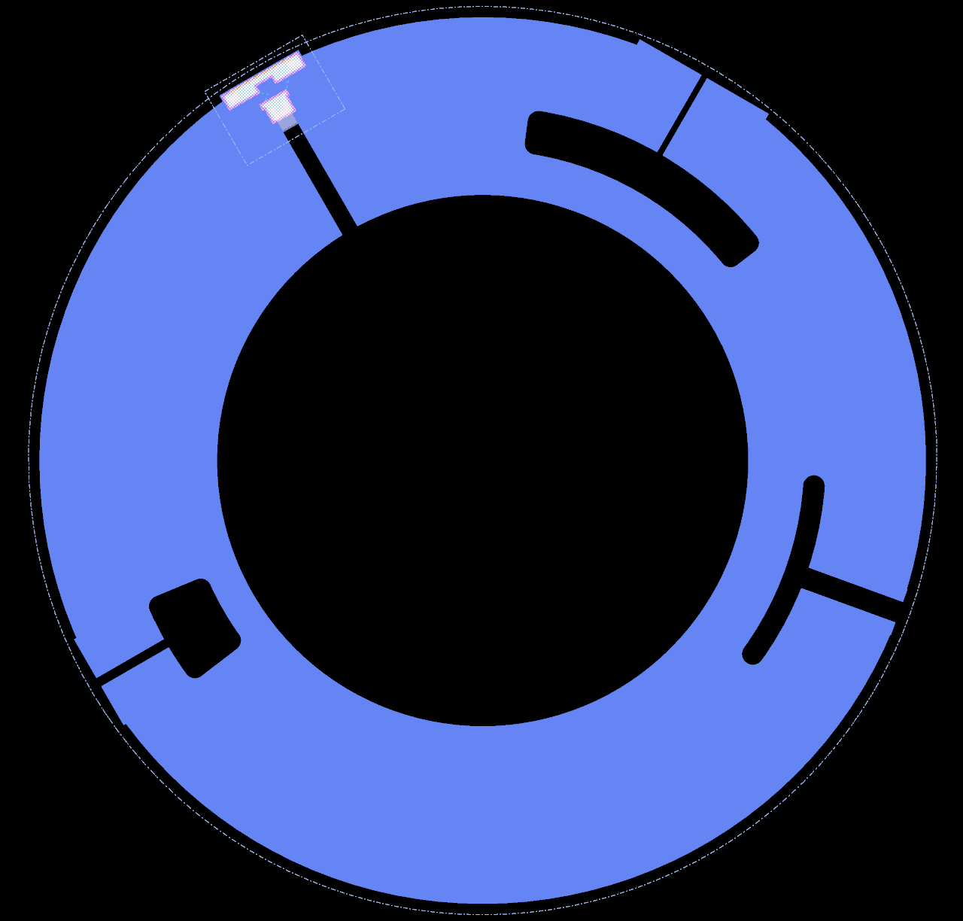
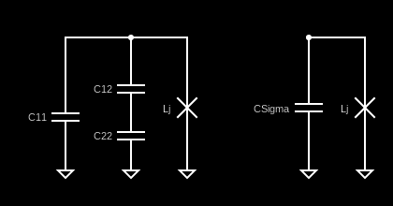
Grounded island transmon qubit
Lj
One SC islands (1) which shunt to ground the Josephson Junction or SQUID (Lj).
Islands size determines the charging energy, which depends on CSigma.
We can add one (island 2) coupler or more to couple the qubit to the readout resonator or other qubits.
1
2
=

Slide 15
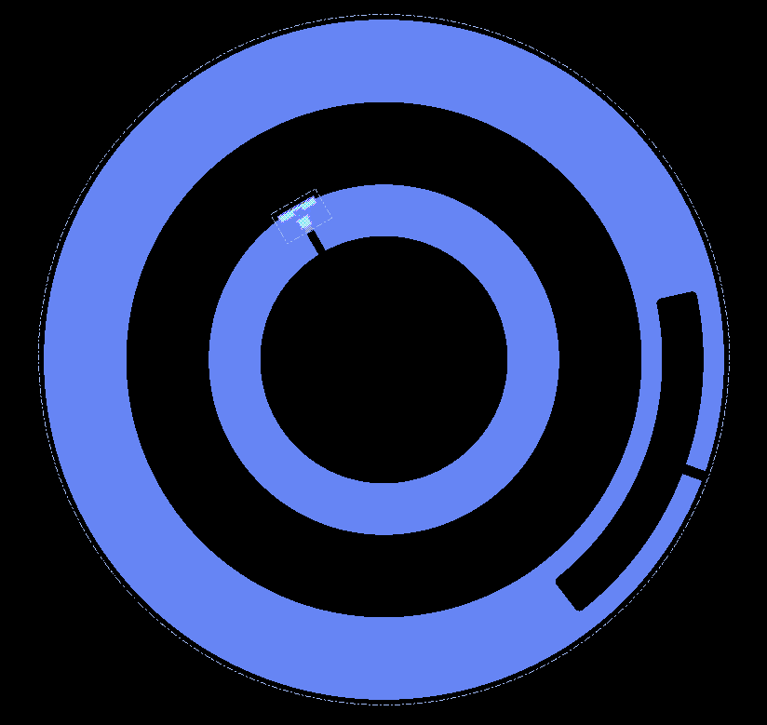
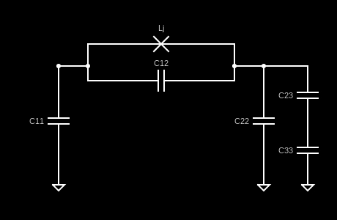
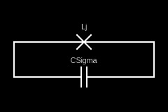
Floating transmon qubit
Two SC islands (1 is the inner, 2 is the outer) which capacitively shunt the Josephson Junction or SQUID (Lj).
Islands size and distance between them determines the charging energy, which depends on CSigma.
We can add one (island 3) coupler or more to couple the qubit to the readout resonator or other qubits.
Example circuit (C13≈0)
Lj
1
2
3
=

