Slide 1
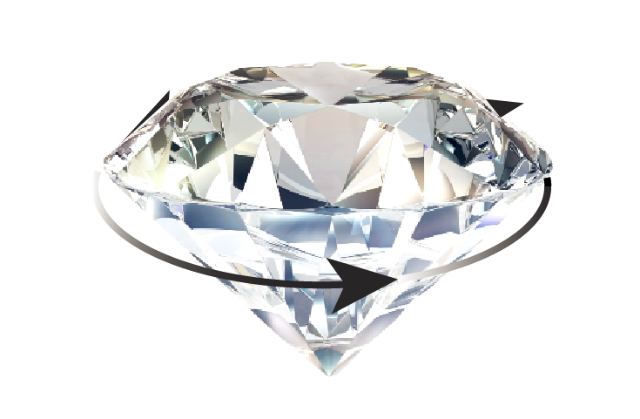


Classical rotation of quantum spins and quantum rotations of classical particles
Dr Alexander Wood
School of Physics, University of Melbourne, Australia
Notes:
Subtitle: qubits in a physically rotating frame. Real physical rotations of qubits.

Slide 2
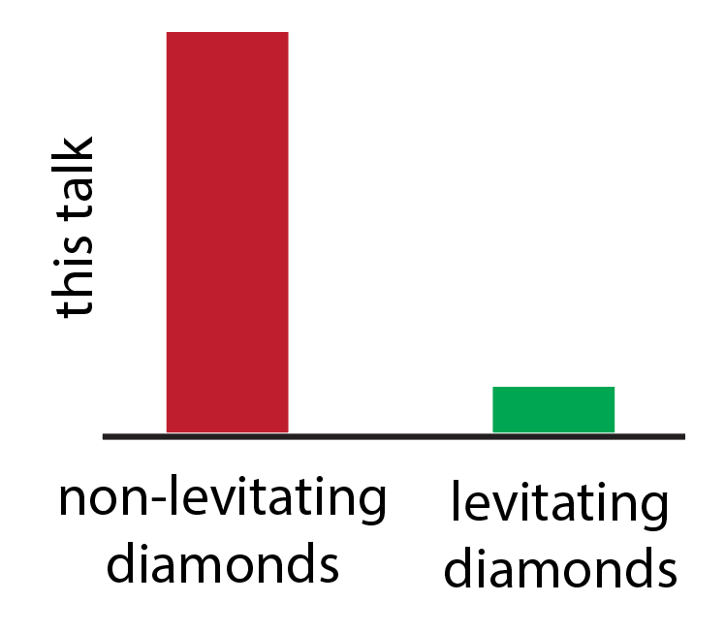
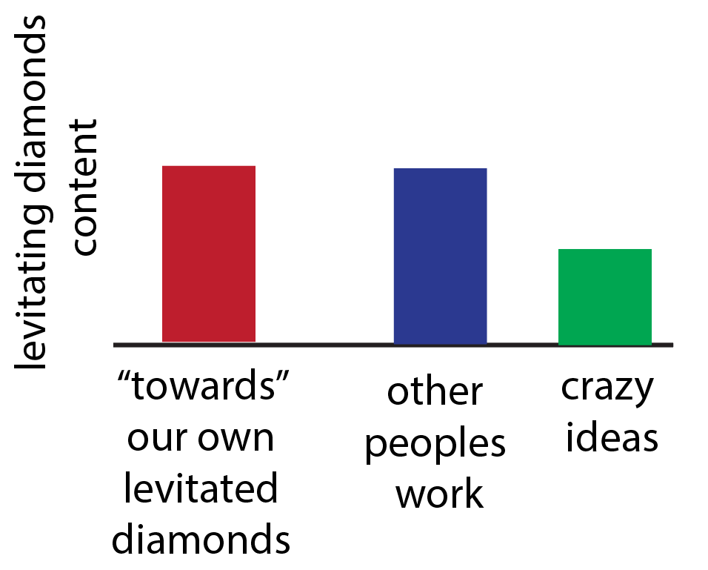
First: a disclaimer! We’re new here!
Most of this talk is “clamped”, also “strongly coupled to gravitation”
A lot of what I will talk about is very relevant for levitated particles hosting quantum spins, eg nanodiamonds with NV centres…

Slide 3


Trapped particles rotate!
How does classical rotation on quantum timescales affect spin?
Fictitious fields and forces
Quantum phase shifts due to rotation
Time dependent coupling to control fields:
  Challenges for quantum control
  Opportunities for quantum sensing

Slide 4
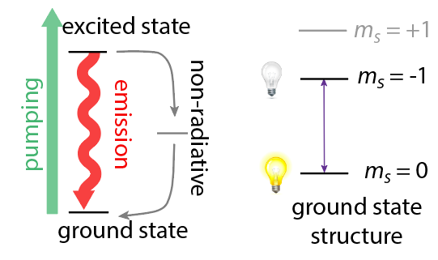
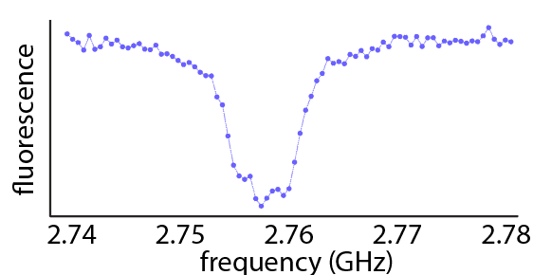
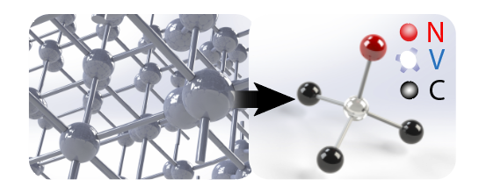
The NV centre as a quantum sensor
Two-level system sensitive to ac and dc magnetic fields, electric fields, strain, pressure, temperature, rotation, …
Optical preparation and readout, microwave control: no wires!
Simple experimental requirements, cheap, robust and versatile

Slide 5
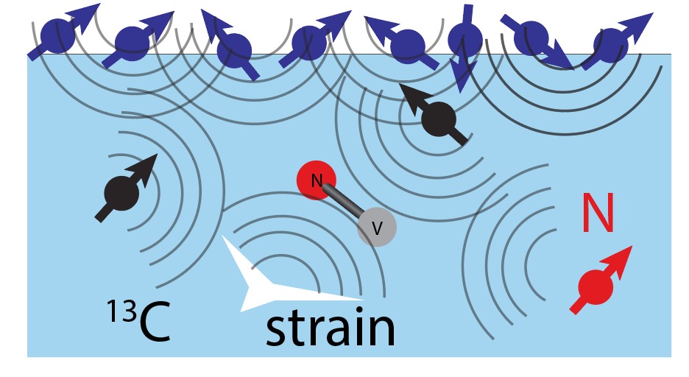
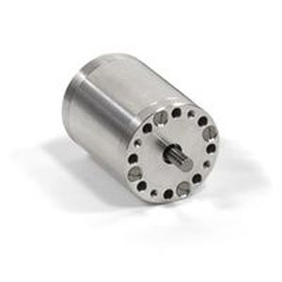


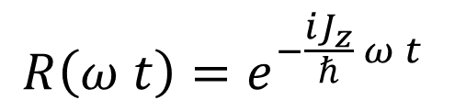


Classical rotation on quantum timescales
Ideally, we would like one revolution within the NV coherence time $T_{2}$
Problem: NV coherence time $≈100−300μs$
$f_{rot}∼250,000$ rpm
Solution: a very good rotation operator
$$R\left(ω t\right)=e^{−\frac{{iJ}_{z}}{ℏ} ω t }$$
500,000 rpm (8.333kHz, 120$μ$s)
Notes:
So lets spin a diamond. Specifically, lets spin a diamond so that its period is essentially the coherence time

Slide 6
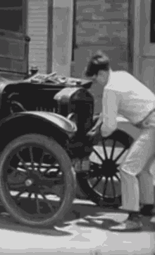
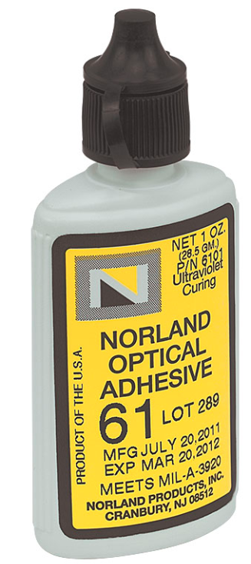
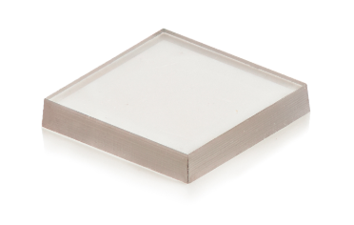
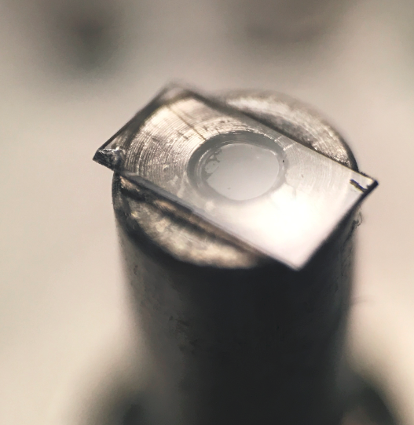



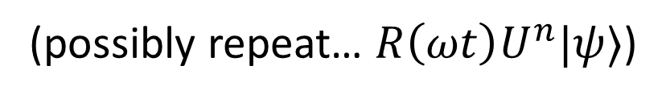
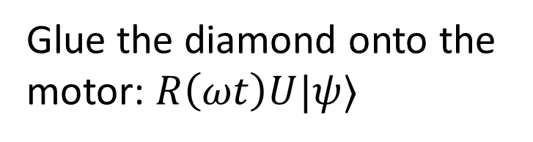
Applying a classical rotation operator to quantum spins
Diamond with NV centers, $|ψ⟩$
500,000rpm Swiss motor, $R(ω t)$
Expired UV adhesive, $U$
Glue the diamond onto the motor: $R\left(ωt\right)U|ψ⟩$
(possibly repeat… $R\left(ωt\right)U^{n}|ψ⟩$)

Slide 7
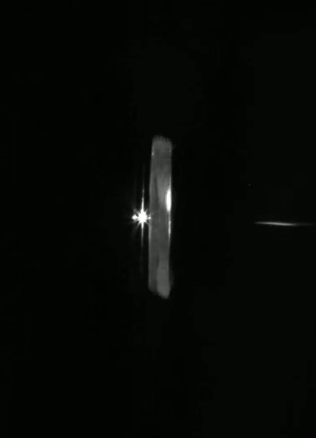
Objective lens
300μm
mw wire
diamond
Rotation at 200,000rpm
Stroboscopically imaged
rotor

Slide 8
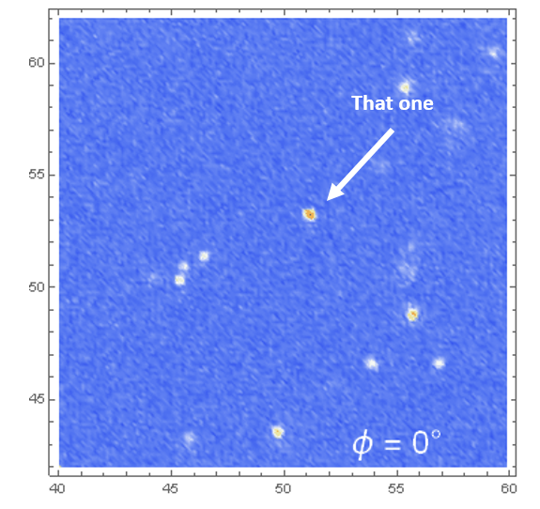
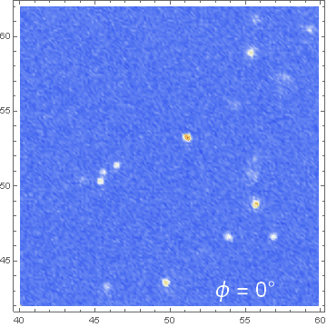
Slight problem…
Err.. that one?
Factor of 1000
slowed
A. A. Wood et al, Science Advances 4 (5), eaar7691 (2018)

Slide 9
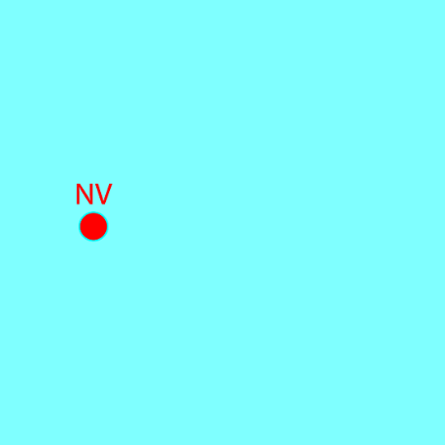
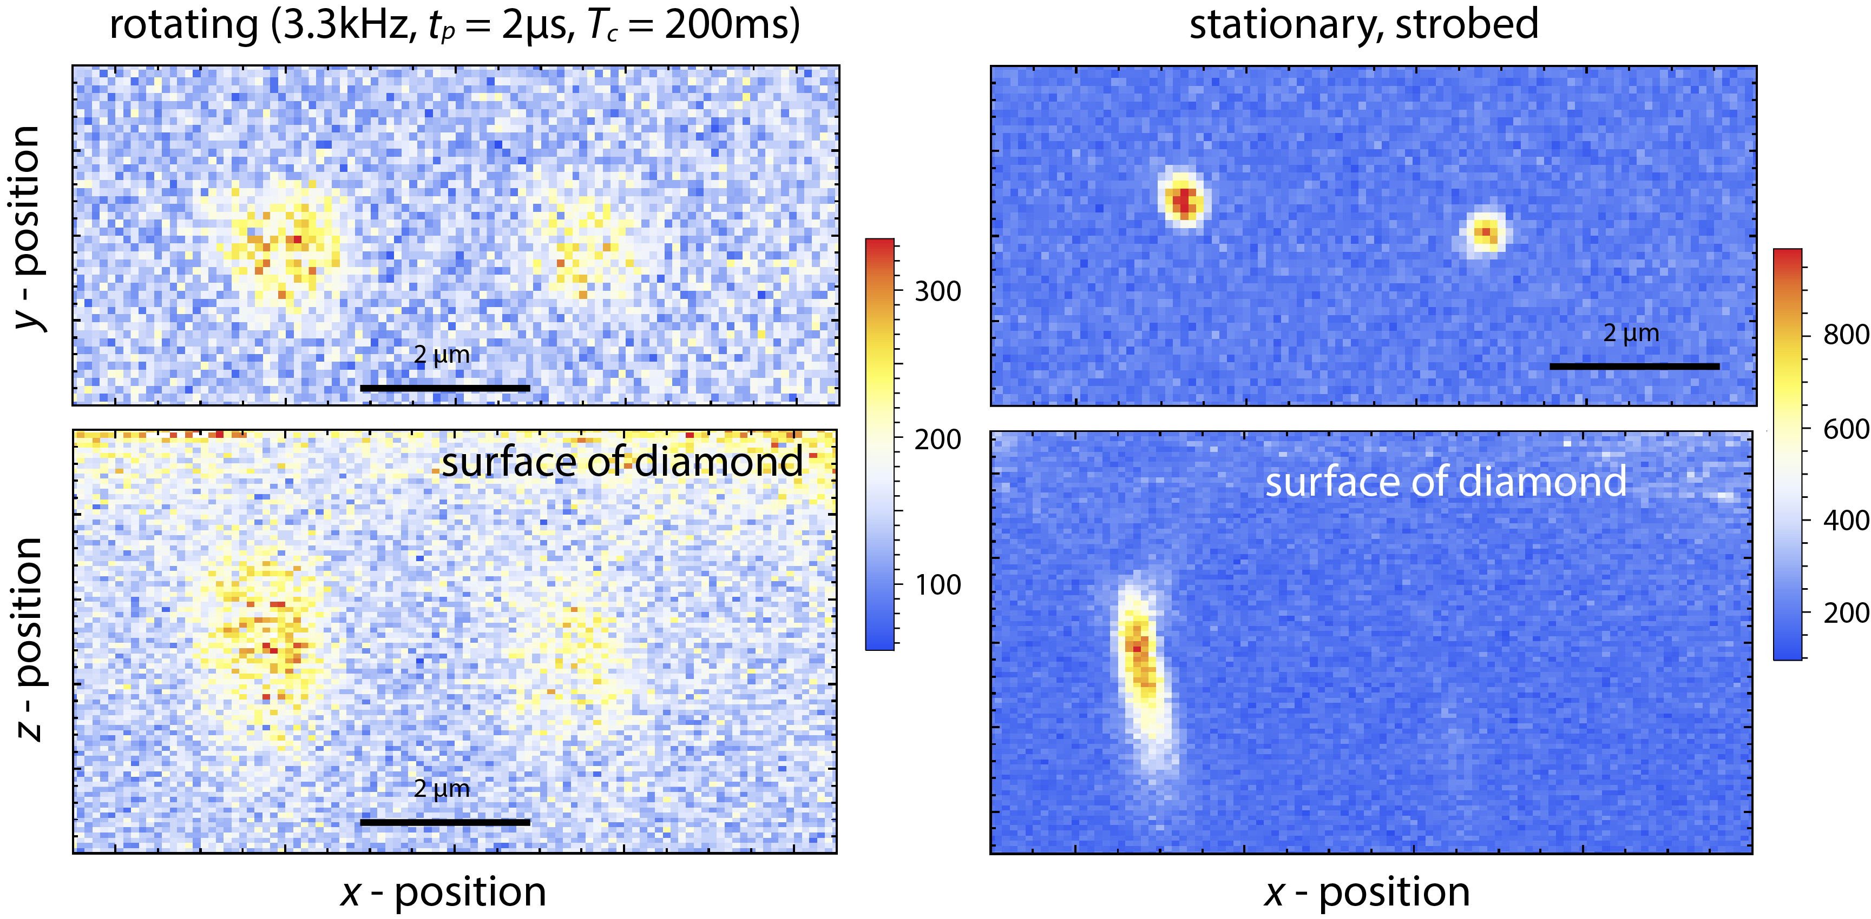
Control of single NVs
MOTOR CONTROL
Trigger
FPGA
Strobed confocal microscopy
Image single NVs rotating at 200,000rpm (3.33kHz)
Laser
APD
DIAMOND
Science Advances 4 (5), eaar7691 (2018)
Notes:
So just summing up, what have we learnt:
We can control ensembles of rapidly rotating rotating qubits,
Detect rotationally induced magnetic fields, and then the NV provides this really unique system where we can use these fields for quantum control.
There’s really a huge range of things we can look at, like new regimes of magic angle spinning as well as spin bath engineering, and I invite you to check out our poster where we’ve adapted these techniques to look at single NV centres in the rotating Frame.

Slide 10
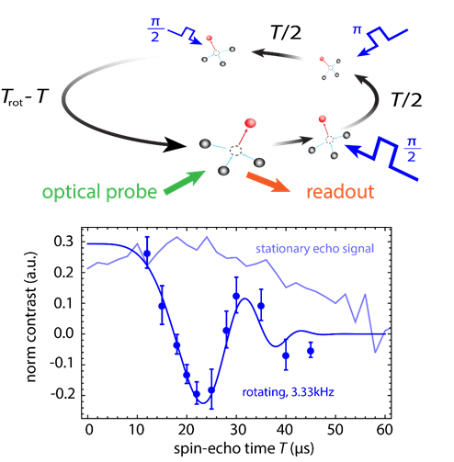
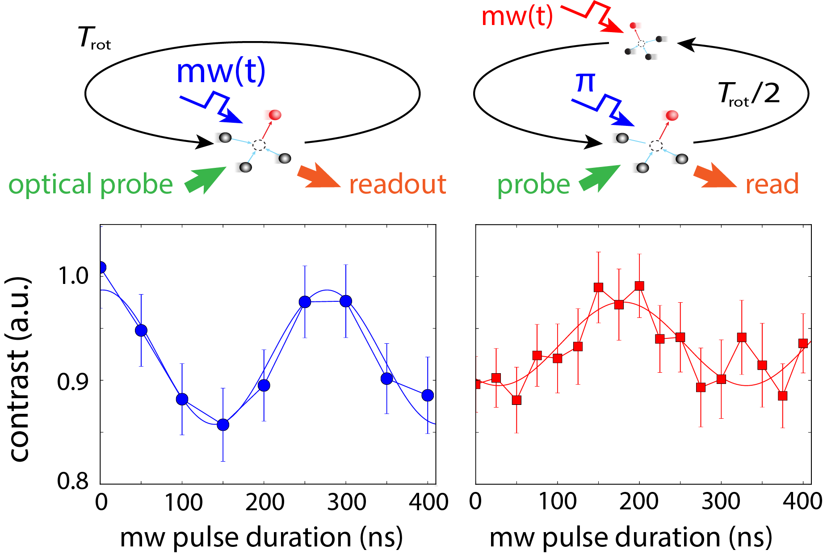
Quantum state control in the rotating frame
Rabi oscillations
Spin-echo interferometry
Initialized to bright state
Initialized to dark state
Science Advances 4 (5), eaar7691 (2018)

Slide 11
Outline: rapidly rotating NV centres in diamond
Why we spin diamonds at 500,000 rpm and how we measure NVs at the same time
Fictitious fields and where to find them
Quantum phases from classical rotation
Measuring DC magnetic fields 30x better than Ramsey magnetometry
Rotating nuclear spins: polarisation and coherent control
Towards levitated classical particles coupled to quantum spins

Slide 12
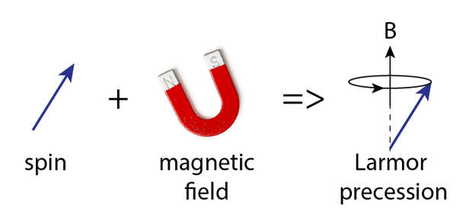
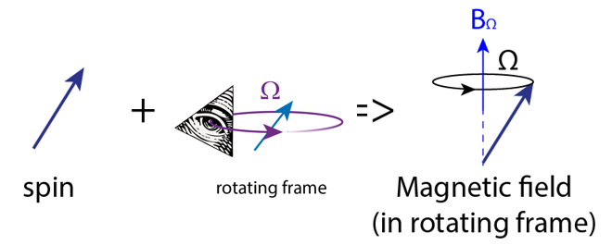
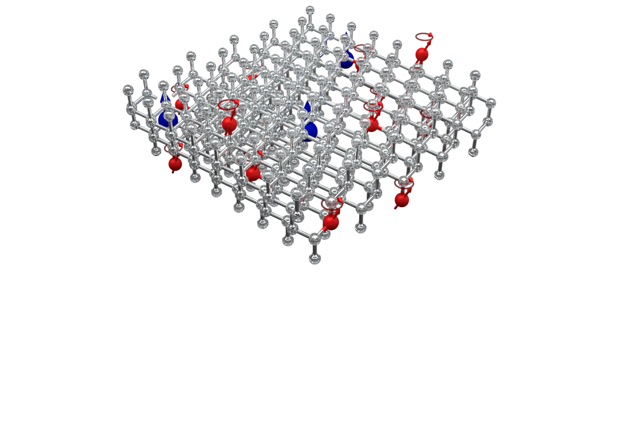
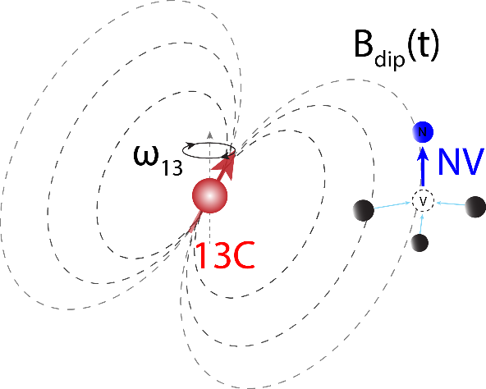
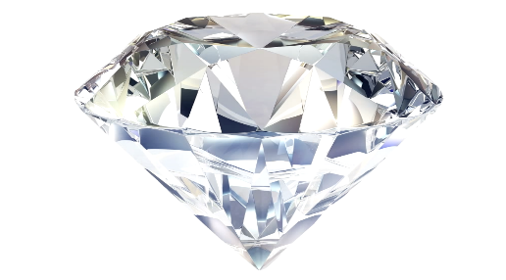
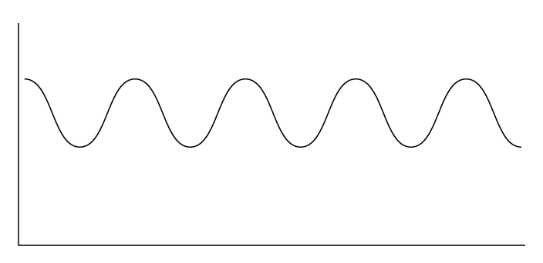








Fictitious fields are found in rotating frames:
$$ω=γ\text{B}$$
$$B_{ω}=ω/γ$$
$$B_{ω}$$
$$ω$$
$$ω$$
$B_{ω}=ω/γ$, weak for NVs (0.3mG/kHz) but…¹³C nuclei see a much larger effect $(\sim 1$G/kHz)
$$B_{dip}\left(t\right)$$
$ω_{13}=γ_{13}B$
$γ_{13}=1.075$kHz/G
Measure ¹³C precession frequency using NV ac (spin-echo) magnetometry

Slide 13
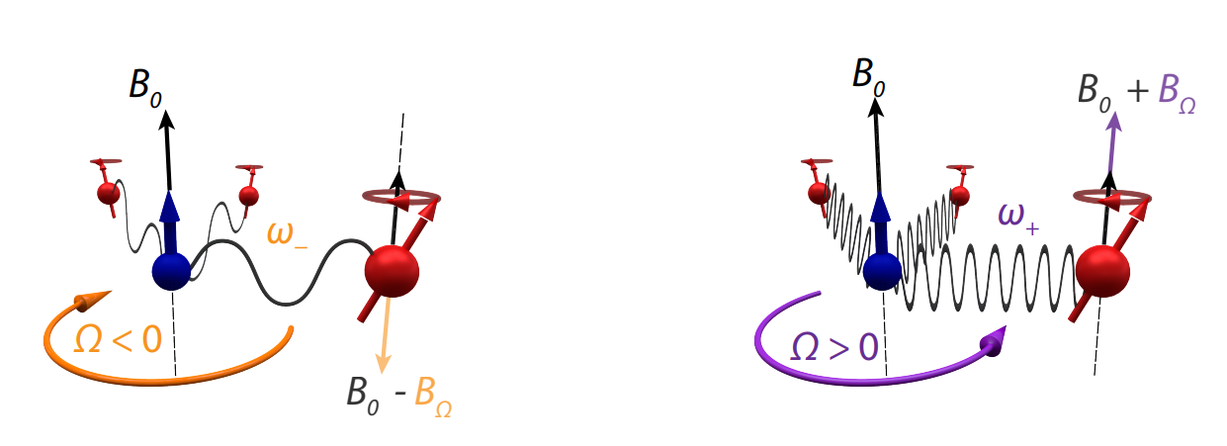
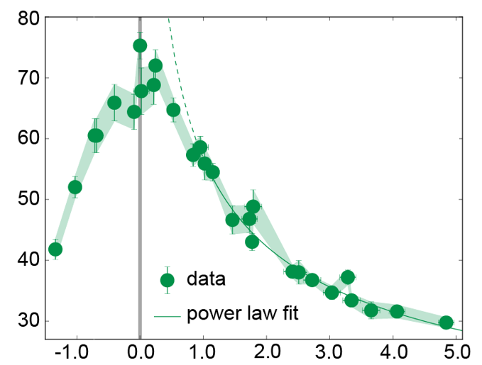
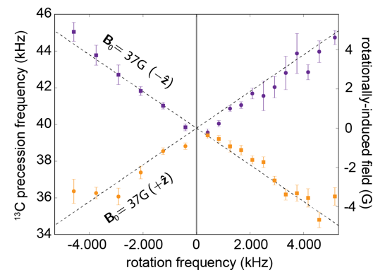
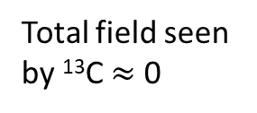


Fictitious fields: with real effects
¹³C precession frequency shifts due to rotation:
NV measures frequency shift
Total field seen by ¹³C $≈$ 0
Coherence time ($μ$s)
Total field $B+B_{fict} (G)$
AAW et. al. Nature Physics 13 1070-1074 (2017)

Slide 14
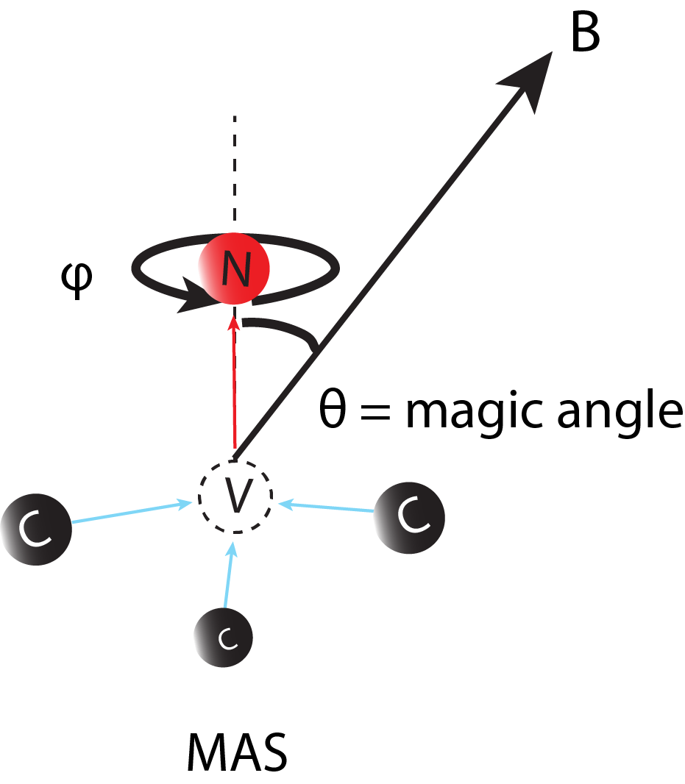
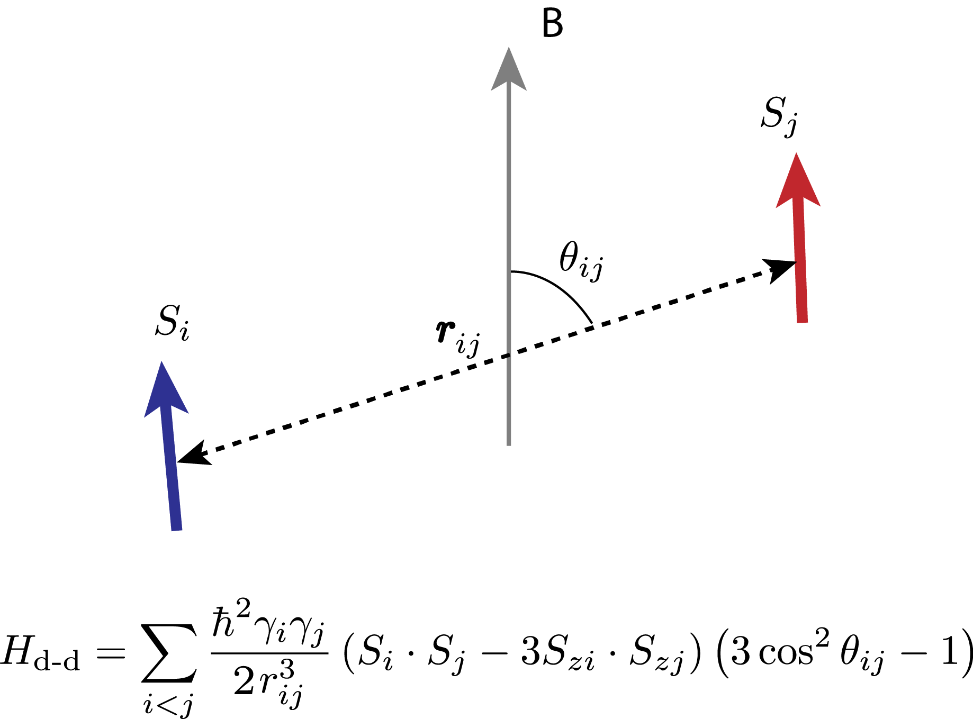

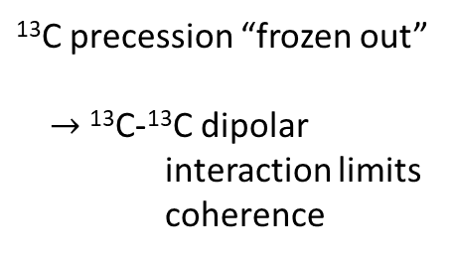

Quantum control with rotation
Homonuclear decoupling to prolong coherence?
Magic angle spinning?
¹³C precession “frozen out”
$→$¹³C-¹³C dipolar interaction limits coherence
Coherence time ($μ$s)
Take home: rotation of quantum spins causes fictitious magnetic fields with real effects, which can be detected and harnessed
Total field $B+B_{fict} (G)$
See PRB 104 085419 (2020) for why this didn’t quite work

Slide 15
Outline: rapidly rotating NV centres in diamond
Why we spin diamonds at 500,000 rpm and how we measure NVs at the same time
Fictitious fields and where to find them
Quantum phases from classical rotation
Measuring DC magnetic fields 30x better than Ramsey magnetometry
Rotating nuclear spins: polarisation and coherent control
Towards levitated classical particles coupled to quantum spins

Slide 16
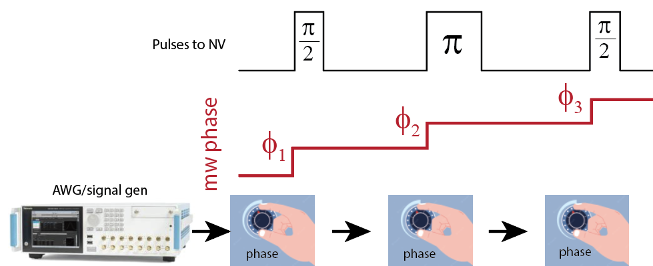
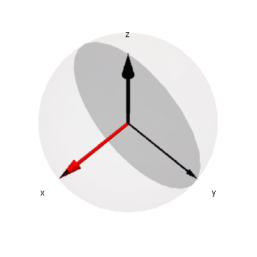
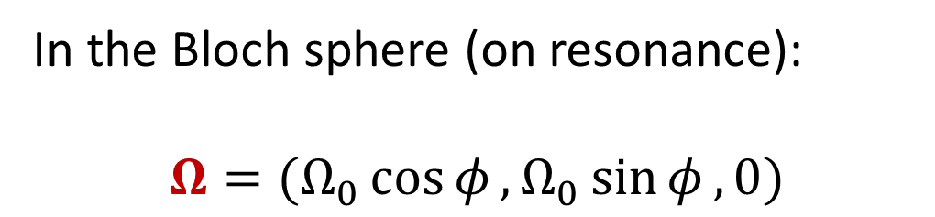
Microwave phase shifts: the easy way
Let’s say we do a spin-echo and vary phase of mw field directly with a signal generator
In the Bloch sphere (on resonance):
$$Ω=(Ω_{0}\cos{φ},Ω_{0}\sin{φ}, 0)$$
Phase changes = rotation of mw field in rotating frame, i.e. $S_{x}→S_{y}$

Slide 17
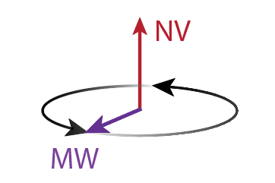
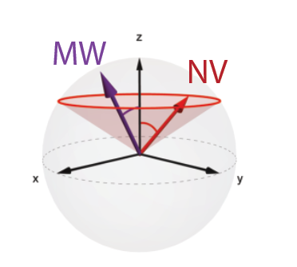
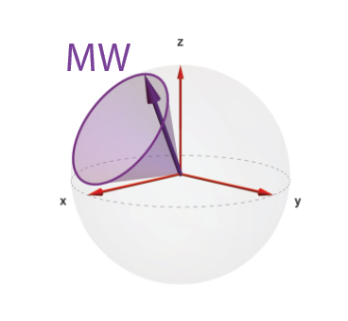
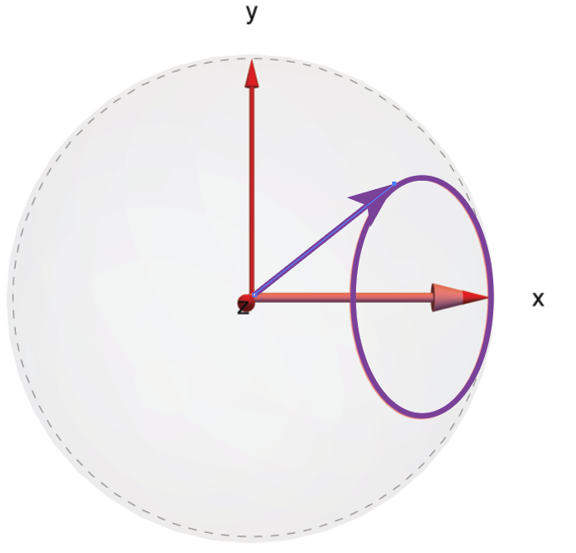


Microwave phase shifts: the HARD way
Physically rotating the microwave field also changes the phase
But we’re rotating the NV axis:
(view from the top)
mw rotating frame
+ RWA
$$R^{−1}\left(ωt\right)R^{−1}\left(θ_{NV}\right)→$$
$$→$$
Lab frame
Rotating NV frame
mw-rotating frame of NV
Rotation of the NV imprints an effective phase on mw field

Slide 18
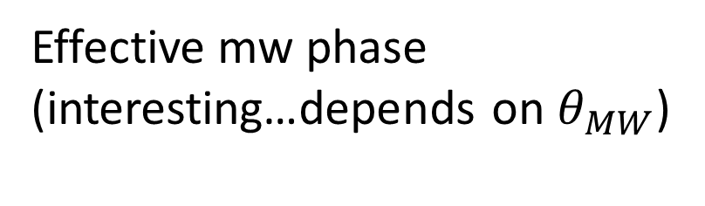

MW Hamiltonian in the rotating frame
Interaction Hamiltonian:
$$H_{int}=\left(\begin{matrix}0 & \frac{1}{2}Ω_{0}(cosθ_{NV}\cos{φ}\sin{θ_{mw}}−\cos{θ_{mw}\sin{θ_{NV}+i\sin{θ_{mw}}\sin{φ)}}} \\ \frac{1}{2}Ω_{0}(cosθ_{NV}\cos{φ}\sin{θ_{mw}}−\cos{θ_{mw}\sin{θ_{NV}−i\sin{θ_{mw}}\sin{φ)}}} & 0\end{matrix}\right)$$
$$a−ib$$
$$a+ib$$
$Ω=|(a±ib)$|
$$φ_{mw}(φ_{rot}, θ_{MW})= Arg(a±ib)$$
Angular variation of mw coupling (boring…)
Effective mw phase
(interesting…depends on $θ_{MW}$)
A. A. Wood et al, Phys Rev Lett 124 (2), 020401 (2020)

Slide 19
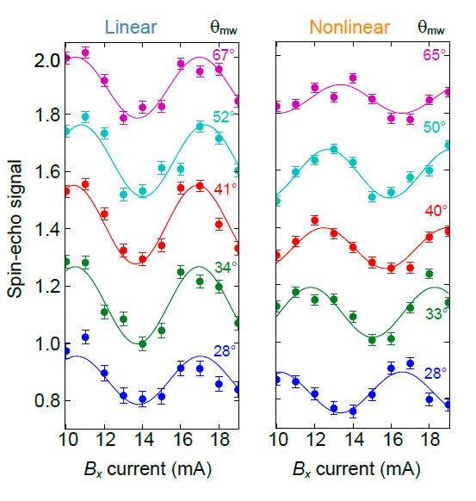
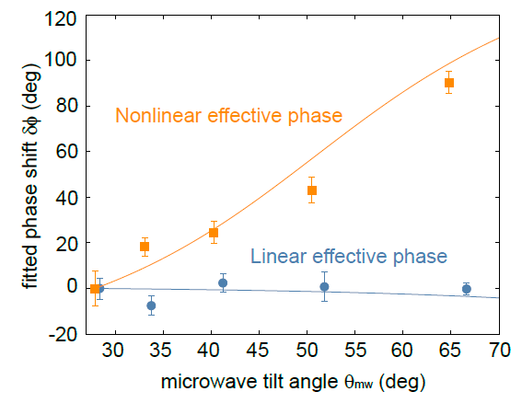
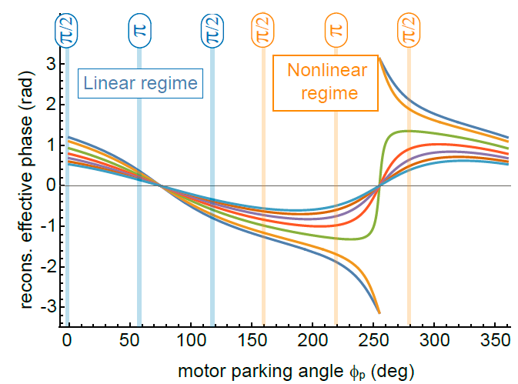
Detecting quantum phases from classical rotation
Linear
(running phase)
Nonlinear
(osc. phase)
Take home: physical rotation induces non-trivial (geometric) phase shifts that can be detected, applications in navigation
(?)
Diamond rotation angle (deg)
A. A. Wood et al, Phys Rev Lett 124 (2), 020401 (2020)

Slide 20
Outline: rapidly rotating NV centres in diamond
Why we spin diamonds at 500,000 rpm and how we measure NVs at the same time
Fictitious fields and where to find them
Quantum phases from classical rotation
Measuring DC magnetic fields 30x better
Rotating nuclear spins: polarisation and coherent control
Towards levitated classical particles coupled to quantum spins

Slide 21
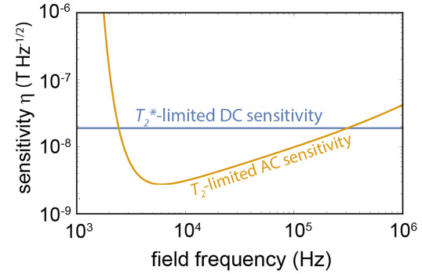
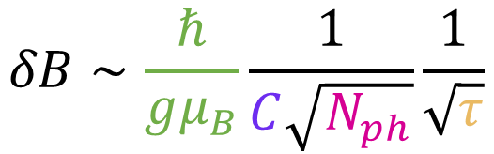

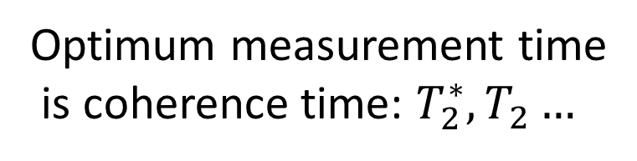



AC vs DC magnetometry
Optimum measurement time
is coherence time: $T_{2}^{∗}, T_{2}…$
$γ$, shift per tesla
Sensitivity= “minimum detectable field
In 1s of averaging”
$$δB∝\frac{1}{\sqrt{τ}}$$
$$δB∼\frac{ℏ}{gμ_{B}}\frac{1}{C\sqrt{N_{ph}}}\frac{1}{\sqrt{τ}}$$
Measurement time
Bright-dark contrast ($C∼$0.3)
Number of photons
NV is a better AC magnetometer than DC
DC fields: $τ_{opt}=T_{2}^{∗}∼1μ$s
AC fields $τ_{opt}=T_{2}∼100μs$

Slide 22







If only there were a way…
…to up-convert DC fields to AC, sensitivity limited by $T_{2}$ rather than $T_{2}^{∗}$…
Rotation of the diamond does this for us when both the magnetic field $B$ and NV axis $n$ make angles to the rotation axis:
$$B$$
AC modulation proportional to $θ_{NV}$
Measure DC fields with AC sequences:
$$\sqrt{T_{2}^{∗}/T_{2}}∼10×$$
Sensitivity boost!
$$B$$
$$ω_{NV}(t)∝B⋅n(t)$$
A. A. Wood et al, Phys Rev B 98 (17), 174114 (2018)

Slide 23




vs Ramsey
DRUM vs Ramsey:
10s avg per point
30s avg per point
Take home: rotation of quantum spins can dramatically improve sensitivity for magnetometry and sensing applications
$δB=0.86\text{m}\text{T}$Hz^{-1/2}
$δB=28nT$Hz^{-1/2}
$θ_{NV}={40}^{∘}, \left\langle 110\right\rangle$-cut

Slide 24
Outline: rapidly rotating NV centres in diamond
Why we spin diamonds at 500,000 rpm and how we measure NVs at the same time
Fictitious fields and where to find them
Quantum phases from classical rotation
Measuring DC magnetic fields 30x better than Ramsey magnetometry
Rotating nuclear spins: polarisation and coherent control
Towards levitated classical particles coupled to quantum spins

Slide 25






Rapid rotation of nuclear spins
$$\left|m_{S},m_{I}\right\rangle =|+1, 0, ±1⟩$$
The NV nuclear spin has much longer coherence than the electron spin,
$T_{2,N}^{∗}∼1−2ms$ (c.f. $T_{2,e}^{∗}∼100μs$)
Rotation requirements much more modest, but nuclear spin is not polarised by green light, except at ESLAC (500G): $|0, +1⟩$
Very sensitive to angle ($θ>1^{∘}$) typically prevents polarisation
$$|−1, 0, ±1⟩$$
$$|0, 0, ±1⟩$$
NV nuclear spin quantum gyro: Phys. Rev. Lett. 126, 197702 (2021), Sci. Adv. 7 abl3840 (2021)

Slide 26



Initialisation, manipulation, measurement
Synchronise now to angle of NV axis
Laser polarises and reads nuclear spin state
RF manipulates nuclear spin
B = 500G rotates through 360°
B
RF
NV
A. A. Wood et al Phys. Rev. Research 3, 043174 (2021)

Slide 27



Feedforward control
A. A. Wood et al Phys. Rev. Research 3, 043174 (2021)
two-level splitting
Off-axis field mixes electron and nuclear spin states, results in 1MHz variation of nuclear qubit splitting
Vary rf drive frequency to feed-forward, ensuring resonance
Time ($μs$)
Nuclear gyromagnetic ratio reduces
R. Goldblatt, A. Martin and A. Wood, PRB 105 L020405 2022

Slide 28



A. A. Wood et al Phys. Rev. Research 3, 043174 (2021)
Spin-echo, spin locking
Feedforward of rf frequency and rf pulse time enables coherent control
Ramsey, spin echo
Spin locking
Take home: rotation can do interesting things – and nothing – to nuclear spins coupled to electron spins

Slide 29
Outline: rapidly rotating NV centres in diamond
Why we spin diamonds at 500,000 rpm and how we measure NVs at the same time
Fictitious fields and where to find them
Quantum phases from classical rotation
Measuring DC magnetic fields 30x better than Ramsey magnetometry
Rotating nuclear spins: polarisation and coherent control
Towards levitated classical particles coupled to quantum spins

Slide 30

Levitated rotating nano/microdiamonds (NMDs)
Mechanical rotation offers a simple and highly controllable means to probe rotational physics
Everything I have talked about here can be done with levitated diamonds, and turned up to 11!
More experimentally challenging: NMDs have shorter coherence times – need faster rotations and thus vacuum
Trapping in vacuum: optical tweezers cause too much heating, so use electro/magnetostatic traps, eg Paul trap

Slide 31

Levitated rotating nano/microdiamonds
Anything we can do levitation can do better!
20MHz rotation of NMDs!
Berry phase on NV spins!
2T fictitious field (¹³C)!
Rotation faster than quantum decoherence!
Also: Perdriat et al arXiv:2309.01545 2023 (rotation intrinisic to Paul trap) Voisin et al arXiv:2407.19754 2024 (nuclear spins in Paul trap)

Slide 32

Levitated NMDs coupled to quantum spins
Better yet: quantum spins coupled to mechanical rotation
Mechanically-detected NV magnetic resonance and cooling of spin libration [Delord et al, Nature 580 56-59 (2020)]
Intrinsic AM -> orbital AM
quantum EdH effect

Slide 33





Towards our own levitated rotating NMDs
Can we mechanically detect the flip of a single spin in a levitated nanodiamond?
Ring-style Paul trap in UHV system ->
Silica-coated nanodiamonds: the best of both worlds?
Russell Goldblatt,
Postdoc
Ex-Rb MOT system

Slide 34









Next few months:
Wavelength dependence of ND heating (500nm – 3.5$μ$m)
Optical trapping of silica-coated NDs
NV charge dynamics – surface charge control?
Russ Goldblatt
(PhD/postdoc)
Prof Andy
Martin
Thanks for your attention!
Collaborators: CUNY + ANU, Charge control projects
Artur
Lozovoi
Gabriel
Lopez
Morales
Carlos
Meriles
Marcus
Doherty
(ANU)
Tom Delord
Notes:
Thanks!

Slide 35


Slide 36


Rotation speed dependence
Sensitivity depends on rotation speed
Faster rotation speeds improve duty cycle, but eventually accumulate less phase
Slow rotations limited by $T_{2}$
A. A. Wood et al, Phys Rev Applied, 18 054019 (2022)

