Slide 1
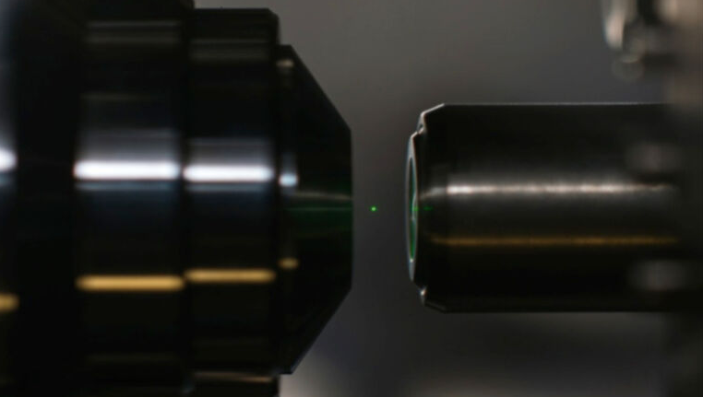


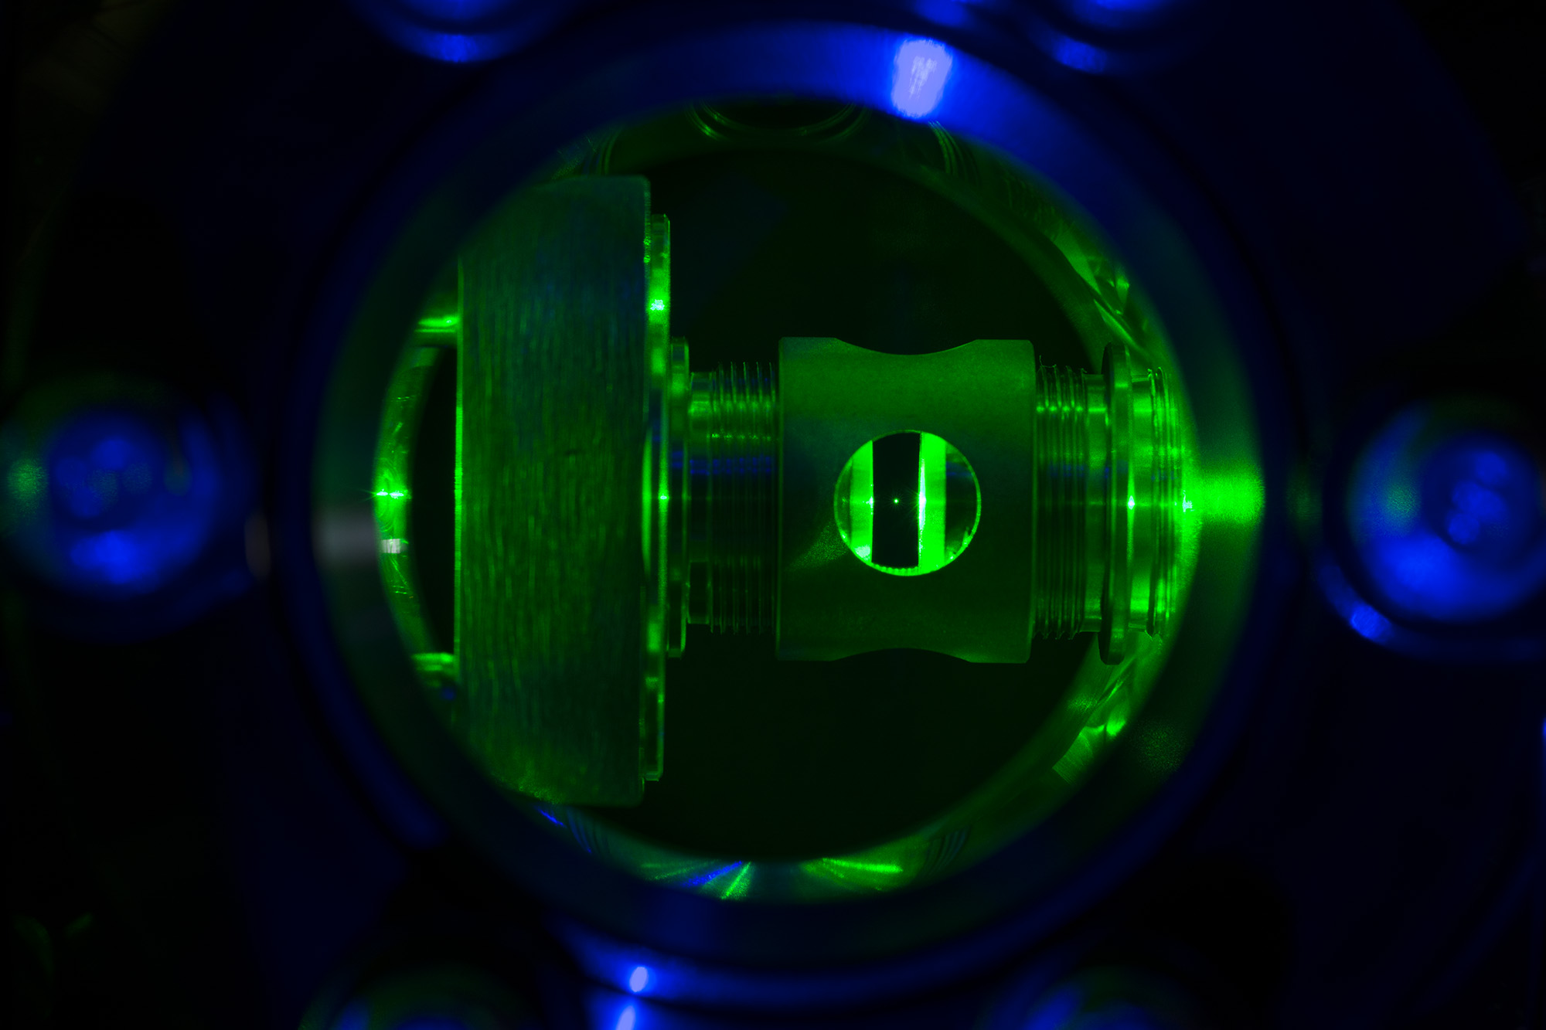
Librational ground-state cooling
of a levitated nanoparticle
Lorenzo Dania
Notes:
Im a post doc in the photonics laboratory. Today I am happy to show you very fresh data from the lab about librational ground state cooling

Slide 2
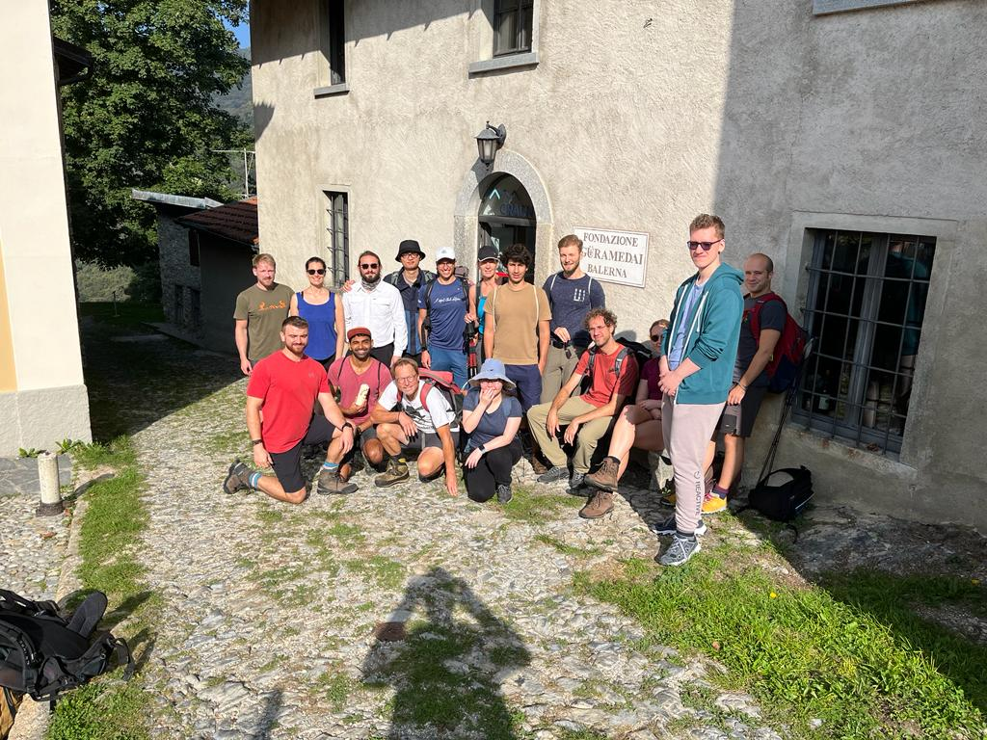
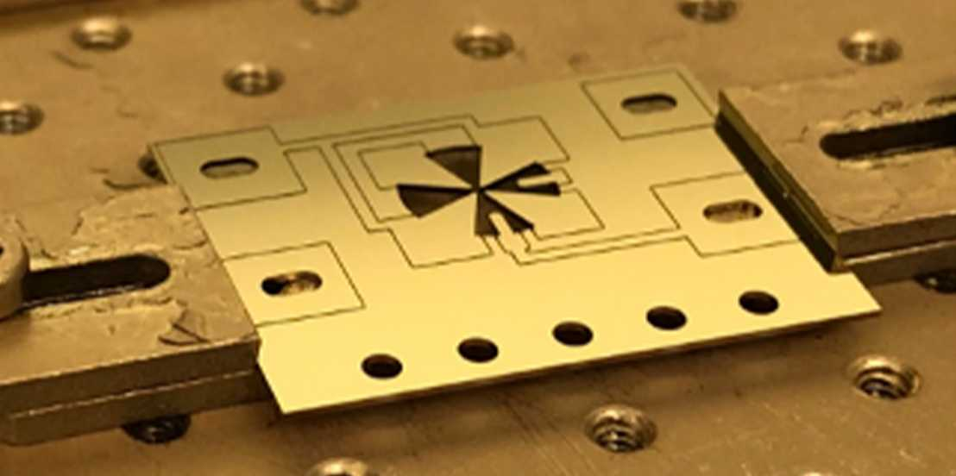
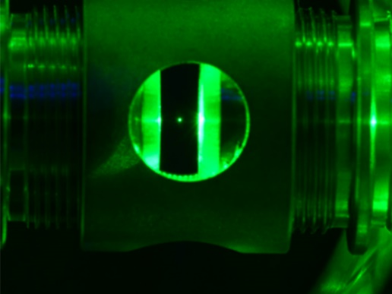
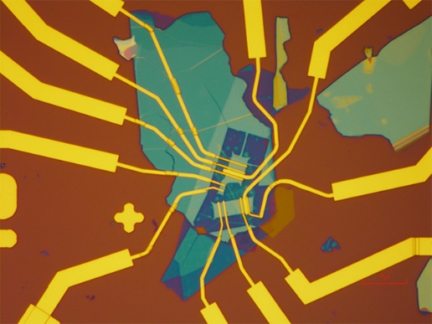

Ion traps
Optical tweezers
2D materials
Prof. Lukas Novotny’s group:
2D optoelectronics
Levitodynamics
  Metrology
  Quantum foundation
Prof. Lukas Novotny’s group:
2D optoelectronics
Levitodynamics
  Metrology
  Quantum foundation
Jayadev Vijayan
Johannes Piotrowski
Lukas Novotny
Notes:
First, let me introduce you our group. The photonics lab is lead by Lukas N. Lukas follows two main areas of research: one is 2D photonics and optoelectronics device for on-chip sources, bhjiop+
+èand the other is optomechanics with particles. We use this devices and experiment for metrology and quantum f.

Slide 3
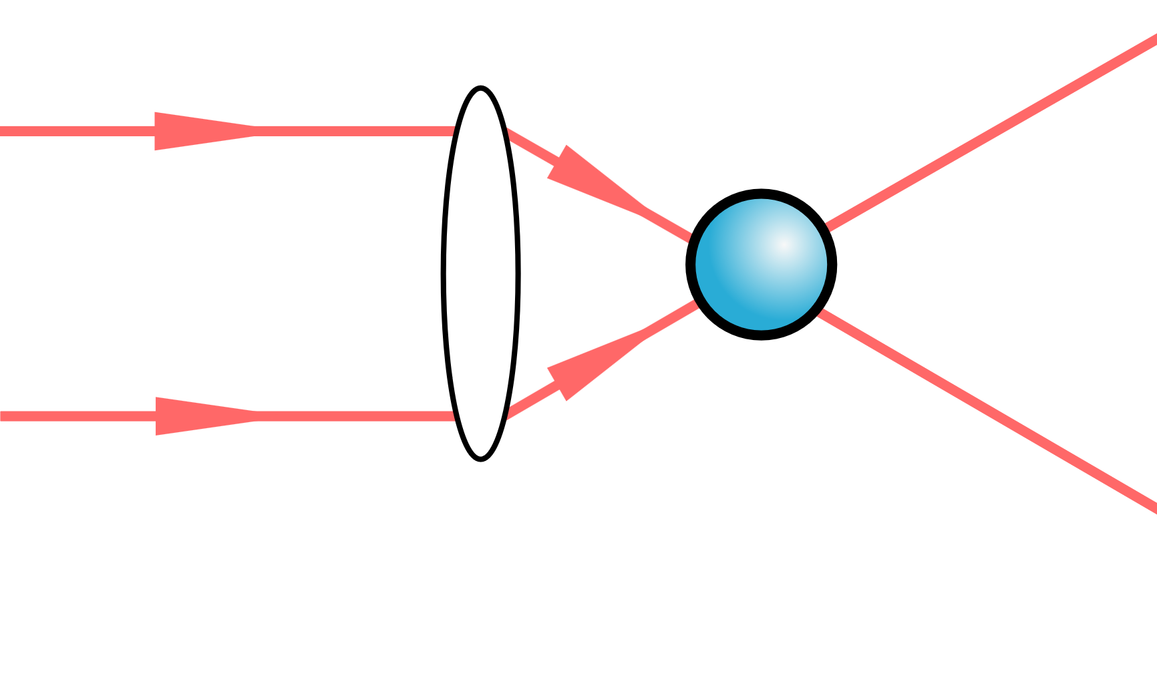
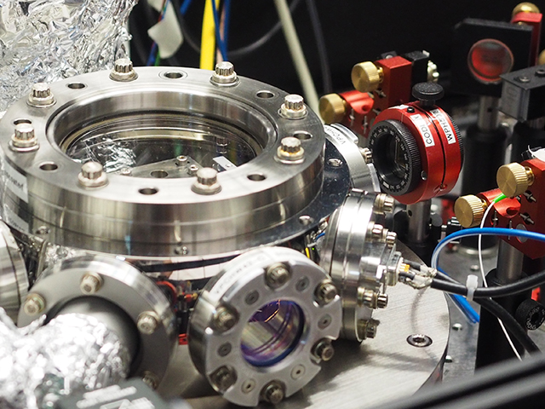
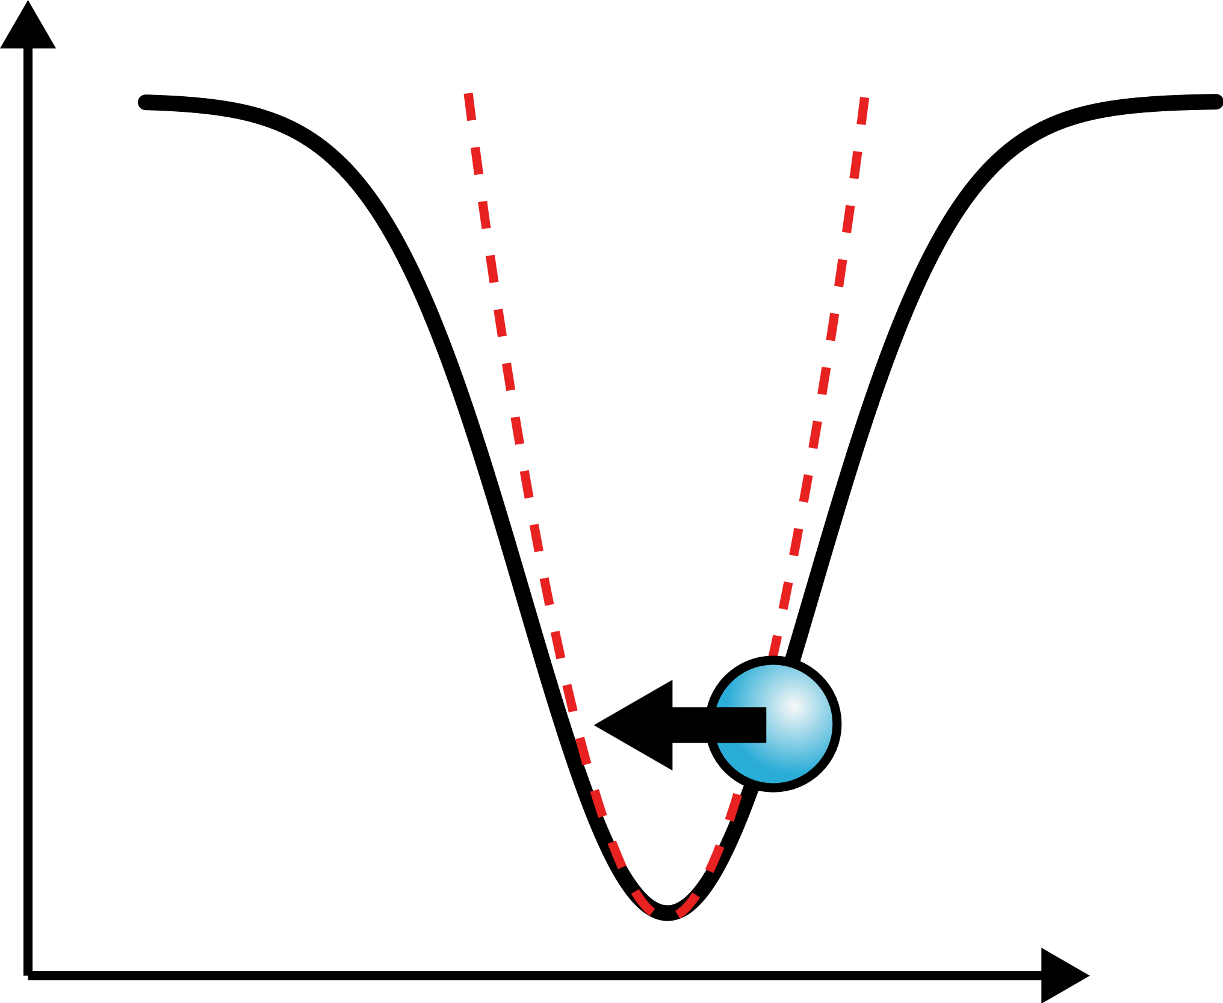
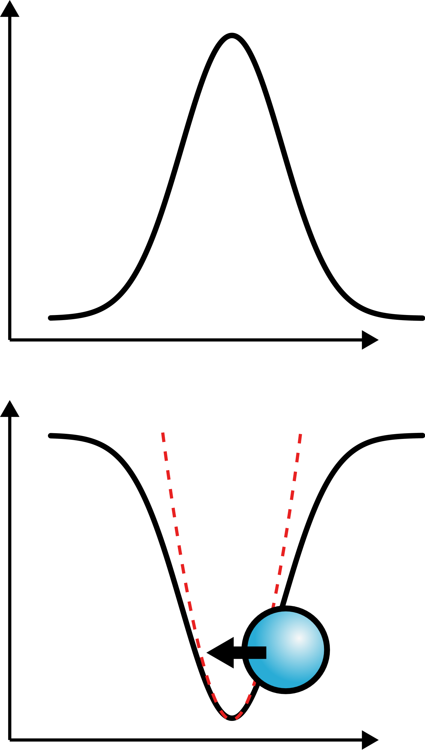

Optically levitated nanoparticles
Vision: create a massive delocalized quantum state
of motion: test collapse models, quantum gravity
Levitation:
1) mechanical degrees of freedom with high Q factor
2) Tunable trapping potentials
3) coulomb/magnetic/optical force transducer
z
~100 nm silica particle
Induced dipole
What have been achieved so far?
Intensity
Quantum ground state cooling:
researchers focused on
symmetric particle trapping and
translational modes ground state cooling. GS
was achieved either by cavity cooling or by feedback
Potential
$$Ωm$$
Translation motion
~ 100 kHz
Ultra-high Q-factor
Tunable trapping potential
Universal force transducer
No clamping losses
z
Notes:
My talk today is about optically levitated nanoparticles. We are here in a conference about mechanical oscillators, let me tell you why I think
levitated particles are very cool ones. First, they are very easy to build.
If we are here is because we all believe that levitated particles have some unbeatable properties compared to clamped systems. Some of these properties were greatly illustrated in the previous talks: we have ultra-high q only because we have no physical constratints, we have tunable trapping potentials…
What makes nanoparticle special is the control achieavable on the trapping potential, and the total absence of clamping losses.

Slide 4
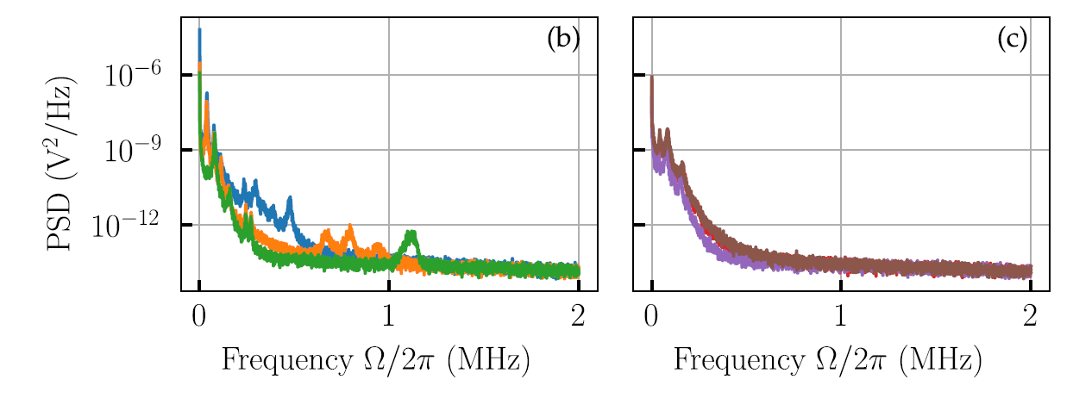
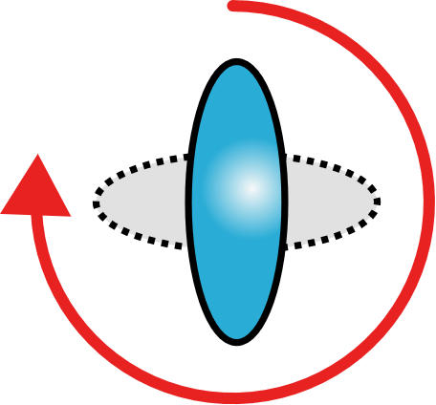
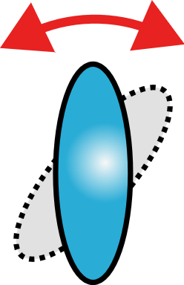
Trapping of anisotropic particles
The position of a particle is trapped by a gradient of the light intensity, which can be created by focusing the light. However, the orientation of the particle interacts with the polarization of the light. This means that the particle senses and is affected by the vectoral nature of the light field. Besides the ability to locally sense field directions, it opens up the possibility to manipulate the orientation without affecting the COM motion
Rotation motion
~ GHz
Libration motion “trapped rotation”
~ MHz
Asymmetric particles trapping:
Show additional angular motional modes
High frequency harmonic motion
Less prone to mechanical noise
Beneficial for ground state cooling
Torque sensing
What have been achieved so far:
Cooling via direct feedback based on optical detection
Cavity cooling
Coupling to embedded color centers
Thermal states: GS is needed for quantum operations
Today: first ground state cooling of librational mode
of an optically levitated nanoparticle via cavity cooling
Notes:
Another special property unique of levitation, that somehow was a bit less explored experimentally compared to the com modes, is rotation. This is something that clamped systems cannot really compete at all, it is a uniquedegree of freedom for unclamped systems.
There are two regimes of rotation motion. If driven by circular light, a particle will spin. If trapped by linear light, the particle undergoes angular oscillations
If a particle has an asymmetric shape, then it become possible to orient it in space. This means that now the particle becomes susceptible to external torques, that can generate new motional modes like rotational modes or trapped rotations, or librations

Slide 5
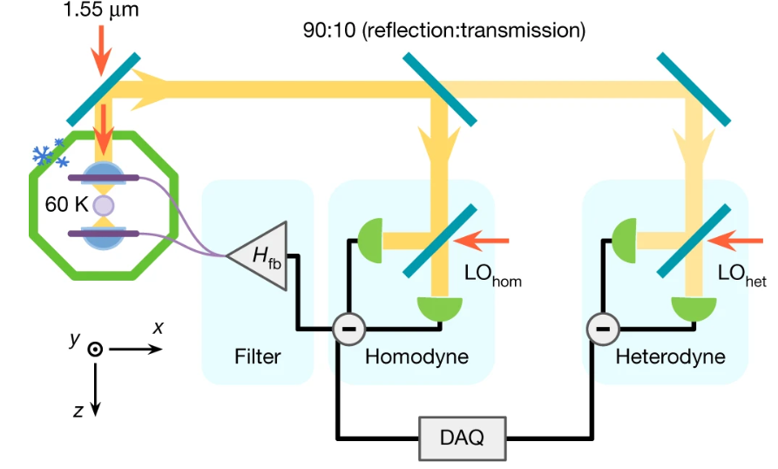
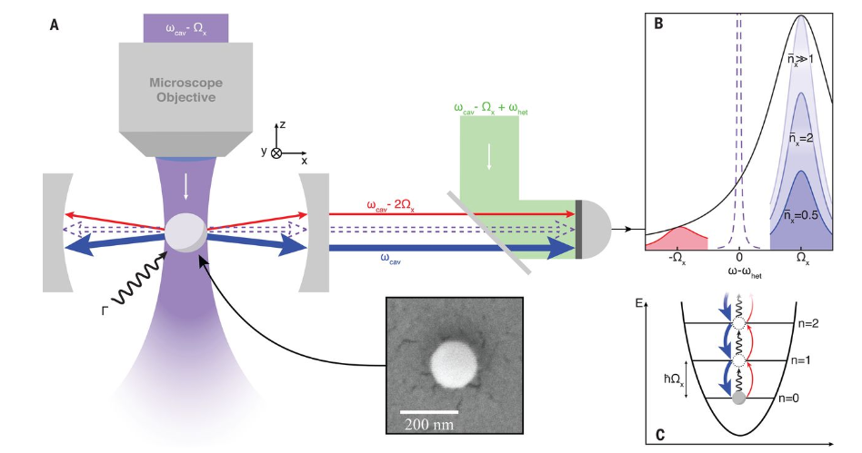
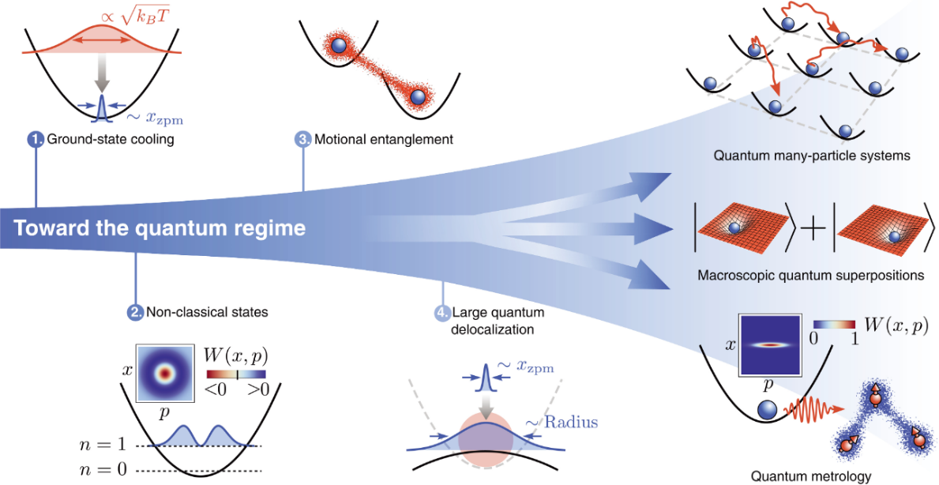
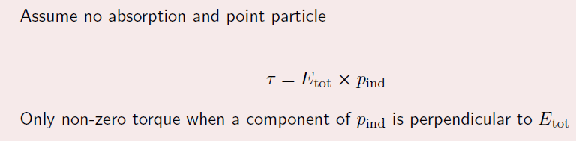
Quantum optomechanics with levitated particles: Ground state cooling
F. Tebbenjohanns et al., Nature 595, 378–382 (2021)
L. Magrini et al., Nature 595, 373–377 (2021)
U. Delić et al., Science 10.1126 (2020)
Today: ground state cooling of a librational mode
via cavity cooling
Quantum ground state cooling:
researchers focused on
symmetric particle trapping and
translational modes ground state cooling. GS
was achieved either by cavity cooling or by feedback
Cool things that we can turn off potential
To expand the wave function
On the other hand, turn it off means to
Really have high chances of loosing the particle

Slide 6
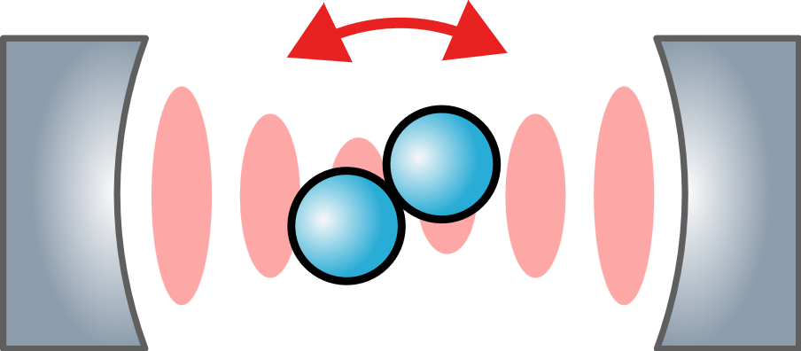
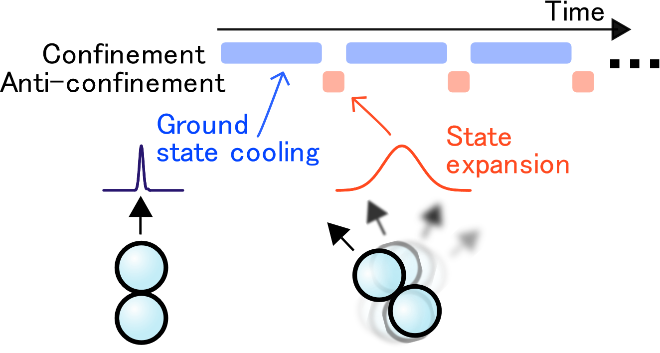
Outline
Trapping the orientation of an anisotropic particle
Cavity cooling of librational modes
Outlook
Trapping the orientation of an anisotropic particle
Cavity cooling of librational modes
Outlook

Slide 7
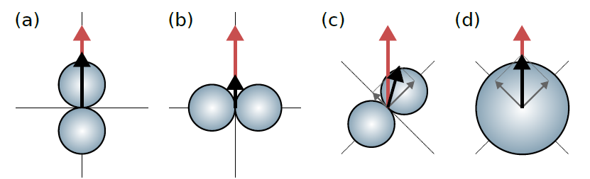

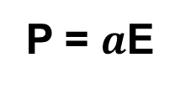
Angular mechanical confinement with light
Anisotropic scatterers ($\overset{⃡}{α}≠ α_{0}I$) experience torque
$\vec{τ}= \vec{p}×\vec{E}$
E
P = $a$E
Fons van der Laan, Rotational levitodynamics, PhD thesis (2022)
Notes:
To exert a torque on a particle with light it is necessary that its dipole moment does not align with the external field. Here I give two example for a spherical particle and for a nanodumbbell (that is two balls glue together). For the sphere, the polarizability is a scalar, and so there will never be torque.
For the dumbbell instad, the polarizability alpha has different entries along the particle principal axes. This means that if the external field (in red) is parallel to one of the two principal axes, there will be no torque. But if there is an angle, then p (in black) is no longer parallel to E, and there can be a torque

Slide 8
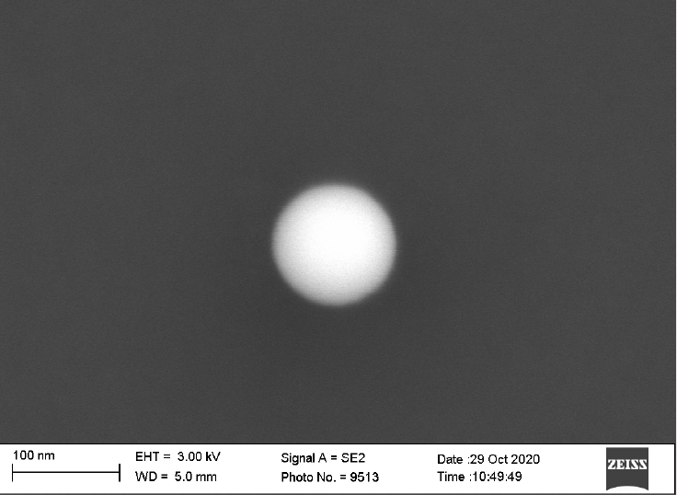
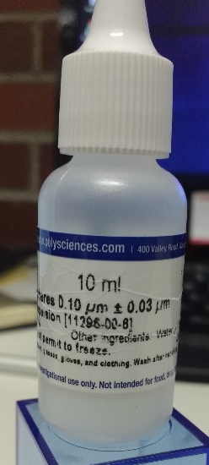
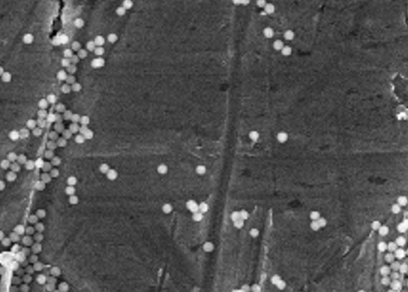
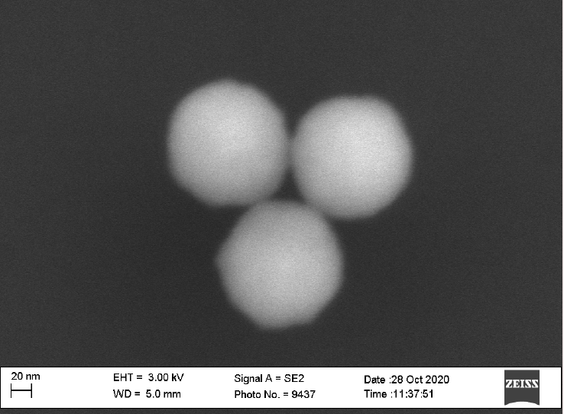
Anisotropic particles
500 nm
120 nm silica spheres
Trap via nebulizing a liquid solution at ambient conditions
Notes:
I talked you about dumbbels because that’s the easiest way we can get anisotropic particles. In fact we buy spherical particles, bu sometimes we trap clusters…
How can it be reproducible? Thanks to optical detection

Slide 9
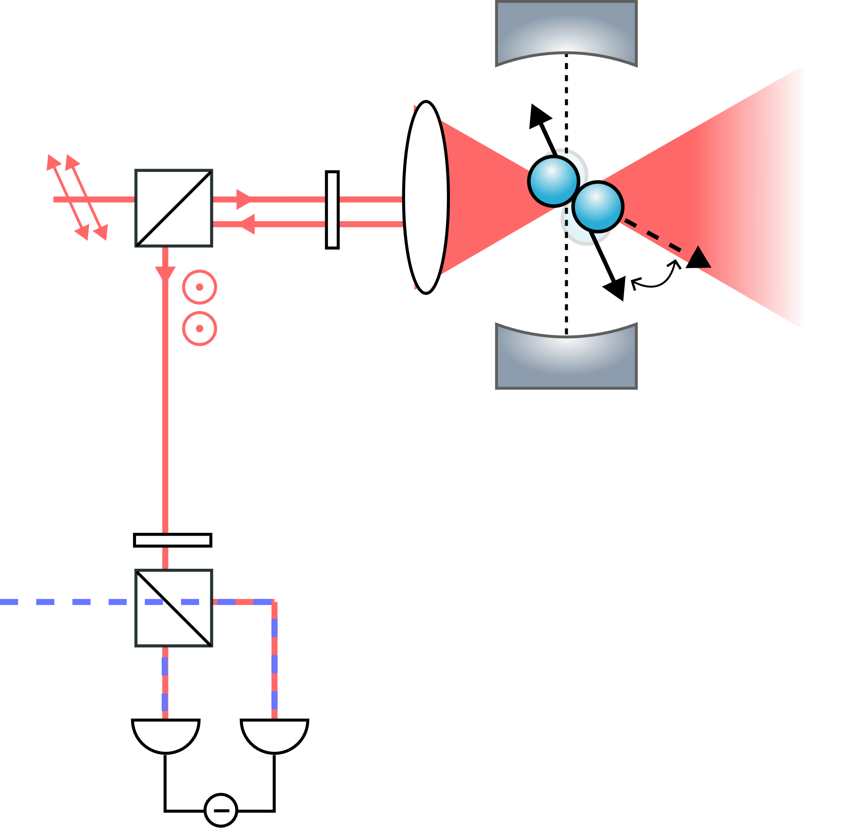
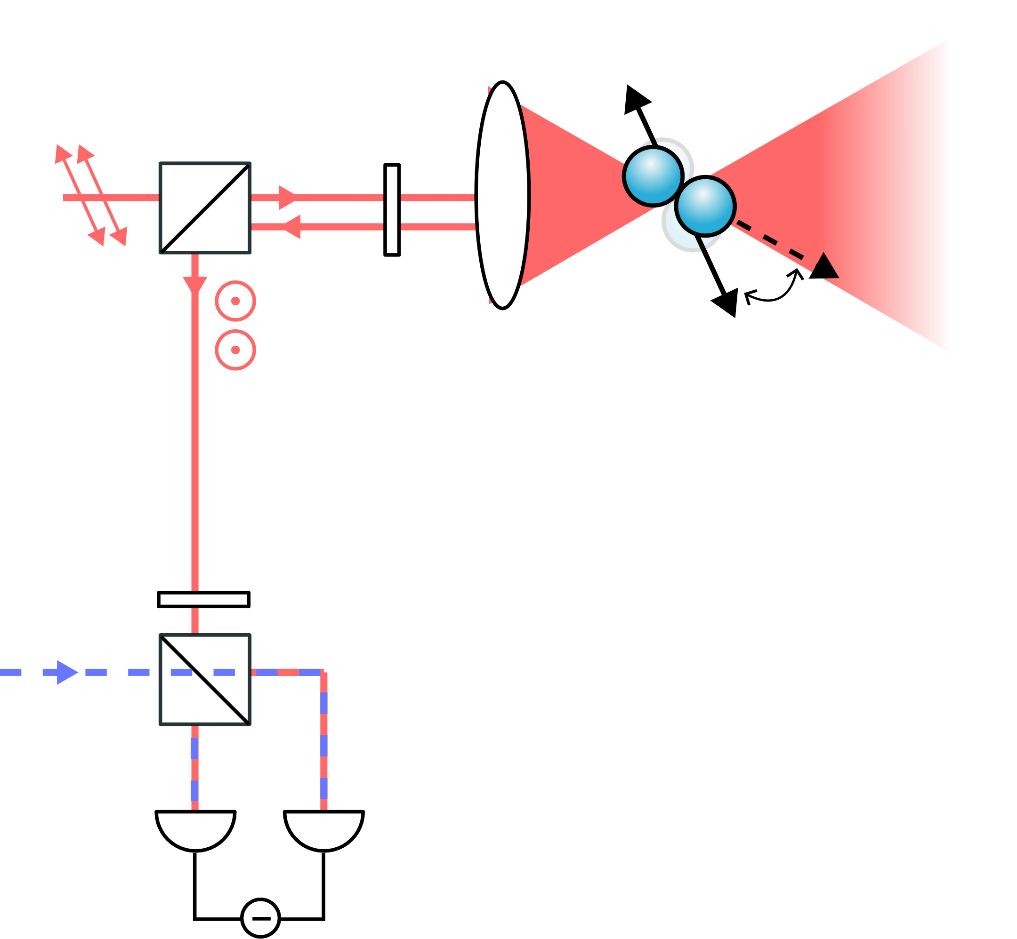
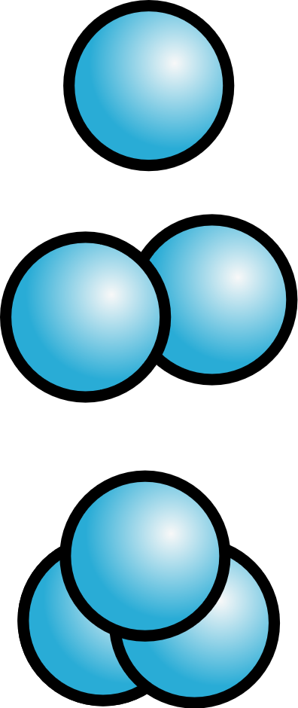
Angular motion detection
Single particles
PBS
QWP
Clusters
LO
HWP
Balanced
detector

Slide 10
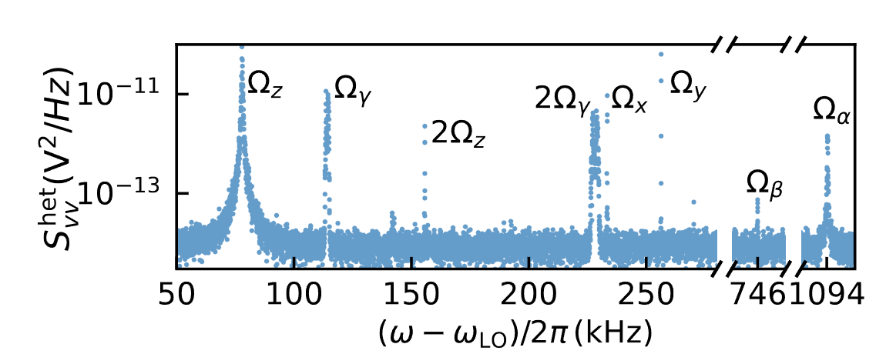
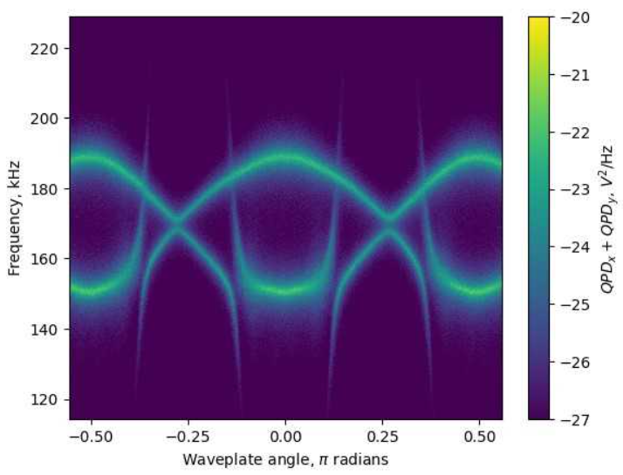
Angular motion detection and tuning
Libration modes
Stable frequencies
Cavity cooling in resolved sideband
Low phase noise at high frequencies
Fast dynamics
Notes:
The interesting thing of this plot is also that the libration has very high frequency compared to com, you can see this better here
High frequency is good because we have less mechanical noise, which in the past was found to be a limiting factor for cavity cooling.
Also the cool thing is that while we scan the angular mode frequency, almost nothing happens to the COM modes

Slide 11
Outline
Trapping the orientation of an anisotropic particle
Cavity cooling of librational modes
Outlook

Slide 12
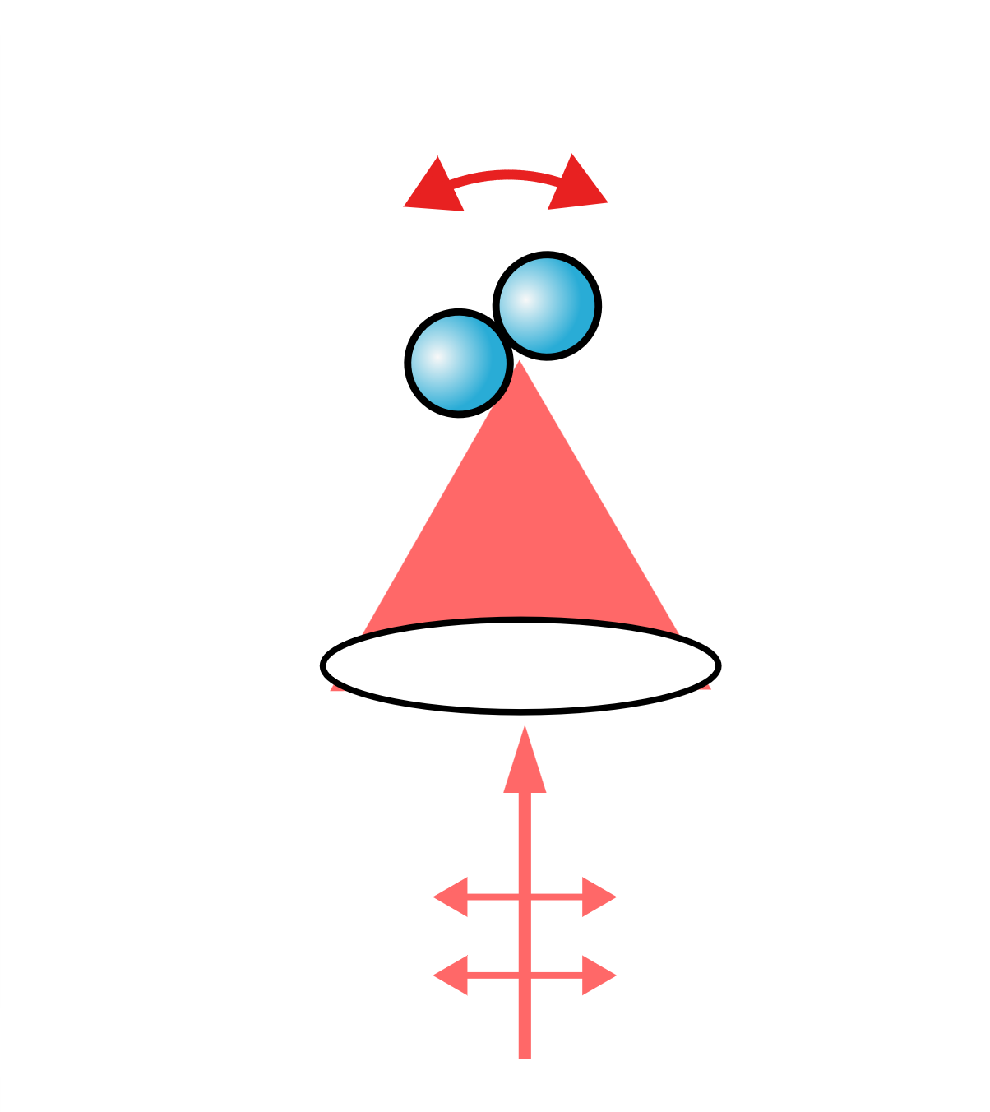
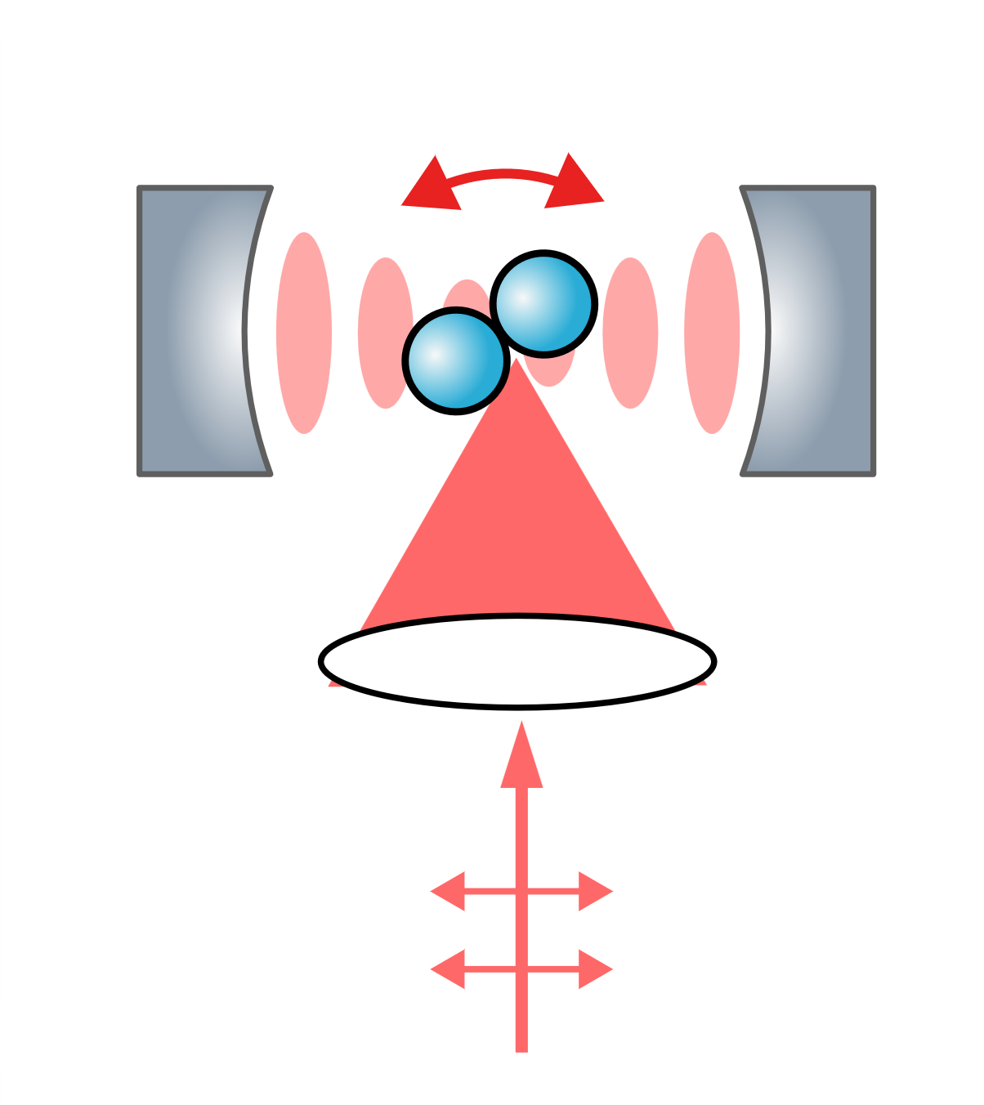
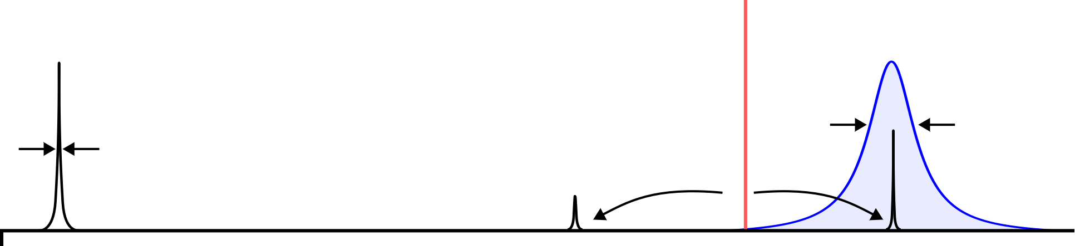
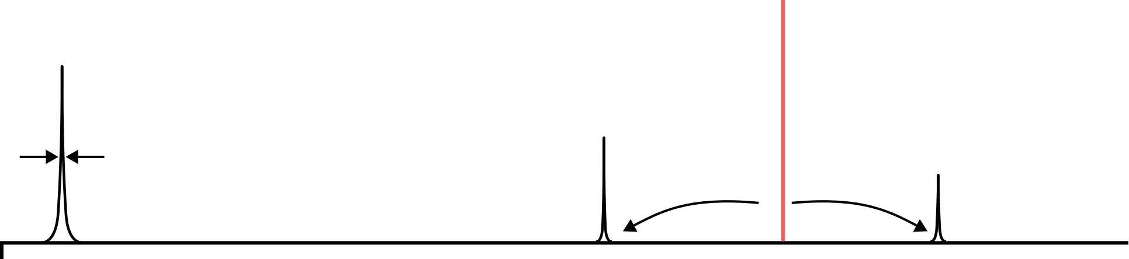









Cavity sideband cooling and thermometry
$$Ωm$$
Why a cavity:
high lib freq-> lower temperatures
Passive (easier) cooling of all 6 modes
Possible to later use cavity field to couple distant particles towards entanglement
Also, another experiment in our labs is pursuing librational fb cooling
Require sideband resolved
regime to cool to ground state
$$Δ$$
$$\text{ω}\text{L}$$
$$κ$$
$$Γm$$
$$−Ωm$$
$$Ωm$$
$$Ωm$$
$$\text{ω}\text{L}$$
Notes:
Cavity cooling is a well enstalished technique to remove energy from mechanical oscillators using light.
Our opical tweezer has frequency omegaL. The particle will scatter this light, but the particle motion also will show up as sidebands on the scattered light field.
The upper sideband is associated with the process of removing energy from the mechanics at the expense of the cavity field,
While vice versa the lower sideband is associated with the opposite process, where the mechanics get actually heated up by light.
If we now interface our optomechanical experiment with a high Q cavity, the cavity density of modes might enhance or suppress one of these two processes, depending on its detuining:
For realizing cavity cooling, which is what we want, we have to use the cavity to enhance the upper sideband. This happen when the cavity detuning equals to the mechanical frequency. This works better in the resolved sideband regime, that is, when the cavity is narrower than the ssidebands seuparation

Slide 13
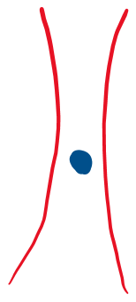

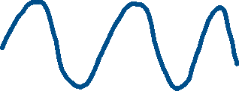



Particle position and polarisation
Optimal for center-of-mass cooling
Laser phase noise in an optical cavity
Optimal for libration cooling

Slide 14












Particle position and polarisation
Cavity populated only by libration motion
Cavity mirrors
H-polarized tweezer

Slide 15
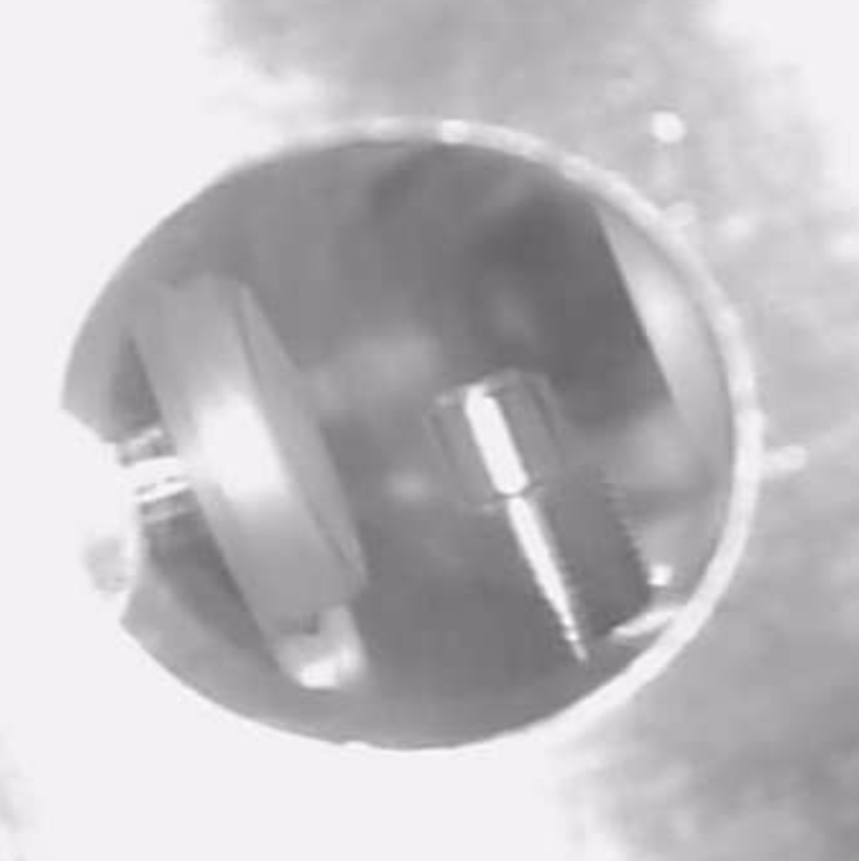
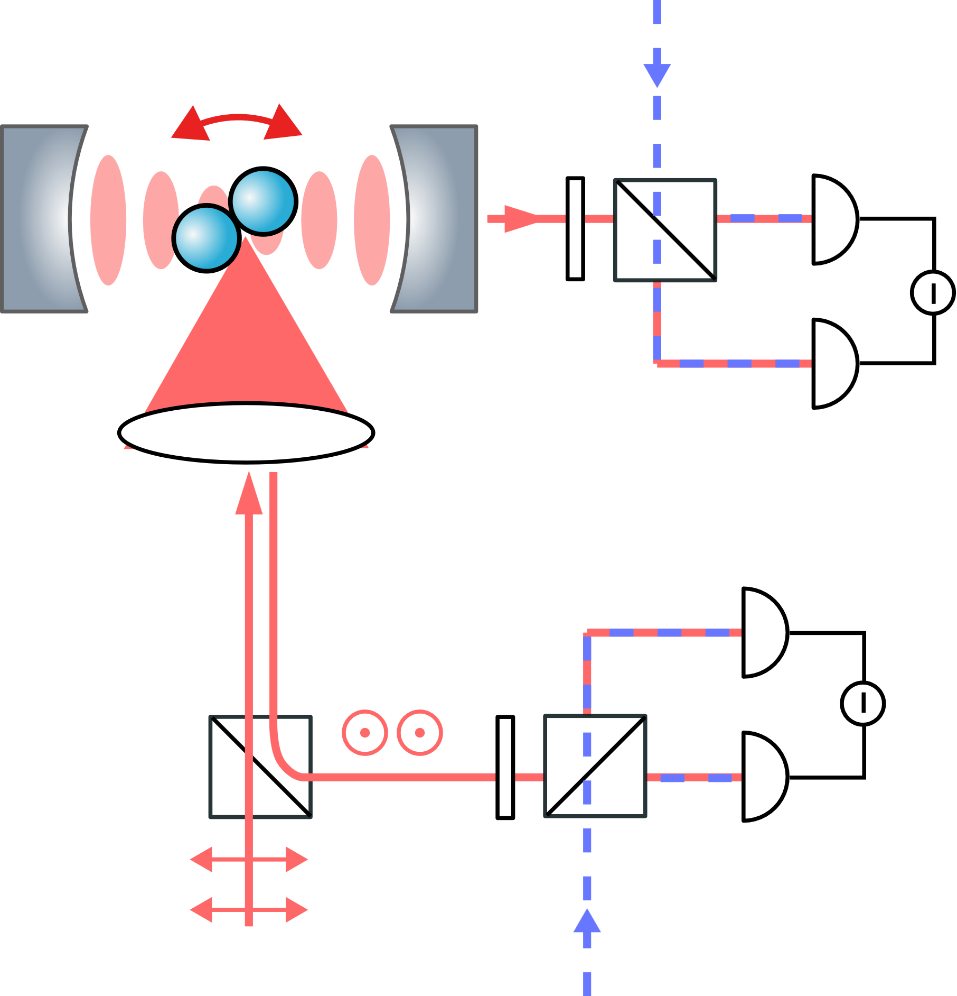
Experimental setup
Tweezer lens
Cavity mirrors
Tweezer wavelength | 1550 nm
Tweezer power | 1 W
Libration frequency | ~1.1 MHz
Cavity linewidth | 330 kHz
Pressure | 10⁻⁹ mbar
Temperature | 300 K
PBS
$Ωm/κ$ >> 1
Balanced
detector
HWP
LO

Slide 16
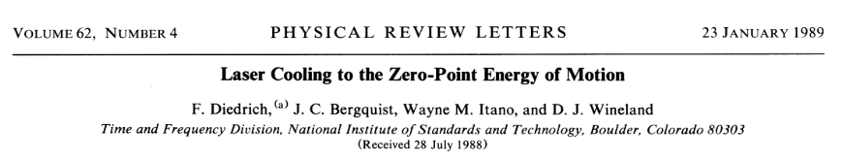
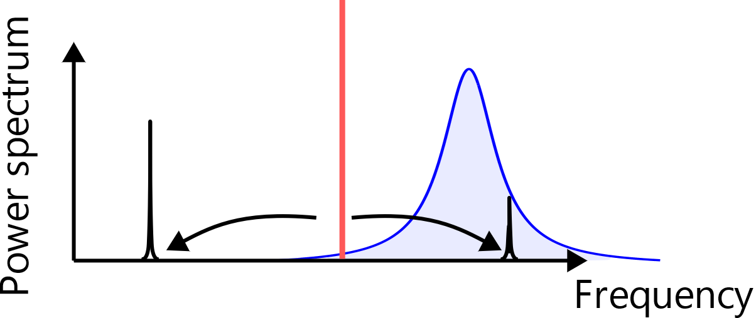
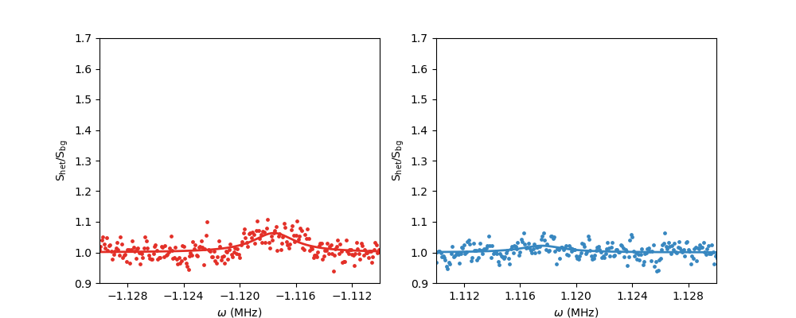
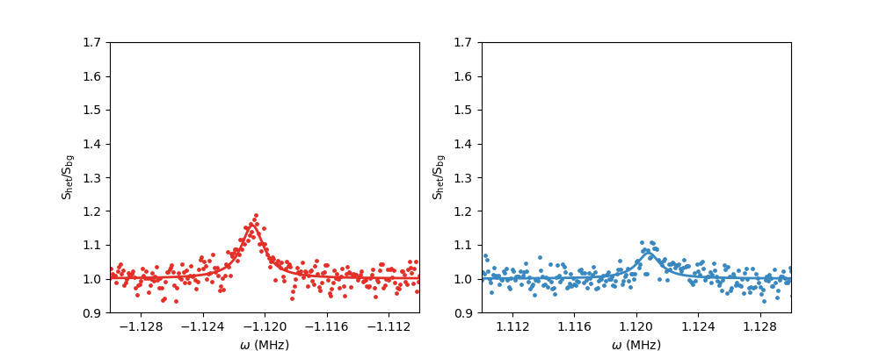
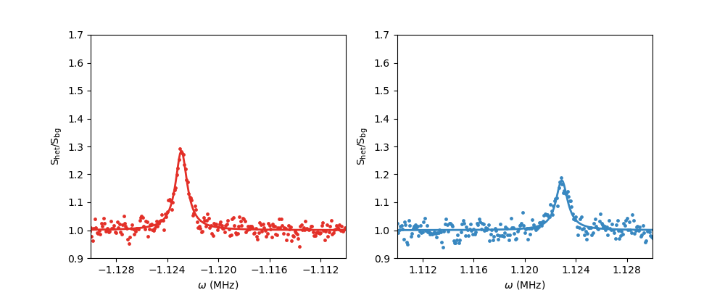
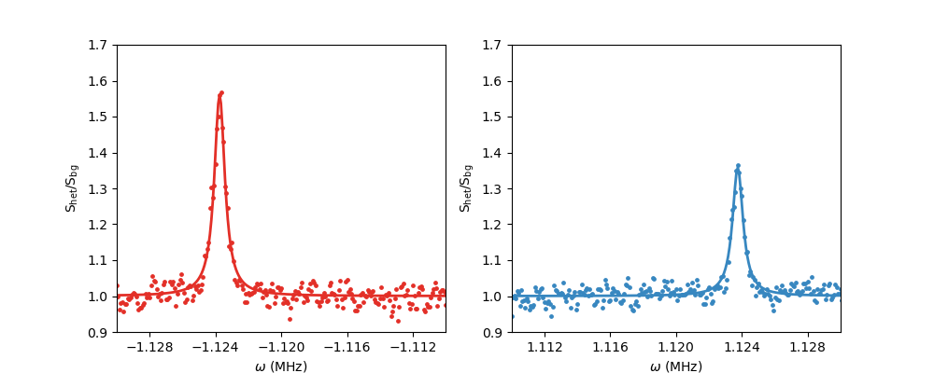
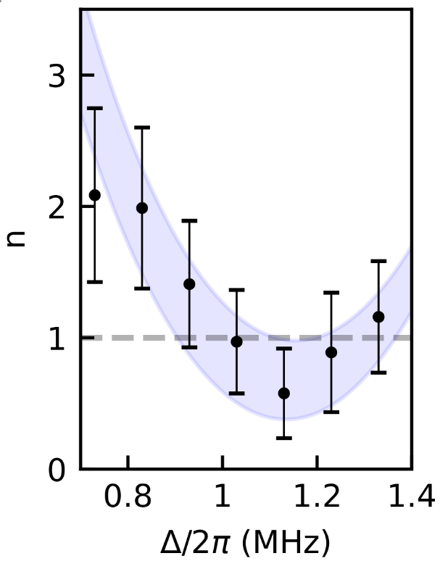
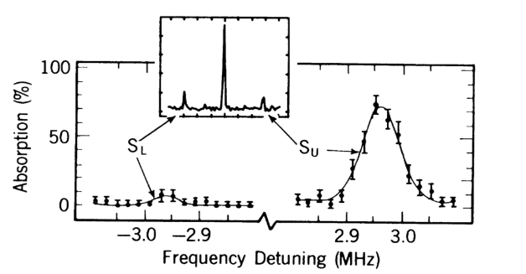






Detuning scan
$$Δ$$
Sideband cooling of trapped ions
$$Δ=0. 8 MHz$$
$$Δ=0. 9 MHz$$
$$Δ=1.0 MHz$$
$$Δ=1.1 MHz$$
~n+1
~n
n = 0.6 $±$0.3
Notes:
And this is a ground state of libration motion obtained via cavity cooling, but verified by a free-space detector.

Slide 17
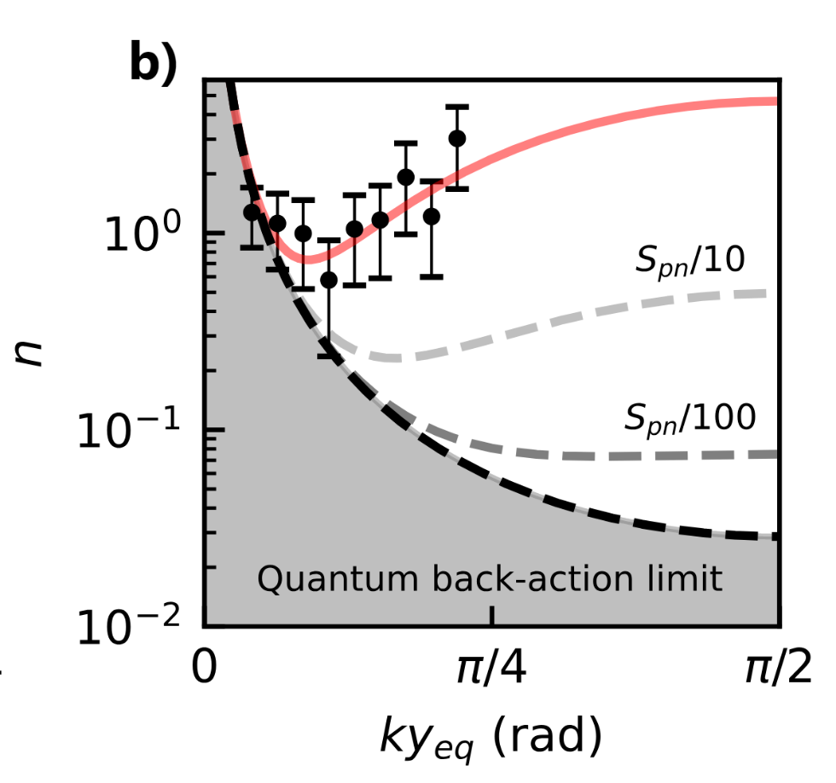
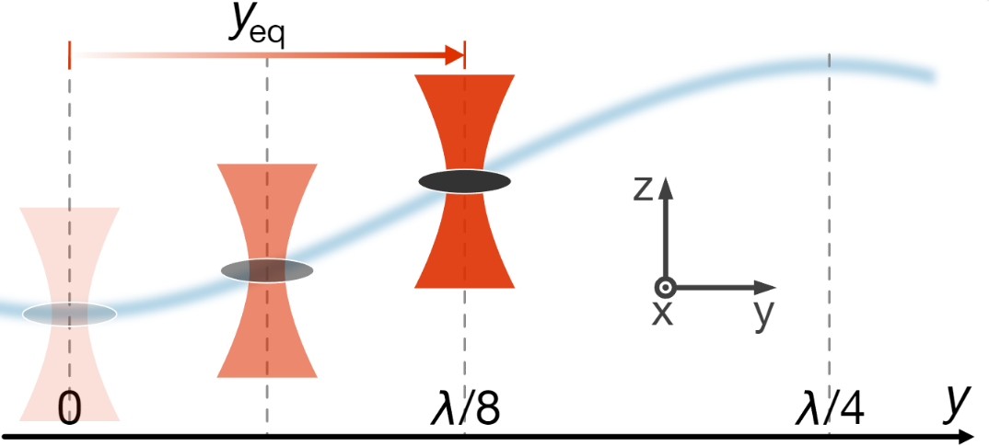
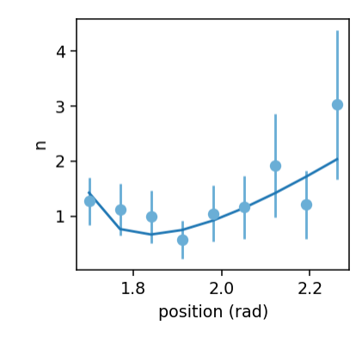
Cooling limit
High-purity states preparation via
phase noise cancellation
Notes:
We were happy to see that our cavity works well to ground state cool both com and librational motion, but we expected the libration occupation to be much smaller than that.

Slide 18
Outline
Trapping the orientation of an anisotropic particle
Cavity cooling of librational modes
Outlook

Slide 19





Another mode in the quantum regime
MEMs x_{zp}~10⁻¹⁵ m
Notes:
OK, we agree that rotations are unique to paritcles…. But what is better, rotation or COM? Better for macroscopic quantum mechanics

Slide 20







Another mode in the quantum regime
MEMs x_{zp}~10⁻¹⁵ m
Notes:
OK, we agree that rotations are unique to paritcles…. But what is better, rotation or COM? Better for macroscopic quantum mechanics

Slide 21
Ground state expansion
Notes:
OK, we agree that rotations are unique to paritcles…. But what is better, rotation or COM? Better for macroscopic quantum mechanics

Slide 22









Ground state expansion
Interference effects from free evolution
“free fall” without a drop
Notes:
OK, we agree that rotations are unique to paritcles…. But what is better, rotation or COM? Better for macroscopic quantum mechanics

Slide 23






Coupling levitated particles to ion qubit
String of
calcium ions
A Levitated
Nanoparticle
Resonance interaction
only possible with
librational modes
D.S. Bykov, L. Dania, F. Goschin, T.E. Northup
arXiv:2403.02034 (2024)

Slide 24
Conclusion
Angular mechanical motion in the quantum regime
  Measured sideband asymmetry
  Ground state cooling (n<1)
Outlook
  Minimize phase noise to reach high-purity state
  Wave function expansion via inverted potential
  Free evolution, orientation revivals
First step towards hybrid quantum
system with levitated nanoparticle
and ion qubit

Slide 25

Ground state fast expansion
MEMs x_{zp}~10⁻¹⁵ m
T. Weiss et al., PRL 127, 023601 (2021)
Notes:
OK, we agree that rotations are unique to paritcles…. But what is better, rotation or COM? Better for macroscopic quantum mechanics

Slide 26


What limit a quantum state “size”?
MEMs x_{zp}~10⁻¹⁵ m
Weiss, PRL 127, 023601 (2021)
What have been achieved so far:
Cooling via direct feedback based on optical detection
Cavity cooling
Coupling to embedded color centers
Thermal states: GS is needed for quantum operations
Asymmetric particles trapping:
Show additional angular motional modes
High frequency harmonic motion
Less prone to mechanical noise
Beneficial for ground state cooling
Torque sensing
Nanoparticles can do free fall (like atom interferometry) to expand the
state. Or even accelerate the expansion with inverted anti-confining
potentials. The point is that there is no clamping limit due to
Today: first ground state cooling of librational mode
of an optically levitated nanoparticle via cavity cooling

Slide 27

Jayadev Vijayan
Prof. Lukas Novotny’s group:
2D optoelectronics
Levitodynamics
  Metrology
  Quantum foundation
Johannes Piotrowski
Lukas Novotny

Slide 28



Laser phase noise
Phase noise
We care only about phase noise at the cavity frequency

Slide 29





Phase noise detection and feedback: our implementation
Pitaya filter response
+ ampli

Slide 30



Phase noise cancellation: in-loop and out-of-loop detection
In-loop (phase detector)
Out-of-loop (cavity detector)
Feedback: off
Feedback: on
Shot noise

Slide 31
Angular mechanical confinement with light
The position of a particle is trapped by a gradient of the light intensity, which can be created by focusing the light. However, the orientation of the particle interacts with the polarization of the light. This means that the particle senses and is affected by the vectoral nature of the light field. Besides the ability to locally sense field directions, it opens up the possibility to manipulate the orientation without affecting the COM motion

Slide 32



Anisotropic particles
What have been achieved so far:
Cooling via direct feedback based on optical detection
Cavity cooling
3) Coupling to embedded color centers
Asymmetric particles trapping:
Show additional angular motional modes
High frequency harmonic motion
Less prone to mechanical noise
Beneficial for ground state cooling
Torque sensing
Today: first ground state cooling of librational mode
of an optically levitated nanoparticle via cavity cooling
Today: first ground state cooling of librational mode
of an optically levitated nanoparticle via cavity cooling

Slide 33





Detections comparison
Cavity vs free space read-out
Cavity detection
Free-space backward detection
~n+1
~n
Free space detection can be used to calibrate against vacuum fluctuations
Detuning independent detection efficiency
  no suppression of stokes sideband anymore
  Cavity phase noise does not affect detection
  no strong rely on detuning calibration
Notes:
And let me give a proof of this, we have here two set of spectra

Slide 35



Cavity sideband cooling and thermometry
n+1
n
$\text{ω}\text{L}$ - $Ωm$
ω_{L}
$\text{ω}\text{L}$ + $Ωm$

Slide 36

Cavity vs free-space motion read-out
Sideband cooling of trapped ions
~n+1
~n
Notes:
Historically we had the cavity detection first, let me tell you why I prefer now the free space detection

Slide 37




Cavity sideband cooling and thermometry
$$Δ$$
n+1
n
$\text{ω}\text{LO}$ - $Ω$_{lib}
ω_{LO}
$\text{ω}\text{LO}$ + $Ω$_{lib}

Slide 38


Cavity sideband cooling and thermometry
$$Δ=Ωm$$

