Slide 1

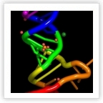
​
A tool for systematic retrieval of structural RNAs in a broad evolutionary context
- GERONIMO
​Agata Kilar, PhD
Computational Approaches to RNA Structure and Function – Benasque 2024

Slide 2
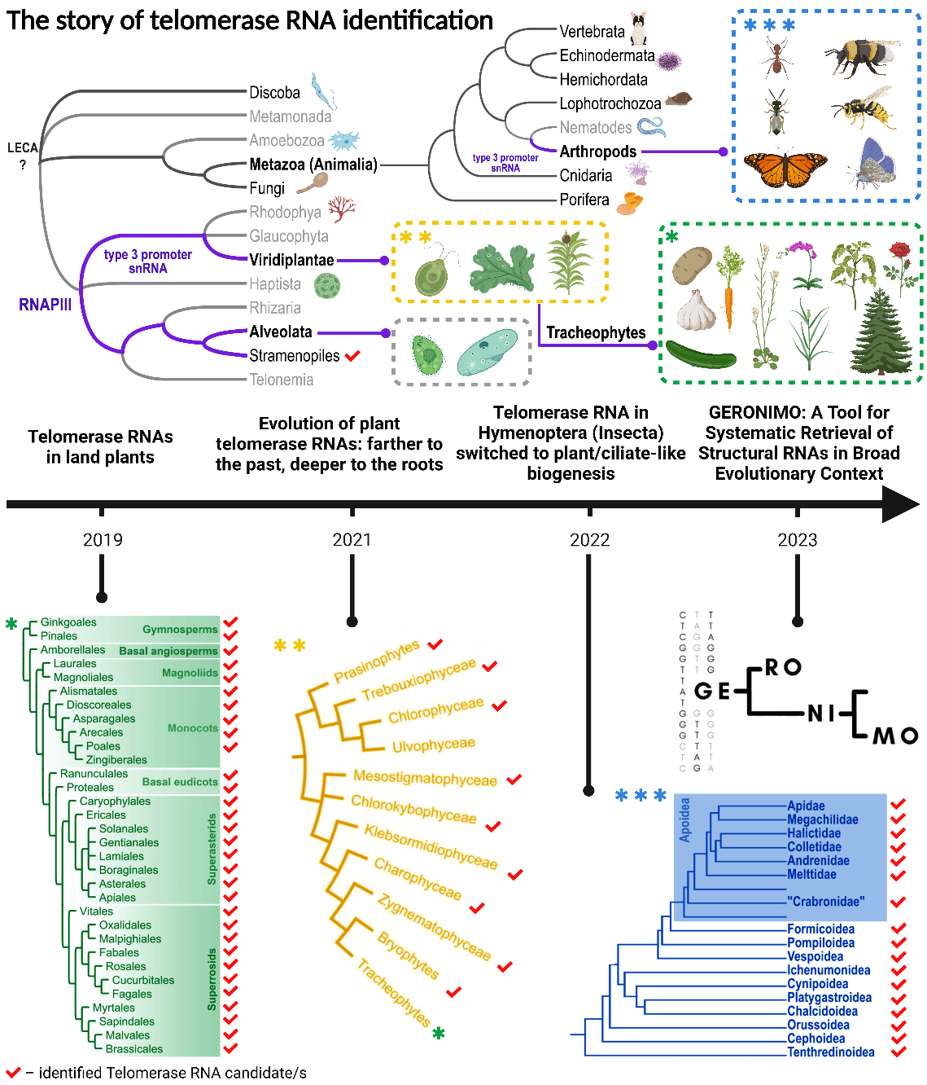
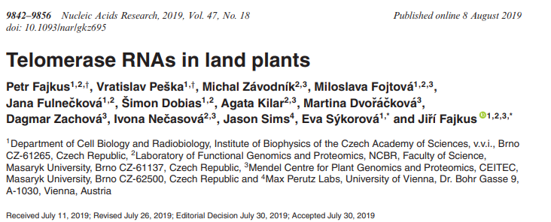
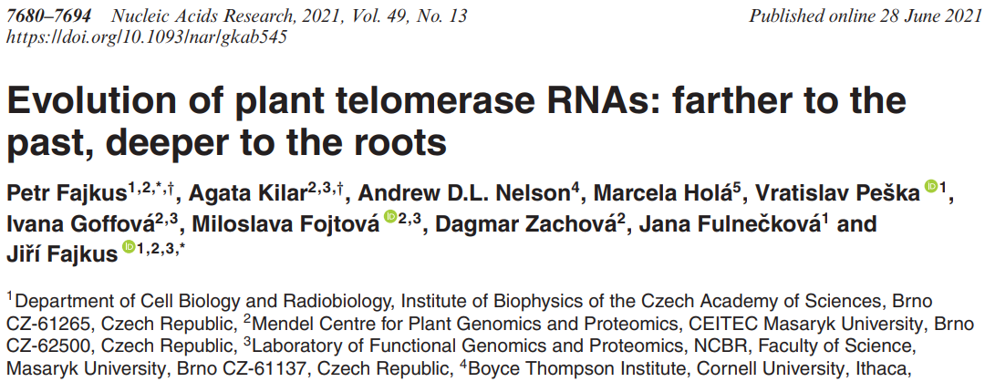
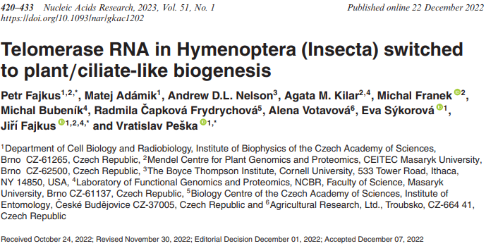
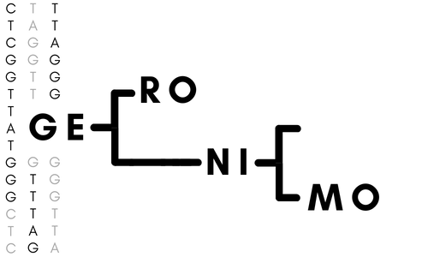
SUMMARY
Novel telomerase RNA candidates across the Viridiplantae kingdom and Arthropoda

Slide 3
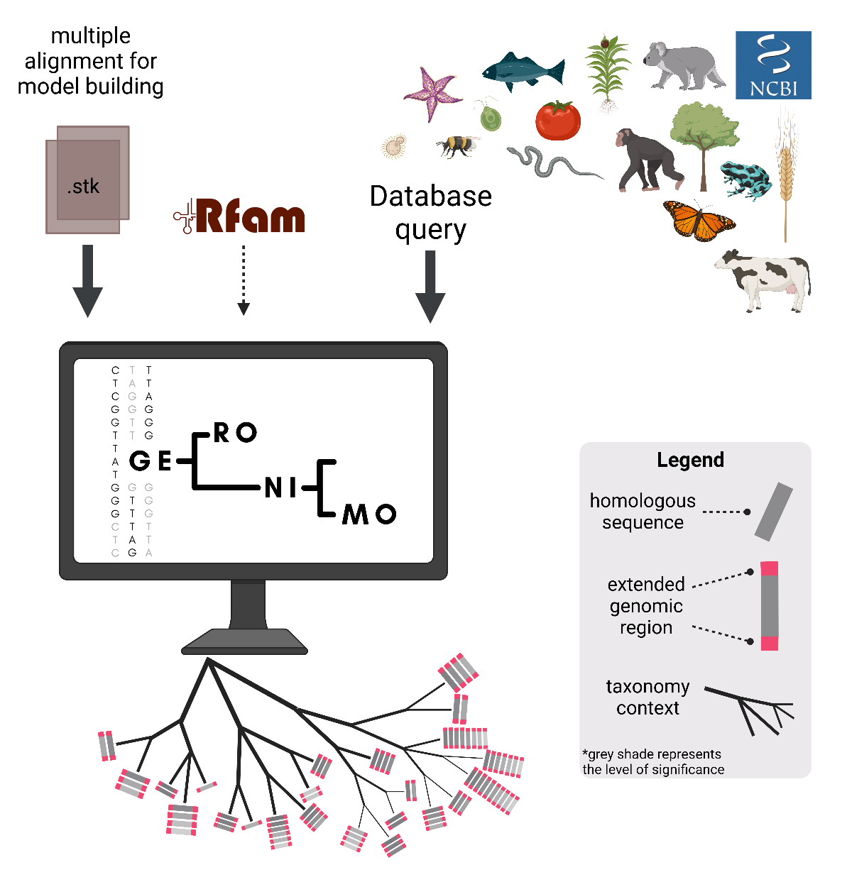
RESULTS
GERONIMO
utilizes CM from Rfam
builds CM from .stk
automatically downloads genome assemblies from database query
performs searches using Infernal - cmsearch
adds upstream/downstream flanking region
provides taxonomy context
+
config file
one command
Notes:
The use of CMs in bioinformatics methods can help in the identification of heterogeneous sequences such as TRs.
We discovered novel TRs by focusing on the transcript sequence and its promoter.
We developed GERONIMO, a tool designed to identify novel ncRNAs that allows for efficient searches across multiple genomes simultaneously.
GERONIMO provides promising candidates for novel sequences, supplemented with evolutionary context and extended genetic region.
It is a comprehensive bioinformatics tool that can provide insights into the possible homologies of different types of ncRNAs in any taxonomic group.
The tool can lead to a better understanding of evolutionary relationships, paving the way for more comprehensive and effective studies.

Slide 4
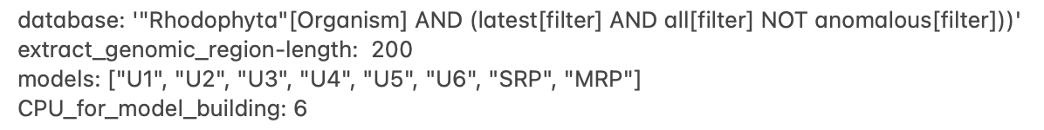
GERONIMO
config.yaml
+
snakemake -s GERONIMO.sm
--cores 8
--use-conda
results/summary_table.xlsx
Notes:
Rhodophyta – red algae

Slide 5
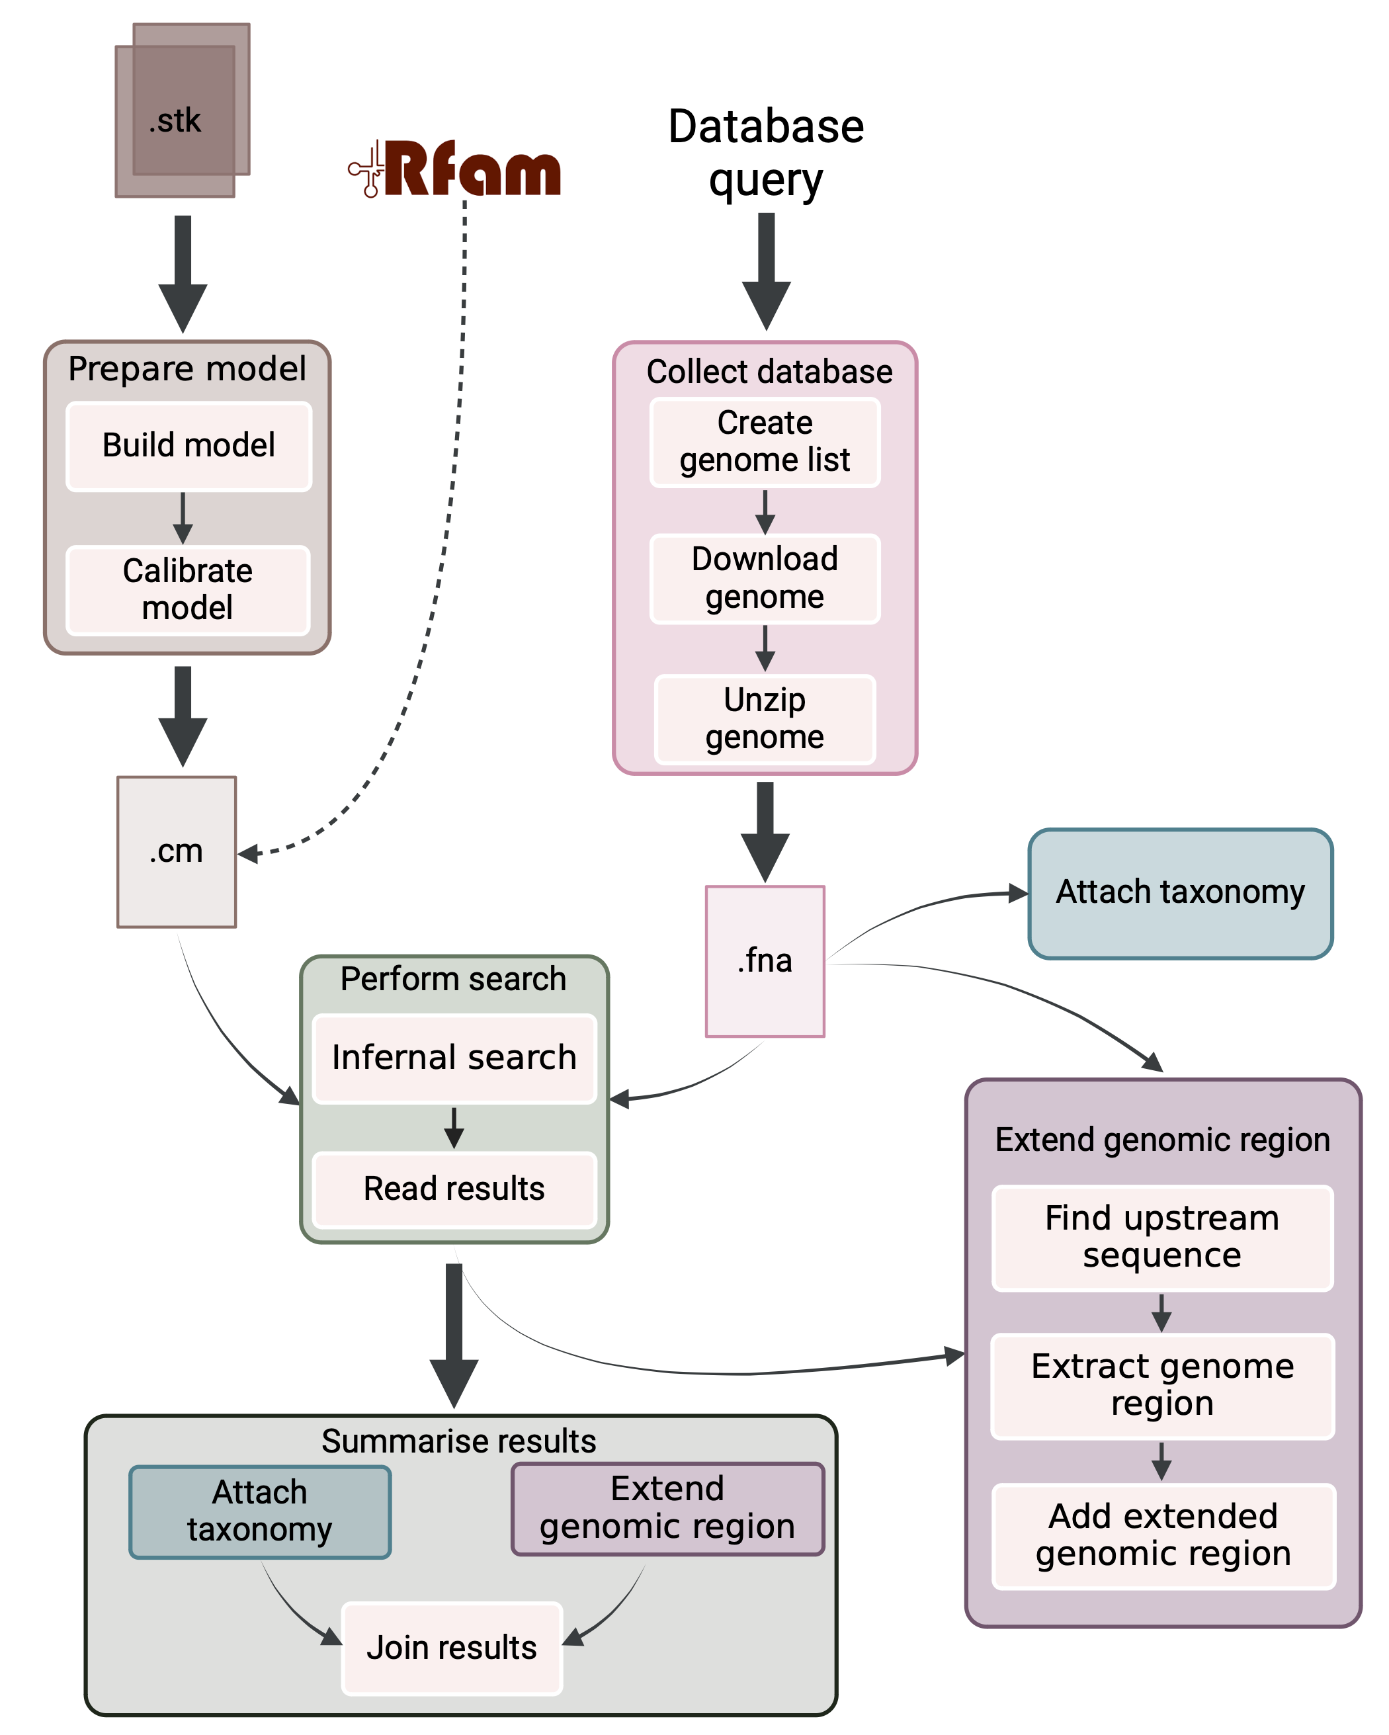
RESULTS
GERONIMO
*each module in a separate conda environment
Notes:
The use of CMs in bioinformatics methods can help in the identification of heterogeneous sequences such as TRs.
We discovered novel TRs by focusing on the transcript sequence and its promoter.
We developed GERONIMO, a tool designed to identify novel ncRNAs that allows for efficient searches across multiple genomes simultaneously.
GERONIMO provides promising candidates for novel sequences, supplemented with evolutionary context and extended genetic region.
It is a comprehensive bioinformatics tool that can provide insights into the possible homologies of different types of ncRNAs in any taxonomic group.
The tool can lead to a better understanding of evolutionary relationships, paving the way for more comprehensive and effective studies.

Slide 6
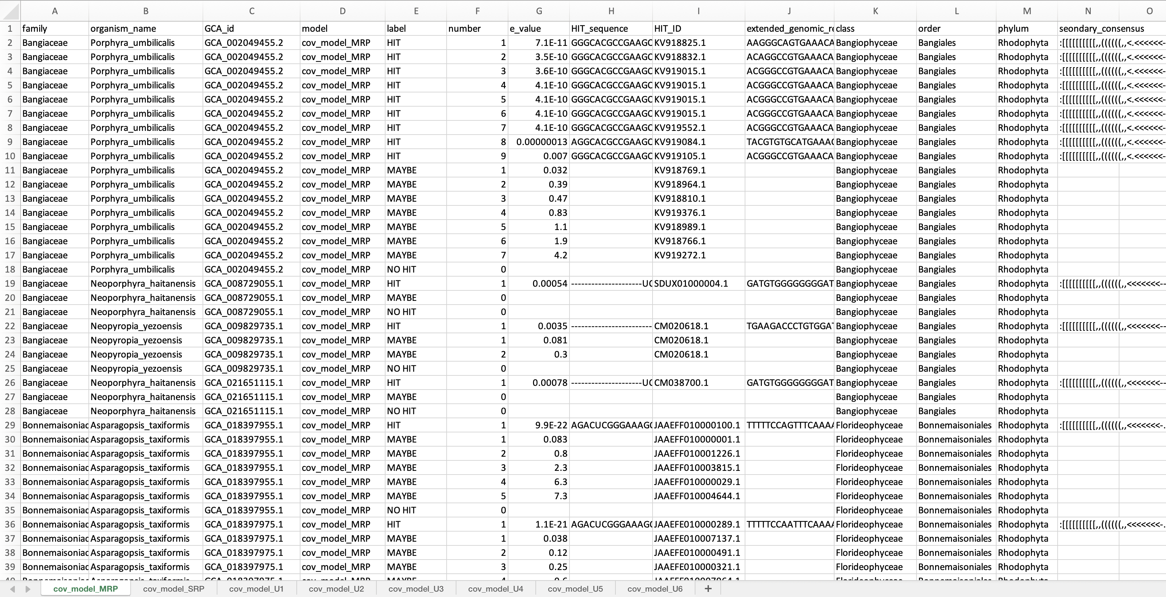
RESULTS
GERONIMO
Summary table (.xlsx)
infernal results concatenated into one table
results arranged by taxonomy
Notes:
The use of CMs in bioinformatics methods can help in the identification of heterogeneous sequences such as TRs.
We discovered novel TRs by focusing on the transcript sequence and its promoter.
We developed GERONIMO, a tool designed to identify novel ncRNAs that allows for efficient searches across multiple genomes simultaneously.
GERONIMO provides promising candidates for novel sequences, supplemented with evolutionary context and extended genetic region.
It is a comprehensive bioinformatics tool that can provide insights into the possible homologies of different types of ncRNAs in any taxonomic group.
The tool can lead to a better understanding of evolutionary relationships, paving the way for more comprehensive and effective studies.

Slide 7
Summary table (.xlsx)
family

Slide 8
Summary table (.xlsx)
organism name

Slide 9
Summary table (.xlsx)
GCA id

Slide 10
Summary table (.xlsx)
covariance model

Slide 11
Summary table (.xlsx)
label
“!” – HIT
“?” – MAYBE
NO HIT

Slide 12
Summary table (.xlsx)
hit number

Slide 13
Summary table (.xlsx)
e-value of the hit

Slide 14
Summary table (.xlsx)
hit sequence

Slide 15
Summary table (.xlsx)
contig id

Slide 16
Summary table (.xlsx)
hit with extended genomic region

Slide 17
Summary table (.xlsx)
class

Slide 18
Summary table (.xlsx)
order

Slide 19
Summary table (.xlsx)
phylum

Slide 20
Summary table (.xlsx)
secondary structure consensus

Slide 21
Summary table (.xlsx)
results separated by models

Slide 22
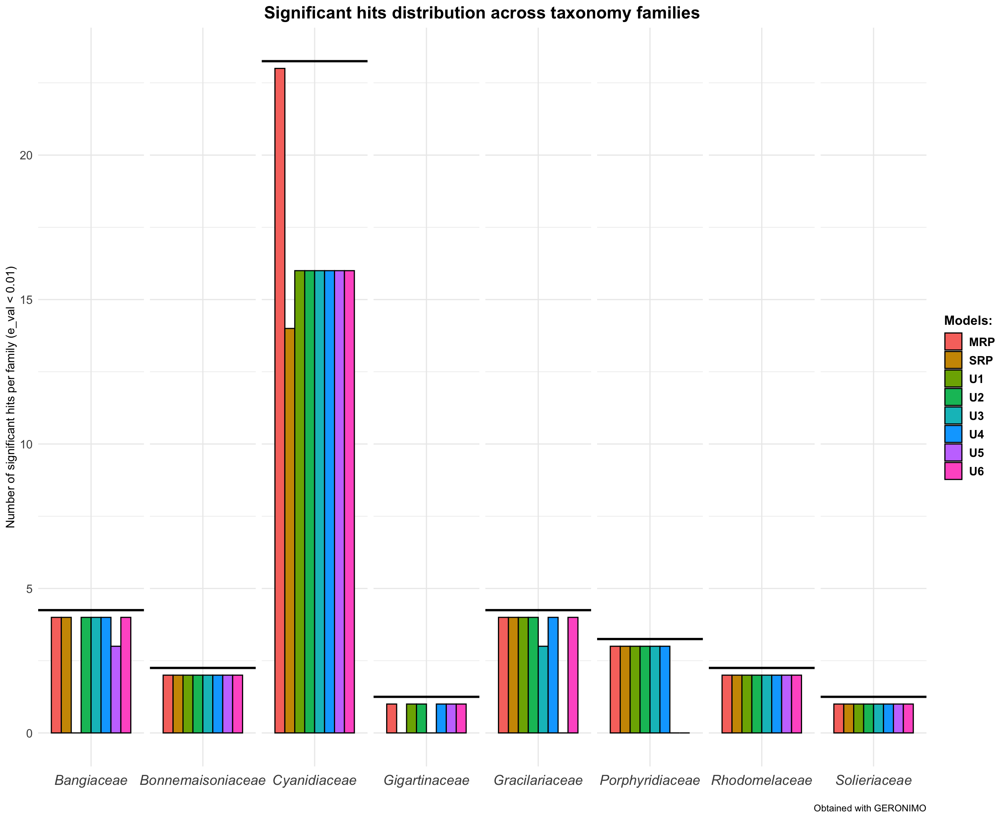
RESULTS
GERONIMO

Slide 23
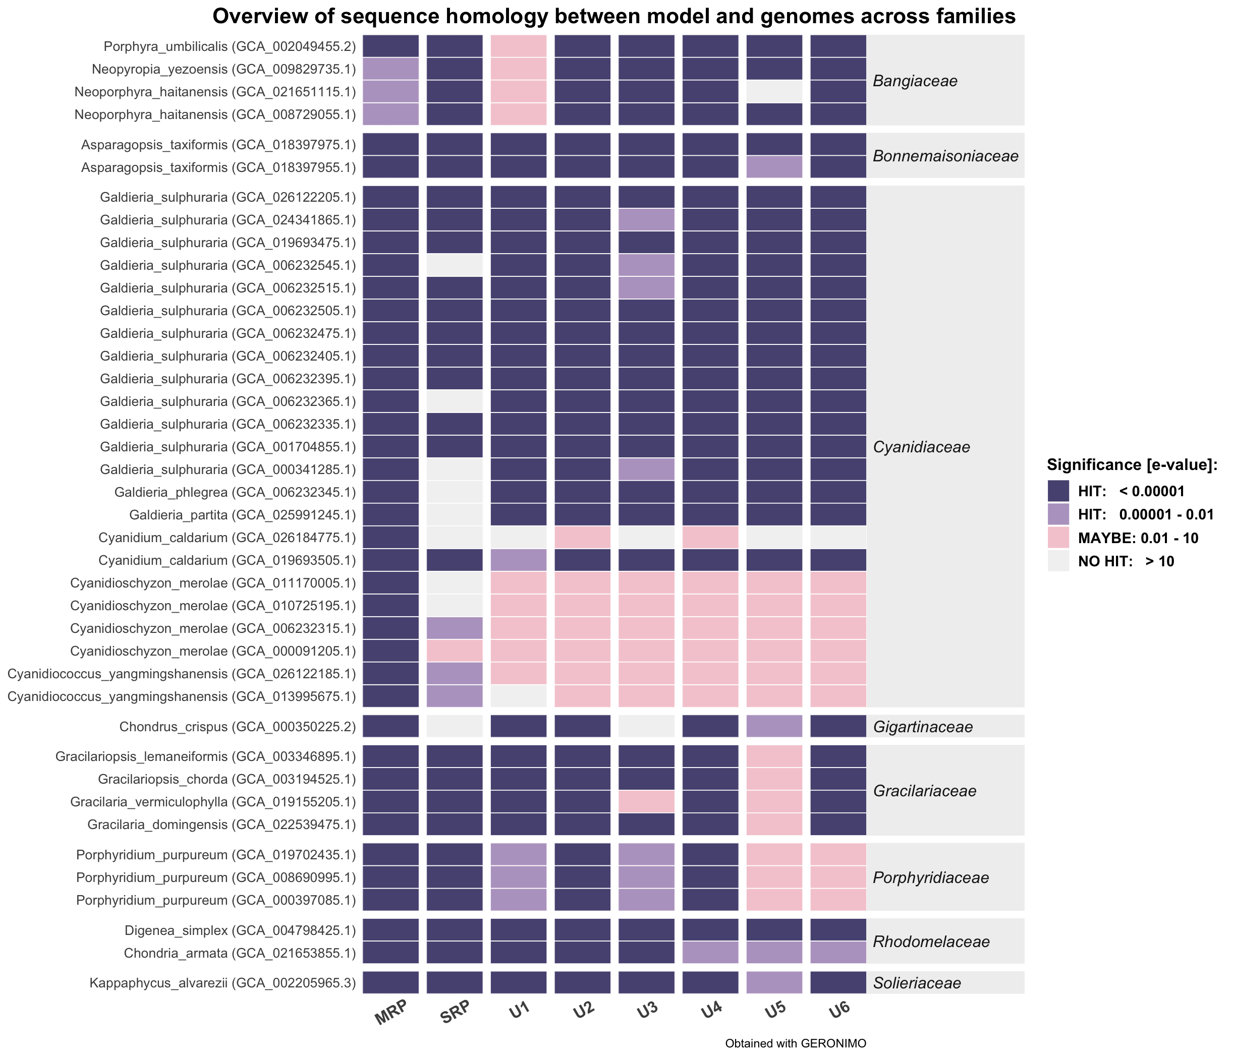
RESULTS
GERONIMO

Slide 24
Why to use GERONIMO?
SUMMARY
High-throughput capability
Integrated workflow
Automated data retrieval and preparation
Comprehensive output
Customizable and extensible
Enhanced reproducibility and documentation
GERONIMO automates and scales up the process of searching for ncRNA genes across multiple genomes, saving time and computational resources.
Notes:
1. High-Throughput Capability: Designed to handle large-scale genomic datasets efficiently. It automates and scales up the process of searching for ncRNA genes across multiple genomes, saving time and computational resources.
2. Integrated Workflow: Utilizes Snakemake for workflow management, ensuring that each step of the analysis (from downloading genomes to generating results) is reproducible and systematically organized. This integration simplifies the process, reducing the likelihood of errors and ensuring consistency.
3. Automated Data Retrieval and Preparation: Automates the retrieval of genomic data from databases like NCBI, preparation of covariance models, and configuration adjustments, facilitating a more user-friendly experience.
4. Comprehensive Output: Produces detailed summary tables, taxonomic distribution plots, and heatmaps, providing a comprehensive overview of the results. These visualizations help in better understanding and interpreting the data.
5. Customizable and Extensible: Allows users to input custom covariance models or use existing ones from databases like Rfam, and adjust configurations to tailor the analysis to specific research needs.
6. Enhanced Reproducibility and Documentation: conda environments and documentation

Slide 25
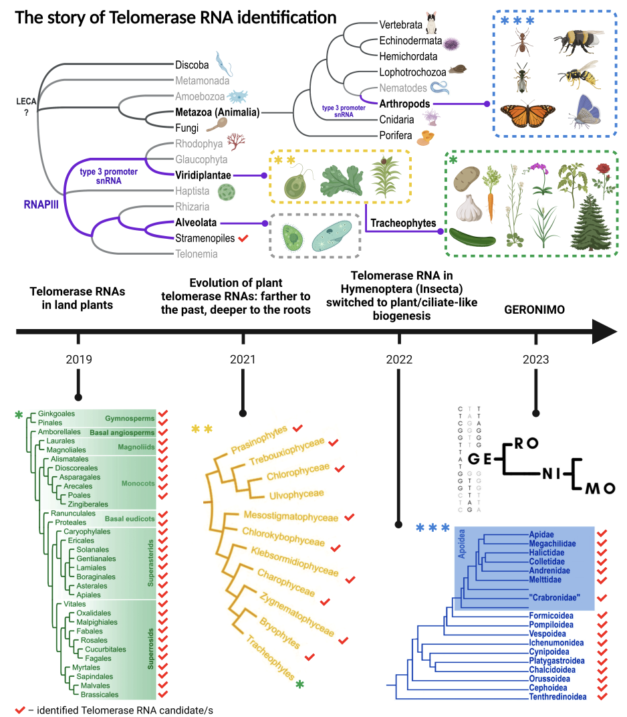






Acknowledgements
Jiří Fajkus
Thank you!
Petr Fajkus
328 novel TRs

Slide 26
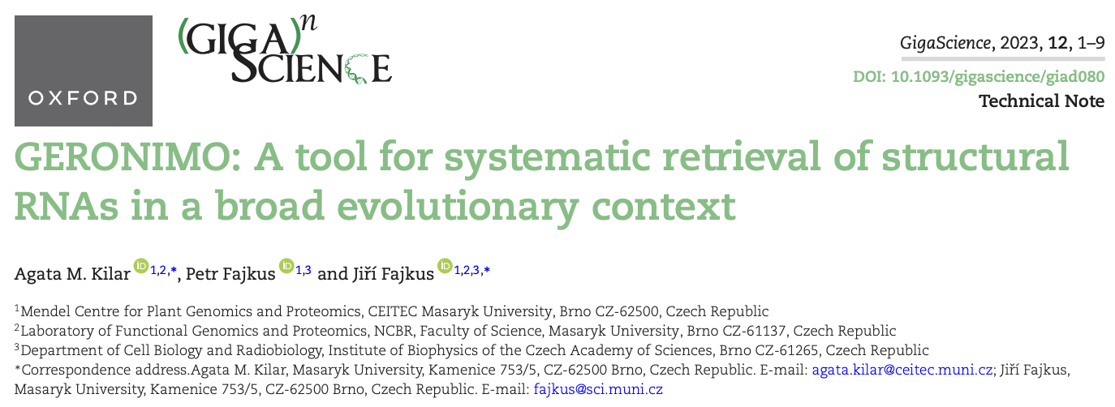








https://workflowhub.eu/workflows/547?version=1
bio.tools ID: GERONIMO
Feedback and new feature ideas welcome!
@AgataKilar
akilar@fas.harvard.edu

