Slide 1
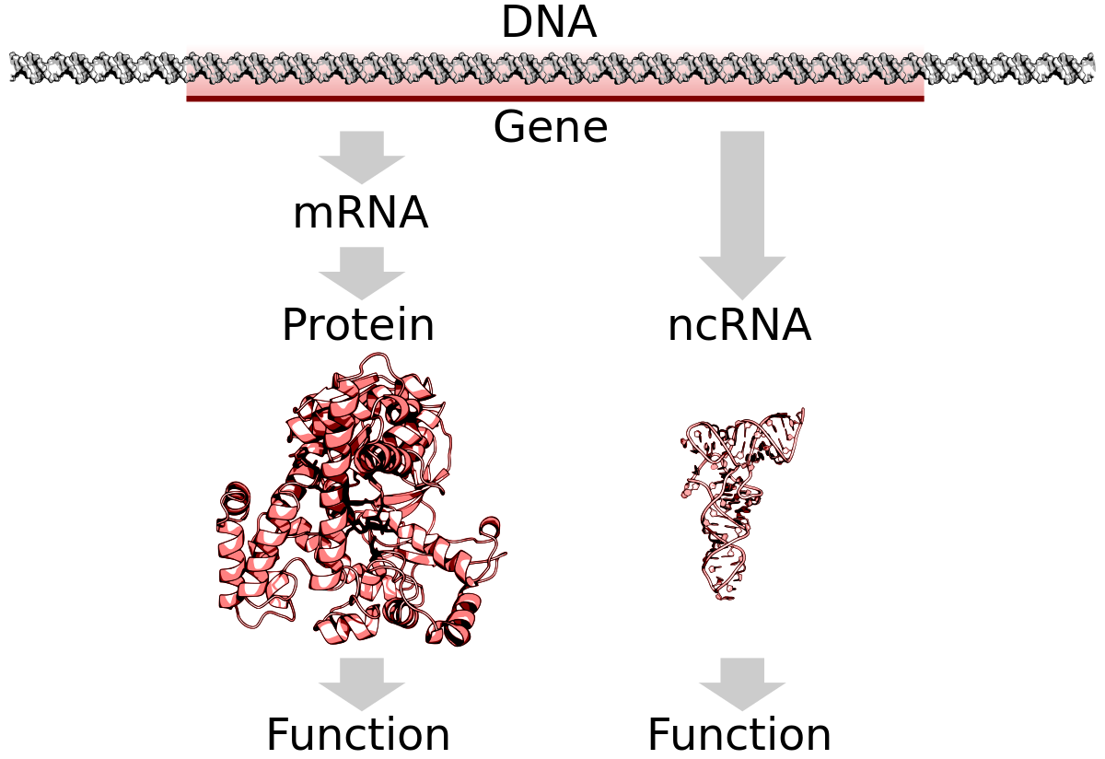
Mammalian SRA lncRNA Encodes a Protein
Serafina Nieves
Graduate Student in the Eddy Lab

Slide 2
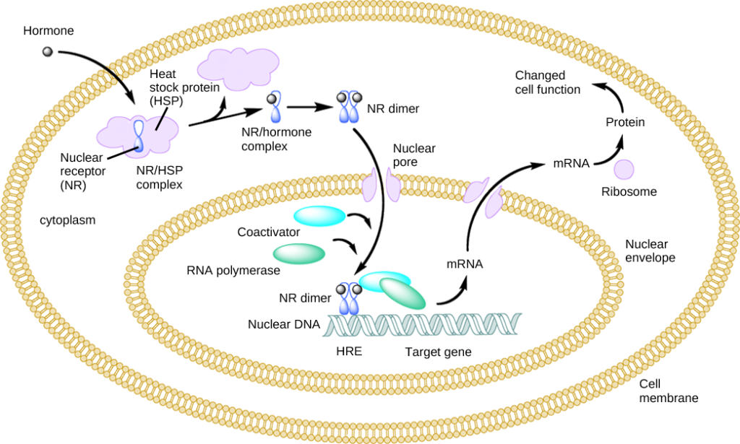
Nuclear receptors have coactivators
Ligands can pass the plasma membrane and bind nuclear receptor
Nuclear receptors change conformation and bind coregulators
Together they regulate gene expression
Wikipedia

Slide 3
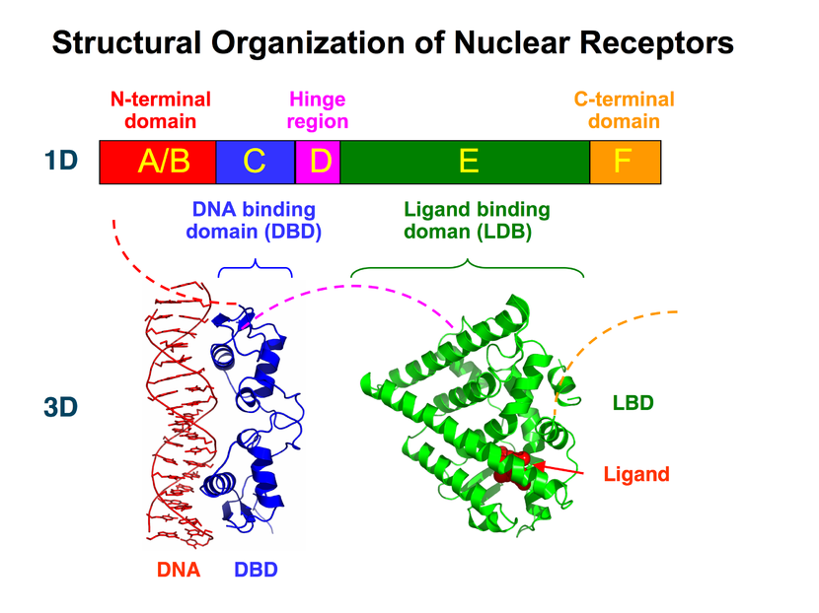
Nuclear receptors have N-terminal domains of uncertain function
AF-1 present in the poorly conserved N-terminal domain (structure not resolved)
AF-2 present in the highly conserved ligand binding domain
Binding assays to AF-2 revealed several coregulators of NRs, so maybe there are some AF-1 specific coregulators as well?
Wikipedia
Notes:
Label that this is general schematic for nr (but this one is specifically ppar)
Following the idea that there was a second activating domain

Slide 4
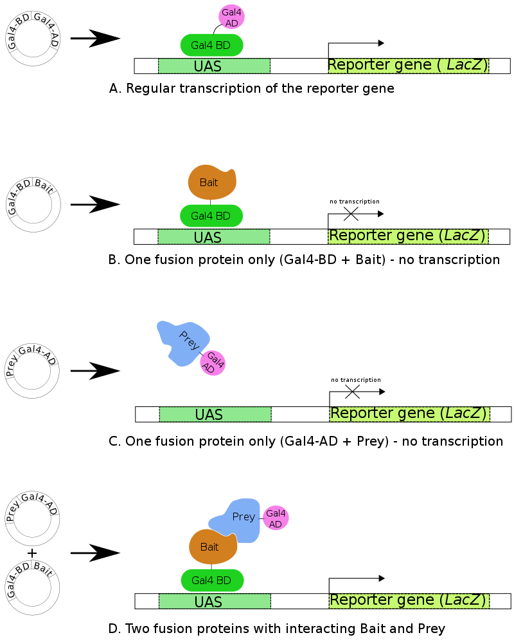
Assay for AF-1 binding
partners
Bait of your choice (in this case AF1)
Find the prey proteins that can bind bait and bring GAL4 BD and AD domains in proximity
Create the prey fusion proteins with a cDNA library from B lymphocytes, to test many proteins at once
Lanz et al. 1999 performed this assay and isolated an RNA?
Wikipedia
Notes:
Include figure about how you would find rna in this assay

Slide 5
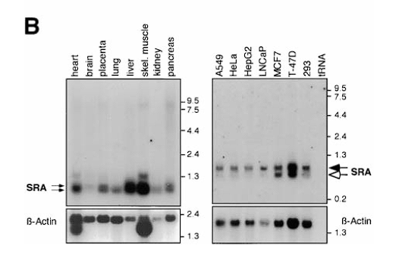
Several isoforms of SRA1 expected
Yeast 2 hybrid screen revealed an RNA that could bind to the AF1 domain of nuclear receptors
In vitro translation of SRA did not yield detectable protein products, nor could they be detected with SRA specific mAbs
Introducing stop codons did not alter ability of SRA clones to enhance PR activation
Lanz et al. 1999

Slide 6
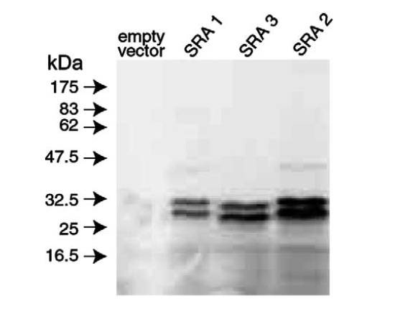
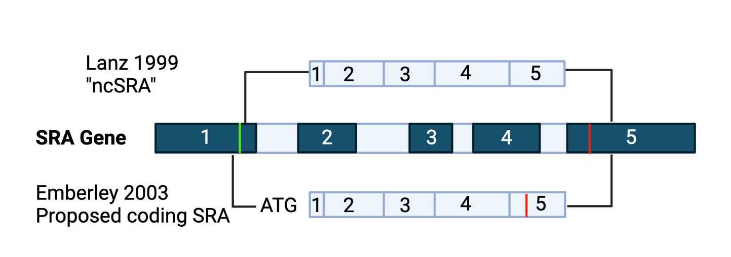
SRA1 encodes a protein
Emberley et al. 2003

Slide 7
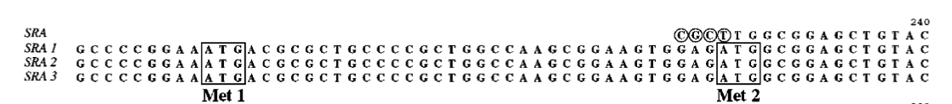
Lanz 1999 SRA sequence is a truncated mRNA
How was the 224 / 236 amino acid protein missed in the first place?
Unclipped vector sequence disguised the ATG
Start of Lanz 1999 clone
Emberley et al. 2003

Slide 8
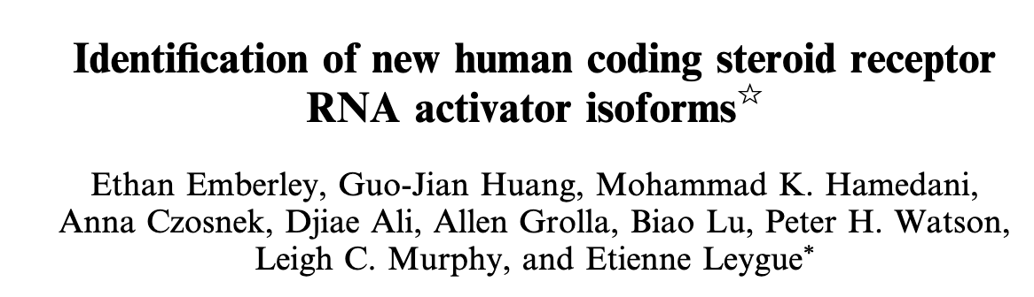
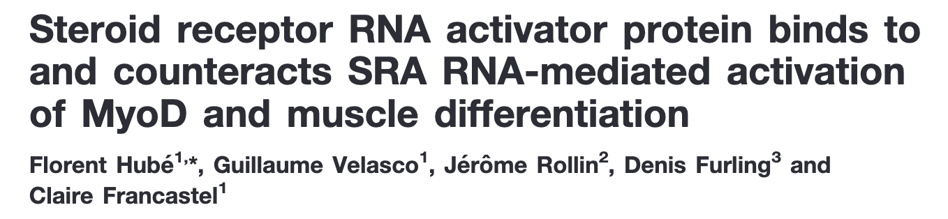
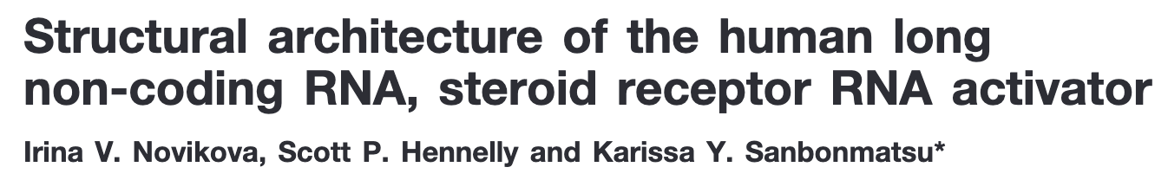
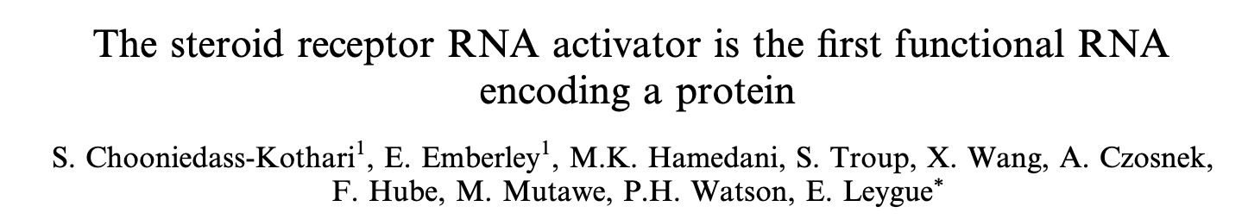
SRA considered seminal example of “dual functional” lncRNA

Slide 9



McKay et al. (Cech Lab) challenges some claims about SRA protein
SRAP localizes to the nucleus (a requirement of nuclear receptor activators)
SRAP doesn’t bind SRA in a purified system or cultured cells, at least not specifically
Knocking down SRA RNA actually enhances progesterone receptor response, but… SRA is supposed to be an activator?
McKay et al. 2014

Slide 10
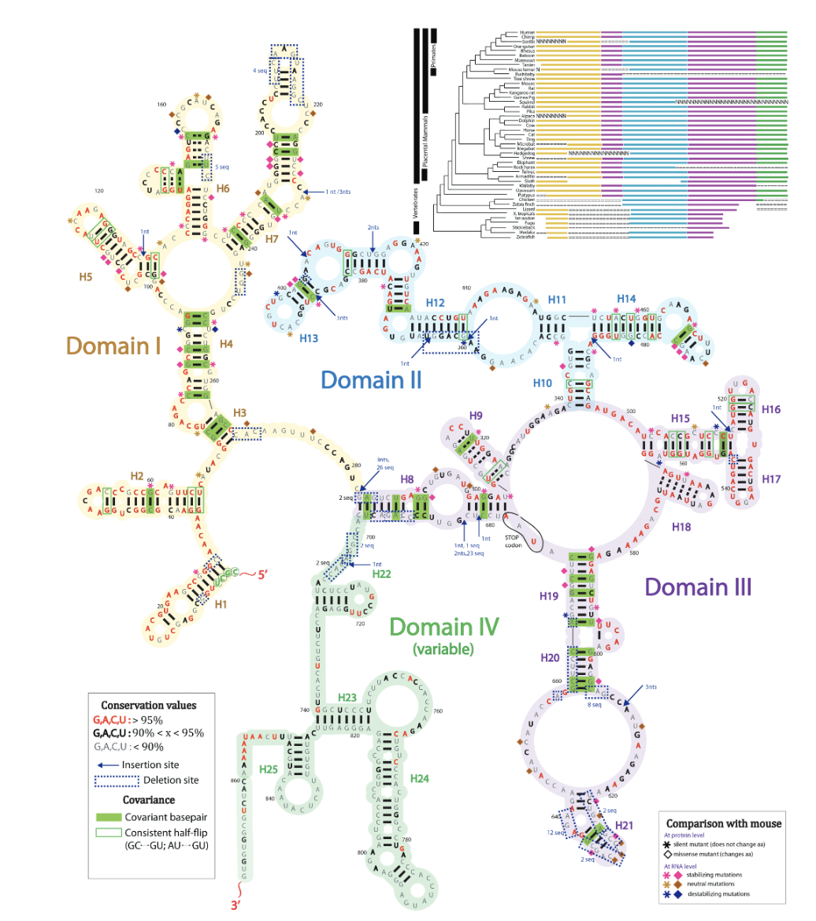
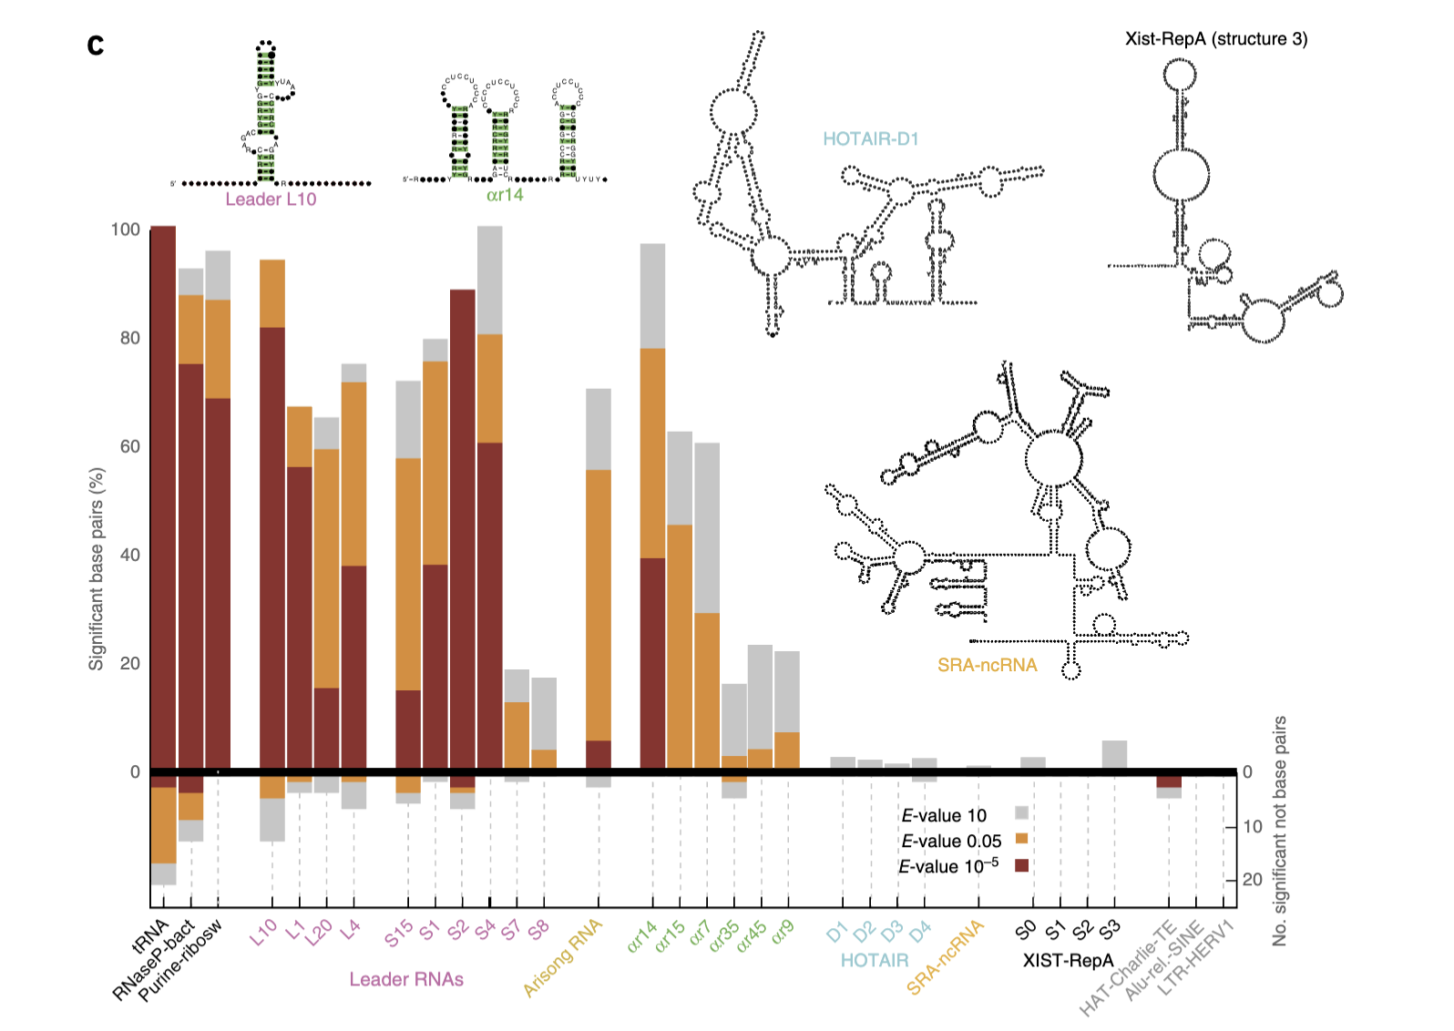
No covariation support for mRNA structure
Novikova et al. 2012
Rivas et al. 2017

Slide 11
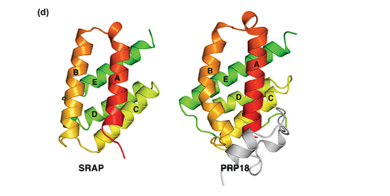
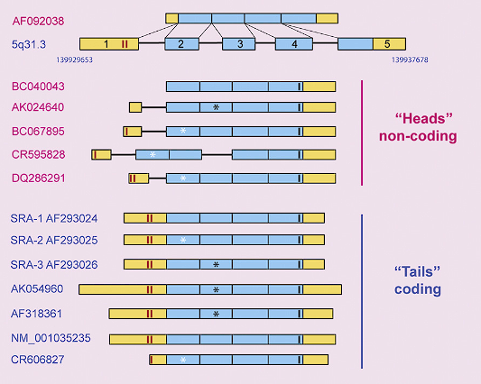
Open Questions
If SRA doesn’t coactivate progesterone receptors, then what does it do?
  McKay et al. shows structural similarity between SRAP and PRP18
  SRAP has a potential long-lost relative called PRP18, a yeast protein involved in splicing
  Sequences are dissimilar, not detected by BLAST
  HMMER reveals distant homologs
There are many proposed isoforms, but which are significant (functional)?
  There are coding and non-coding isoforms that have been cloned
  Only 3 isoforms are apparent from the Northern
  Which isoforms are actually expressed, and does the non-coding or coding isoform dominate?

Slide 12
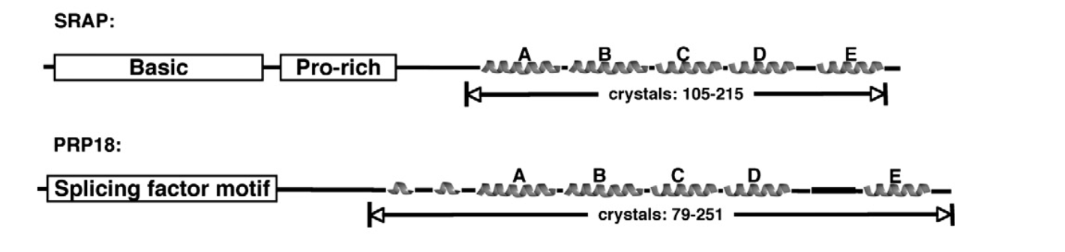
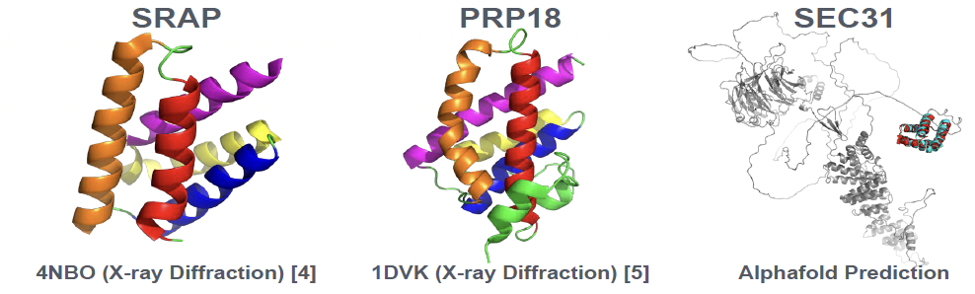
SRA protein has peculiar homologs
Identified with HMMER
SRAP forms one small domain of SEC31
PRP18 is a splicing factor component of U5
SEC31 is a component of the COPII vesicle coat
Notes:
Add 2d domain picture

Slide 13
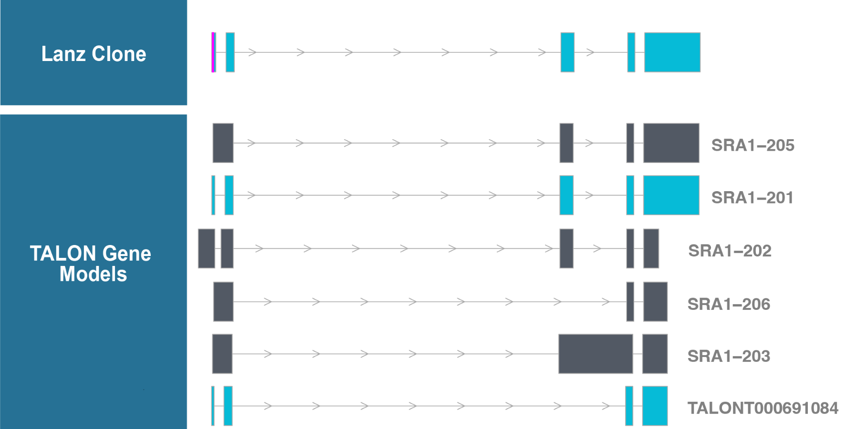
Analysis of long reads shows SRA1 has only 2 major isoforms
Lanz clone is equivalent to the coding isoform (SRA1-201), except for 4 nucleotides of unclipped vector sequence
Dominant isoforms
Used in structural analysis (Novikova)
Notes:
Add Lanz clone, swap direction, add arrows to point out the dominant isoforms, intron retention introduces a frameshift that should target the isoform for NMD

Slide 14
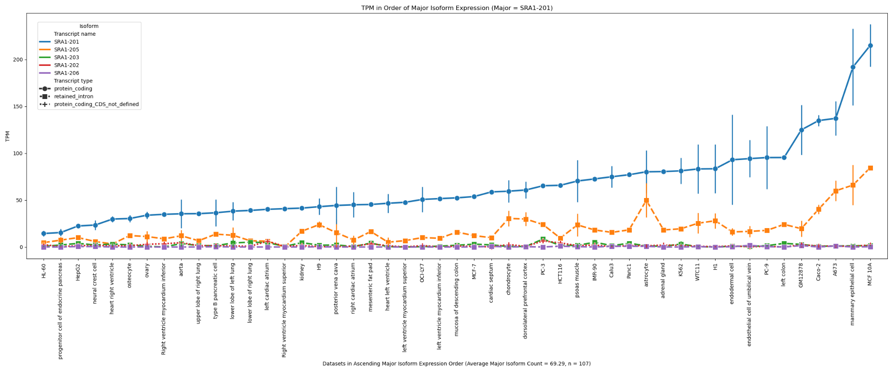
2 major isoforms, but coding always dominates
Notes:
Is lncSRA tissue specific. Major / minor isoform track in expression. ncSRA in one cell type, cSRA in others? no.

Slide 15
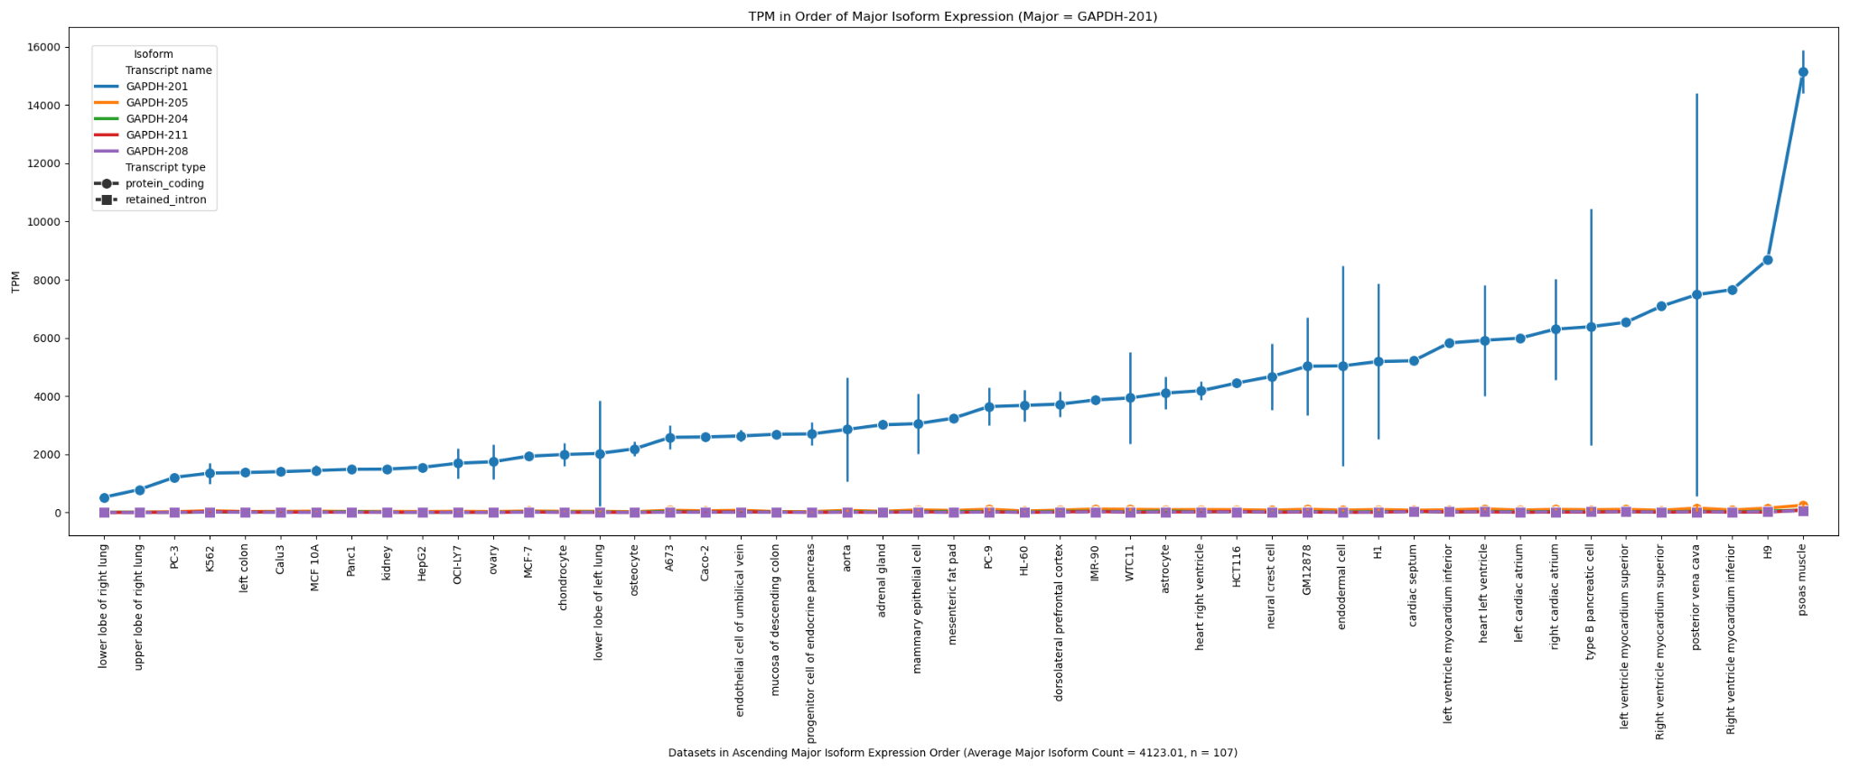
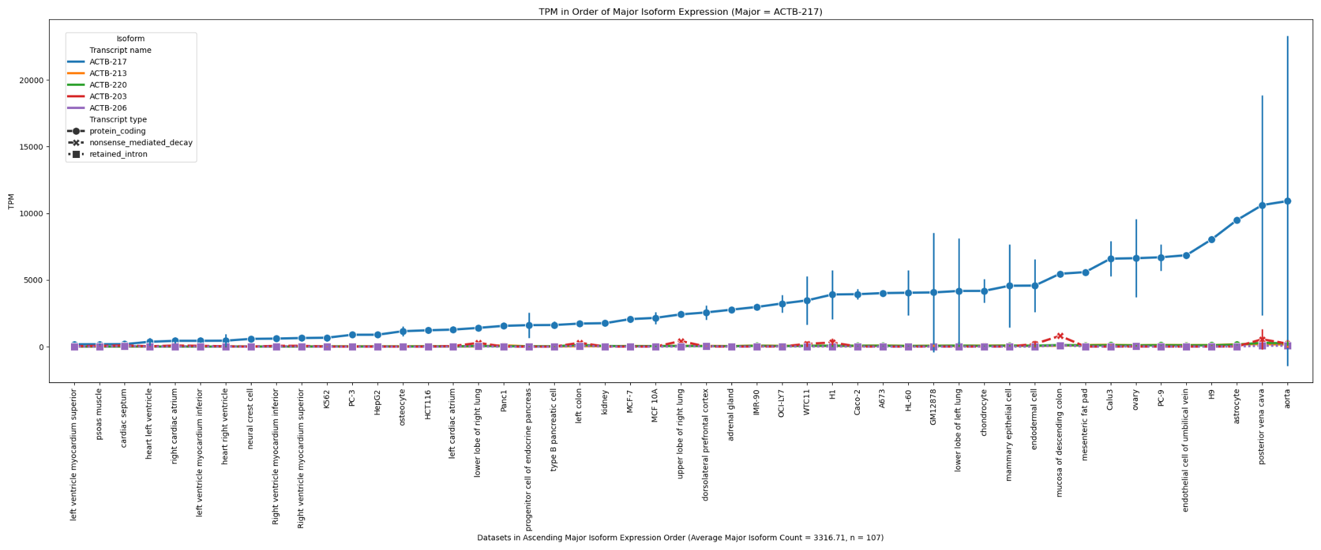
Is this level of intron retention unusual?

Slide 16
SRA lncRNA was misannotated
The Lanz 1999 clone is an unclipped vector artifact and should be considered a truncated mRNA
However, there are several experiments over the last 25 years that support the idea that SRA can function as a ncRNA
  These experiments were performed on the misannotated Lanz isoform, which was assumed to be non-coding
There IS an apparent non-coding isoform at significant abundance
  It is not tissue specific
  It tracks the expression of the coding isoform
  It has not been studied thus far

Slide 17


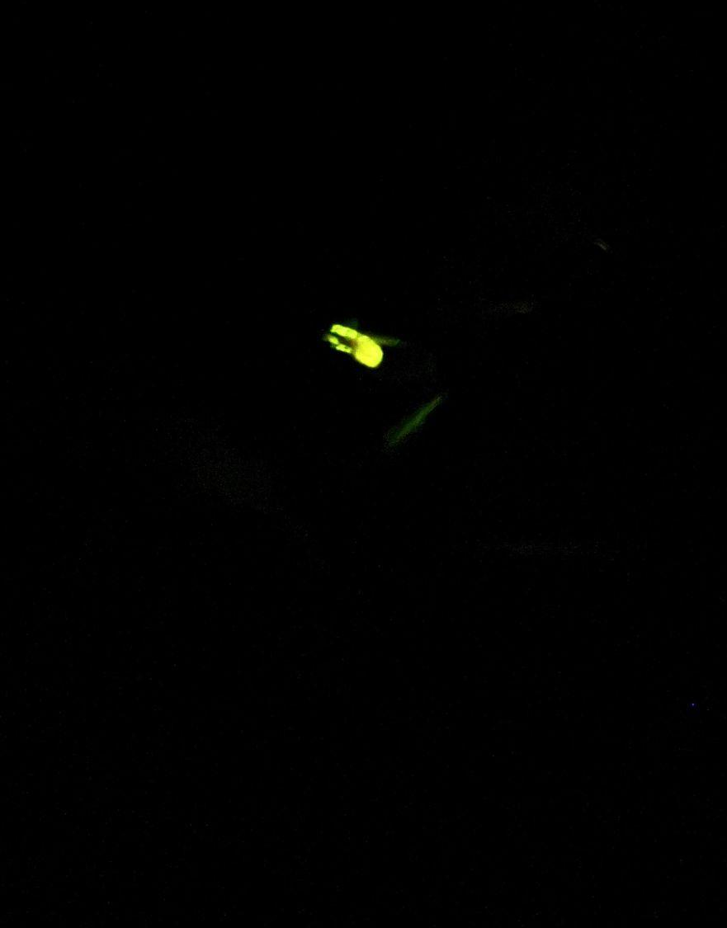
Thank you to the organizers!!!
Elena Rivas
Eric Westhof
Centro de Ciencias de Benasque Pedro Pascual
Thank you to the Eddy and Rivas Labs
Sean Eddy
Elena Rivas
Nick Carter
Tom Jones
Jenny Chen
Nick Hilgert
Kumaresh Krishnan
Liana Merk
Arpan Sarkar
Kumar Sarthak
Agata Kilar
Marcin Magnus
Marcell Szikszai
Ariane Berelowitch
Thanks to Kate Shulgina for urging me to go to this conference :D
Glow worm

