Slide 1
Sparsified Minimum Free Energy Algorithms
for RNA secondary structures
By Mateo Gray

Slide 2
Why Sparsification?
Memory is a large constraint on the size of a sequences that can be predicted
Sparsification of memory can also lead to improvements in time as it reduces the solution space the algorithm has to go through
Algorithms which can predict more complex structures can become available for larger sequences.
Notes:
So, first I want to go into why we are looking at sparsification. The more obvious point is that for algorithms, especially pseudoknotted algorithms, we largely become constrained by the amount of memory we can utilize. By reducing our memory space through sparsification, we allow ourselves to predict larger sequences. The next part is flowed into by our first point, Our sparsification of memory can lead to improvements in time. Sparsification is based on the idea that a standard matrix (2D in the algorithms we are currently looking at) contains many non-optimal values which are unnecessary to find the optimal structure at the end. Normally however, we would still have to go through these values. By constraining our solution space through the sparsification of our matrix, we can avoid going through the calculation of unnecessary values and reduce our time as well.
Lastly, every algorithm has a subset of structures which they can predict. As you become more general in the prediction of complex structures, time and space usage increases dramatically and you are often limited in sequence length. Sparsification can allow us to predict more general and more complex structures for larger sequence lengths when applied correctly.

Slide 3
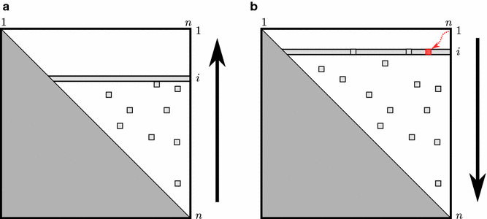
Standard 2D matrices
Triangular matrix
Space complexity of O(n²)
Will, S., Jabbari, H. Sparse RNA folding revisited: space-efficient minimum free energy structure prediction. Algorithms Mol Biol 11, 7 (2016). https://doi.org/10.1186/s13015-016-0071-y
Notes:
As mentioned briefly in the previous slide, our point of comparison is a standard 2 dimensional triangular matrix, primarily seen is pseudoknot-free and some pseudoknotted algorithms. There exists higher dimensionality data structures for more complex structures but that is not within this work currently. In these standard algorithms, we would have two main steps, shown in a) and b) above. a) represents the folding of structure and gives us the optimal energy. b) represents traceback where the corresponding optimal structure is found. As all values are gone through, all values within the white and light gray space is needed for the whole process, leading to a space complexity of O(n²) where n is the sequence length. Algorithms of this type often have multiple matrices to represent different substructure types such as a base pair, a branch, or an external loop (and many more for pseudoknotted versions).

Slide 4
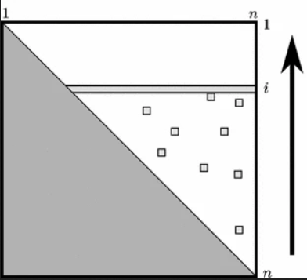
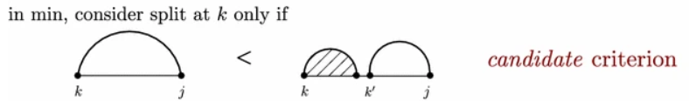
Candidates
Will, S., Jabbari, H. Sparse RNA folding revisited: space-efficient minimum free energy structure prediction. Algorithms Mol Biol 11, 7 (2016). https://doi.org/10.1186/s13015-016-0071-y
Notes:
For this reason, we reduced the number of entries in the matrix that need to be saved to find the energy using what is termed Candidates.
Candidates are substructures which are not optimally partitionable into two or more substructures. In the figure on the left, we show them by the square boxes left over after we pass the row. The criterion for determining candidates is shown on the right. Here, we show that the base pair k.j is a candidate if and only if k is the optimal pair, thus far, for j to pair to. By storing only these candidates, we can restrict the data structures to linear space and the candidates, where the number of candidates are typically much less than N^2.

Slide 5
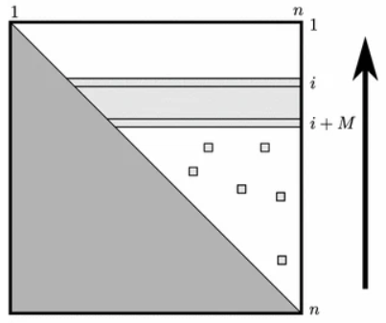
Folding
Will, S., Jabbari, H. Sparse RNA folding revisited: space-efficient minimum free energy structure prediction. Algorithms Mol Biol 11, 7 (2016). https://doi.org/10.1186/s13015-016-0071-y
Notes:
The figure above shows the energy filling process. We can see the region i to i+M highlighted. This area represents the region looked at for finding internal loops (nx31). Internal loops represent the most time-consuming portion of the prediction as the inner base pair can be any base pair within that region. By utilizing the sliding window of saved values of size M, We can forget the values not covered by the M rows and recompute the optimal energies for those regions through just candidates. This tactic is sufficient for finding the optimal energy of the folded sequence.

Slide 6
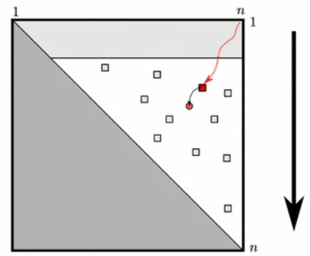
Problems during traceback
Will, S., Jabbari, H. Sparse RNA folding revisited: space-efficient minimum free energy structure prediction. Algorithms Mol Biol 11, 7 (2016). https://doi.org/10.1186/s13015-016-0071-y
Notes:
However, we run into a problem in traceback for finding the structure using just candidates. As the inner base pair of an internal loop is not always a candidate, we can lose track of entries necessary for tracing back and finding the structure. Within a simple energy model, such as base pair maximization, this would not be an issue. However, within a realistic energy model, due to the added complexity, we needed to implement another measure to avoid recomputation of the rows.

Slide 7
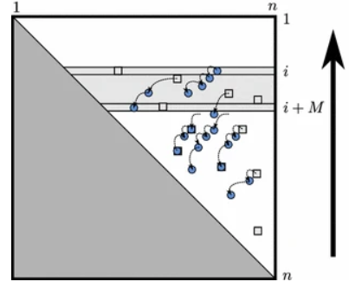
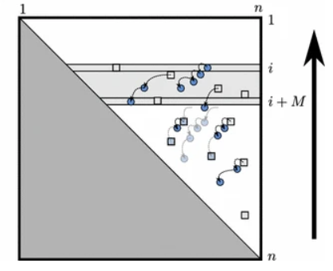
Trace arrows and garbage collection
Will, S., Jabbari, H. Sparse RNA folding revisited: space-efficient minimum free energy structure prediction. Algorithms Mol Biol 11, 7 (2016). https://doi.org/10.1186/s13015-016-0071-y
Notes:
For these cases where the inner base pair is not a candidate, we implement what are termed Trace arrows. Trace arrows are directed edges between one matrix entry and another. Within the figures above, we can see arrows pointing from the squares (candidates) to circle entries (non-candidates). These trace arrows which point to entries not saved as candidates allows for the avoidance of the recomputation of rows
To make trace arrows more efficient and to save space, several optimizations were added. Trace arrows which would point at a candidate are avoided, as candidates can be recomputed efficiently. As well, a garbage collection function is implemented to remove trace arrows which are found to be no longer accessible. As we only have partial information of the matrix while folding and during traceback, arrows, which do not point from candidates, and are not part of the MFE trace, will not be able to be found later in the trace. As such, these cases are garbage collected to save space for trace arrows, while still making the reconstruction of the structure possible later.
With these changes laid out, we move into a new problem, the combination of sparsification with dangles.

Slide 8
Summary
Sparsified pseudoknot-free structure prediction with realistic energy model
O(n+nZ) time and O(n+Z+T) space [1]
  Z is the number of candidates,
  T is the number of trace arrows,
  Z is typically much less than n²
So far with no dangle contribution!
1.Will S, Jabbari H. Sparse RNA folding revisited: space-efficient minimum free energy structure prediction. Algorithms for Molecular Biology 11 (2016) https://doi.org/10.1186/s13015-016-0071-y

Slide 9

SparseRNAFolD
Sparsified pseudoknot-free structure prediction including dangles
Runs in O(n+nZ) time and O(n+Z+T) space
Notes:
The first algorithm that we worked on utilizing this sparsification is SparseRNAFolD. SparseRNAFolD can predict pseudoknot-free structures including dangles. Dangles being something we will talk about momentarily. SparseRNAFolD also runs in O(n+nZ) time and O(n+Z+T) space where Z is the number of candidates, T is the number of trace arrows, and Z is typically much less than n².

Slide 10
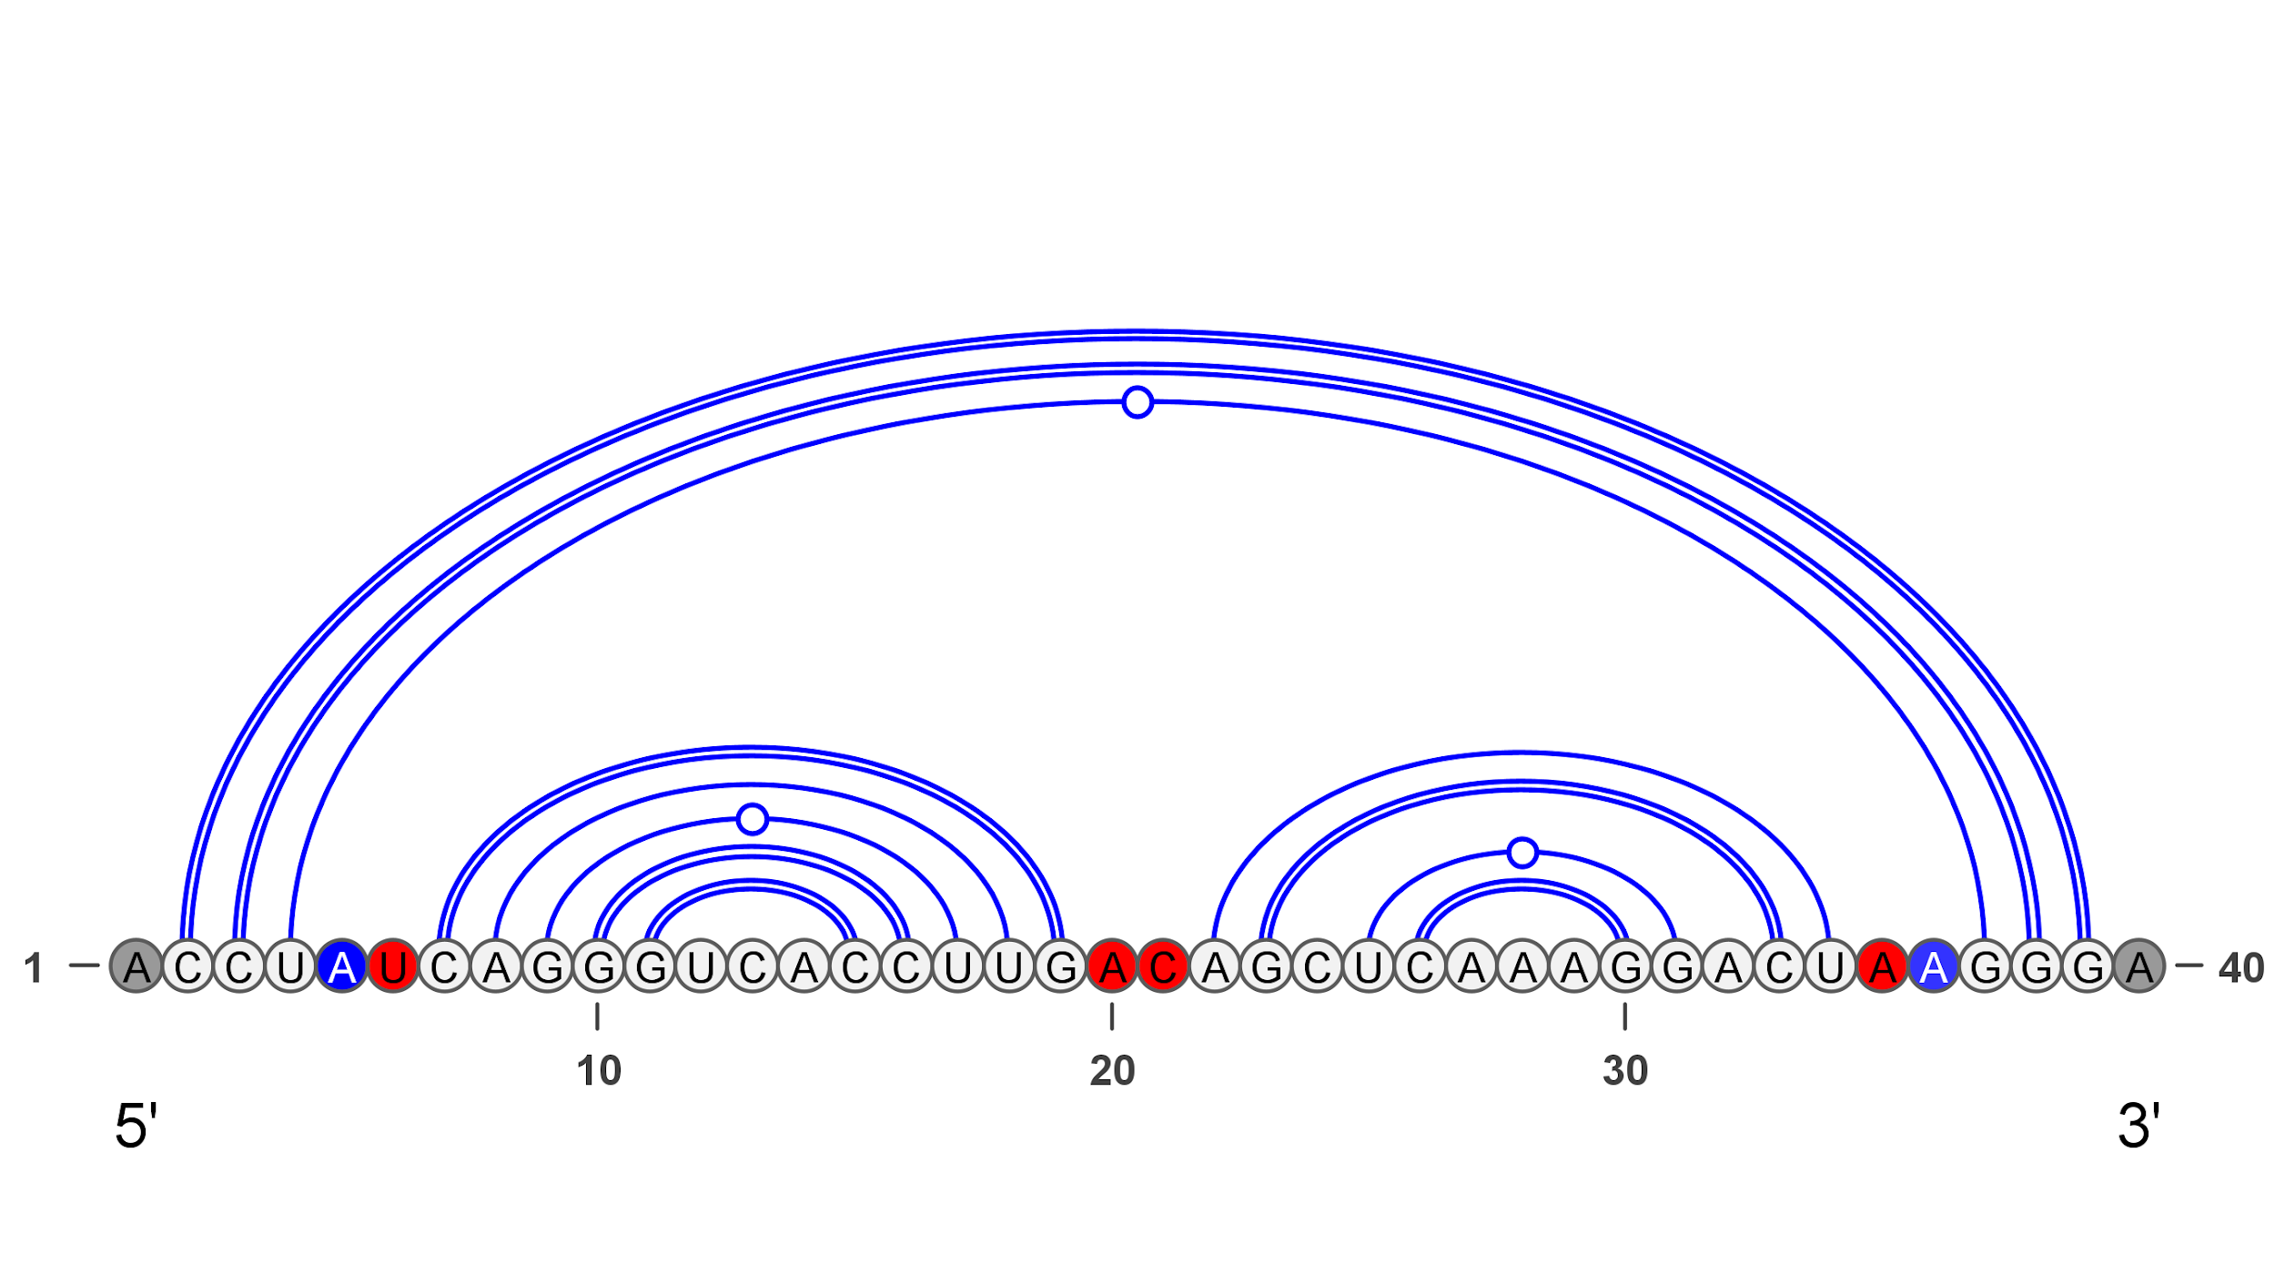


Dangles
“No Dangle”:
“Always Dangle”
Notes:
Dangle energies are a subset of energies used in finding the minimum-free energy structure – which occur at the ends of a stem-loop structure
At the time, to the best of our knowledge, dangle energies had not been implemented in any sparsified MFE-based algorithms for RNA secondary structure prediction.
The three types of dangles we focus on in pseudoknot-free prediction is external loop dangles, and dangles on the multiloop closing pair and the inner base pairs.
Dangles have three ways of being handled which we have labelled as the “No dangle” model, the “Always dangle” model, and the “exclusive dangle” model
The “no dangle” model is the simplest form of handling dangles whereby dangles are ignored. Neglecting dangle energies has been shown to lead to greater inaccuracies during prediction, and so this energy model is often avoided.
The “always dangle” model is the second version for handling dangles. It involves treating the two bases adjacent to a base pair as the dangle without respect to if they are paired or dangle elsewhere. We implement that as a dangle_53 energy which is the combination of a dangling base on the 5’ side and 3’ side. Overall, this is a simplified version of handling dangles as it avoids needing to save any extra values, and always assumes the type of dangle is 53’. While it has been shown to be better than neglecting dangles completely, ignoring factors for whether dangles can contribute leads to a less realistic energy model.

Slide 11
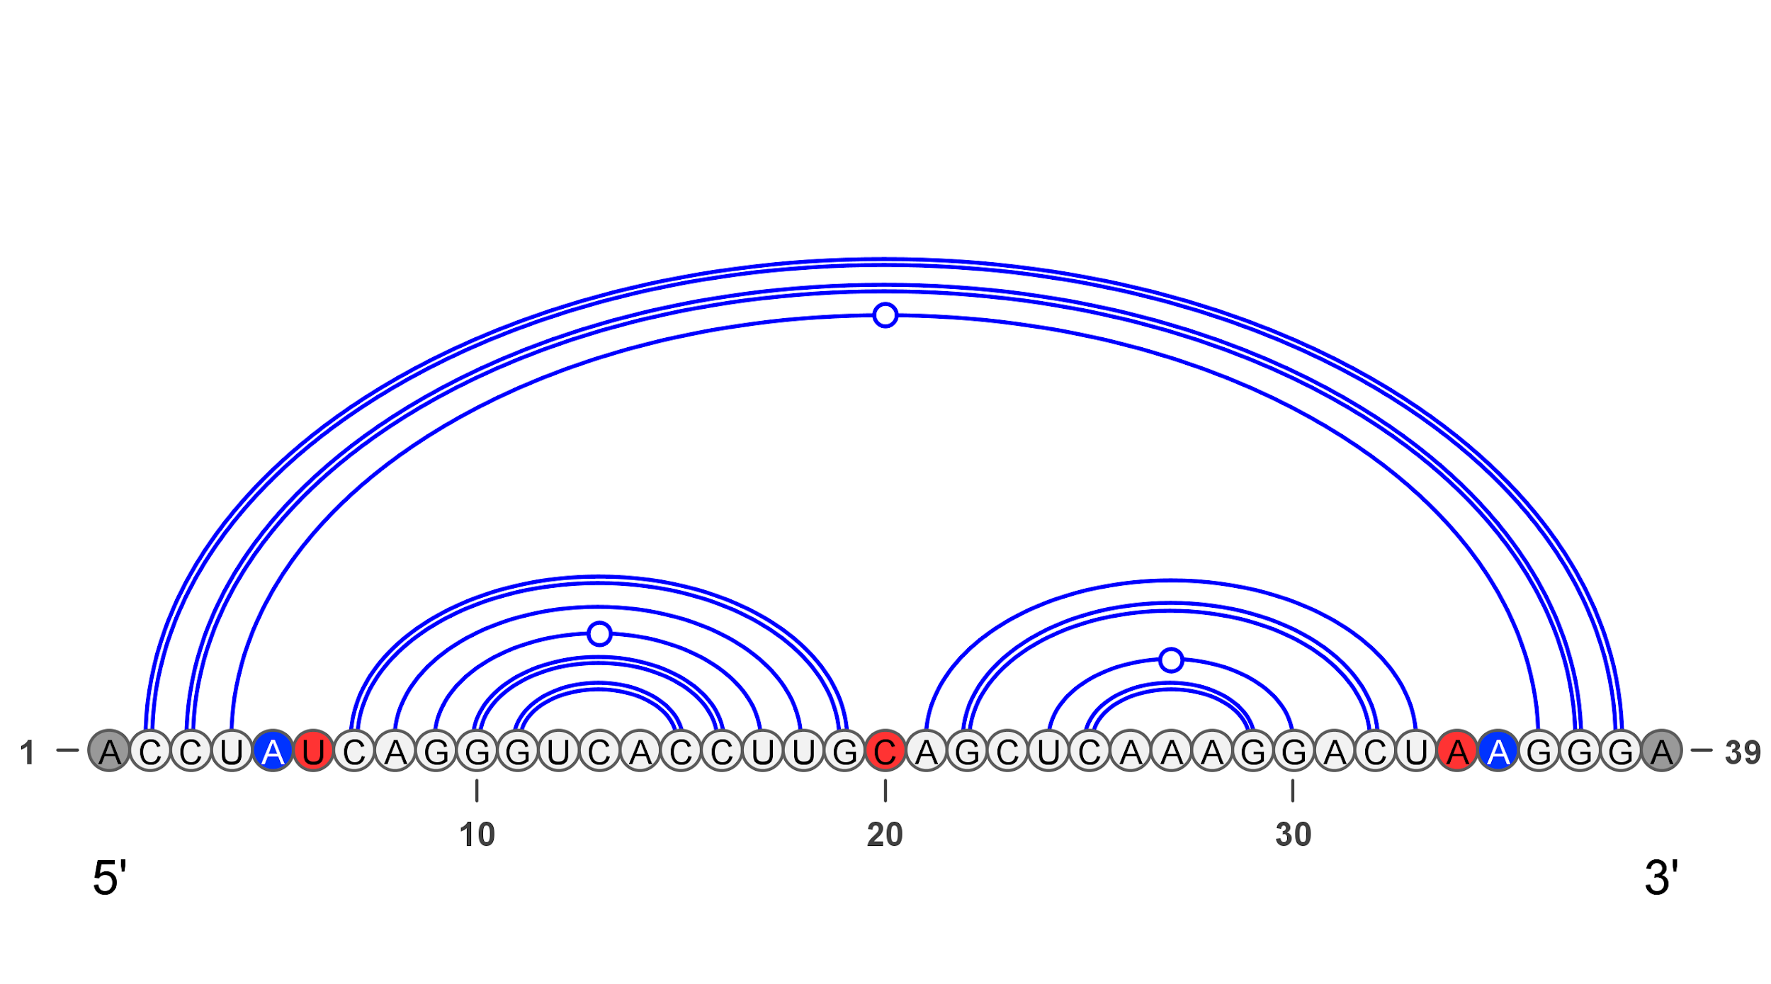
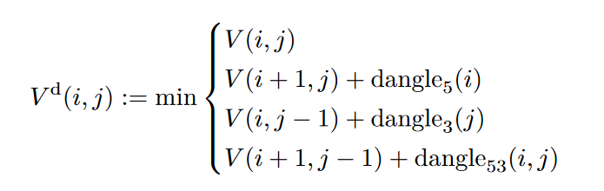
Dangles
“Exclusive Dangle”
Notes:
The last type of dangle model is “exclusive dangle”. Exclusive dangle looks at the dangles on either the left or right side or both. As paired bases cannot contribute to a dangle and two base pairs cannot have the same dangle, the energy model is more complex and requires more information to be tracked. Implementing this within a sparsified algorithm is the focus for this algorithm due to the added complexity.
Here, we have a modified version of the example before. We can see that there is now only a single base between the two inner base pair stems. Within an “Always dangle” model, we would have 5’3’ UC dangle on the left stem and a 5’3’ CA dangle on the right side. Note that base “C”s contribution will be double counted in “Always dangle” model. However, with the “Exclusive dangle” model, that is not possible. Instead, we have to keep track of which stem the base dangles off of to avoid double counting dangling bases, which leads to a higher complexity for storing information
This complexity only furthers when moving to pseudoknot dangles, the original motivation for this work

Slide 12
SparseRNAFolD
No dangles
Index
Energy
Exclusive Dangle
Index
Energy for internal loop
Energy for multiloop
Energy for external loop
Type of dangle for multiloop
Type of dangle for external loop
Notes:
For the change to handling more complex dangles, we modified the data structure of the candidates to hold the energies for a base pair as part of a multiloop and an external loop (two of the cases where dangles occur). The original stored energy is kept as the energy for the internal loop. As we need to keep the information for a base pair i.j which could be part of an interior loop, as well as the base pair which is the min {i.j, i+1.j, i.j-1, i+1.j-1} plus the dangle energies for the specific loop, separating each energy was found to be necessary. Another problem that we run into, is that while the energies for each loop is sufficient for finding the final energy, it is not sufficient for finding the structure in traceback. For this, we would require the type of dangle for both the multiloop and external loop to also be stored. In order to decrease the additional information that is needed to be stored in a candidate, we also added Bit encoding – change slide

Slide 13



Bit encoding
Encoding
Decoding
Notes:
To handle the direction of a dangle, we introduced bit encoding to the new candidate values. The motivation for bit encoding was to handle the direction while reducing the values saved in the candidates
The bit encoding involved shifting the bits for the energy by two and putting a ‘00’, ‘01’, ‘10’, or ‘11’ for no dangle, 5’ dangle, 3’ dangle and 53’ dangle, respectively
As the bit encoding does not change the size of the datatype, we were able to reduce the new candidate data structure to just the index and three energy values.

Slide 14
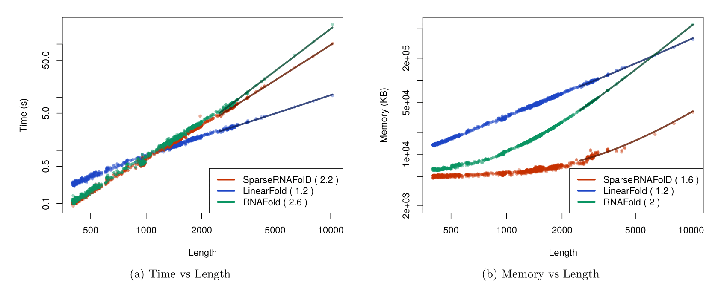
Results
Notes:
RNAFold is a non-sparsified but still very time efficient version of MFE RNA secondary structure prediction algorithm. As such we used it as a validation of correctness for our algorithm and used it as the first basis of comparison. It’s theoretical time and space complexity is O(N³) time and O(N²) space, where N is again the size of the sequence.
Another algorithm we compared against is Linearfold, a heavily sparsified heuristic RNA secondary structure prediction algorithm. It’s theoretical time and space complexity is O(Nb log(b) ) time and O(Nb), where b is the beam width. Beam width is specific value within LinearFold and is usually a constant of 100. The key differences with LinearFold is that it is not an exact model. Just like our SparseRNAFolD it does implement the more complex exclusive dangle energy model.
For context, within our plots, we use a log-log scale.
As well, within the legend, we show the empirical exponents by fitting a curve to the empirical results.
For time, we found that SparseRNAFolD had comparable time to RNAFold and a lower time than LinearFold for up to about 1000 bases. After that, the lower time complexity of LinearFold becomes visible
We found that for all sequences predicted on, with lengths up to 4381 nucleotides, that SparseRNAFolD requires 9x less memory than LinearFold and 8x less than RNAFolD. LinearFold’s base memory usage is much higher than SparseRNAFolD or RNAFolD; however, due to RNAFold’s higher complexity, it almost reaches LinearFold’s memory while SparseRNAFolD does not within the dataset

Slide 15
Summary
SparseRNAFolD [2]
3 dangle models: “No dangle”, “Always dangle” and “Exclusive dangle”
Faster than Linearfold up to 1000 length
Can it be extended to pseudoknotted RNA secondary structure prediction?
2. Gray, M., Will, S. & Jabbari, H. SparseRNAfolD: optimized sparse RNA pseudoknot-free folding with dangle consideration. Algorithms Mol Biol 19, 9 (2024). https://doi.org/10.1186/s13015-024-00256-4

Slide 16
Extension to pseudoknots – Spark (unpublished)
Utilization of sparsification within pseudoknot prediction
  with realistic energy model
Implementation of dangles within pseudoknots
  what dangle types should be considered?
Notes:
The purpose of this work is the utilization of sparsification within pseudoknot prediction, including dangles. Presently, on the work we’ve done, we have not extended dangling ends to pseudoknots and keep non-crossing structures as dangleable and crossing structures as non-dangleable. We will talk about this more later, and will start on background and then our work into pseudoknot prediction.

Slide 17
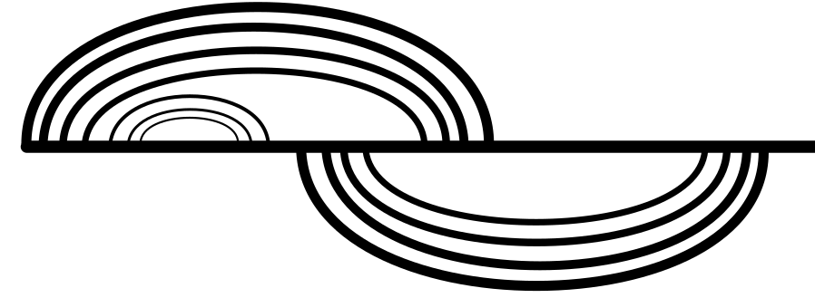
Bi-secondary structure
A Bi-secondary structure refers to a structure that can be split into two pseudoknot-free secondary structures
Notes:
A bi-secondary structure refers to a structure that can be split into two pseudoknot-free secondary structures. This set of structures is often visualized in an upper and lower plane such as the one below.

Slide 18
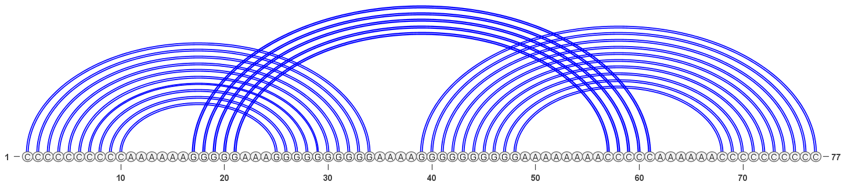
Bands
Bands refer to the chain of stacking base pairs distinguished by inner and outer base pair [i₁,i₂] U [j₁,j₂] e.g [1,10] U [25,34]
Notes:
Bands refer to the chain of stacking base pairs distinguished by inner and outer base pair [i1,i2] U [j1,j2]. In this image, we have three sets of bands: [1,10] U [25,34], [17,21] U [57,61], and [39,48] U [68,77].

Slide 19

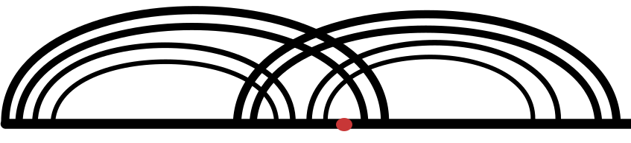
Density
Density refers to the number of bands which cross a given point k.
Density-2
Density-3
Notes:
To further look at different classes of bi-secondary structures, we define the term density to refer to the number of bands that cross a given base k, and the density of a structure to be the maximum number of bands over all k. For our program, we focus on specifically density-2 structures which are a subclass of bi-secondary structures. This includes structure types like h-type pseudoknots and kissing hairpins as well as arbitrary structures of the same class. We give two examples of structures showing density. The one on the left is a standard density-2 h-type pseudoknot. The structure is made up of two bands, and no point is crossed by more than two bands at once. On the right, we have a density-3 structure. Due to spacing of the base pairs from each other, we have four bands in this picture - two on the left and two on the right. We also find that there exists a spot, an example is shown with the red dot, where there are 3 bands crossing a point. Due to this, we would call this a density-3 structure

Slide 20
Spark
Density-2 pseudoknotted structure prediction
Based on the HFold recurrences [3]
Constraint based prediction
Runs in O(n+nZ) time and O(n+Z+T) space
3. Jabbari H, Condon A, Pop A, Zhao Y. HFold: RNA Pseudoknotted Secondary Structure Prediction Using Hierarchical Folding. In: Algorithms in Bioinformatics, pp. 323–334. Springer, Berlin, 2007. https://doi.org/10.1007/978-3-540-74126-8_30.
Notes:
From these terms, we come to our following algorithm, unpublished at the moment, Spark. Spark is a density-2 possibly-pseudoknotted structure prediction algorithm. Generally, we take an input structure as a constraint for the final structure. These input structures are the basis from which the pseudoknots form in the final structure. This is based off of the hypothesis of hierarchical folding in RNA. That is, that non-crossing pseudoknot-free structures form first and then crossing or pseudoknotted base pairs form sequentially afterwards. Taking into account that an input structure is not always available, if no input structure is given, we also generate an energy efficient stem to work off of. To be specific, we find the most energy efficient stem within the sequence, whose number of base pairs is greater than 3.
Similar to SparseRNAFolD, Spark is O(n+nZ) in time and O(n+Z+T) in space where Z is the number of candidates and T is the number of trace arrows. While there are more candidate structures to take into account, this would be seen as only a constant multiplied by Z.

Slide 21
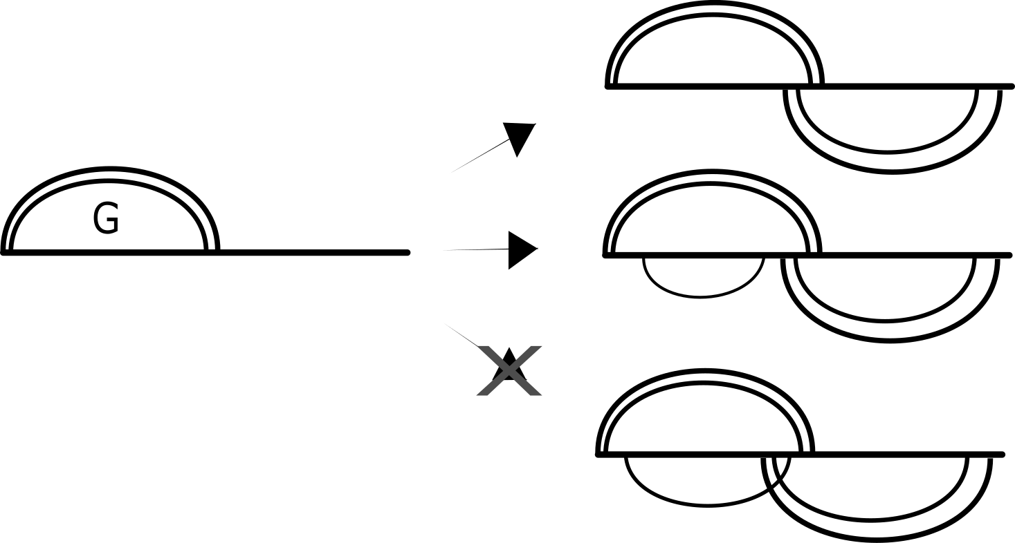
Constraint-based pseudoknot prediction
Spark takes an pseudoknot-free input structure G and returns G∪G’, where G’ is another pseudoknot-free structure, and the result of G∪G’ is MFE_{G}
Notes:
As mentioned previously, Spark is a constraint-based pseudoknot prediction algorithm. What this means is that Spark takes an input or constraint structure G. From G, we find another pseudoknot-free structure G’ such that GuG’ creates the MFE structure given G. In the figure above, we show how base pairs can be added to find the final structure. In the 3rd case, despite the fact that these base pairs could be combined and form into a density 2 structure. G’, the section we are adding to G would be pseudoknotted which is not possible for us. As can be expected, for constraint-based prediction, the input structure takes a large role in the accuracy of the final structure. For cases where partial information is known, this is great as the partial information contributes to the final structure. However, as good partial information is not always known, we also have an iterative version of Spark similar to Iterative-HFold. This iterative-ness allows for changing of the input structure so that input structure is not the limitation or at least as much of one.

Slide 22
Increased number of recurrences
Each recurrence required a triangular matrix or a full square matrix
Each of these recurrences had to be sparsified
Notes:
For Spark, we model the recurrences after the HFold recurrences for pseudoknots from Jabbari 2007. Each of these recurrences required a triangular matrix to store the relevant energies. Auxiliary matrices were full square matrices and contained information about the bands within G. Within Spark, we are sparsifying each recurrence and relevant data structure. For the energy matrices, this meant changing the triangle matrices into one dimensional arrays and candidates. For the auxiliary matrices, we defined a data structure which requires nlog(n) space and can compute information relevant to the bands in G in constant time.

Slide 23
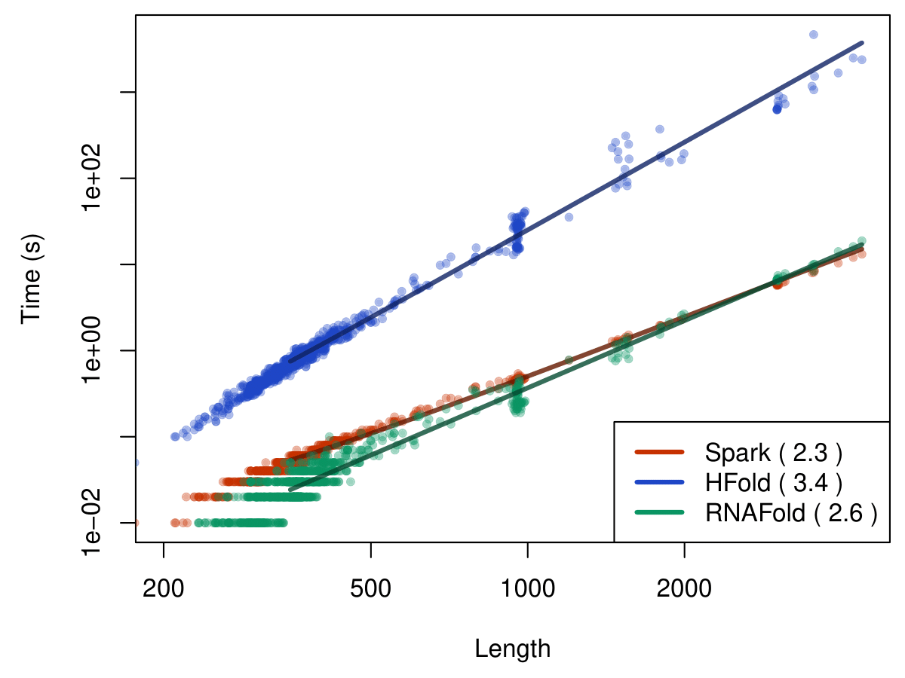
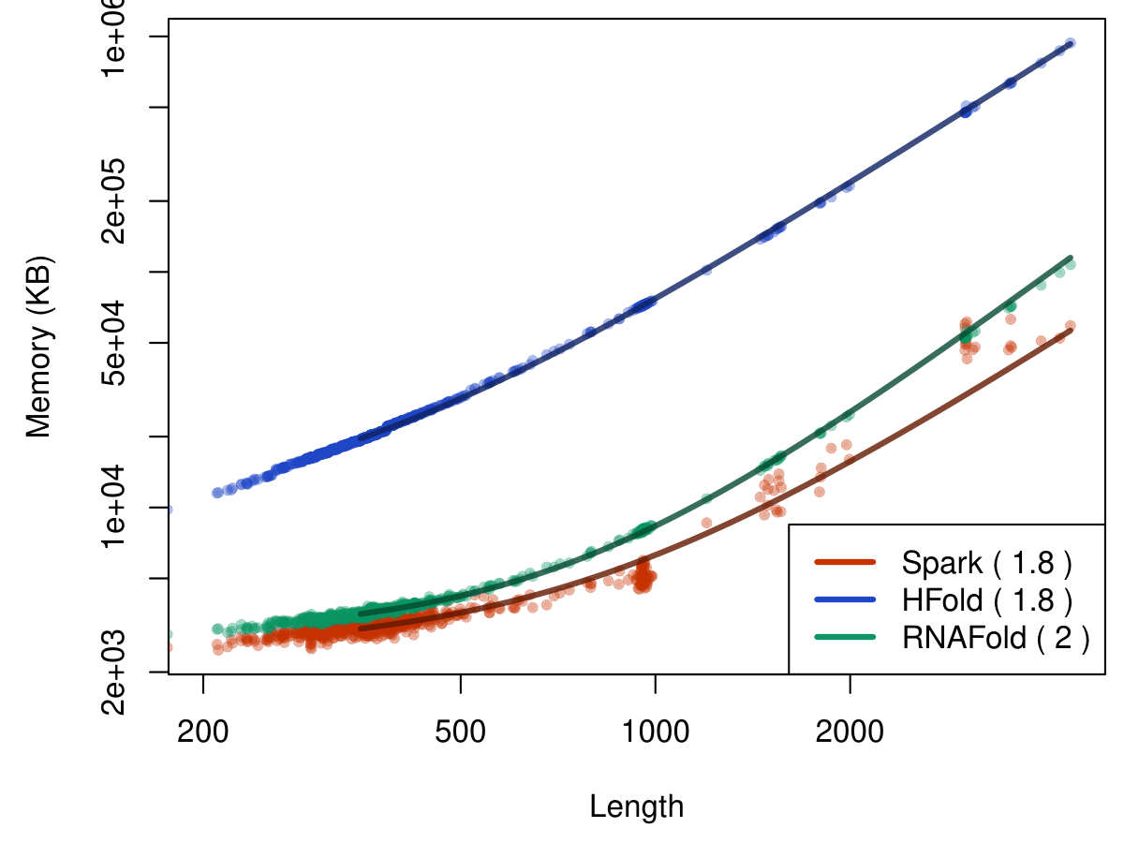
Results
Notes:
Presently, we’ve run Spark against two state of the art algorithms: RNAFold and HFold. RNAfold is a pseudoknot-free algorithm which is used to show how we’ve made a pseudoknotted algorithm whose time and space is minimally different up to 4000 and actually starts to become faster still around the 4000 mark. We’ve also shown HFold. HFold is limited to only 5000 length, and, in larger sequences, more than 100x slower than Spark, while covering the same subset of pseudoknots. We’ve also run Spark on larger sequences, namely SARS-COV-2 as its 30,000 length provides a good goal. Utilizing an input structure obtained by combining conserved regions found by a member of our lab, we ran Spark on this input structure, and got an output in only 19 mins and 1.5 GB of memory.

Slide 24
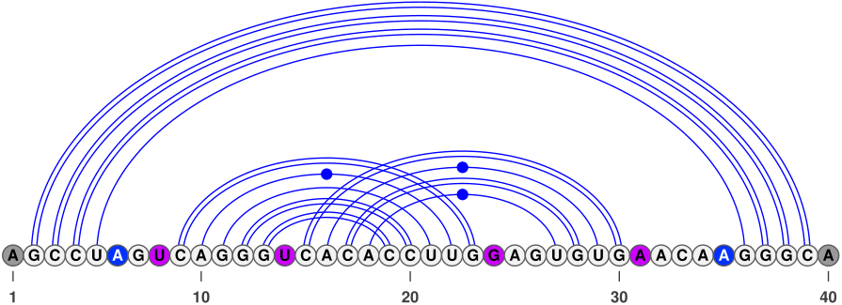
How to view dangling ends in pseudoknots?
Notes:
We represent above a pseudoknotted structure, specifically a multiloop containing a pseudoknot, and bring up the question of how should the dangles within this pseudoknot be characterized. Is it the case that we should only look at the outer bases for the whole base pair, namely U-8 and A-31, should we look at each stem within the pseudoknot, U-8 and G-24 and then U-14 and A-31. Any thoughts on this is appreciated, thank you.

Slide 25
Thank you
Mateo Gray
mateo2@ualberta.ca
University of Alberta
COBRA Lab
SparseRNAFolD

Slide 26
Sparsification of auxiliary matrices
We first focused on the sparsification of the auxiliary matrices
We reduced the space of these from O(n²) to O(nlog(n))
Time complexity is nominally constant time for all functions within
Notes:
We first focused on the sparsification of the auxiliary matrices. These were originally a full 2d matrix. We introduced a data structure we call sparse tree which reduced the space complexity while not increasing the time complexity. Finding the pairing bases for the constraint structure is in constant time. We also can find the borders of a band (dependent on the space we are looking at with i and j) in constant time for inner band borders and nominally constant time for outer band borders. The worst case time complexity is O(n) based on the number of branching pairs within outer band border. Finding whether for a region [i,j] there are no bases within the region that pair with to bases outside it is also constant time.

