Slide 1
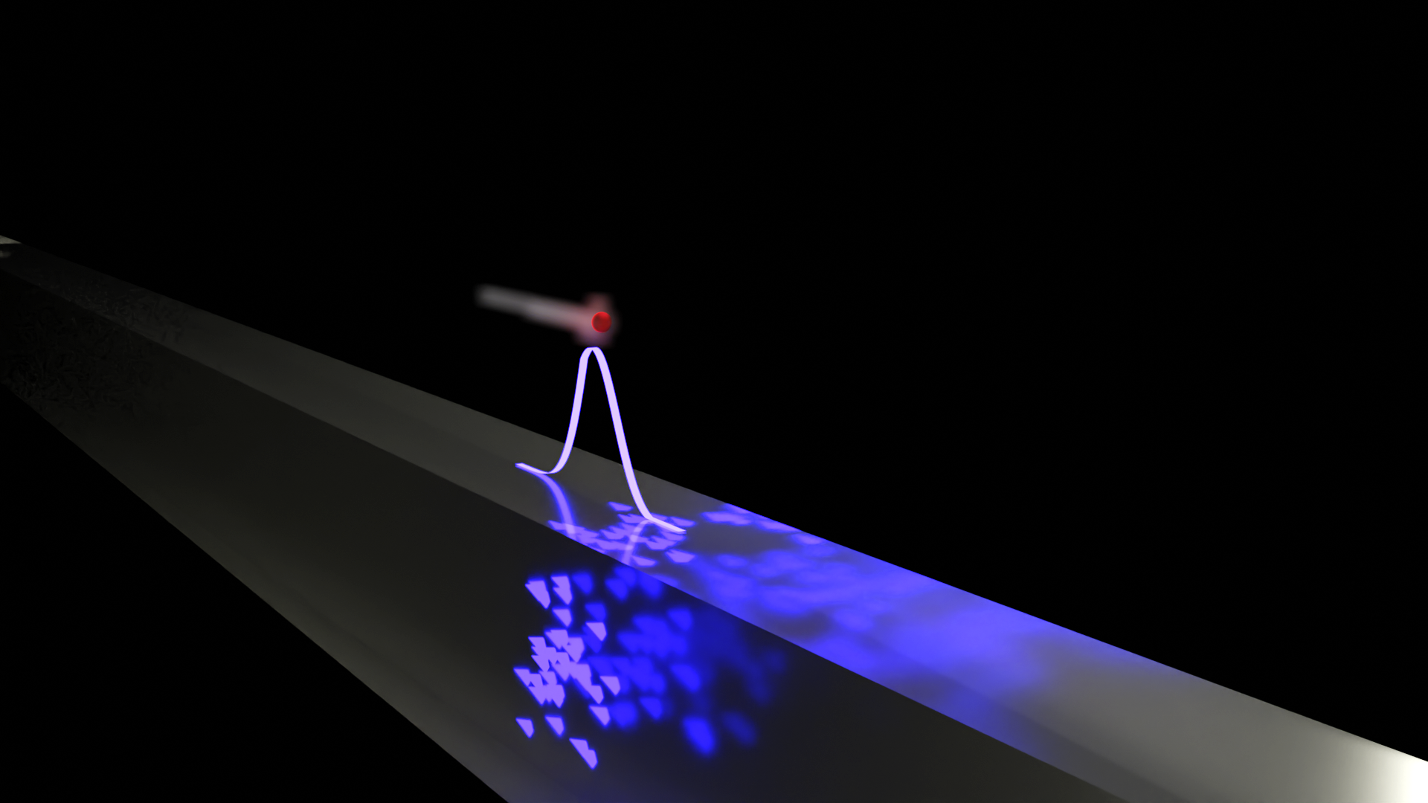



QUAFE: free electrons for quantum sensing and metrology
Cruz I. Velasco^{1*} and F. Javier García de Abajo^{1,2}
¹ICFO - The Institute of Photonic Sciences, Castelldefels (Spain)
²ICREA - Institució Catalana de Recerca I Estudis Avançats, Barcelona (Spain)
*cruz.velasco@icfo.eu
Nanolight
Benasque (Spain), March 2nd, 2026
Notes:
Good afternoon everyone, my name is Cruz Velasco, I am a PhD student at the nanophotonics theory group at ICFO, under the supervision of Javier García de Abajo, and today I am going to tell you about Quantum free electronics, a protocol proposed in one of our recent works where we show that free electrons can be used to generate quantum light and to perform quantum sensing of optical phases.
Quantum sensing leverages the quantum properties of light and matter to perform measurements that have increased sensing capabilities when compared to those obtained by using classical or coherent states of light.

Slide 2

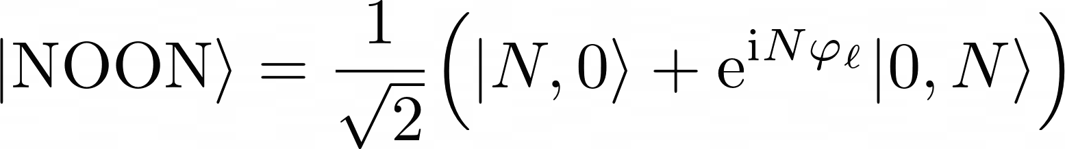
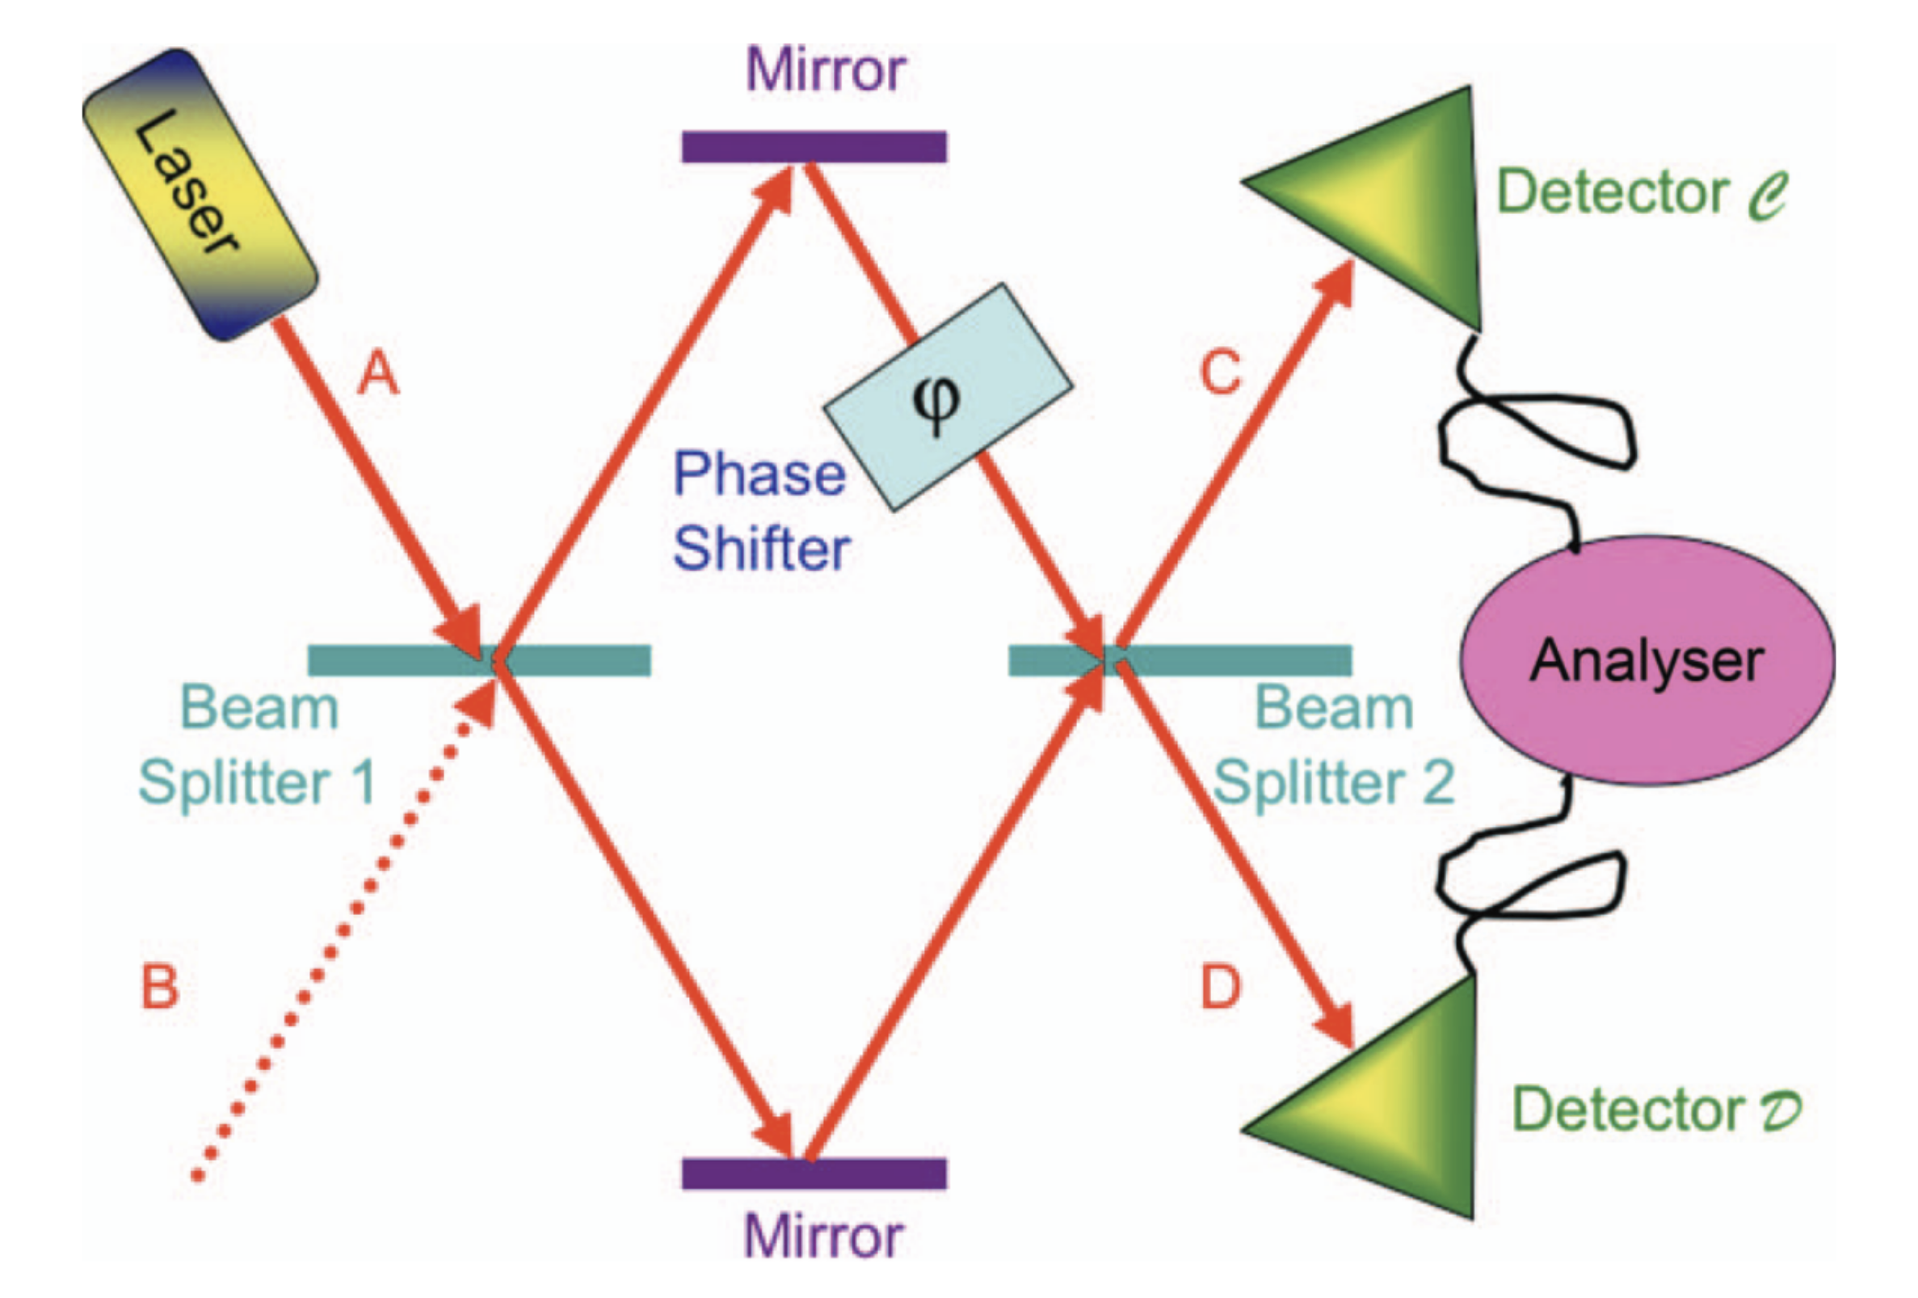
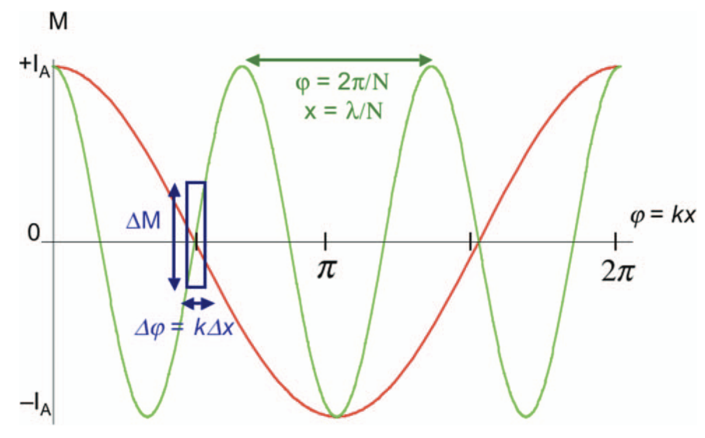

NOON states
$$Δx∝λ/N$$
Johnathan P. Dowling, Contemp. Phys 49, 125 (2008)

Slide 3
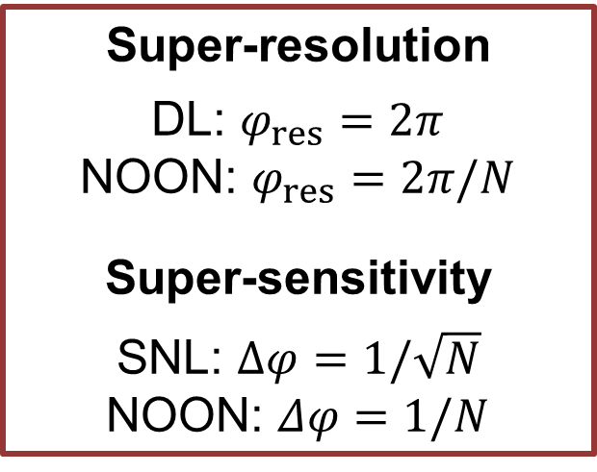
NOON states
$$Δx∝λ/N$$
Super-resolution
DL: $φ_{res}=2π$
NOON: $φ_{res}=2π/N$
Super-sensitivity
SNL: $Δφ=1/\sqrt{N}$
NOON: $Δφ=1/N$
Johnathan P. Dowling, Contemp. Phys 49, 125 (2008)
Notes:
NOON states are sought after in the context of quantum sensing and metrology due to the way in which pase-shifts affect them.
Due to this a measurement perfomred by NOON states beats at the same time the diffraction limit by a factor of N and the SNL by a factor of sqrt(N).

Slide 4
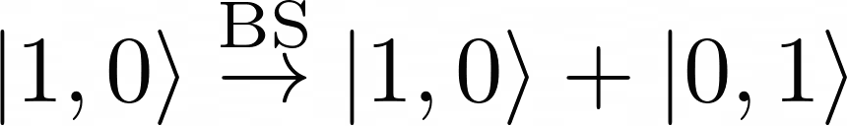
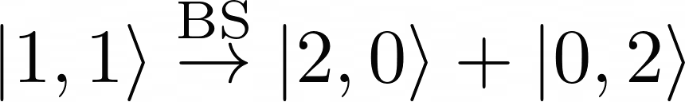
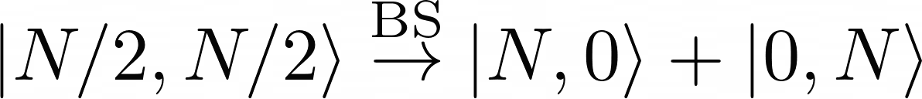


Challenges in generation of NOON states
Low-N NOON states
$$N=1:$$
$$N=2:$$
Hong Ou Mandel effect
High-N NOON states

Slide 5
Challenges in generation of NOON states
Low-N NOON states
$$N=1:$$
$$N=2:$$
High-N NOON states
removing the non-NOON components by projection…
$$N=3$$

Slide 6
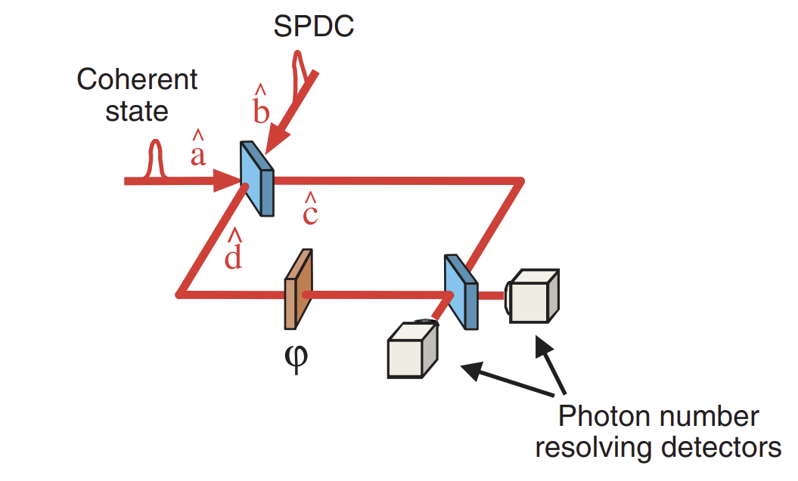
State of the art
High-N NOON states
I. Afek, O. Ambar and Y. Silberberg, Science, 328 (2010)

Slide 7
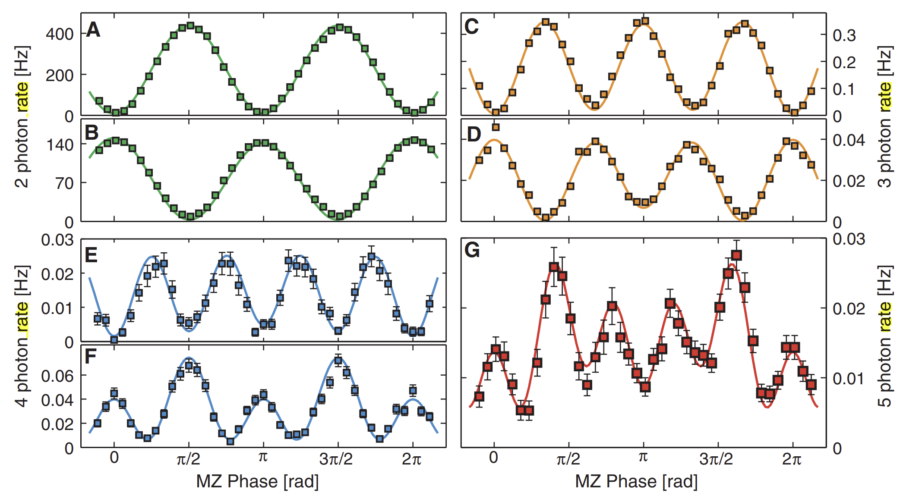
State of the art
High-N NOON states
I. Afek, O. Ambar and Y. Silberberg, Science, 328 (2010)
N=2
N=3
Sub-Hertz rate
N=4
N=5

Slide 8
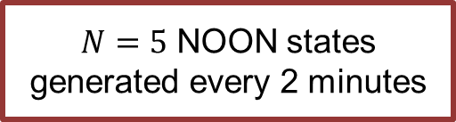
State of the art
High-N NOON states
I. Afek, O. Ambar and Y. Silberberg, Science, 328 (2010)
N=2
N=3
Sub-Hertz rate
$N=5$ NOON states generated every 2 minutes
N=4
N=4
N=5

Slide 9
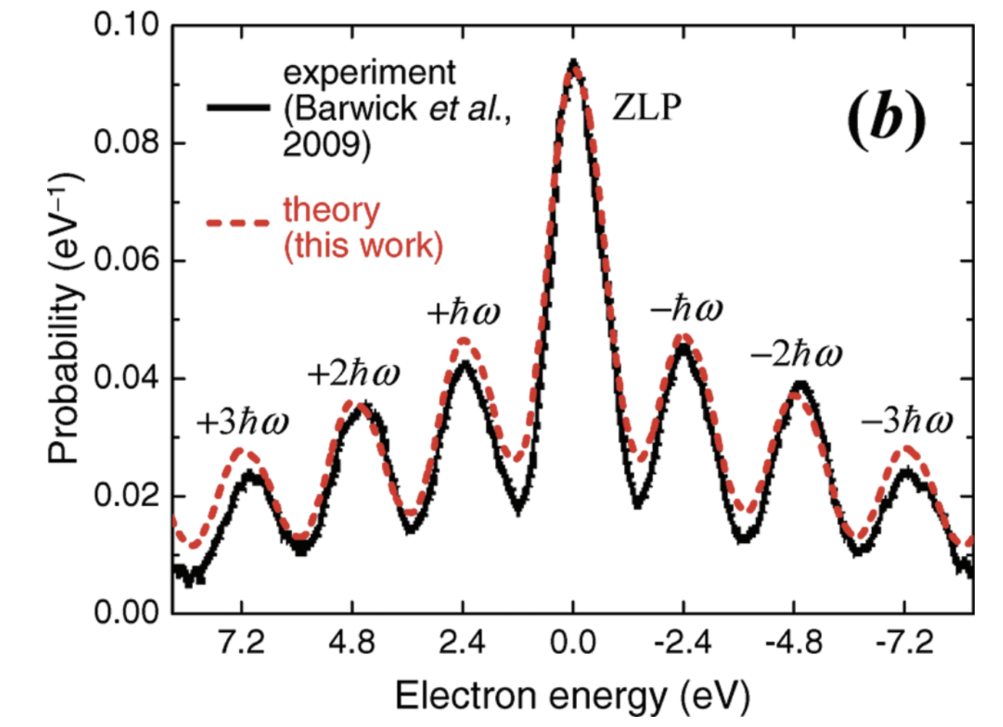
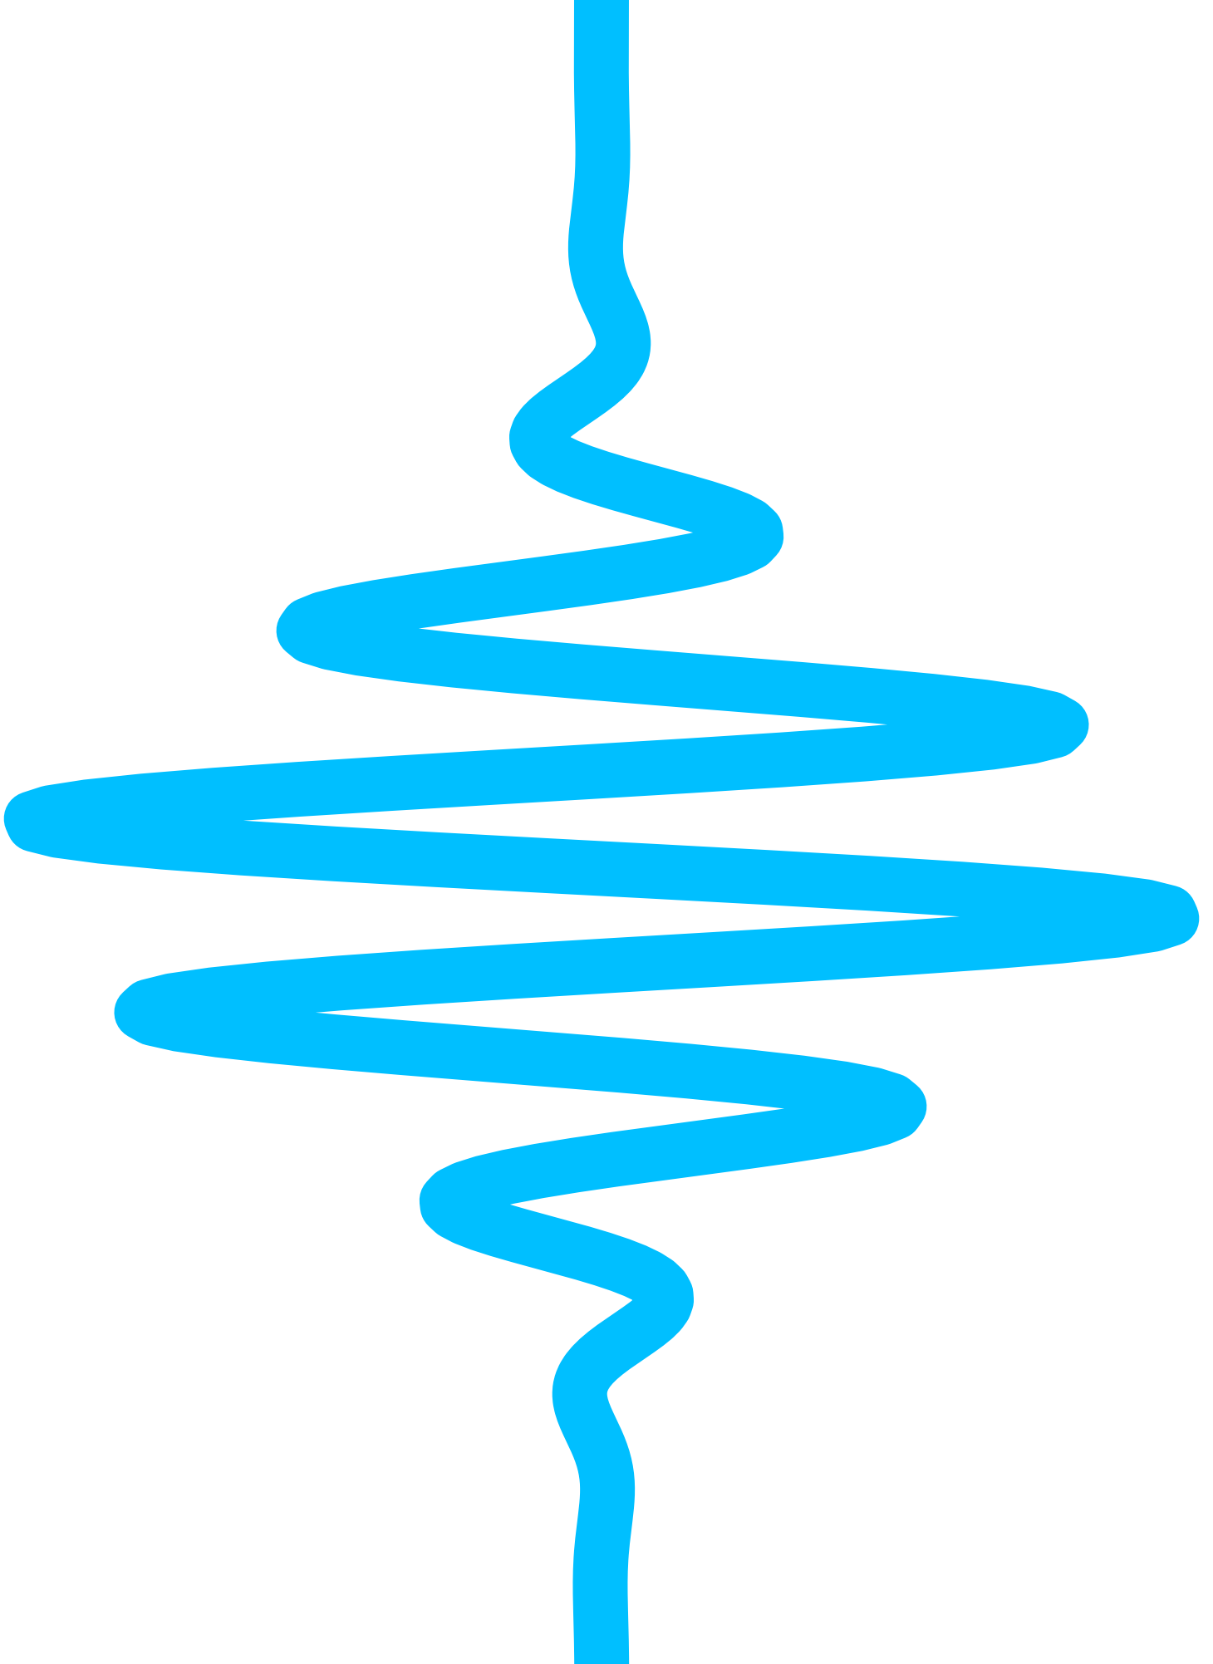




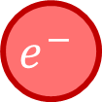
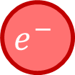

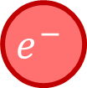


Free electrons as light generators
$\left|ℰ\right\rangle =\sum_{ℓ=−∞}^{∞}{α_{ℓ}\left|ℰ_{0}+ℓℏω\right\rangle }$
$$|ℰ_{0}⟩$$
$$e^{−}$$
waveguide
$$v$$
$$e^{−}$$
emission
$$|α⟩$$
absorption
$$v$$
$$|ℰ⟩$$
$$e^{−}$$
$$t$$
energy resolved electron detector
F.J. García de Abajo, A. Asenjo-Garcia and Mathieu Kociak, Nano Lett., 10 (2010)
Notes:
A free electron electron characterized by a narrow distribution around its kinetic energy E0…

Slide 10


Free electrons as light generators
$\left|ℰ\right\rangle =\sum_{ℓ=−∞}^{∞}{α_{ℓ}\left|ℰ_{0}+ℓℏω\right\rangle }$
$$|ℰ_{0}⟩$$
$$e^{−}$$
waveguide
$$v$$
$$|0⟩$$
$$e^{−}$$
emission
absorption
$$c/n=v$$
$$v$$
$$|ℰ⟩$$
$$e^{−}$$
$$t$$
energy resolved electron detector
F.J. García de Abajo, A. Asenjo-Garcia and Mathieu Kociak, Nano Lett., 10 (2010)

Slide 11


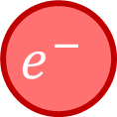
Free electrons as light generators
$$|ℰ_{0}⟩$$
$$e^{−}$$
$$\left|ℰ_{0}−Nℏω\right\rangle$$
$$e^{−}$$
waveguide
$$v$$
$$|0⟩$$
$$e^{−}$$
entanglement
$$c/n=v$$
$$v$$
$$|N⟩$$
$$|ℰ⟩$$
$$e^{−}$$
$$t$$
energy resolved electron detector

Slide 12
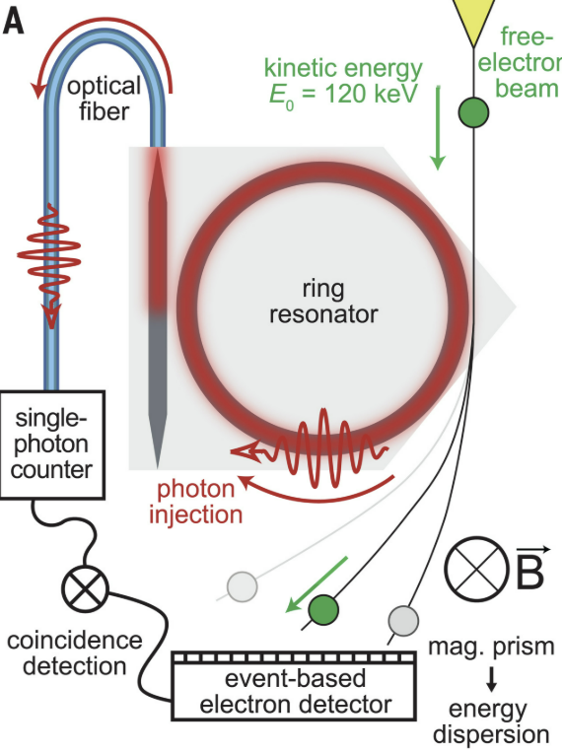
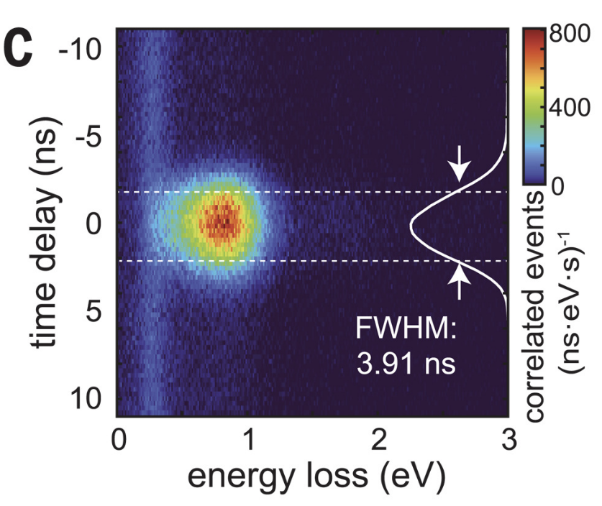
Free electrons as light generators
single-photon state generation
$$|ℰ_{0}⟩$$
$$e^{−}$$
waveguide
$$v$$
$$|0⟩$$
$$e^{−}$$
$$c/n=v$$
$$v$$
$$|ℰ⟩$$
$$e^{−}$$
$$t$$
energy resolved electron detector
A. Feist, ..., T. Kippenberg, and C. Ropers, Science (2022)

Slide 13
Free electrons as quantum light generators
electron wave
transmission grating
50/50 split electron wave (25%)

Slide 14


Free electrons as quantum light generators
electron wave
$$|ℰ_{0}⟩$$
$$e^{−}$$
waveguide
$$v$$
$$|0⟩$$
transmission grating
$$e^{−}$$
$$c/n=v$$
$$v$$
$$|ℰ⟩$$
$$e^{−}$$
$$t$$
energy resolved electron detector
50/50 split electron wave (25%)

Slide 15



Generating NOON states with free electrons
C.I. Velasco and F.J. García de Abajo, Nat. Commun. 17, 868 (2026)
splitting of the incident free electron
$$|0⟩$$
$$|0⟩$$
interaction with two identical waveguides
$$ℏω∼1 eV$$
recombination to eliminate which-path information
energy resolved measurement heralds the creation of NOON states

Slide 16


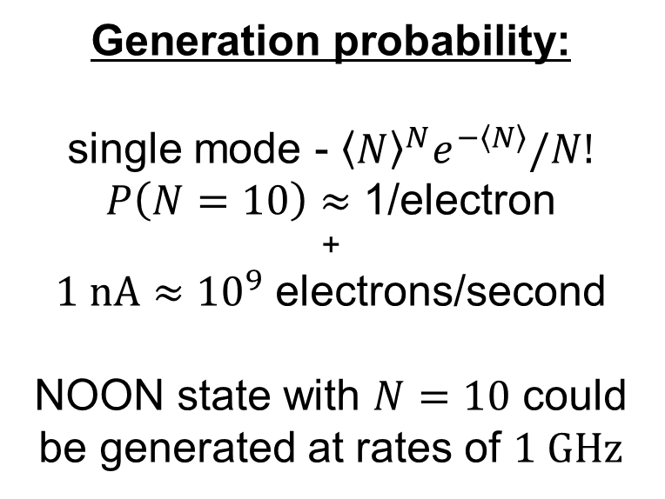

Generating NOON states with free electrons
C.I. Velasco and F.J. García de Abajo, Nat. Commun. 17, 868 (2026)
splitting of the incident free electron
Generation probability:
single mode - ${\left\langle N\right\rangle }^{N}e^{−\left\langle N\right\rangle }/N!$
$P\left(N=10\right)≈\text{1/}$electron
+
$1 nA≈{10}^{9}$ electrons/second
NOON state with $N=10$ could be generated at rates of $1 GHz$
$$|0⟩$$
$$|0⟩$$
interaction with two identical waveguides
$$ℏω∼1 eV$$
recombination to eliminate which-path information
energy resolved measurement heralds the creation of NOON states

Slide 17
Beating the state of the art
C.I. Velasco and F.J. García de Abajo, Nat. Commun. 17, 868 (2026)
photonic NOON states with N = 10-20 generated at GHz rate, beyond current technology (N=5 at sub-Hz rates)

Slide 18


Detection of NOON states
C.I. Velasco and F.J. García de Abajo, Nat. Commun. 17, 868 (2026)
splitting of the incident free electron
$$|NOON⟩$$
interaction with two identical waveguides
$$ℏω∼1 eV$$
recombination of the two paths
the amplitude of each outgoing path will depend on the relative phases acquired during interaction with light
gains in an energy resolved measurement correspond to the interaction with NOON state

Slide 19
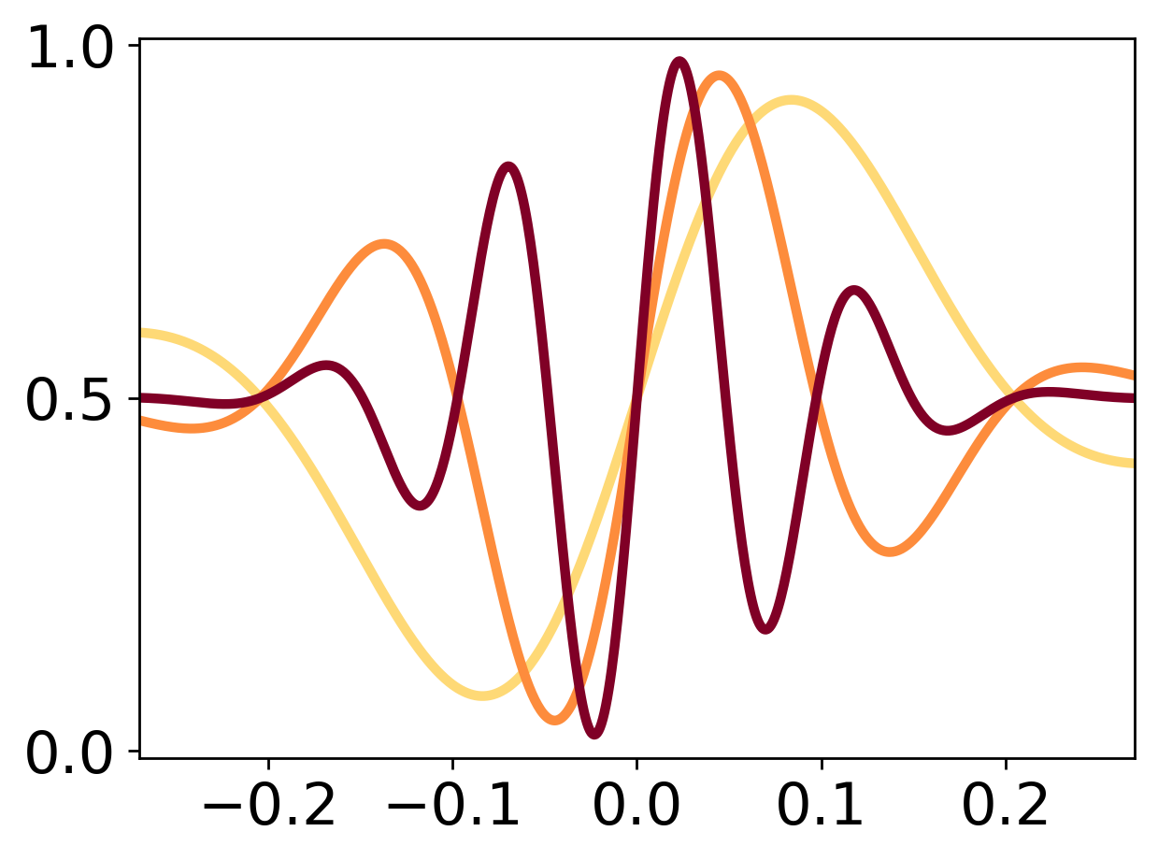






QUAntum Free Electronics
C.I. Velasco and F.J. García de Abajo, Nat. Commun. 17, 868 (2026)
$$|0⟩$$
$\left\langle N\right\rangle =5$
$\left\langle N\right\rangle =10$
$$φ_{ℓ}$$
Detection probability
$\left\langle N\right\rangle =20$
$$φ_{ℓ}$$

Slide 20

QUAntum Free Electronics
C.I. Velasco and F.J. García de Abajo, Nat. Commun. 17, 868 (2026)
$$|0⟩$$
$\left\langle N\right\rangle =5$
$\left\langle N\right\rangle =10$
$$φ_{ℓ}$$
Detection probability
$\left\langle N\right\rangle =20$
$${π−φ}_{ℓ}$$

Slide 21






Conclusions
NOON states are sought after tools that can provide super-resolved and super-sensitive measurements by exploiting quantum properties.
$$|0⟩$$
Free-electrons as generators and detectors of quantum states of light.
High rate generation of high-NOON states (N = 10 for 1 GHz).
$$φ_{ℓ}$$
QUAntum Free Electronics emerging from split electron beams and waveguides for quantum sensing and metrology.
QUEFES

Slide 22
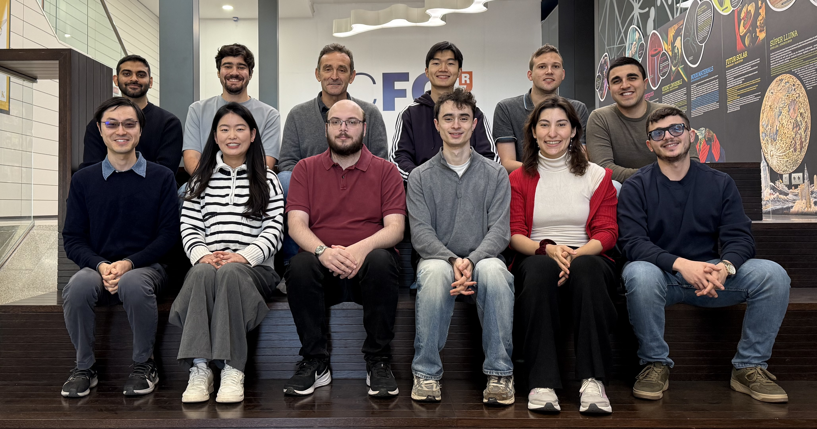
NPT Group – PhD and Postdoc positions available
QUEFES

Slide 23
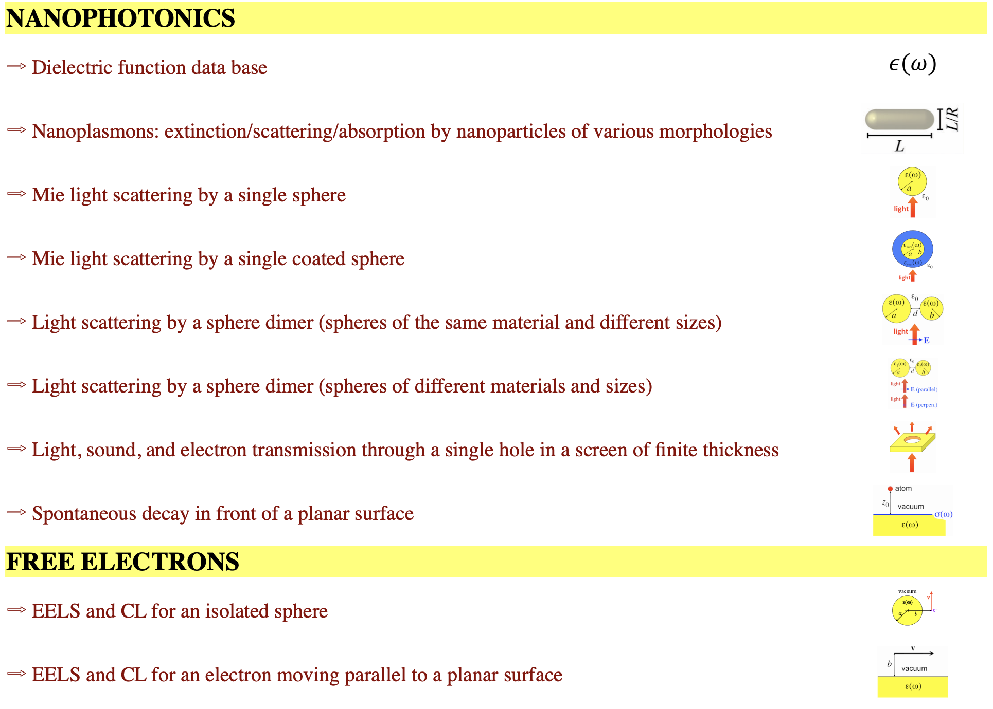

http://www.nanophotonics.org → widgets

Slide 24
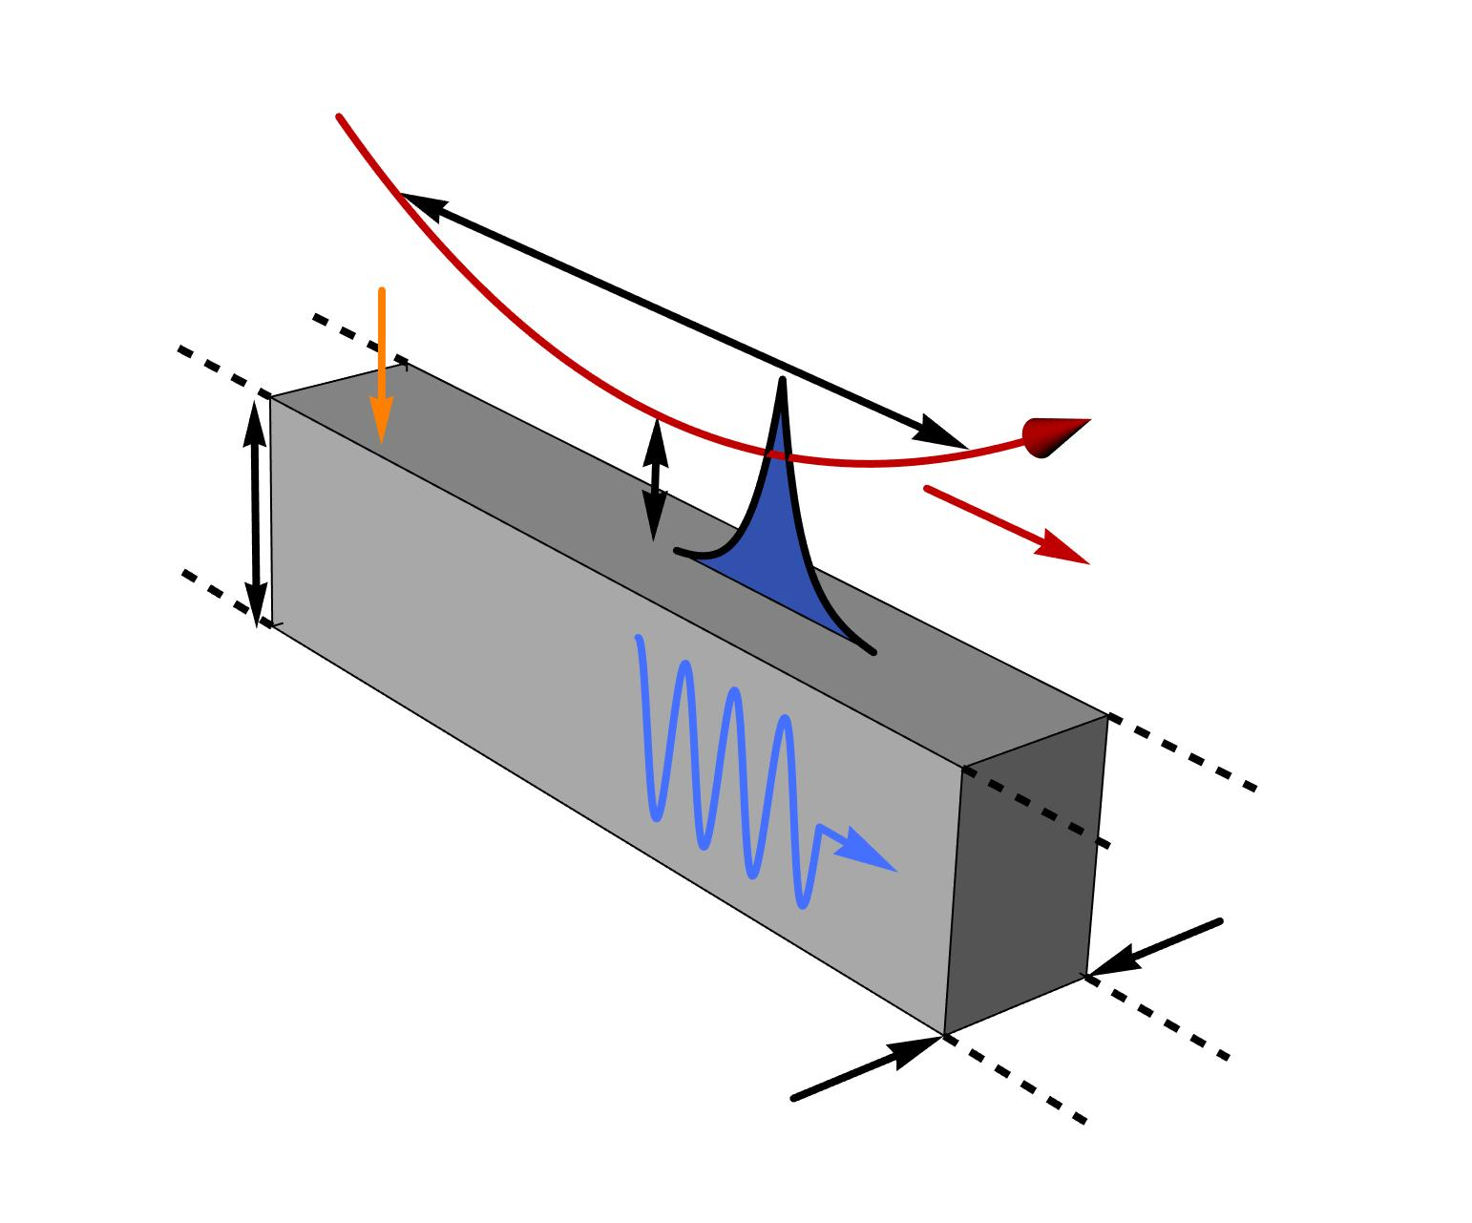
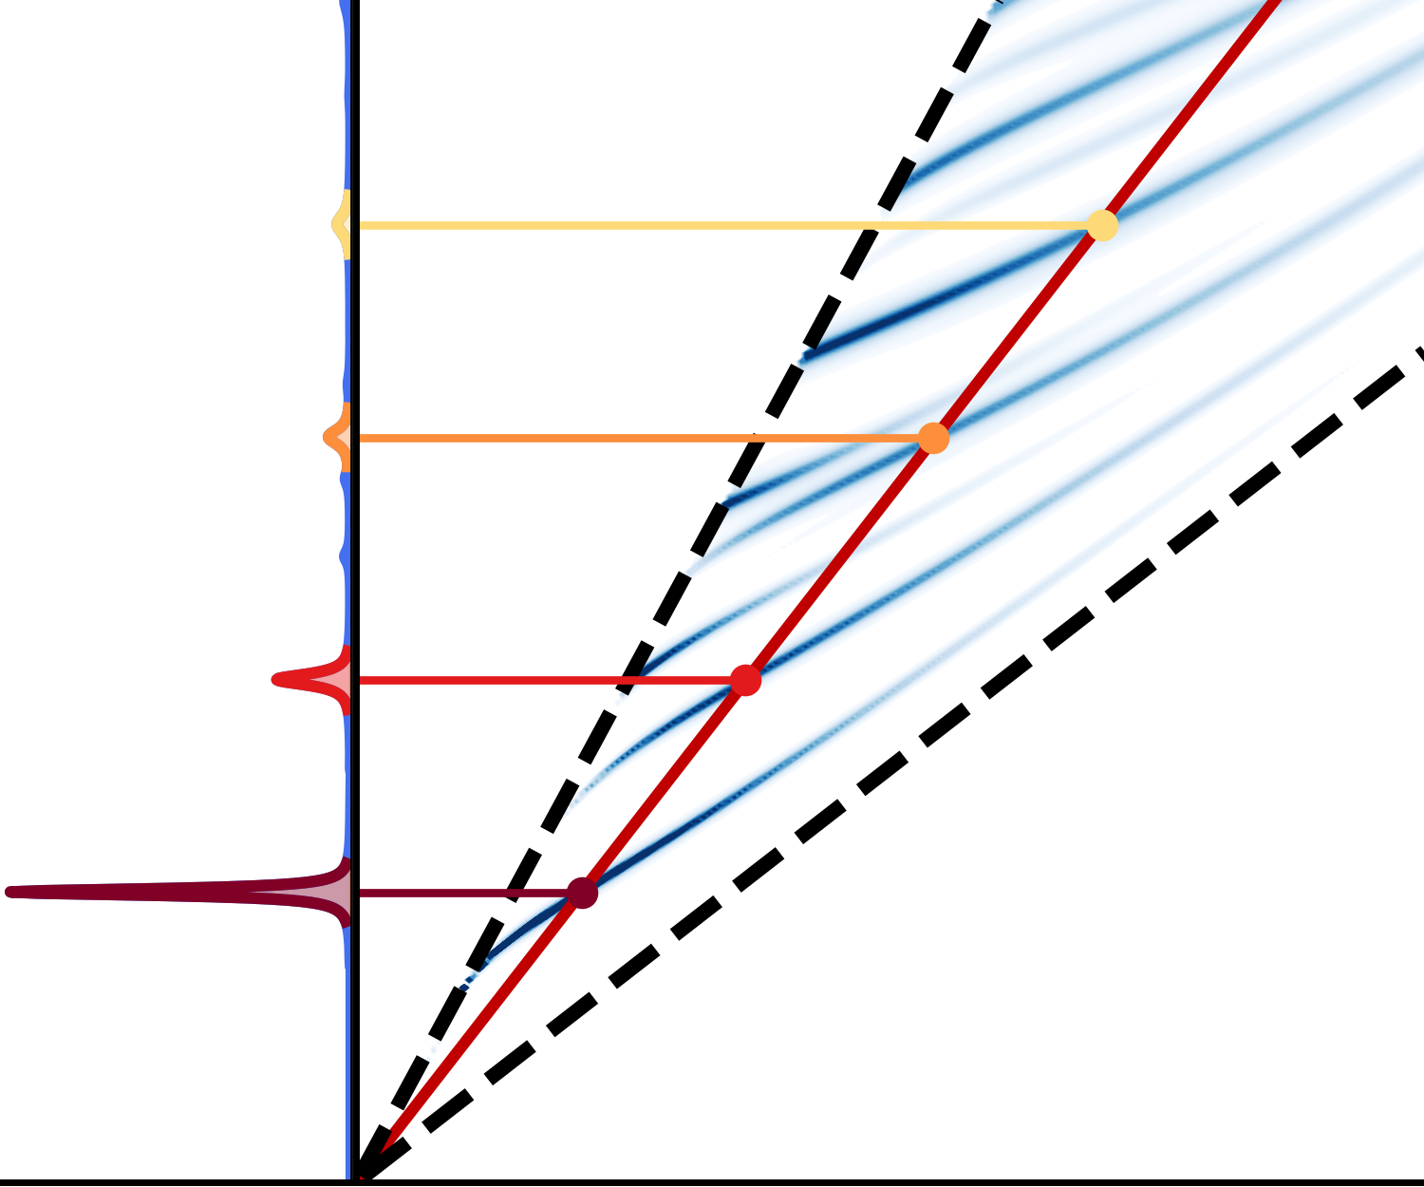










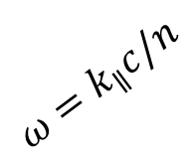








Electron-light coupling scheme
C. Velasco and F.J. García de Abajo Nat. Commun. (2026)
electron
$$Wω/c$$
$$ω=k_{∥}c$$
$$ω=k_{∥}v$$
$$E_{DC}$$
$$L_{eff}∼{100}^{′}s μm$$
$n=3$
$n=2$
$$h$$
$$b$$
$$β_{0}$$
$n=1$
$$≈v$$
$$ω=k_{∥}c/n$$
$$ω_{0}$$
$n=0$
waveguided mode
$$W$$
$$\left\langle N_{0}\right\rangle ={\left|β_{0}\right|}^{2}∼{10}^{′}s$$
$$P(ω)$$
$$Wk_{∥}$$

Slide 25
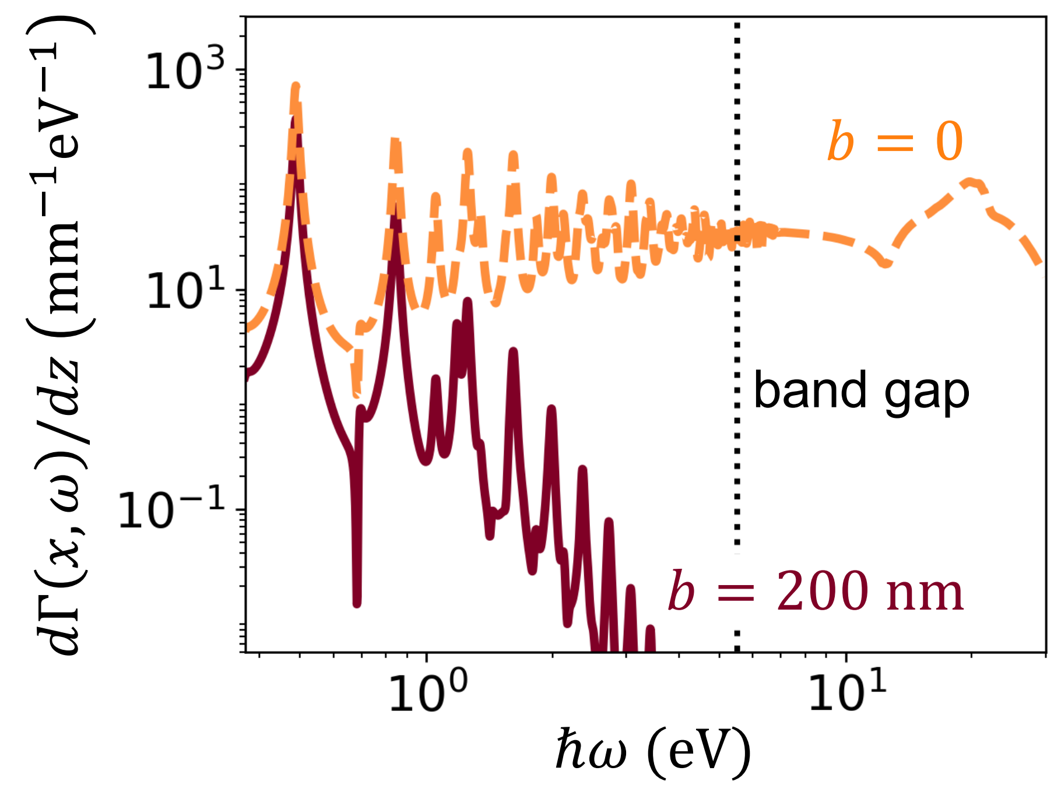
Electron-light coupling scheme
C. Velasco and F.J. García de Abajo Nat. Commun. (2026)
electron
$$E_{DC}$$
$$L_{eff}∼{100}^{′}s μm$$
$$h$$
$$b$$
$$β_{0}$$
$$≈v$$
$$ω_{0}$$
waveguided mode
$$W$$

Slide 26

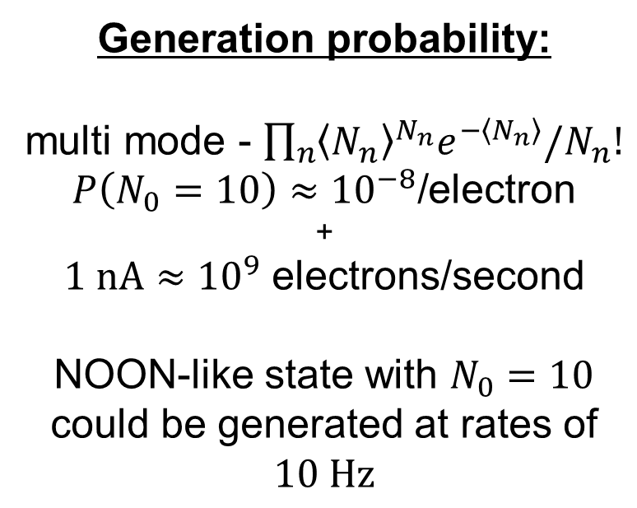
Generating NOON states with free electrons
C. Velasco and F.J. García de Abajo Nat. Commun. (2026)
splitting of the incident free electron
Generation probability:
multi mode - $\prod_{n}{{\left\langle N_{n}\right\rangle }^{N_{n}}e^{−\left\langle N_{n}\right\rangle }/N_{n}!}$
$P\left(N_{0}=10\right)≈{10}^{−8}\text{/}$electron
+
$1 nA≈{10}^{9}$ electrons/second
NOON-like state with $N_{0}=10$ could be generated at rates of $10 Hz$
$$|0⟩$$
$$|0⟩$$
interaction with two identical waveguides
$$ℏω∼1 eV$$
recombination to eliminate which-path information
energy resolved measurement heralds the creation of NOON states

